Slide 1
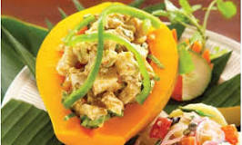
Farmer behind the Food
Promoting local produce in everyday eating
Charlotte Chan Mow, Orator Hotel, Samoa

Slide 2
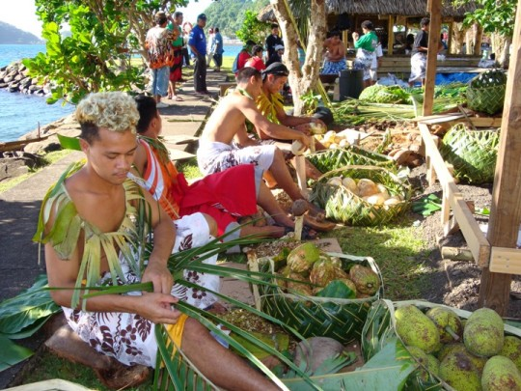
Why is local cuisine important to Tourism
Culture identifies people and this is one of the main reason that draws a person to pick a destination.
Food also identifies a country and can be a draw card to increase tourism in your country. We have seen this in the last 15 years people fascinated by food seen on TV.
Important to keep the local cuisine alive just like a country’s culture and language.

Slide 3
Why is the relationship between a farmer and chef important
They both need each other
To ensure that the ingredients to cook our local cuisine can still be cooked
We need the food to be authentic and not using overseas products as substitutes
To support the economy with the slogan “Buy local you support your neighbour”
Continuous relationship of good supply of local produce means good local food.
Good for the economy

Slide 4
Why is local cuisine cooking important to a chef
Any tourist destination will promote every aspect local from their culture, language, sceneries and even food.
Tourists first question on a menu is they want to try local food and to many disappointments as Restaurant operators and chefs we have it wrong. We try to cook the food our tourists are having everyday at home.
Chefs need to use the local cuisine to promote the country. They need to use local produce to revamp a dish from another country and make it local.
Local cuisine is the next tourism factor of destination or in fact is already for many other countries.

Slide 5
What are farmers and chefs doing now
Our Hotel we grow our own vegetables, fruits and herbs.
We belong to Farmers Association in Samoa. This way we get assistance on how to grow our produce and very important we have a great relationship with small and medium size plantations.
We now tell farmers what is needed in Restaurants or hotels for their menus. They are aware that 4 things are important to us quality, consistency of supply, right type of produce and price.
Our vegetables and herbs are grown openly where our guests can see where the fresh produce their eating is growing.

Slide 6
When there is excess produce we assist our farmers to sell their produce so that they will not struggle to sell and still feel positive and supply us consistently.
Working together to get species for certain produce such as fruits to try and get them to fruit all year.

Slide 7
Assistance in Training
I joined in 2014 SPTO training for Agribusiness Culinary Course
Found it very useful and what I learnt from their I used in July 2015 to revamp a very famous dish for the NZ Samoa friendship week competition.
We recreated Beef Wellington by using local produce and still tasted like beef wellington but even better
Going to courses as such and having people like Chef Colin Chung it was really an eye opening for myself.
Sometimes we think we know it all but experiences from
such well experienced chefs in local island cuisine are much
needed.

Slide 8
Samoa has now formed their own Culinary Association and I believe it’s important for this association not only to concentrate on getting chefs trained and all but also to push the use of local produce over the overseas products.

Slide 9
Actions
Orator Hotel for the last 6 years have promoted local cuisine on our Sunday Toanai (lunch) you can see it is mentioned in Robert Oliver-Meakai Cook Book
1 November 2016 we will officially launch our Farmer Behind the Food Activity. This concept is live Samoan cooking –umu and our chefs cooking 2 dishes and guests will then enjoy a buffet lunch enjoying the food they help cook. It’s about the whole experience for the tourist
Lomi Lomi Activity where we promote the use of local herbal for medicinal and beauty use. Look at Rachel Hunter Beauty Tour show she goes all around the world to find the secrets why people have beautiful ageless skin. EG coconut oil is not just to cook with but you can use for your for body, food and beauty purposes.

Slide 10
TV Program Food Hospital based in UK are pushing the use of food to cure, prevent or save people from taking medicines to cure themselves. Our ancestors have passed to us through generations secrets of all the goodness of our local cuisines. We must continue to pass that our children.
As the saying goes “YOU ARE WHAT YOU EAT” Promoting our
healthy local cuisine and secret beauty tips using food and
herbal medicine is such a great Tourist Destination promoting
factor.

Slide 11
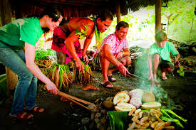
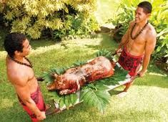
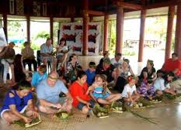

Slide 12
