Slide 1
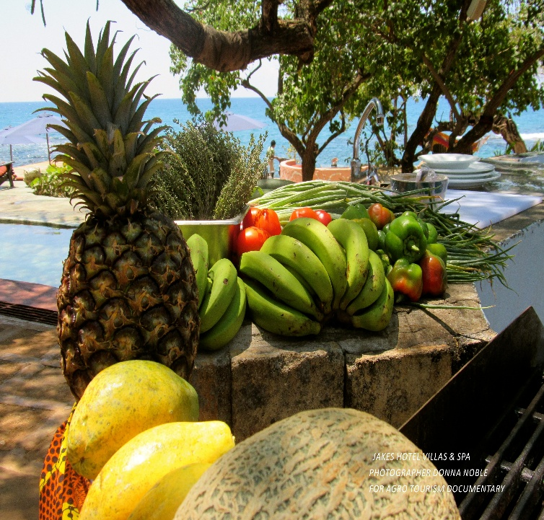
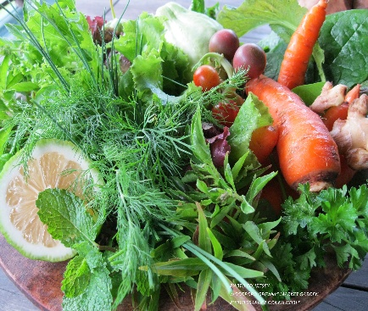
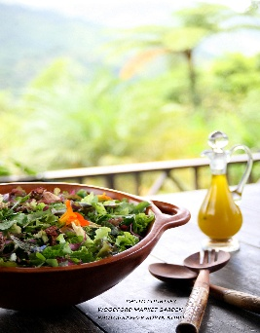
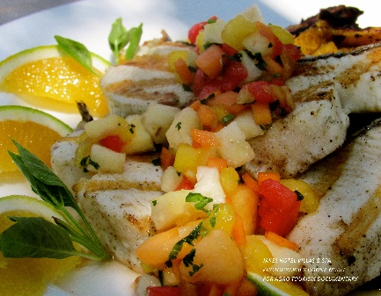
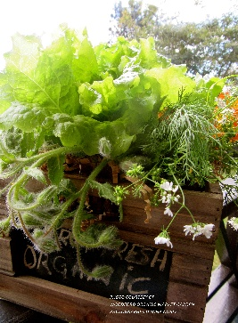
Best practices in agritourism across the Caribbean
Ena Harvey, Expert in Agritourism, IICA, Caribbean
Brussels Policy Briefing n. 46: Agribusiness development in SIDS:
The potential of tourism-related markets

Slide 2
Why Agritourism?
Caribbean agriculture has been struggling to remain competitive
  small producers across the region are struggling to compete in their own markets.
  since the 1980s, Caribbean countries have been accommodating ever increasing levels of food imports that compete directly with their indigenous crops and products
The travel and tourism industry constitutes the leading service export for the Caribbean, with total export earnings accounting for, on average, one-quarter of the region’s Gross Domestic Product (GDP)
Tourism is the life-blood of many Caribbean economies
Agritourism presents a promising avenue for diversification and trade growth for the AGRI-FOOD sector in many Caribbean states

Slide 3
Some Key Messages
Need to be clear on why we are into Tourism and who should benefit from Tourism
Local communities cannot be an “after thought” or a means to an end to protect tourism investments
Tourism cannot be successful without a sustainable food production sector and climate smart agriculture
Agricultural biodiversity and heritage and the culture of food in the Caribbean enhance the “value proposition” of a sustainable tourism product
Agrotourism must be integrally linked to Food & Nutrition Security and to the management of Chronic Non Communicable Diseases (NCDs)

Slide 4
IICA Initiatives (with partners)
Regional Strategy for Agrotourism (approved at CWA by Ministers of the Alliance and COTED) – 2011
Regional Food Tourism Strategy (with CTO and OAS funding) – 2013
CWA 2013, Guyana: 2 workshops on Investment in Agrotourism and Economic Empowerment of Women in Agribusiness (CTA, WIBDI, SPC, Chef Oliver, Ministers from Samoa and Tonga)
CWA 2014, Suriname: Pacific Ministers from Vanuatu attend CWA and plan for Pacific Week of Agriculture in 2017

Slide 5
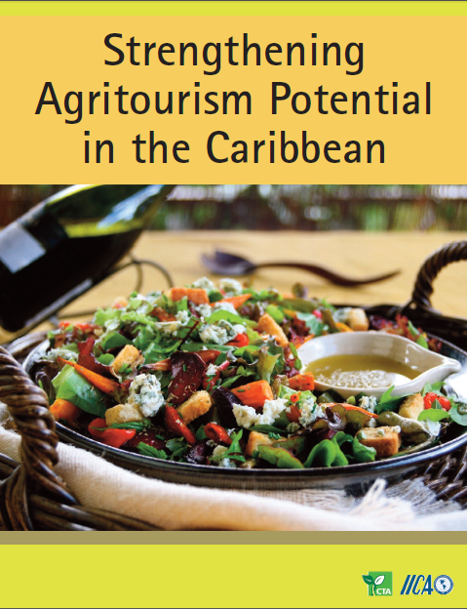
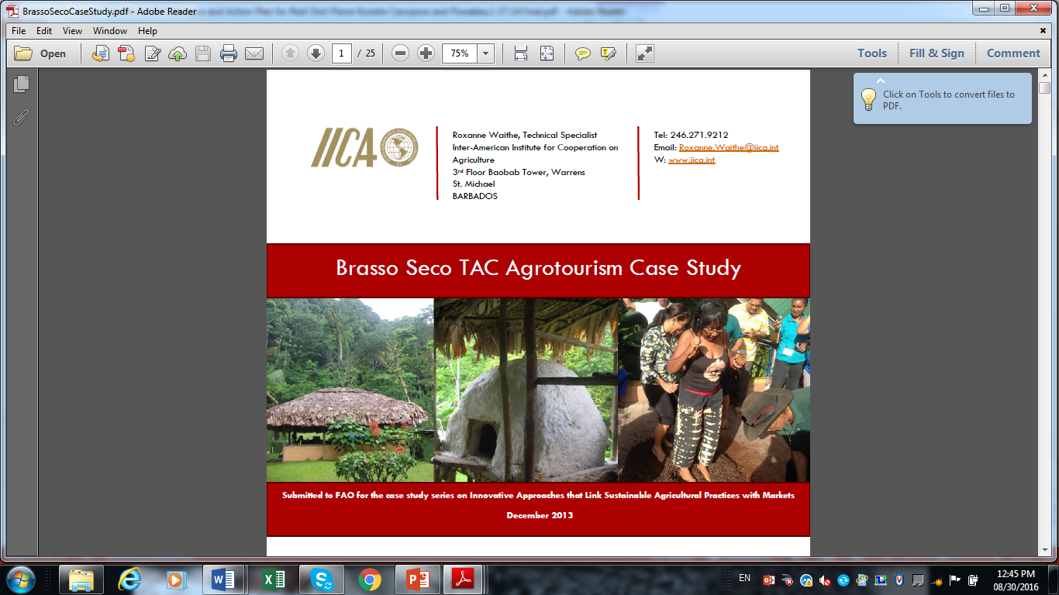
IICA Initiatives (with partners)
1st Caribbean Agribusiness Forum (CTA) – Grenada, 2014
Documentation of 10 Best Practices (Grenada, Jamaica, Haiti, St. Lucia, Suriname) (CTA-IICA-UWI)and publication of Brasso Seco Case Study, T&T (with FAO)
1st Pacific Agribusiness Forum, Fiji (Caribbean participation from IICA, CANROP, CAFAN, CABA, Cbn Export, UWI)
CTA/IICA/CABA: 2nd Caribbean-Pacific Agribusiness Forum, Barbados, 2015 (Vanuatu, Seychelles, Samoa, Fiji)
  Chefs’ Development Network
  Knowledge Sharing Platform
  Vanuatu Workshop on Agrotourism Policy
Vanuatu Agrotourism Policy Setting Workshop, May 2016
Notes:
Chefs have a unique part to play in making the food system more environmentally sustainable, socially just, and delicious. They connect producers and consumers, understand where food comes from, and know what consumers want.

Slide 6
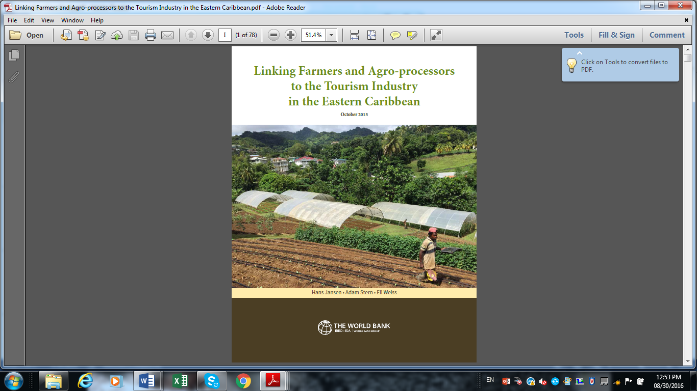
Recent Developments: Eastern Caribbean States
World Bank Study: Linking Farmers and Agro-Processors to the Tourism Industry - 2015
Agrotourism Demand Study under EU -10th EDF – 2014
OECS Agrotourism Resource Centres (National AT Linkages Committees: Policies, Action Plans - ongoing)
  Grenada (Marketing Board, Belmont Estate Chocolate, “Glamping”)
  St. Vincent & the Grenadines (Food Festivals, Agricultural Heritage, yachting sector)
  St.Lucia (Food tourism, farm tours, small cruises / yachts, private sector aggregators along value chain, models for farmer and fisherfolk financing)
Notes:
Jamaica: Ministry of Tourism and Entertainment: Tourism Linkages Hub
Approved by Cabinet decision and established in June 2013 to fulfill the ministry’s mandate to create and sustain linkages throughout productive industries. The hub is funded by the Ministry of Tourism and Entertainment’s Tourism Enhancement Fund
‘Agro-Tourism Farmers Market’ in the resort area of Negril, aimed at boosting the link between tourism and agriculture and promoting the consumption of local produce.

Slide 7
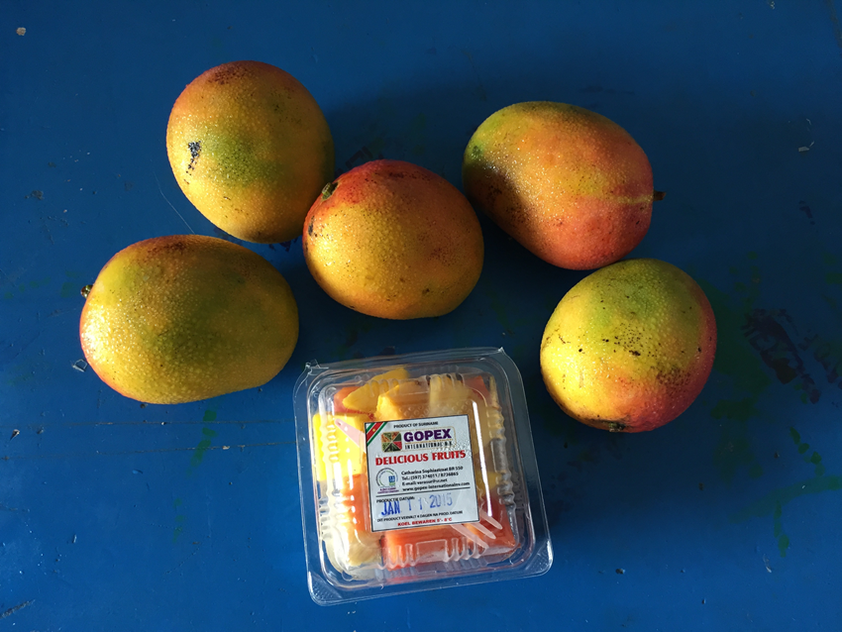
Suriname – Gopex International
GOPEX International is a family-owned and operated agricultural trading company located in the small rural farming district of Saramacca, northern Suriname.
The company has been in existence for more than thirty years.
exports a range of fresh produce to Holland, including bitter gart, okra, pepper, and African eggplant. Also grows a variety of herbs and spices including celery, lentils, parsley, chives as well as fruits, such as mangoes.
currently supplies a wide range of fruits, vegetables and herbs to KFC, Pizza Hut and a number of other restaurants and hotels located in Paramaribo.
The first agri-firm to set up a cold chain facility in Suriname
The first and only company in Suriname’s agricultural sector to have received HACCP certification (attained in 2010) and ISO 2002 certification in 2014
Currently applying for Global Gap certification

Slide 8
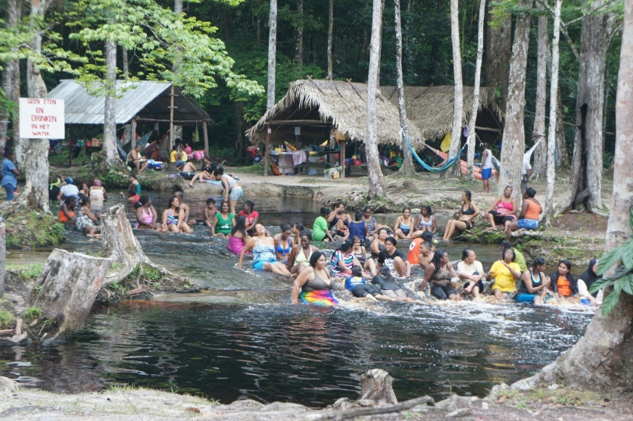
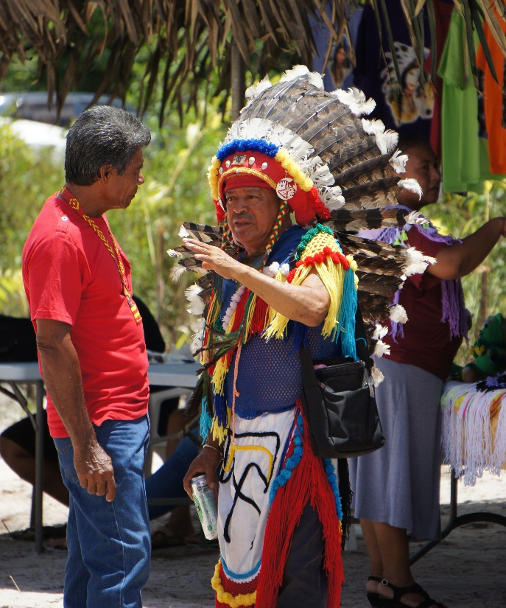

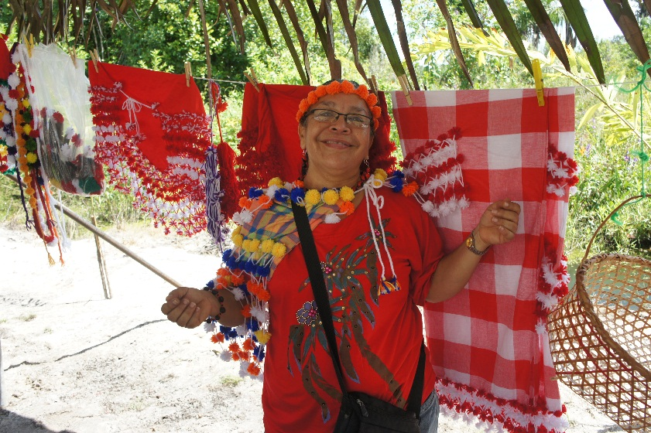
While Suriname’s tourism industry is still in its early stages of development, linking ecotourism interests with local agriculture would provide tremendous opportunities for rural development, income generation and poverty alleviation

Slide 9
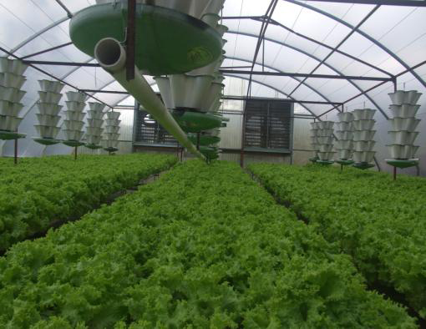
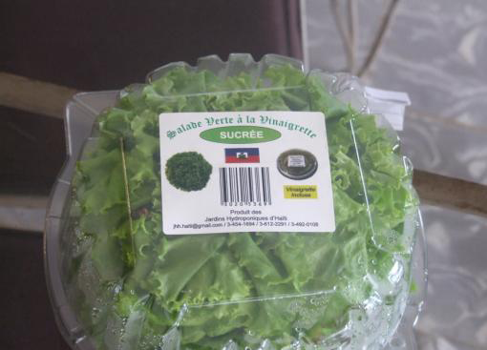
Haiti – Les Jardins Hydroponiques
Opportunity for unemployed youth and women to produce lettuce and culinary herbs for domestic and export markets and introducing innovations into the peasant culture to showcase the potential of high technology farming for improving the standard of living through food production

Slide 10
Key Drivers of Success
Analysis of the case studies reveals several distinct drivers of success:
  Adherence to quality standards and certification
  Maintaining strong market visibility and proactive promotion of products
  Forging strategic business alliances
  Maintaining a high and consistent product quality
  Maintaining strong ties with clientele/trading partners
  Keeping abreast with market trends
  Effective supply chain management and value addition
  Access to financial services

Slide 11
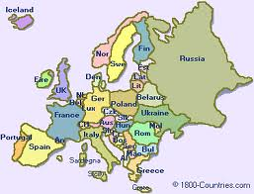
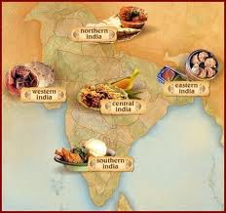

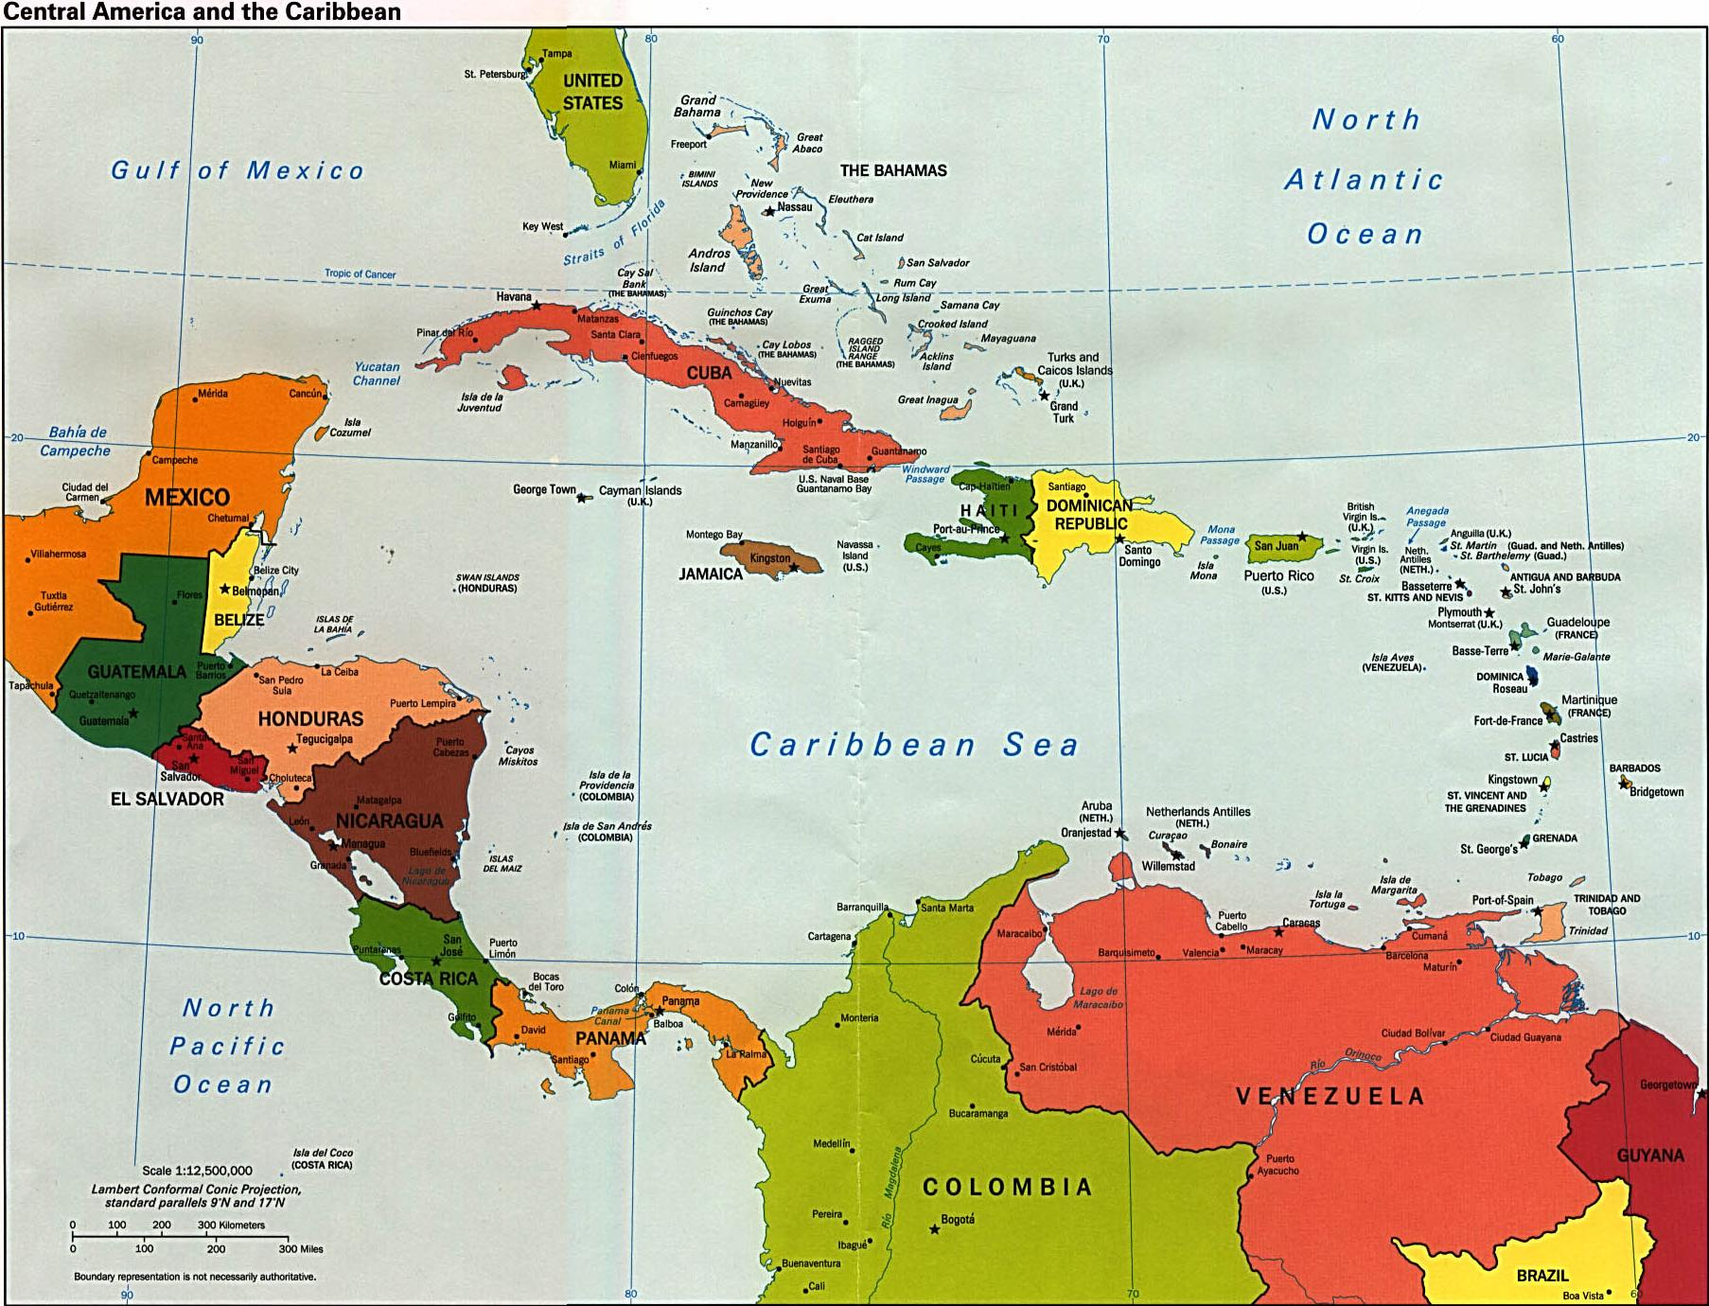
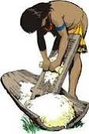
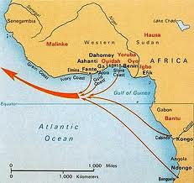
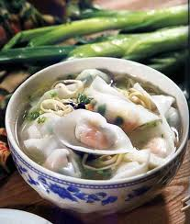
Caribbean Food:
The Original Fusion Cuisine

Slide 12

Food Tourism
A Valuable Development Tool
When done properly, culinary tourism tells the story of the heritage, the people and the landscape of a geographic area.
It reflects 'place', enriches experiences, and can be a valuable tool to boost economic, social and community development.

Slide 13



Using Caribbean Celebrities to endorse our food
One secret weapon:
Jamaican yellow yam

