Slide 1
“MSG Agrifood Opportunities and Strategy in Support of Agrifood Producers”
Henry Sanday, Private Sector Development Advisor MSG Secretariat

Slide 2
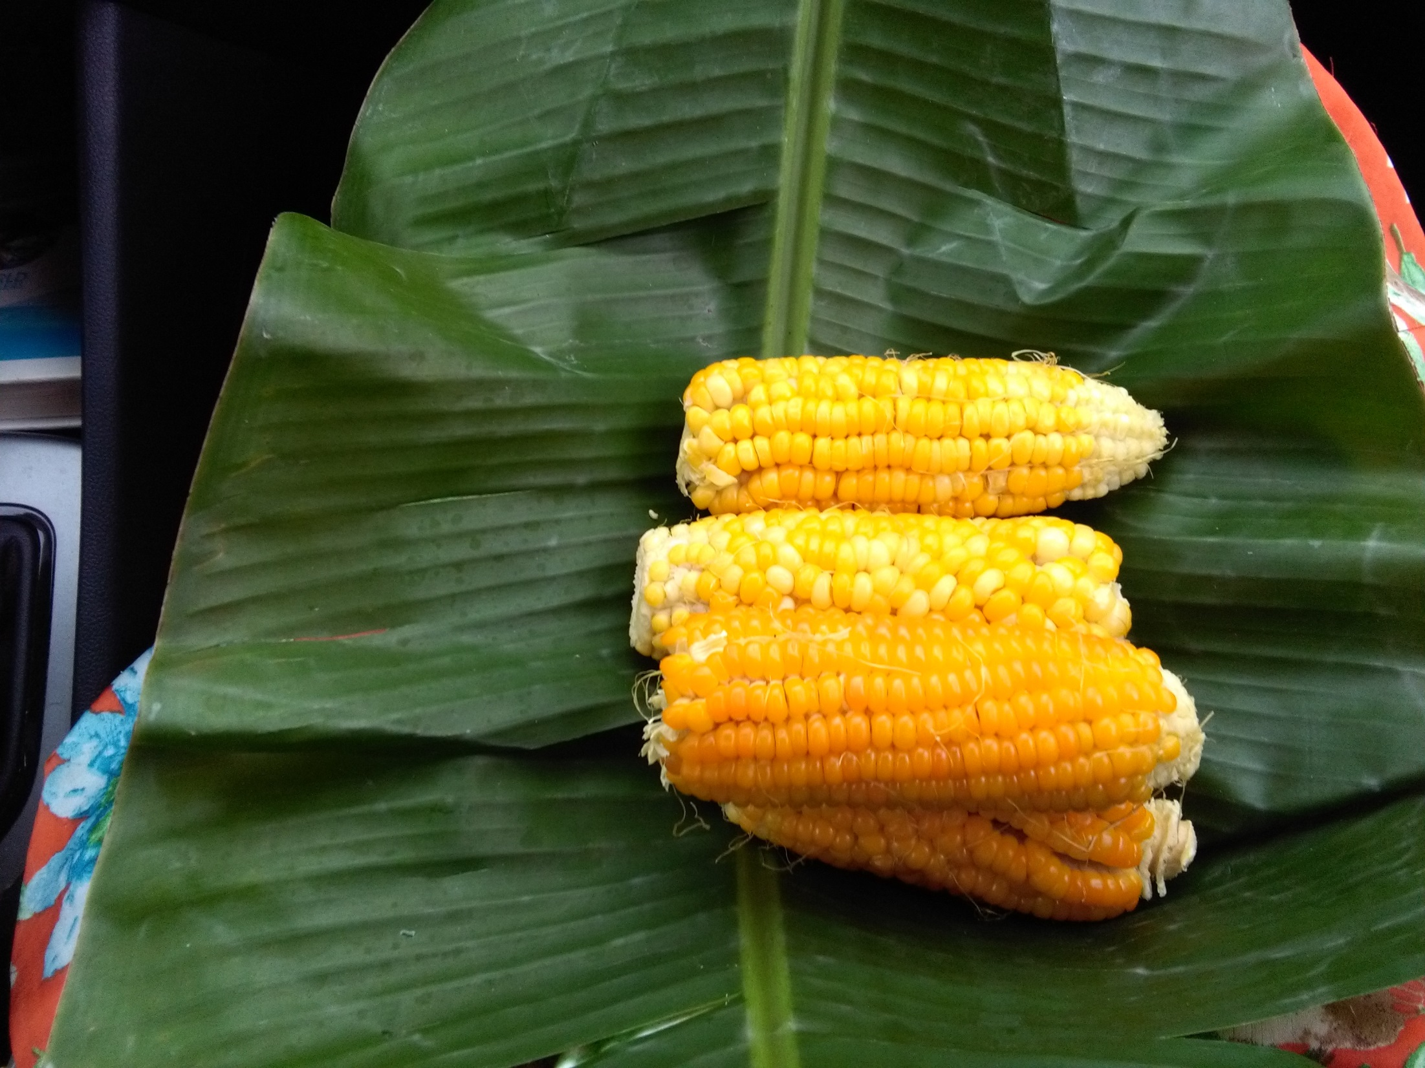
European Union
MSG Secretariat
MSG Agrifood Opportunities and Strategy in Support of Agrifood Producers
2nd Pacific Agribusiness Forum
Apia, Samoa
29 Aug-01 Sep 2016
Henry Sanday
Private Sector Development Advisor
MSG Secretariat, Port Vila, Vanuatu
h.sanday@msg.int; hesanday@gmail.com

Slide 3
European Union
MSG Private Sector Development Strategy
To achieve higher, inclusive and sustainable growth via PSD
Hallmarks:
Unleashing rural & informal entrepreneurship
Inclusive private entrepreneurial development
Enhancing private sector resilience to climate change
Endorsed by Ministers & Leaders on 14 July 2016
In line with MSG 2038 Prosperity for All Plan
Non-sectoral but dovetails priorities of MSG Members’ National Development Strategies (NDS) & ACP PSD Strategy
Cascading NDS linkages: Agriculture to Trade, Tourism & Health

Slide 4
Value-Adding & Linkages in Agribusiness – Selected Examples

Slide 5
“In July 2006, 13 Australian Church visitors stayed home for one week and ate local food. That started my hotel business, informal and without an official opening.”
- Ms Ellis Waragat, Owner & Operator, Kokopo Lodge & Tours Ltd, East New Britain, PNG

Slide 6
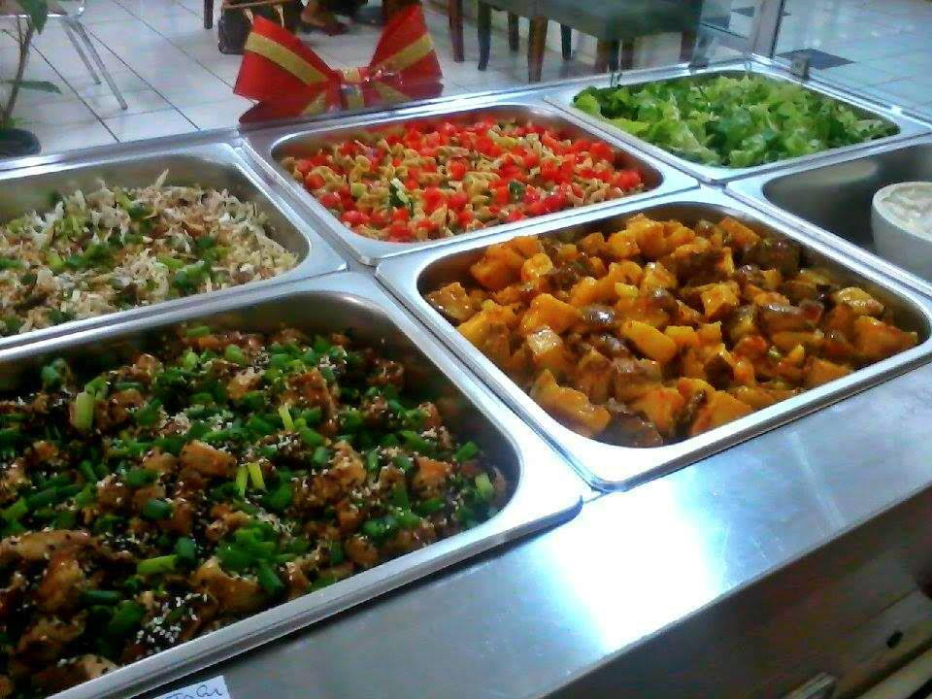
“Our business believes in letting food be thy medicine and 90% of all that we use is sourced from the informal economy.”
Mrs Repeka Uluilakeba, Owner/Operator, Highland Natural Healthy Vegan Food Shop, Suva, Fiji

Slide 8
European Union
Concluding Points
Agriculture, Trade, Tourism & Health (ATTH) linkages absent in NDS
→ Tourism Industry & Promotional Authorities are involved (e.g. Sol Is)
→ More hotels developing their own gardens
ATTH linkages need not just “whole of government” approach but also “whole of nation approach”
→ need for partnerships (industry + traditional chiefs & churches)
Significant agrifood exports unlikely (e.g. PNG infrastructure & climate change)
Voice of SMMEs/informal sector → dialogue & collaboration
Upcoming MSG PSD meetings in Honiara
→ Cooperatives (19 Sep)
→ Small Business Development Centres (20 Sep)
→ Heads of Investment Promotion Agencies (21 Sep)
→ Private Sector & Civil Society Dialogue (22 Sep)

Slide 9
European Union
Thank you
Merci beaucoup
Tank yu tumas
Tank yu tru
Oleti
Vinaka vakalevu

