Slide 1

“Agribusiness Financing: Innovative Financial Solutions to support Agribusiness”
Ian Buck, Facility Manager Samoa AgriBusiness Support Project

Slide 2


SABS Samoa AgriBusiness Support Project
Promoting Agribusiness & Economic Development
2nd Pacific Agribusiness Forum
Apia, Samoa
Session 4
“Agribusiness Financing: Innovative Financial Solutions to support Agribusiness”
Tanoa Tusitala Hotel - 1 September 2016
Presented by: Ian M. Buck B.Ag.Sc.,Grad.Dip.Ag.Econ.,Dip.FS(FP).,FAICD.,FAIM.
Facility Manager
Samoa AgriBusiness Support Project
Supported by the Asian Development Bank and The Government of Samoa

Slide 3
SABS Samoa AgriBusiness Support Project
SABS Samoa AgriBusiness Support Project
Promoting Agribusiness & Economic Development
Promoting Agribusiness & Economic Development
      Session topic
    “Financing Sustainable Agribusinesses
    &
    Business Support Services: improving product quality”
The SABS approach

Slide 4
Project Objective
“SABS is a pilot project designed to improve the financing of the agribusiness sector within Samoa, and raise the capabilities of Samoan agribusinesses to contribute to increasing the GDP of Samoa”.

Slide 5
Project Facility Features
Private Sector Development Project- Has a commercial focus;
To provide Financial Support to participating agribusinesses, via loans from the participating Commercial Banks in Samoa;
To provide Business Support services to participating agribusiness entities through FM & PMU;
Incorporates a Gender Action Plan;
Incorporates M & E to measure outputs against objectives;
Time lines - Design 2012-14; Inception September2014; Implementation October 2014; Official Launch May 2015;
The project has a 7 year time frame from Implementation;

Slide 6
Component A
Finance Support Services
ADB Grant to Government of Samoa - MOF is the EA;
Government of Samoa on-lent Grant to Participating Financial Intermediaries (PFI) via Subsidiary Financing Agreement (SFA) between Government of Samoa and each PFI;
Each PFI holds funds in a special account which are then proportionally allocated to Subloan A & Subloan B components;
  Subloan A = Guaranteed Cash Collateral component – Security - ALL;
  Subloan B = Supplemental Seed Capital Loan – Top up Equity – SOME;
All prospective agribusiness project partners must meet SABS Eligibility Criteria – (Financial & Environmental) to qualify for support;
PFI provides the commercial loan - Projects must meet appropriate credit and other risk-related criteria as determined and applied by each PFI;
Must use the finance for a “qualified project” in accordance with the conditions detailed in the loan agreement with each PFI;
Very Important: All initial discussions with partners held as “Strictly Private & Confidential” & as “Commercial in Confidence”;
Trust & Confidence.

Slide 7
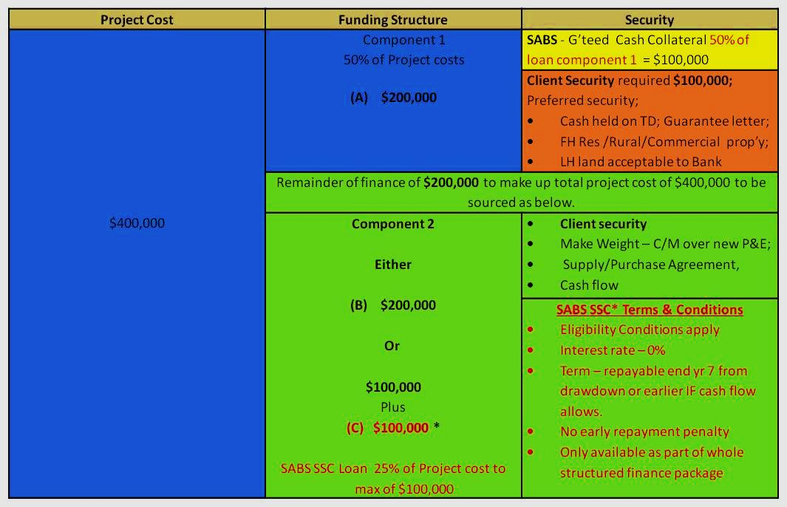
Example Finance Facility

Slide 8
Summary of finance support process
    Allows for considerable flexibility in structuring the finance package;
    PFI may advance a loan of up to 50% of an investment of which SABS could secure through use of Cash Collateral funds (Sub loan A);
      Note 50% for first time sub-borrower ; 30% second time beneficiary;
    Maximum loan amount eligible for cash collateralised support is $750,000 (50% of Project cost of $1,500,000);
    Maximum SABS contribution via cash collateral is $375,000;
    Repayable Supplemental Seed Capital Loan (SSC Loan ) is limited to 25% of Project cost to a maximum of $100,000 per customer;
    SSC Loan is at nil interest with bullet repayment within 7yrs;
    SABS could effectively support a project partner with up to 50% of project cost;
    SABS role is to facilitate access to cost effective finance packages, working collaboratively with PFI and partner agribusiness – three way partnership.

Slide 9
Sustainable Agribusiness
Manage Risk
  Understand the Business-Understand the Risks – “know your client, know your product”;
    Walk through - first impressions etc
    What are the products, and where are the markets ?
  Who is managing the business?
    Track record – financial performance etc
    Time in the business?
    Key person risk strategies etc
  Understand the supply chain characteristics;
    What are the strategies to overcome supply risks to the business?
    How reliable is the supply chain and has the business developed solid supply line relationships?
  Plan & Test – A robust business and finance plan is essential;
    Monitor the finances – actuals to forecasts monthly
  Maintain open lines of communication with the banking partner.

Slide 10
Component B
Business Support Services (BSS)
Is about capacity building - Identify the weak links in the business operation – Business Plan;
Tailor the support to the business – Is not a “one size fits all”;
Engage the appropriate specialists - Precise Terms of Reference for specific support required – Indefinite delivery contracts;
Be prepared for the unexpected – “the known unknowns”
When working in the commercial/private sector you need quick response times – “Time is money”!
SABS role is to facilitate improvement in agri-business performance and meet target market product standards.

Slide 11
BSS (continued)
Examples of business support services;
  Strategic – Tailored Business Planning & Financial management;
  Marketing – Market access; labelling; may include joint venture arrangements;
  Agro-processing - Food technology; Industrial Chemist; Food Production Engineering services;
  Quality Control – Hygiene; Food Safety; Certification (Organic,HACCPS,ISO etc);
  Technology – Agriculture, Agribusiness, Business partnerships;
Expenses shared by SABS project and agribusiness project partner on an 80:20 parallel cost sharing basis – Business Support Services Agreement.
Agribusinesses also supported by a small Agribusiness Innovation Fund on a 75:25 parallel cost sharing basis;
  Small short term expenditures relating to agribusiness expansion or operation

Slide 12
SABS Samoa AgriBusiness Support Project
Promoting Agribusiness & Economic Development
Thank You (Fa’afetai)
SABS Contact Details:
Facility Manager
Level 3 I Ministry of Finance
Central Bank Building I Apia I Samoa
E: ianb @sabs.ws
T: 685 34353 or M: 685 7749478

