Slide 1
Key Outcomes of the FEMM Meeting – April 2017
Presentation to the Regional Capacity Workshop,
24 July 2017, Nadi, Fiji

Slide 2
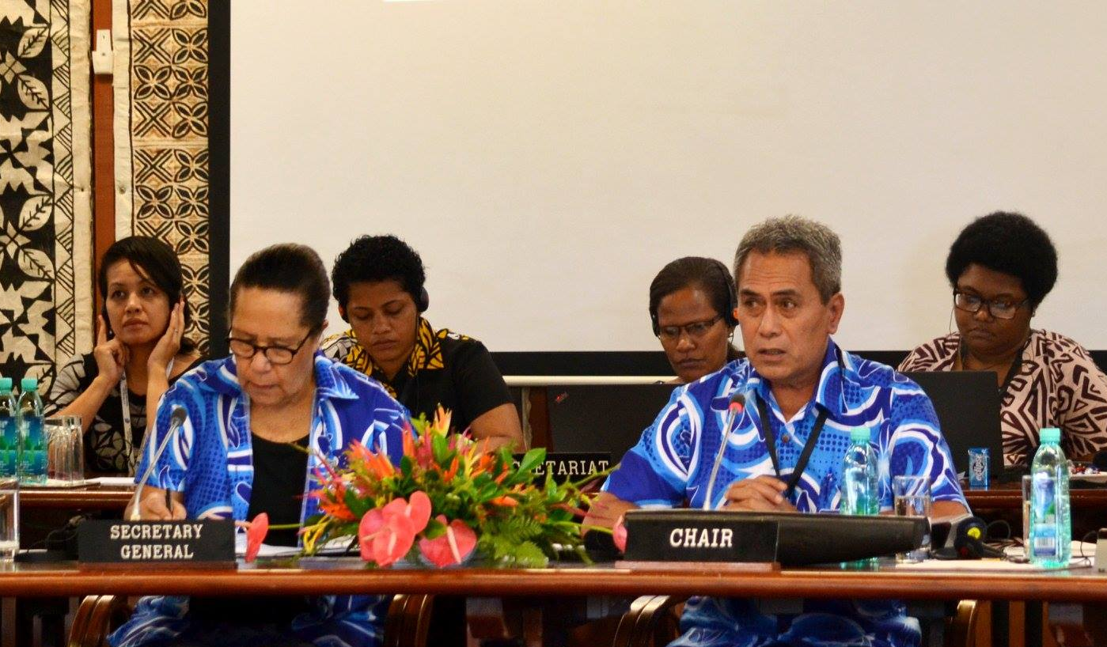
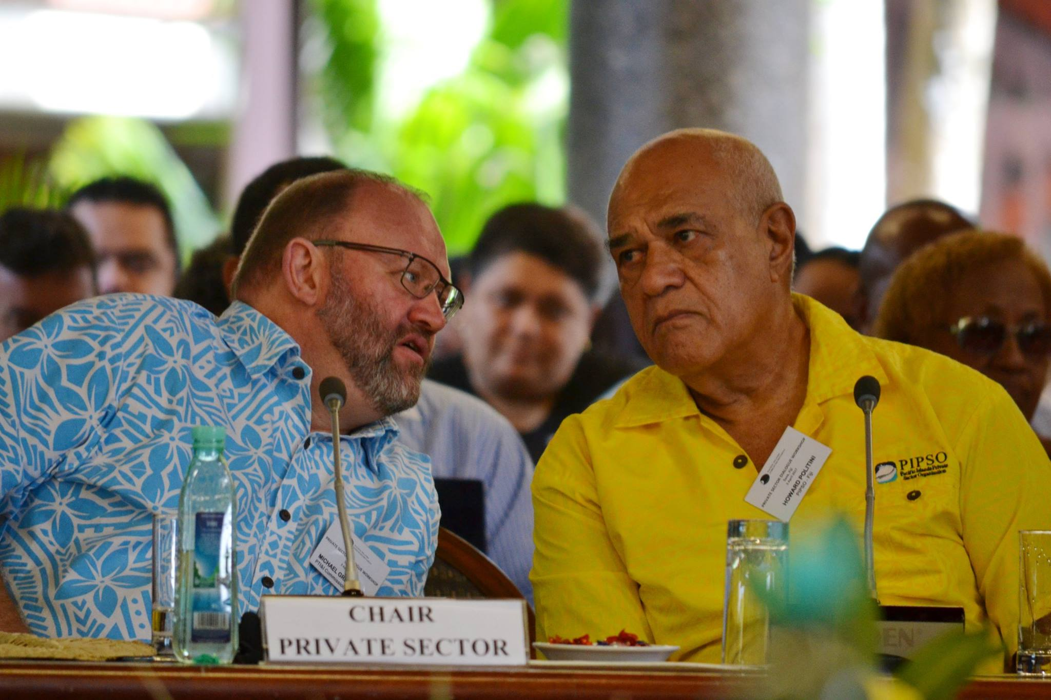
Forum Economic Ministers Meeting (FEMM) 2017
Annual Meeting, April 2017, Suva, Fiji.
3 April – Private Sector Dialogue Workshop 4 April – Forum Economic Officials Meeting 5 & 6 April – Forum Economic Ministers Meeting 6 April – Joint Dialogue between Private Sector and Civil Society
Acknowledge Pat Leota (Samoa), Katalaini Ziru (Solomons Is) & Howard Politini (PIPSO Chair)
2018 FEMM, in Palau.

Slide 3
@ 2017 FEMM:
Regional Development Priorities/Pacific SDGs Roadmap
Framework for Pacific Regionalism: Economic Returns from Fisheries*
Mobility and Standardisation of business processes*
Framework for Resilient Development in the Pacific*
Pacific Framework for the Rights of Persons with Disabilities*
Financing for Development
Pacific Islands Sustainable Development Framework for Interaction with Asia*
Partnership with Government*

Slide 4
@ 2017 FEMM:
Framework for Pacific Regionalism: Economic Returns from Fisheries
Coastal fisheries resources
Agribusiness and agrinutrition
Community enterprises/MSMEs
Sports fishing/tourism
Mobility and Standardisation of business processes
World Bank Ease of Doing Business and Cost of Doing Business rankings.
Reforms: business law and registrations, business licencing – conducive business environment.
Trade agreements

Slide 5
@ 2017 FEMM:
Framework for Resilient Development in the Pacific
Disaster risk/business resilience
Agri-financing and weather risk insurance
Climate change financing/green climate fund
Green business practice
Pacific Framework for the Rights of Persons with Disabilities
Private sector role: as an employer vs environment to support business development
Partnership with Government
Formalise PS/Government relationship with the Private Sector at the national level

Slide 6
@ 2017 FEMM:
Pacific Islands Sustainable Development Framework for Interaction with Asia
overarching set of principles and opportunities in the Pacific’s regional economic interactions with major Asian economies and particularly China.
Working Group – PIFS/PT&I China, PIANGO, PIPSO, SPTO, ADB, USP, FFA, (PITA)
National taskforce – PS representations essential
business opportunities – for the Asian economies and PICs
tourism opportunities, technology, development cooperation etc
with CSOs – human rights and other social dimensions.
diplomatic relations
presented at 2018 FEMM

Slide 7
Outcomes of the Joint Dialogue of Economic Ministers with PS & CSO
Ministers:
Undertook to formalise their relationship with the PS at national level;
Supported engagement with the PS steering committee to progress initiatives on harmonisation of business processes as endorsed by Forum Leaders;
Supported the work to progress regional labour mobility through partnerships with relevant stakeholders, including the Pacific Directors of Immigration;
Encouraged Members to use best practices to improve the business enabling environment;
Supported the implementation of initiatives that promote green business practices;
Supported the efforts by regional industry bodies/professional associations to identify and address skills gaps to meet the demands of the PS; and
Encouraged Members to support business reforms for the development of non-traditional financing mechanisms and platforms for MSMEs and start-ups.

Slide 8
Opportunities for greater engagement with Governments at national and regional levels.
Strengthen NPSOs and CSOs to advocate/lobby their issues.
National mechanisms are important !

Slide 9
Vinaka vakalevu, thank you
Alisi Tuqa
Email: alisit@pipso.org.fj

