Slide 2
Pacific Islands Development Forum
Vision:
A United, Distinctive and Sustainable Pacific Society
Mission:
Enabling Green–Blue Pacific Economies through Inclusive Strategies, Multi-stakeholder Governance, and Genuine Partnerships.

Slide 3
Principles of Green Economy
Is sustainable;
delivers equity;
creates genuine prosperity and wellbeing for all;
improves the natural world;
is inclusive and participatory in decision making;
is accountable;
builds economic, social and environmental resilience;
delivers sustainable production and judicious use of resources;
invests for the future; and
supports and reinforces cultural and spiritual values.

Slide 4
PIDF Membership
Countries
Fiji
Federated States of Micronesia
Kiribati
Marshall Islands
Nauru
Solomon Islands
Timor-Leste
Tokelau
Tonga
Tuvalu
Vanuatu
Organisations
PIANGO
PIPSO

Slide 5
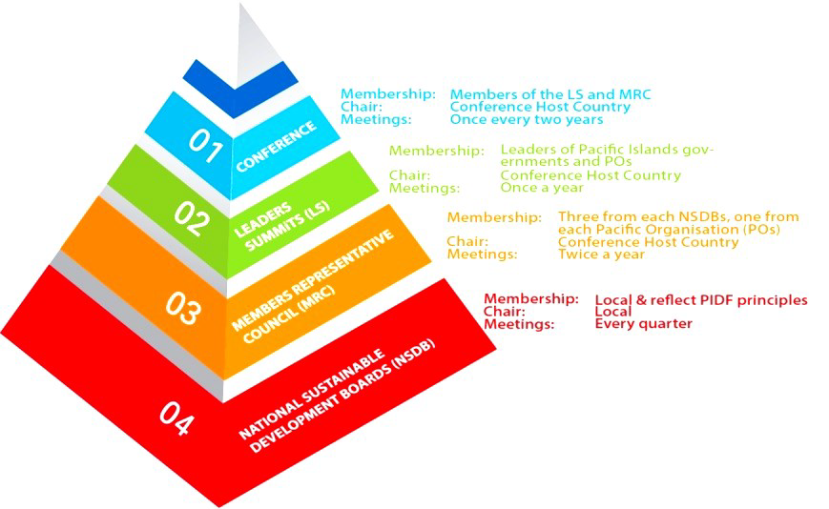
PIDF Governance

Slide 6
National Sustainable Development Boards
Each PIDF member country needs to establish a NSDB
NSDBs have multi-stakeholder membership with representatives from:
Government;
Civil Society; and
The Private Sector.

Slide 7
National Sustainable Development Boards
The PIDF Charter provides the purpose of the NSDB:
Serves as the national focal point and repository of information on all PIDF matters at the national level;
Promotes the establishment of multi-stakeholder and inclusive processes at the national level;
Coordinates the implementation of the decisions of the PIDF at the national level;
Advocates and leads the vision and purposes of the PIDF at the national level; and
Reports to the Members’ Representative Council.

Slide 8
One Pasifika Programme
GOAL: To create and support an enabling environment in PIDF Member Countries for sustainable development that empowers people and safeguards their environment and social fibre and pursues a Green Economy model with full and active participation of their government institutions, civil society and the private sector.

Slide 9
PIDF draft Strategic Plan
M Cluster: Mainstreaming Green Economy
D Cluster: Decarbonisation
of the Pacific
R Cluster: Adaptive Solutions
for Island Resilience
I Cluster: Institutional Arrangements

Slide 10
Mainstreaming Green Economy
To establish Green Growth Frameworks in all PIDF member countries and assist them in formulating a plan of action for their implementation.
To ensure that through a Green Audits mechanism, policy contributes positively to sustainable development for the benefit of people and environment.
To support PIDF member countries reform and develop education curricula to reflect the principles of Green Economy and the Sustainable Development Goals for both formal and non-formal education.
To introduce traditional leaders and resource owners to concepts of Green Economy and Sustainable Development and the benefits of multi stakeholder processes to address the needs of their communities.
To establish a Green Business Centre to assist the Private Sector to design and implement strategies to make their businesses environmentally cleaner.

Slide 11
Green Business Centre
Support businesses to be in a position to introduce cleaner technologies and offset their activities while ensuring their profitability.
Provide incentives, capacity-building, best practices, manuals, on-business tailored support, funding opportunities, web development support for Green business.

Slide 12
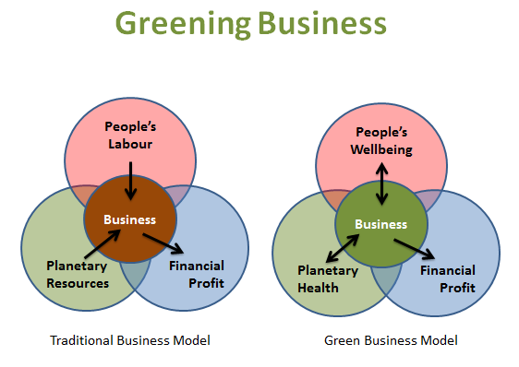
Greening Business

Slide 13
Pacific Green Business Centre
Not a project with an end date
UNDP providing seed funds for establishment
A PIDF and Pacific Islands Private Sector Organisation partnership
Hosted at PIDF

Slide 14
Pacific Green Business Centre Tools
Features Green initiatives
Carry ‘How to’ Guides
Self assessments guides
Self help guides
Links to Green Business resources

Slide 15
PGBC deliverables
The initial focus of the Centre will be on the following deliverables:
Renewable energy
Green packaging
Blue economy
Sustainable tourism
Organic Agriculture
Corporate Social Responsibility

Slide 16
PGBC next deliverables
Next deliverables
Green audits;
Green certification; and
Pacific Environment and Climate Exchange.

Slide 17
Web-portal
The Pacific Green Business Centre is primarily a virtual centre
The portal will have a scalable format with potential of green business sectors contributing to dedicated sections of the portal
Web: www.greenbusiness.solutions
Facebook: pacificGBC
Twitter: @PacificGBC
A mobile app also to be released soon.

Slide 18
THANKS
For further information contact:
Nikhil Lal (nlal@pacificidf.org)
Mark Borg (mborg@pacificidf.org)
Or visit:
www.greenbusiness.solutions

