Slide 1
Business Development & Productivity Specialist Business Advisor
David Sutherland
Davids@pipso.org.fj

Slide 2
AVID Program Funded by DFAT Australia
AVI are the in Country administrators of the AVID Program

Slide 3
PIPSO Productivity Specialist Impact
Work Experience - Brief
Working and Business career 1978 – 2007
Owner Operator Small Business - Transport
Manufacturing & Production Company Production Manager
Management and a Business Management Degree
Supply Chain Management Logistics management
Managed Distribution Centres DC & Logistics Manager
Process improvement and Lean practice Management
Manufacturing Company CSR National Logistics Manager
Privately Owned National Company CEO,
3rd Party Logistics 15 years

Slide 4
PIPSO Productivity Specialist Impact
Work Experience - Brief
Working and Business career 2007 – 2017 10 years
Operational Implementation Management: Project Manager for Implementation of supply chain review and redevelopment from
Production facilities to a Greenfield Distribution centre
Operational structure, Process and procedure review and
implementation of Process improvement thru Change Management
Supply Chain & Logistics Management Implementation
Value Chain Review & Enhancement Hands on Project Manager
Occupation Health & Safety Safety Management

Slide 5
PIPSO Strategic Plan 2016 – 2019 Strategic Focus Areas
1 – Supporting national private sector organisations (NPSOS) to be strong and responsive organisations
2 – Assisting Pacific businesses to enhance their business competitiveness and growth
3 – Championing the interests of private sector in the appropriate fora
4 – Ensuring the sustainability of PIPSO’s resources and enhancing its capabilities

Slide 6
PIPSO Productivity Specialist Impact
PIPSO Strategic Plan 2016 – 2019 Strategic Focus Areas
1 – Supporting National Private Sector Organisations
(NPSOS) to be strong and responsive organisations
NPSO Support
Council Attachments
Women in Business
Manufacture & Trades
Business Disaster Resilience
Youth Entrepreneurs
Participation in Workshops
Mentoring Interim Chairman
Facilitating New Strategic Plan
Collaborate the Creation of Video to
showcase Pacific Island Entrepreneurs

Slide 7
PIPSO Productivity Specialist Impact
PIPSO Strategic Plan 2016 – 2019 Strategic Focus Areas
2 – Assisting Pacific businesses
to enhance their business competitiveness and growth
Businesses Directly Assisted
Agriculture Business 4
Manufacturing 3
Other / Retail 2

Slide 8
PIPSO Productivity Specialist Impact
PIPSO Strategic Plan 2016 – 2019 Strategic Focus Areas
3 – Championing the interests of private sector
in the appropriate fora
Steering Committees
Plastic Reduction Steering Committee- PIFD
Business Disaster Resilience – UN WFP
Interaction with Academia
Program Advisory Committees
Engineer & Physics USP
Business Faculty USP
Development of Workplace Programs

Slide 9
PIPSO Productivity Specialist Impact
PIPSO Strategic Plan 2016 – 2019 Strategic Focus Areas
4 – Ensuring the sustainability of PIPSO’s
resources and enhancing its capabilities
Provide OHS Guidance
Safety Coordinator
Safety Policy Introduction
Provision of Business Development Support
Workshops Facilitation
PIPSO 1
USP - May 2017 - 81
USP - July 2017 - 48

Slide 10
USP Entrepreneurial Workshop Small Business Incubator Workshop
Bula Vinaka
Welcome
USP 2017 Entrepreneurial & Career Fair
Presented by PIPSO
Pacific Island Private Sector Organisation
Participants
81
USP JAPAN ICT CENTRE 02-05 MAY, 2017

Slide 11
Entrepreneur Workshop
“The NEXT Step”
Driving your Idea Vision Concept into a Business Venture.
Facilitated by PIPSO
Pacific Island Private Sector Organisation
Participants
48
USP - JAPAN ICT CENTRE 21 July, 2017 2-4 pm

Slide 12
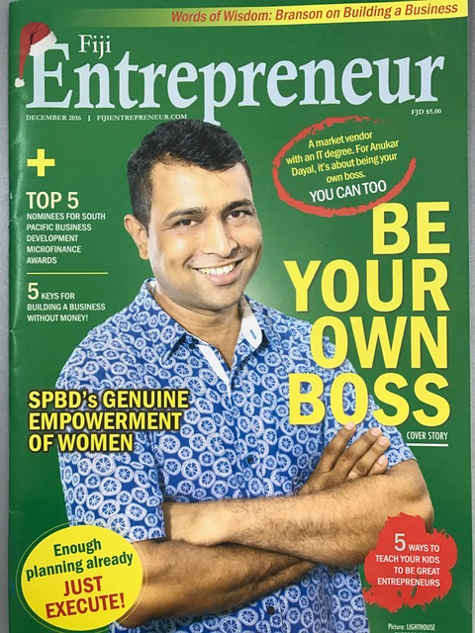
Entrepreneur Workshop
Introducing new initiative
Collaboration with USP and Private Sector
Business Innovation centre
Questions & Discussion with Business owner Panellists

Slide 13
Creation of a
Business Innovation Centre
-Think Tank.
Concept Note
The Aim
To Foster and create a collaborative approach with
USP,
Fiji Business community,
FCEF Business Councils
Other Stakeholders
In Creating a Business Innovation Centre
Think Tank (Similar to an incubator).
The Vision
To connect Business Owners with Assistance to Start, Develop or Grow their Business for sustainability by
Establishing an environment that can facilitate synergy between
USP Students in Business Studies and related fields,
Private Sector Entrepreneurs and Small Business operators.

Slide 14
Business Innovation Centre Concept Note
Mission
Provide Business Study Students with opportunity to:
Provide Hands on & Practical assistance
to Entrepreneurs and Business owners to develop & evolve their Business Ideas, Visions and ventures
Gain Business knowledge,
Learning & Research in Business related activities.
Involvement in Real and Live, Business Activities
Providing Hands on & Practical assistance; will give students the opportunity to be involved in Real and Live, Business Activities and use this experience for their studies and as experience for their CV.
Start-up their own Business
assistance exploring a Business concept

Slide 15
Business Innovation Centre Concept Note
Mission
Providing Entrepreneurs and Small Business Owners, or Aspiring Business people, Access to:
Academic knowledge in related Business fields
Academic Support to physically provide assistance with tasks required to solve business issues.
Support that Provides solutions to business related activities.
Experienced Business Owners Sharing their Skill Knowledge and Experience
Mentor Program

Slide 16
Business Innovation Centre Concept Note
Other opportunities from the “Innovation Centre” could include;
Current Business Funding sources
Provide Consolidated Information of available funding sources
Think Tank Meetings;
Sessions where entrepreneurs or aspiring business people, could present and introduce new ventures or concepts that could be evaluated by experienced Business people and academic personnel, for guidance
Student section of the Youth Entrepreneurs Council
Create a membership stream for students to belong to the FCEF – Young Entrepreneurs Council

Slide 17
Business Innovation Centre Concept Note
Other opportunities from the “Innovation Centre” could include;
Mentor Program
Establish a Mentor program using existing business owners/ people.
Use the Innovation Centre and business people to match Business to a Suitable mentor and provide follow up
Student Business on Campus
Facilitate the creation and implementation and operation of functioning business’ on campus run by students that could be used by Faculty as a venture to study, add value to, and grow.

Slide 18
Business Innovation Centre Concept Note
Where to from here
The concept note has now been shared with Stakeholders
USP Faculty
Commerce & Employers Federation
Business Council Members
Created a Steering committee involving the stakeholders
To decide if there is enough commitment to move forward
Start formulating the Terms of Reference
Next step Moving forward
Introduce to Ministry for Support
Further Involve and obtain the Local business buy in Ownership of the Centre
Develop the program Process and Procedures

Slide 19
PIPSO Specialist Impact
Questions or Comments
Productivity Specialist role
Innovation Centre Concept

Slide 21
Business Development & Productivity Specialist Business Advisor
David Sutherland
Davids@pipso.org.fj

Slide 22
Challengers & Issues I Identify in the Development of Business in Fiji
Funding
Handout Mentality
with out sustainable outcomes
Not measured against a sustainable outcome
Culture
not looking forward – Living for now
Development Assistance
Expat Development force, consultants
Workshops – Participation Certificates
Duplication of programs from many organisations
Non Sustainable development
Little Competency based Training

Slide 23
Contact
David Sutherland
Email: Davids@pipso.org.fj
www.pipso.org.fj

