Slide 1
2017 Work Updates
Presentation to the AGM, Nadi
Fiji 26th July 2017

Slide 2
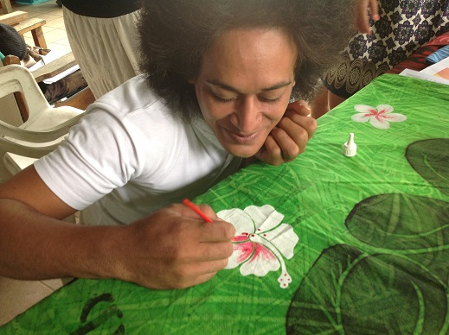
Four Strategic Focus Areas
Supporting NPSOs to be Strong and responsive organizations
Assisting Pacific Businesses to enhance their Business Competitiveness and Growth
Championing the interest of the private sector in the appropriate Fora’s
Ensuring the sustainability of PIPSO’s resources and enhancing its capabilities.

Slide 3
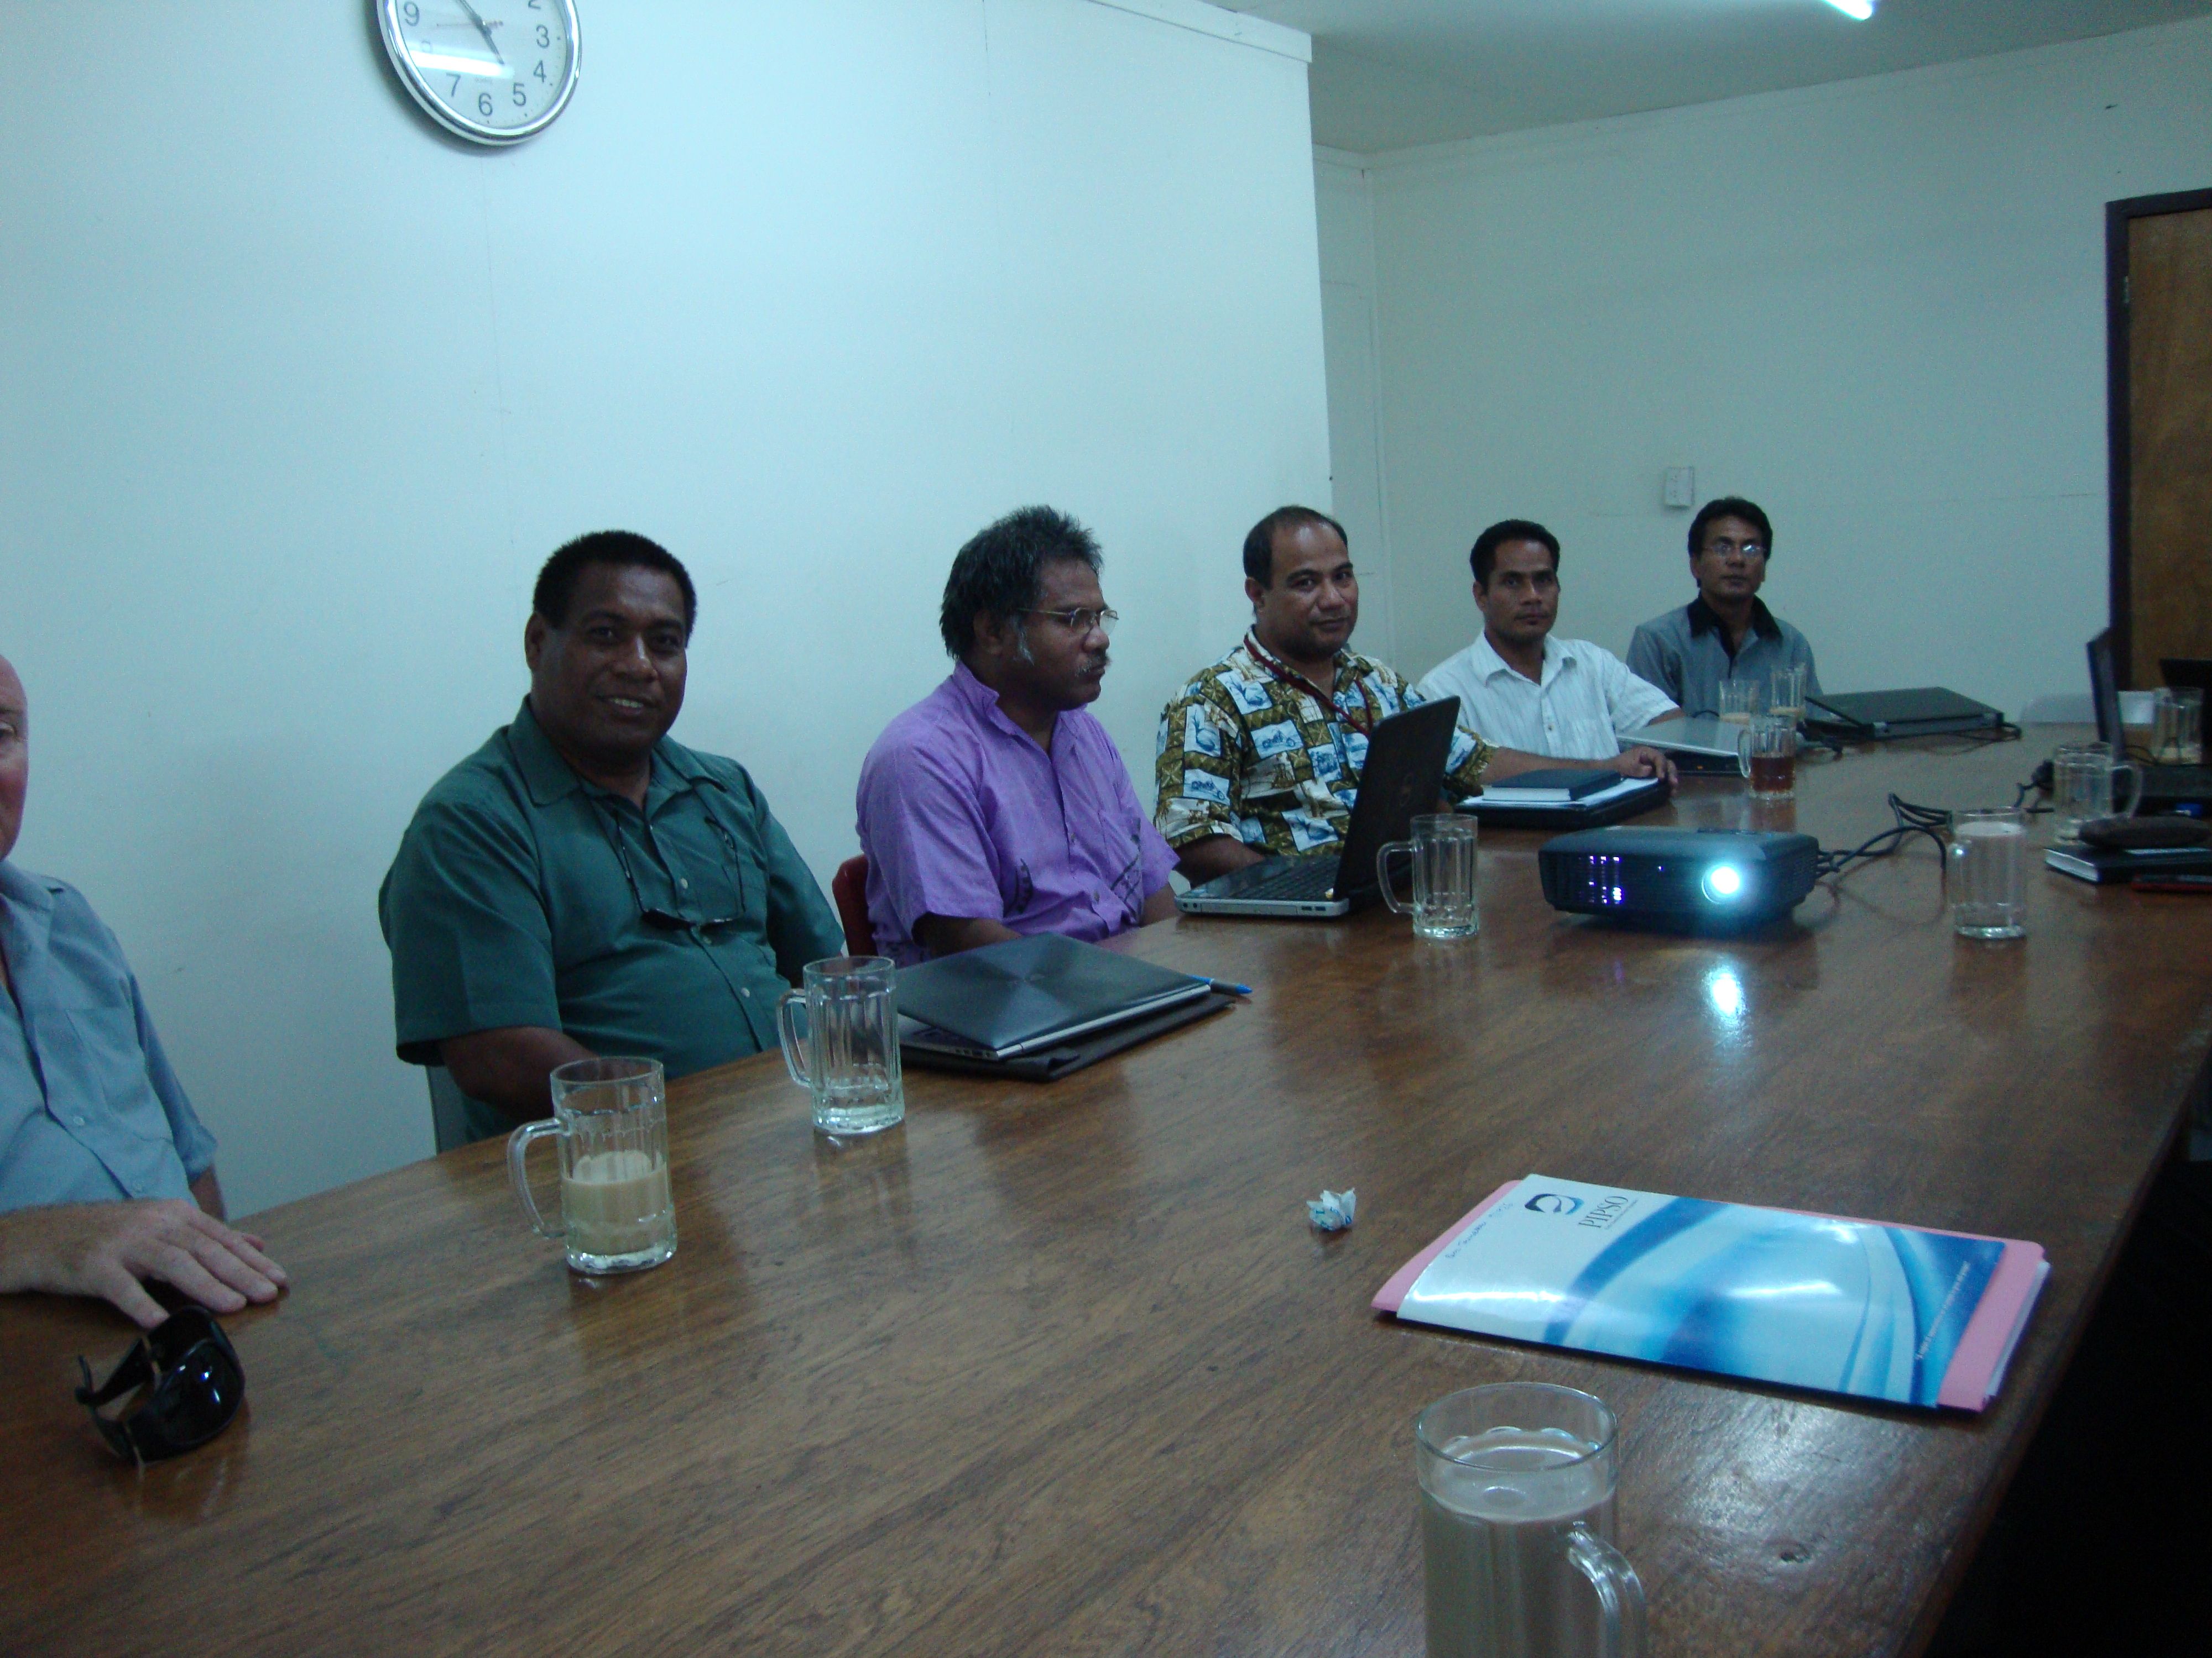
Supporting NPSOs to be Strong and Responsive Organizations
Review of Forum leaders, FEMM & FTMM Outcomes to be undertaken by PIPSO & NPSOs
Developed Action Matrix with PIFS to action implementation relevant to each organization
Conduct E-Surveys to asses NPSOs capacity Building Needs
Prepared and Secured NSA II Funding for NPSOs Capacity
Building
Regional Anti-corruption Code of Conduct
Dissemination of relevant information to NPSOs

Slide 4
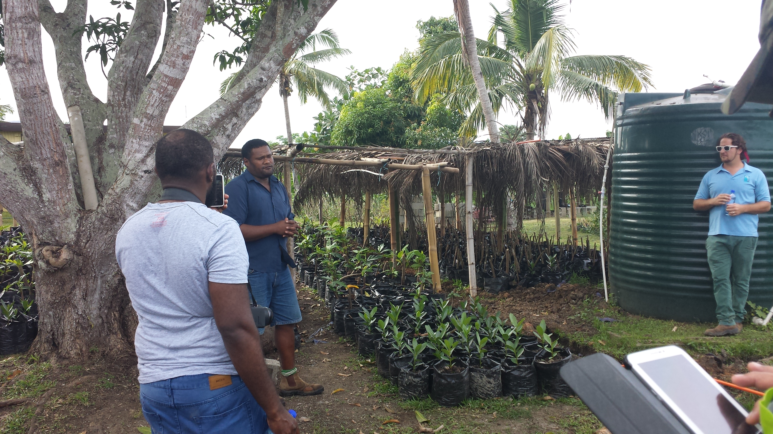
Assisting Pacific Businesses to Enhance their Business Competitiveness and Growth
Knowledge management platform – agribusinesses profiles, coconut industry stakeholders
Finalization of the ACP TBT Food Safety Protocols Training of Trainers
Business resilience work for the region –recruitment of resilience officer
Women in Agribusiness Platform – Research & network platform
Finalization of the Feasibility Study on Collection centres

Slide 5
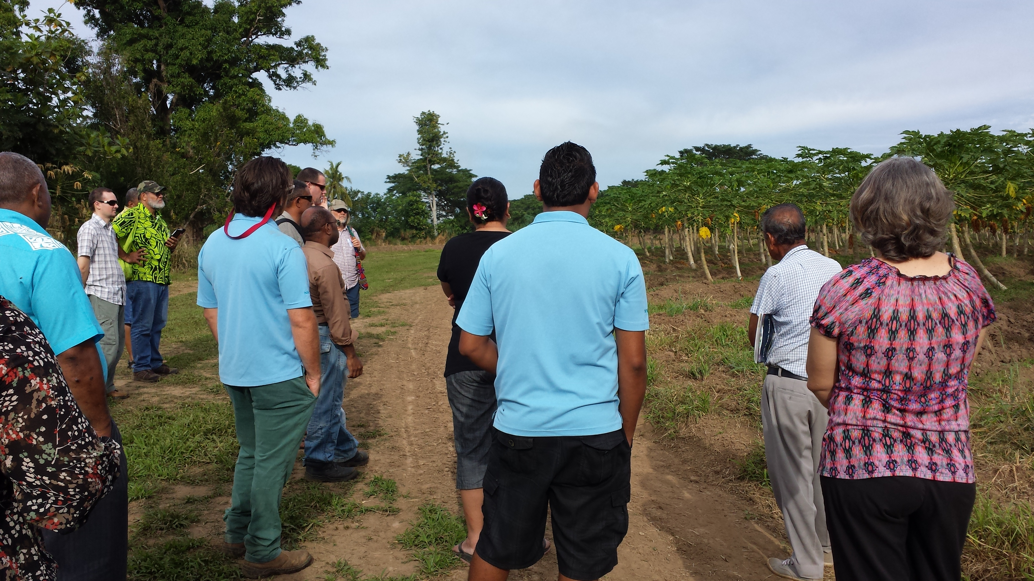
Assisting Pacific Businesses to Enhance their Business Competitiveness and Growth
Business Financial Training
Development of the E- Financial Business Training with COLEACP
EDF11th proposal – focus of tourism Industry
Engagement of the productivity and production specialist
IFAD/CTA Project

Slide 6
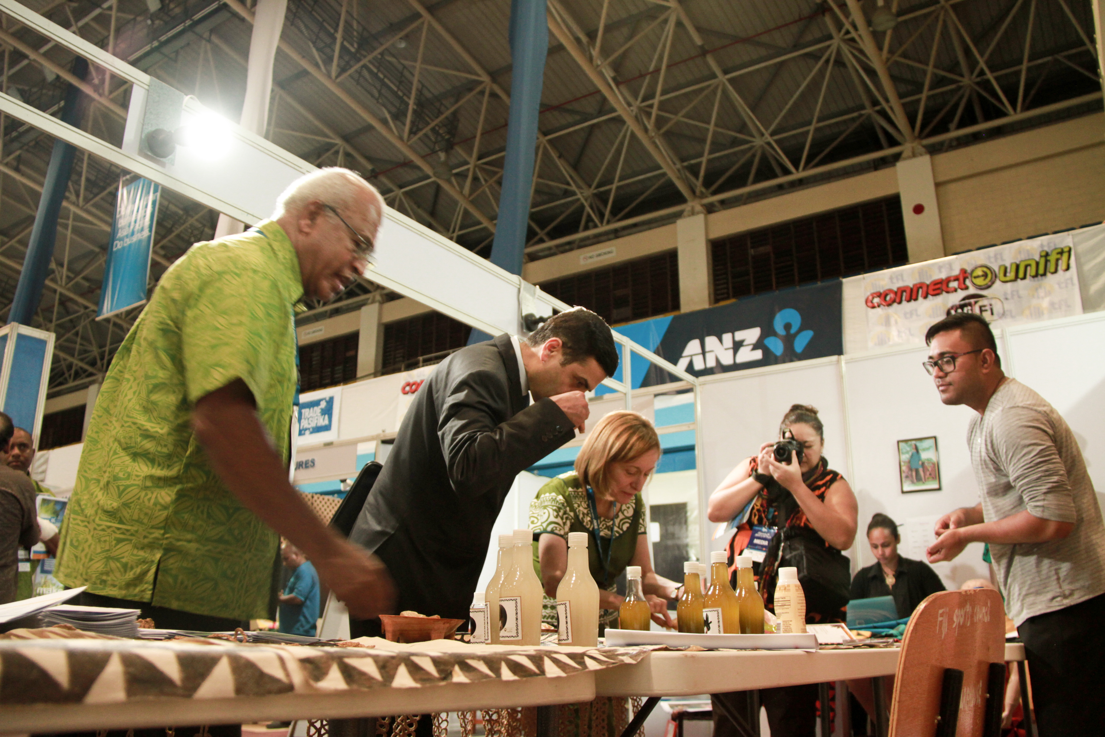
Championing of the interest of the Private Sector in the appropriate Fora
NSA Dialogue on PACER Plus
NSA Committee with PIFS
ICT Regional Taskforce Committee
Pacific TAFE Committee
USP MBA Programme Committee
SPC Women Empowerment Working Group
Pacific Resilience Partnerships – PIFS, SPC, SPREP

Slide 7
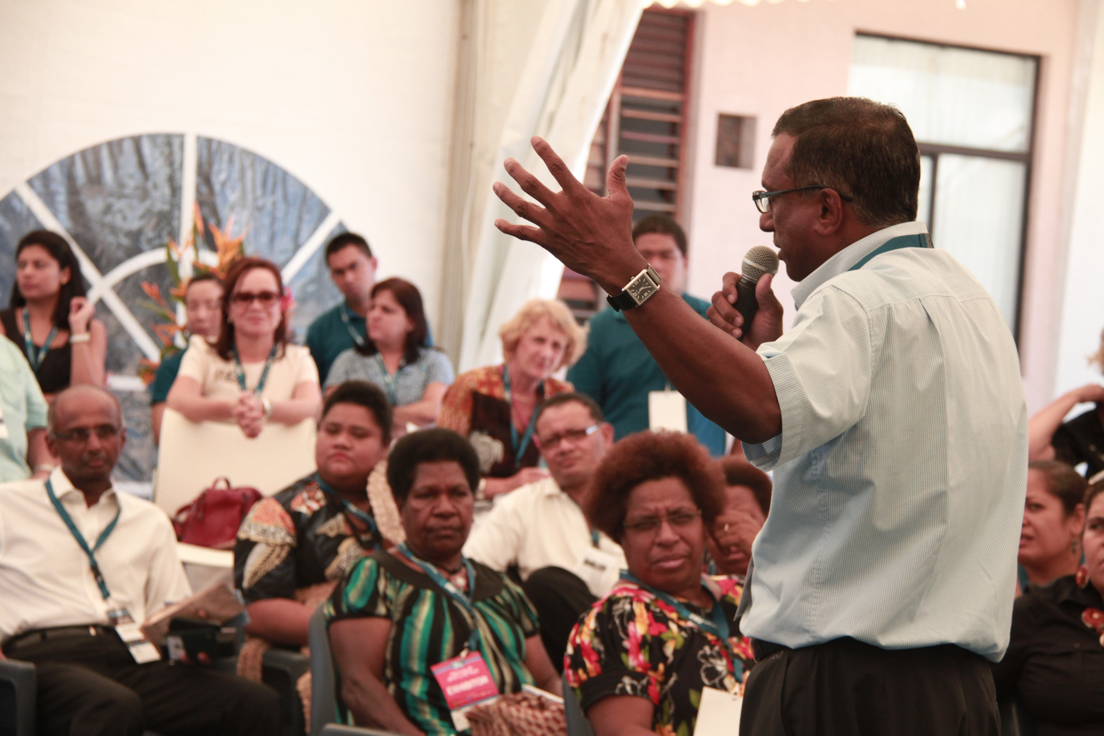
Championing of the interest of the Private Sector in the appropriate Fora
Pacific Women Development Reference Group
ACP Private Sector Steering Strategic Committee
Forum Leaders, FEMM & FTMM
PIDF Officials Working Group
Business Resilience Working Group (SPC, UNDP, PIPSO, UNDISR, UNOCHA, Connecting Business Initiative)
Development of Pacific Sustainable Framework for business connection with Asia

Slide 8
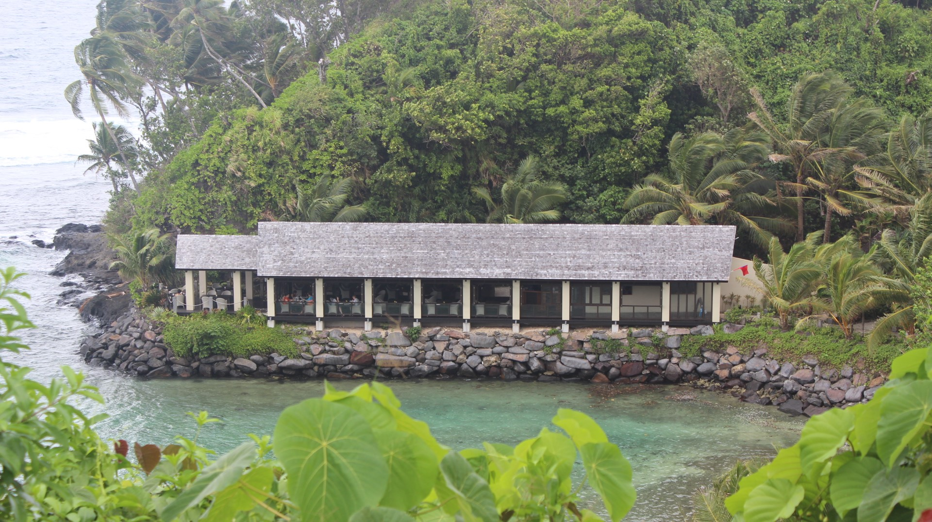
Ensuring the sustainability of PIPSO’s resources and enhancing its capabilities
Recruitment of three Project Officers – IFAD/CTA
Review of Communication Strategy
Development of Risk Management Policy
Development of Procurement Policy
Reviewing of Financing Strategy - need to have sustainable institutional funding
Exchange Officer Programme
Recruitment of Resilience Officer
Attendance of Workshops by Staff/ Presenters

Slide 9
End of the Presentation

