Slide 1
Training Needs Analysis Results for NPSOs for 2017
Presentation to the Regional capacity Workshop, Nadi
Fiji 24th July 2017

Slide 2
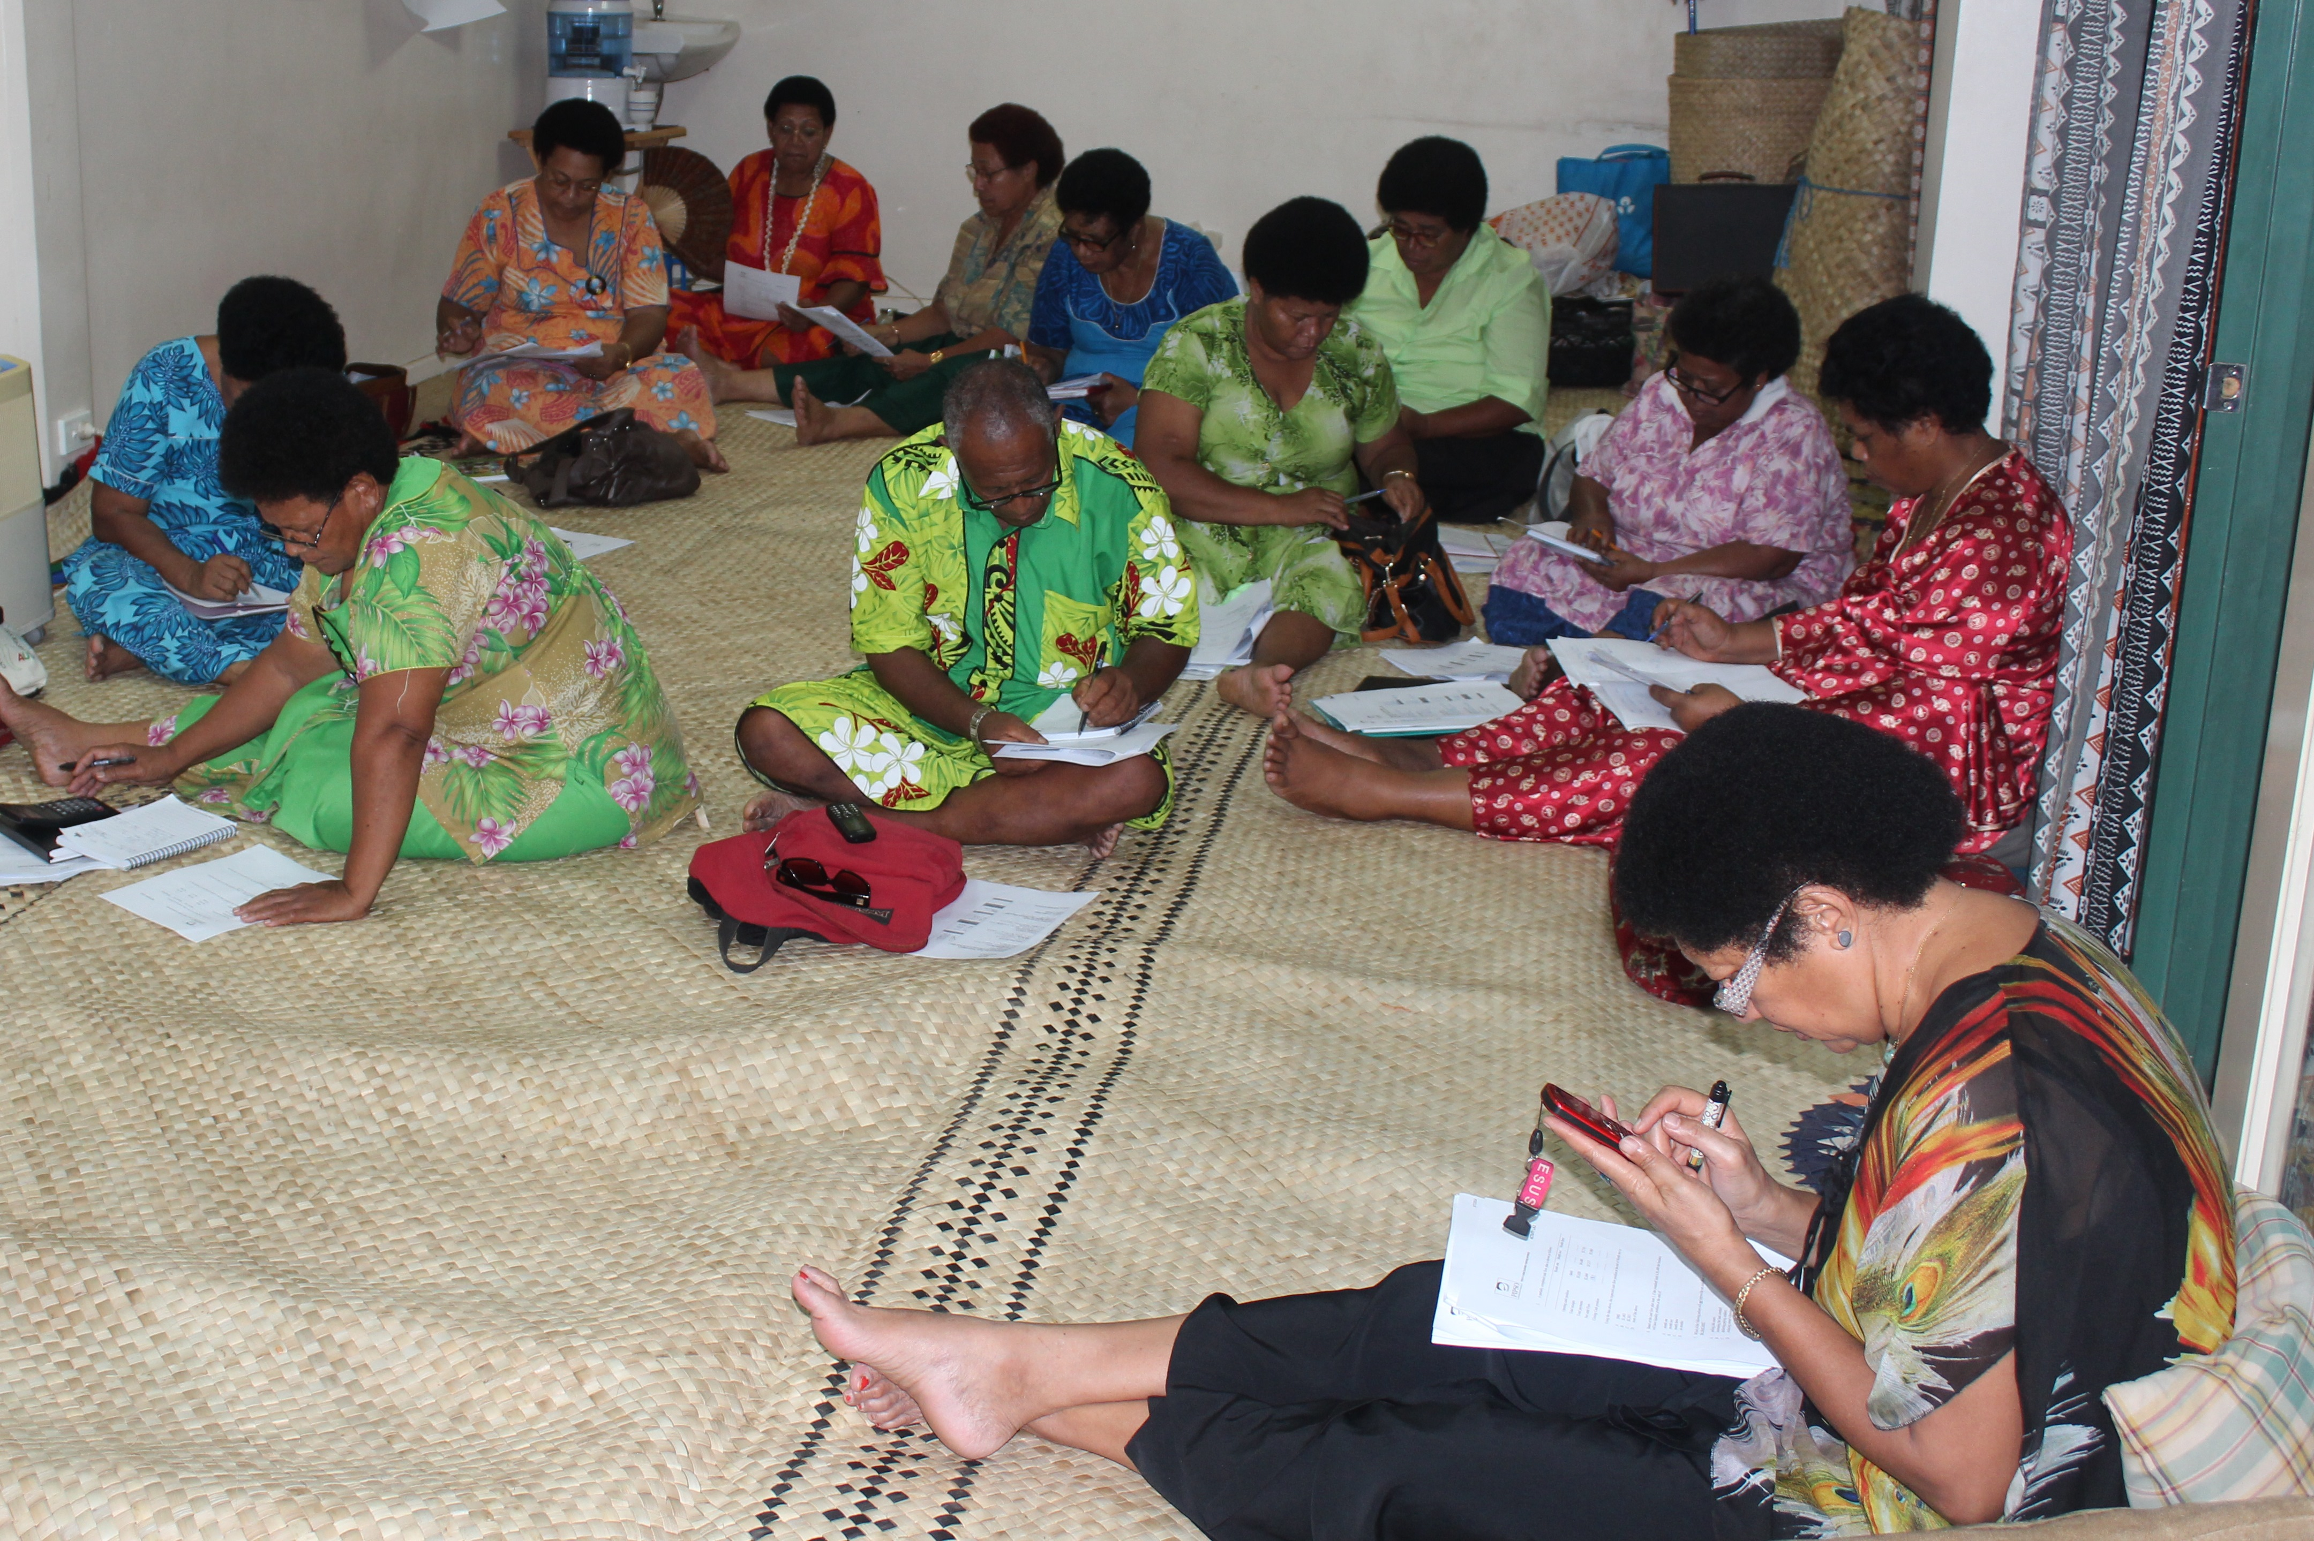
Four Key Areas of Survey
Staffing
Capacity Building Needs of NPSOs & other members
Capacity Building Needs of Businesses
Availability of Training Resources

Slide 3
Staffing at NPSOs

Slide 4
Gaps in Knowledge and Expertise in NPSOs

Slide 5
Organization Skills and Requirements in NPSOs

Slide 6
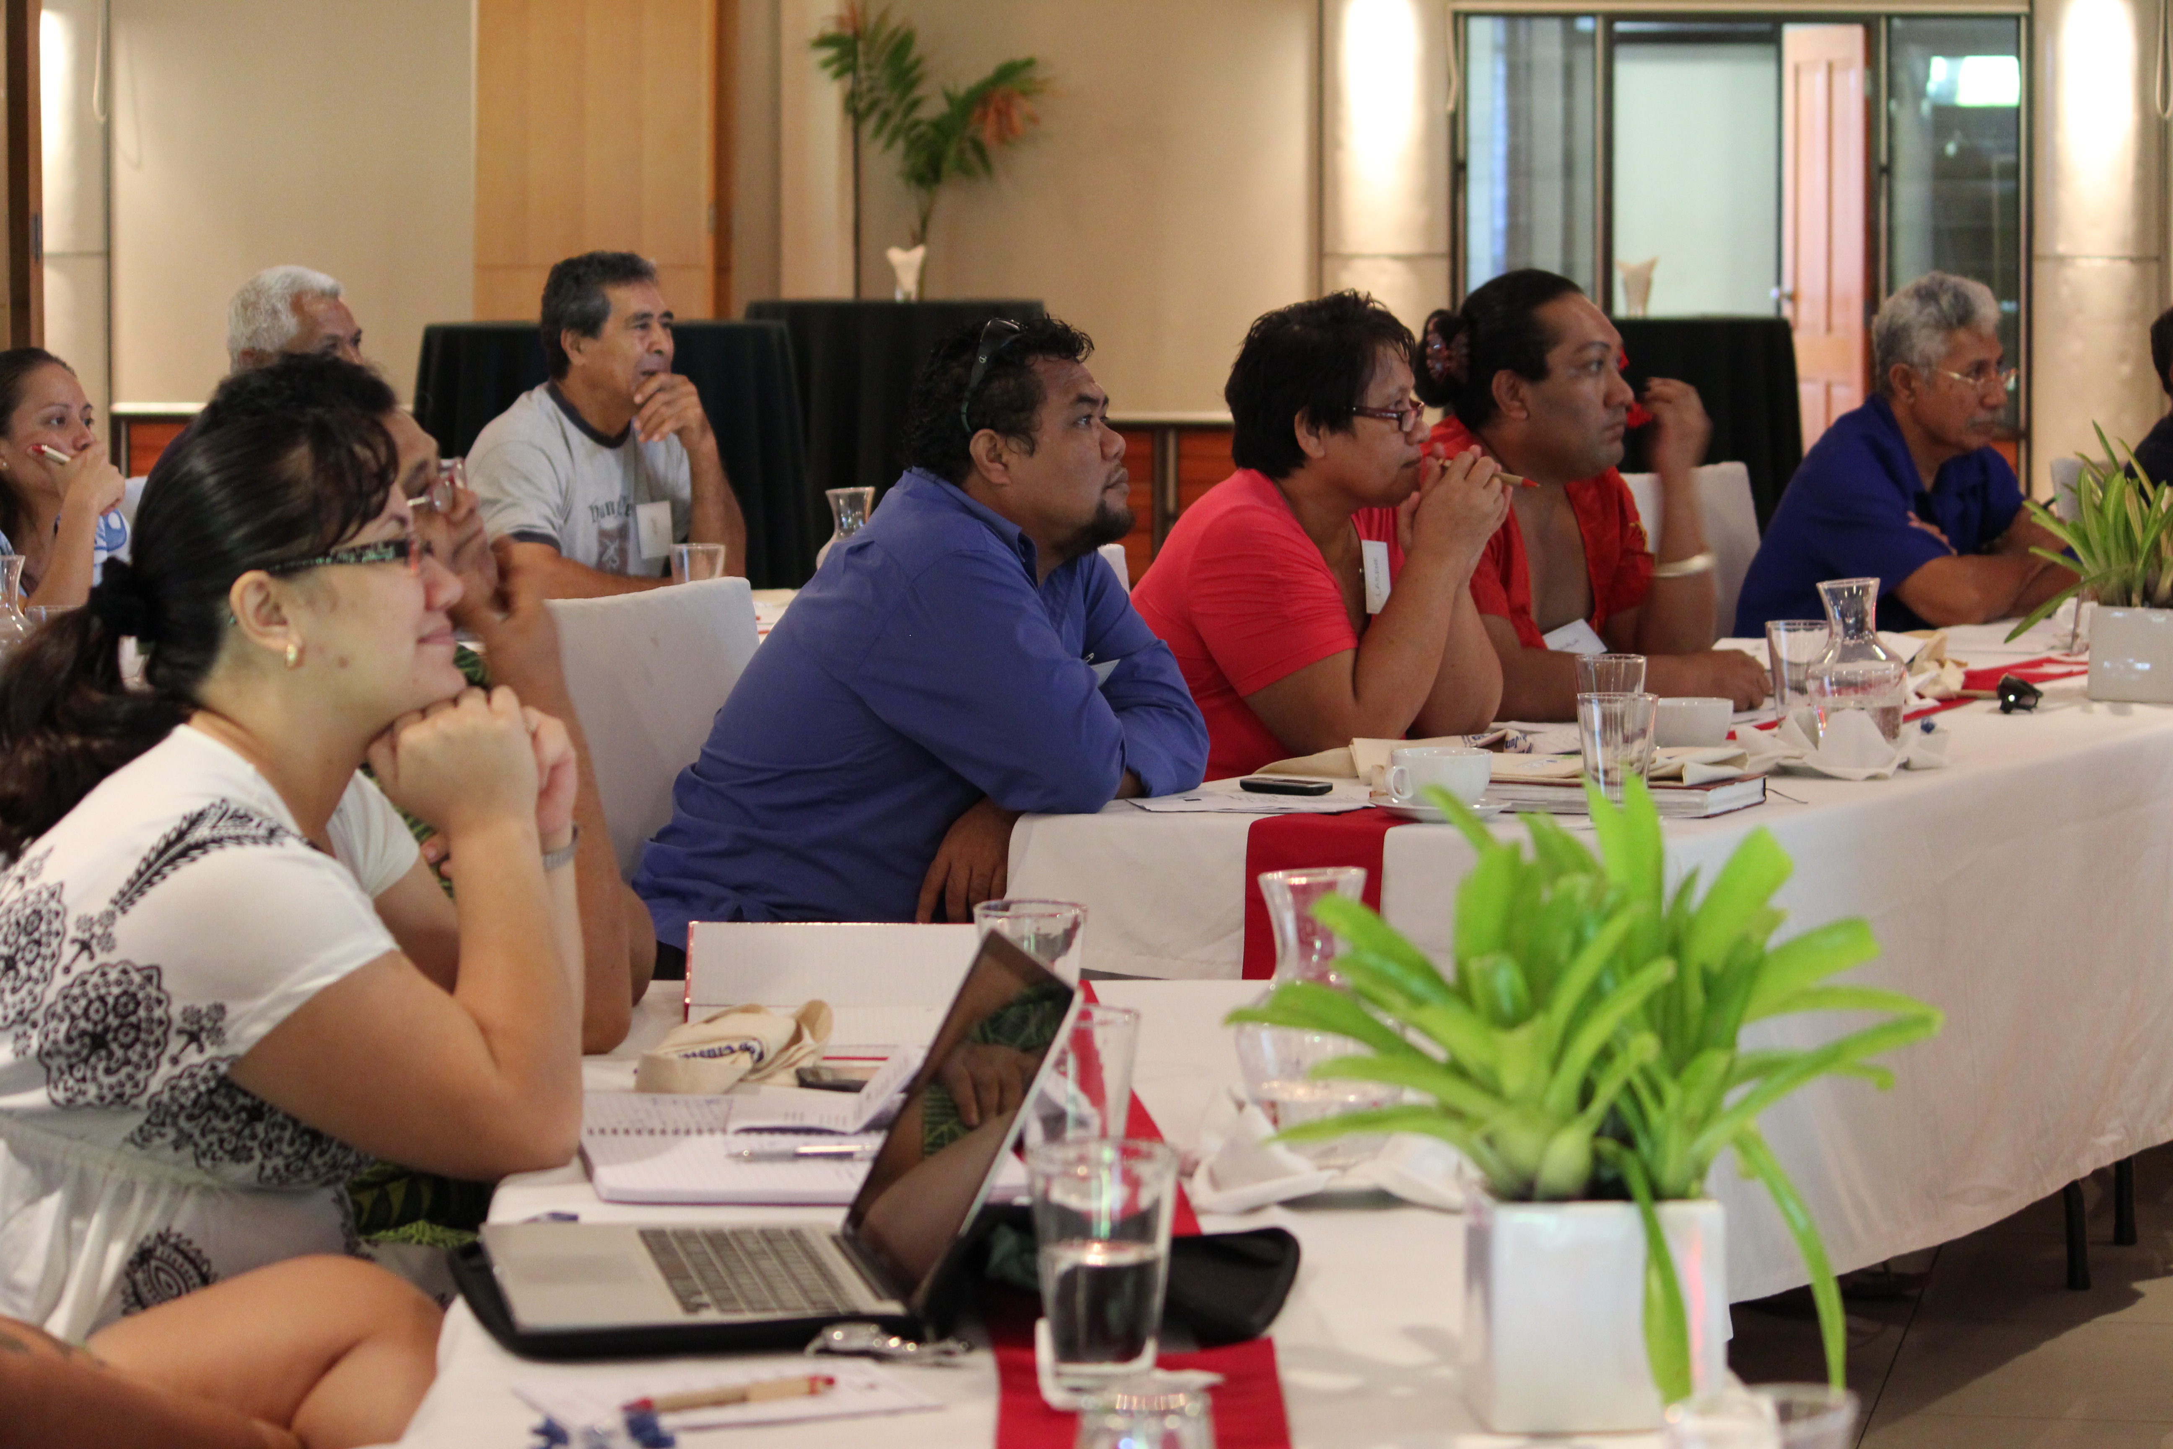
Staff Training Needs Analysis

Slide 7
Assessment of NPSOs Members Training Needs

Slide 8
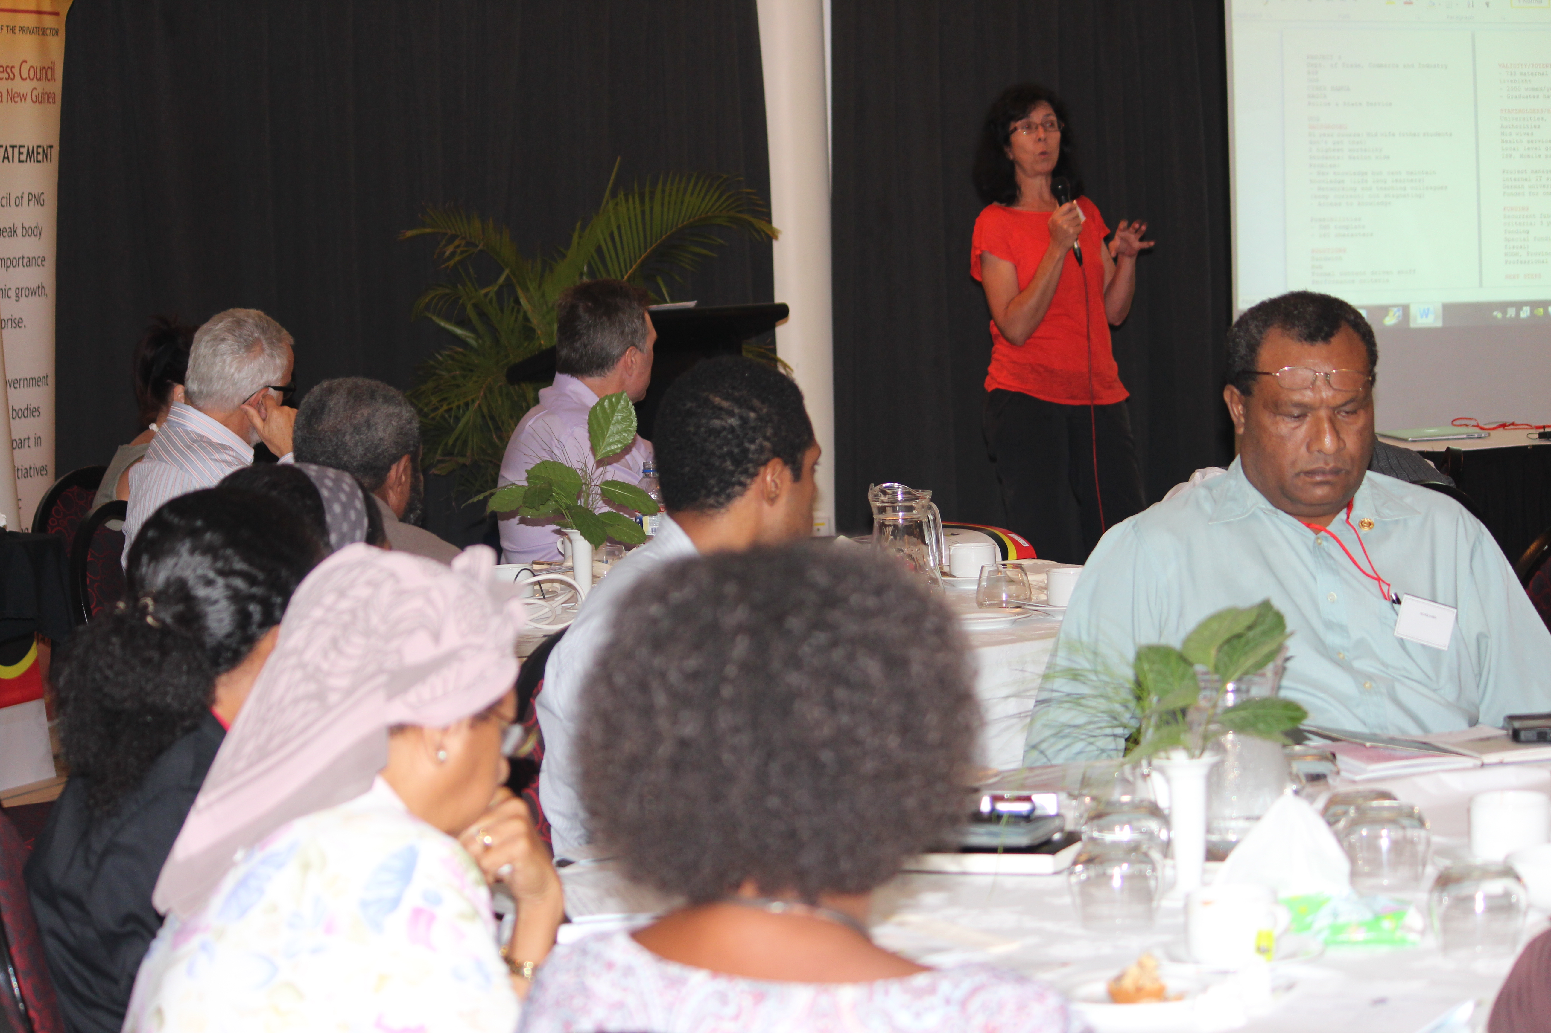
Training Needs of Businesses

Slide 9
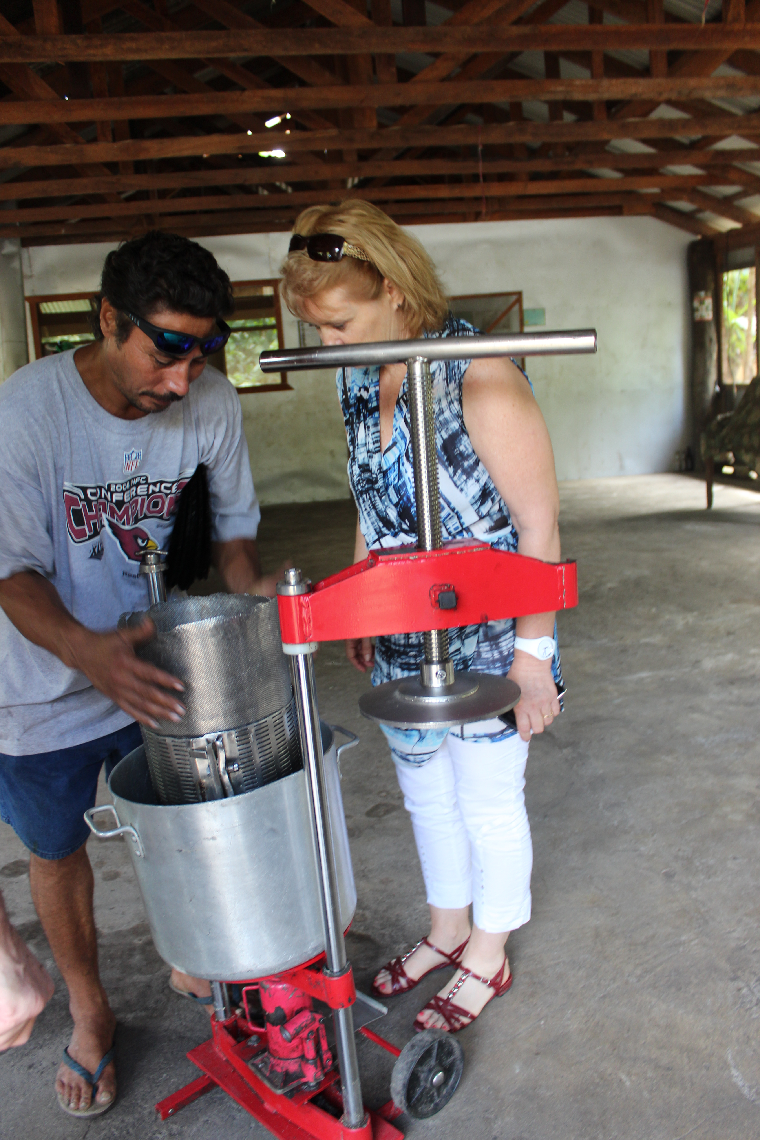
Organisations Working With NPSOs to Provide Training

Slide 10
Budget for Overseas Training
Budget for Local Training

Slide 11
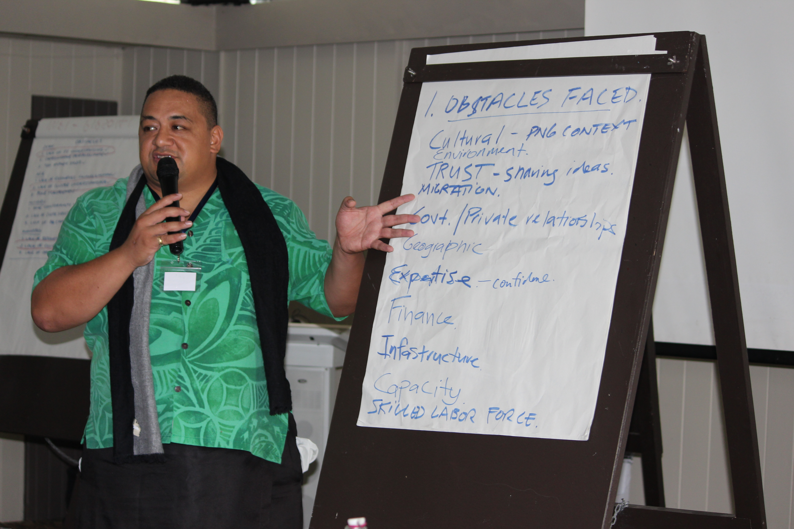
Summary
Need for good staffing - Possibility of engaging AVI to provide technical staff
Huge Skills gaps in many areas - need for organization strengthening to effectively engage in public and private dialogue, policy advocacy and consultation
Great need for technical assistance especially in the areas of preparing funding proposal.
Need for NPSOs to know the demand and areas of training of their members
Conducting surveys can help the NPSOs to support funding proposal

Slide 12
End of the Presentation

