Slide 1
Minimising the impacts of drought
Reducing water wastage
Securing safe drinking water
Maximising water yields
Developing new sources of freshwater
Maintaining water security through innovation

Slide 2
Size
Isolation
Vulnerability
Human resources
Financial resources
Limited land & water resources
Ownership & governance
Self-sufficiency
Maintaining water security through innovation
Notes:
Challenges that exist in the Pacific are unique. In some cases it is challenges caused by shallow aquifers of fresh water lenses such as in the case of Kiribati where to keep a healthy system of fresh water only a certain amount of water can be extracted.
But the other issues of geography and mere access to transport in the vastness of the region create significant challenges that I am sure everyone in this room is familiar with.

Slide 3
Maintaining water security through innovation
Notes:
MDGs – Halve, by 2015, the proportion of the population without sustainable access to safe drinking water and basic sanitation but Pacific didn’t do too well on some of the MDGs
This is reflective of region and not country necessarily
Good examples of innovation exist but collectively we need to do more
Sustainable Development Goals – Ensure access to water and sanitation for all
2.6 billion people have gained access to improved drinking water sources since 1990, but 663 million people are still without
By 2030, achieve universal and equitable access to safe and affordable drinking water for all
By 2030, achieve access to adequate and equitable sanitation and hygiene for all and end open defecation, paying special attention to the needs of women and girls and those in vulnerable situations. In disaster we know the risk of using toliets in evacuation centres for example can increase the risk of violence and assault to women

Slide 4
Maintaining water security through innovation

Slide 5
Daily sustainable yield from Bonriki groundwater reserve = 1.68 million litres per day, equivalent to about 2/3 of an olympic swimming pool
Year | Approx daily share (assuming no losses* and even distribution) | equivalent FMF breakfast cracker buckets
2000 (MDGs signed) | ~45 L/p/d | ~3
2015 (MDGs due) | ~30 L/p/d | ~2
2030 (SDGs due) | ~20 L/p/d | ~1 1/3
2030 drought year | ~15 L/p/d | ~1
If there were no losses (currently probably 50%), and the yield were to be distributed across the total population of South Tarawa (currently 55K), each person would receive…
Notes:
1. This, split equally across the population of Kiribati, in the year 2000 was approximately 45 litres. THREE BREAKFAST CRACKER BUCKETS.
2. Population growth means that more people will need more water from this lense as we continue on from 2000 and in 2015 when the MDGs were due this average split across the population had gone down to 30 litres (2 breakfast cracker buckets)
3. Now if we look forward to 2030 and this is based purely on daily pressures and climate variability this prediction moves down to 20 litres or 1 bucket and 1/3
4. But lets say there is a drought in 2030 which means the reduction in water is 5 litres per person. So we are down to just one bucket. THIS IS THE SPHERE STANDARD based on population and growth rate with a little bit of climate variability added in there
5. However there is non commercial assets that come into play and this is something that private sector equate as lost money which is the seepage in the lines that carry the water to the consumers. This is on average 50% seepage or wasted water running out of the pipes or becoming polluted. This is common across the region and is not just in Kiribati. So you have a drought. You are down to 15 litres a day in 2030 when we are working to meet sustainable development goals on increased access to safe drinking water for everyone and you lose another 50%. This brings it down to 7.5 litres. LITTLE CRACKER BUCKET

Slide 6
Mounting pressures on PSIDS water security
Frequency
Intensity
Degradation
Climate Change
Floods
Drought
Climate Variability
ENSO
Daily Challenges
Water Security
Health
Sanitation
Sustainability
Pollution
Infrastructure
Information
Governance
Capacity
Finance
Maintaining water security through innovation
Notes:
The impact you can have on the daily challenges – the better the protection, resilience and preparedness you have for the climate variability and climate change impacts.
The challenges that exist in this region are a build up of a range of things. We talk about climate change and climate variability. We also talk about disasters and many of you both see the impact of climate change and have faced significant disaster but at the core level what are the daily challenges that impact upon this?
For example – access to safe water, health and sanitation, Governance and having organisations that can support increases in sustainable development which support increased access to things like safe water in efficient ways.
Then we have Climate Variability which is at its core naturally occurring variables. Floods, drought, normal weather conditions.
This is naturally occurring but when you stack climate change on top the predictions show increases or increased severity in things like drought, flooding, intensity of cyclones.
So it makes the first building block of daily challenges and overcoming these harder.
This is a good over all look at business when you think of daily challenges being access to water for manufacturing or irrigation becoming a risk and looking at the climte variability and how it will continue to determine how you can reduce your risks at this first level.

Slide 7
Minimising the impacts of drought
Awareness
Restrictions
Declaration
Warning
Response
Detection
Response
NO ACTION
NO ACTION
EMERGENCY
Emergency averted
Maintaining water security through innovation

Slide 8
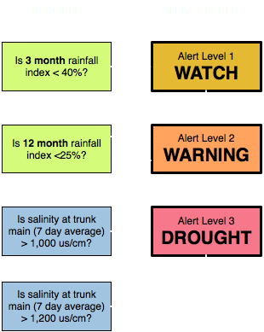
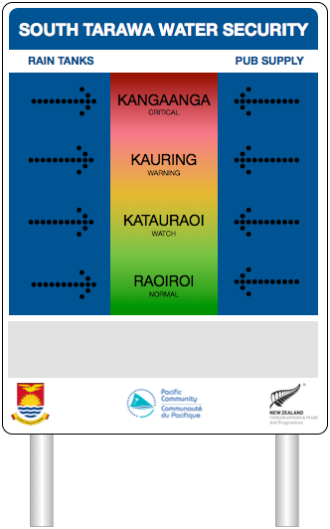
Minimising the impacts of drought
Maintaining water security through innovation

Slide 9
Reducing water wastage
Maintaining water security through innovation

Slide 10
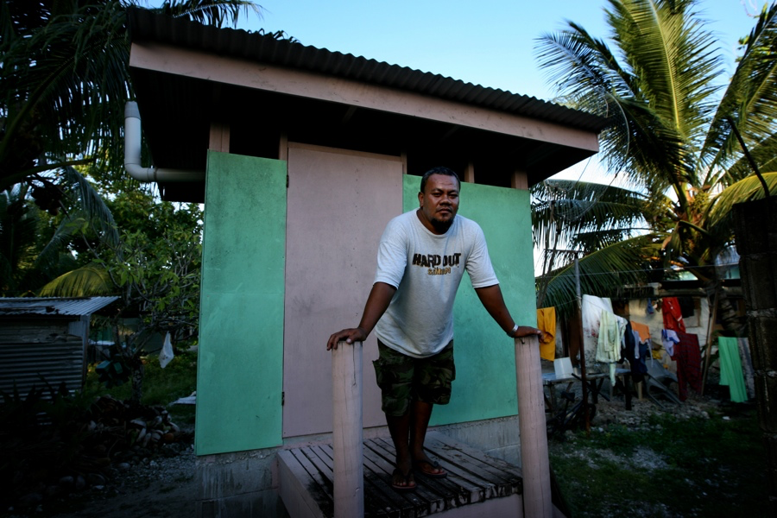
Reducing water wastage
Maintaining water security through innovation
Notes:
Examples of this are installation of compost toilets not just for drought only conditions but all year round to also reduce the impact on the environment when it comes to sanitation waste.
In Tuvalu putting in compost toilets has saved significant water needs not having flush toilets.

Slide 11
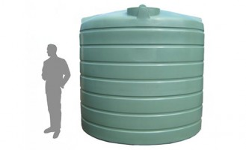
Reducing water wastage
Maintaining water security through innovation
Notes:
Calculated savings of water in drought equate to 8 10,000litre water tanks per year in drought. This means reducing the need for water tank delivery for the country from every 2 months to every 2 years
Organic matter produced from the compost toilets also provides healthy soil for the atoll and for all atoll countries

Slide 12
Securing safe drinking water
Maintaining water security through innovation

Slide 13
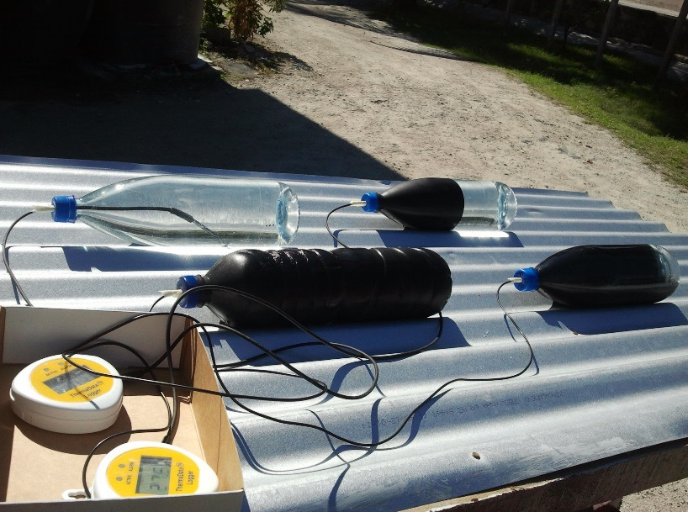
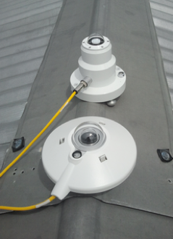
Securing safe drinking water
Maintaining water security through innovation
Notes:
SODIS – some of you may use these Solar Water Disinfection Process or SODIS
It uses intense sunlight and ultraviolet light which the Pacific is RICH in
SODIS stands for Solar Disinfection known as the solar water disinfection process. In short, the intense ultraviolet radiation from the sunlight shining through a nonopaque container filled with nonpotable water will irradiate and kill undesirable pathogens rendering the water safe to drink

Slide 14
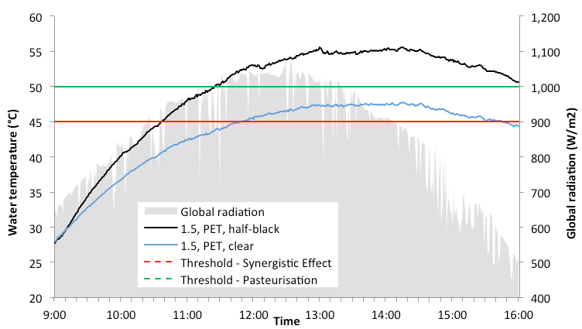
Securing safe drinking water
Maintaining water security through innovation

Slide 15
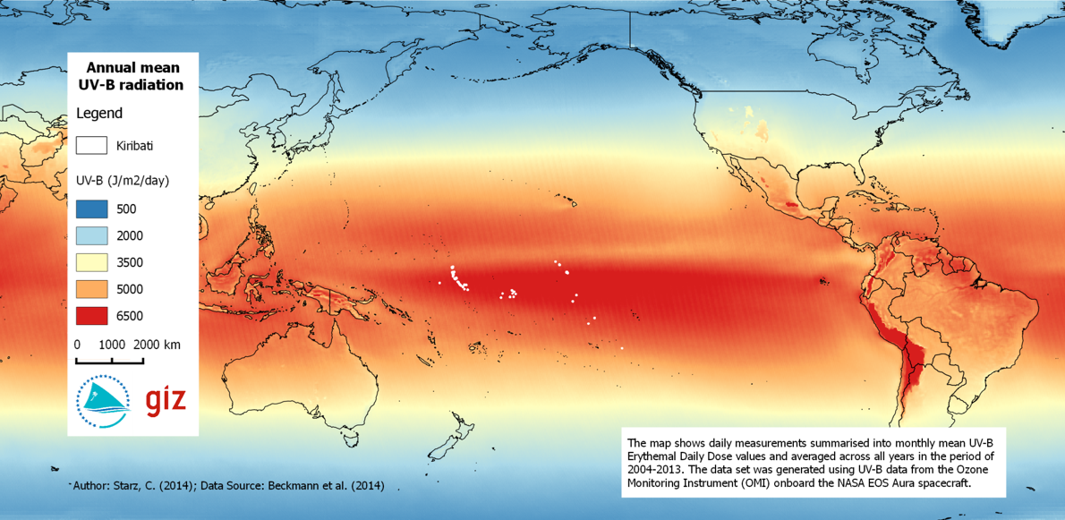
Securing safe drinking water
Maintaining water security through innovation

Slide 16
Maximising water yields
Maintaining water security through innovation

Slide 17
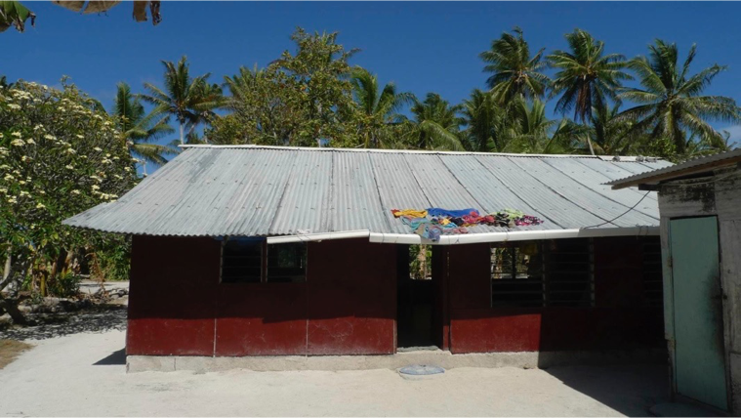
Maximising water yields
Maintaining water security through innovation
Notes:
Looking at guttering and saving water capture from suitable roofs and extending guttering to water tanks has had signficant impact
Research was carried out to understand roof quality and size, number of people in the home and health of the gutters and if there was a water tank.
Parnets with kids off at USP never ran out of water but families were running low regularly.

Slide 18
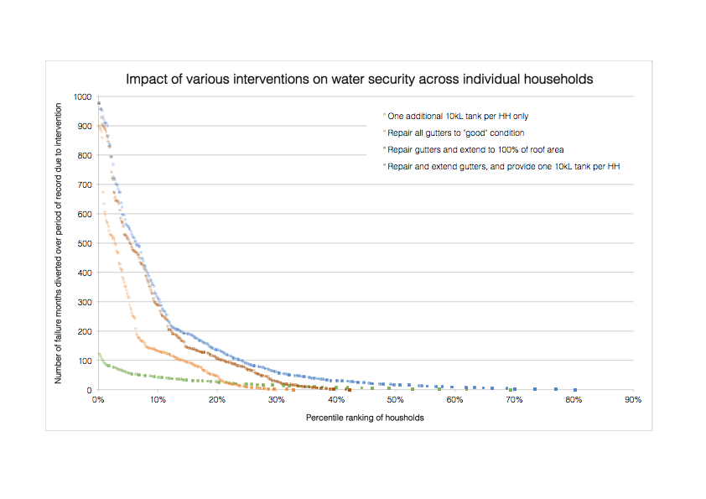
Increasing water yields
Maintaining water security through innovation
Notes:
Extending the guttering, installing tanks in some cases and increased or repairing areas of roof mean increased water capture is possible.
The predictions of this work show repairing and extending gutters with one 10,000 litre tanks.
Crisis is averted more than 1000 times without piping increased and water tanks being installed.

Slide 19
Developing new sources of freshwater
Maintaining water security through innovation

Slide 20
Developing new sources of freshwater
Maintaining water security through innovation
Notes:
Resistivity or conductivity measurement of purified water - mapping on lenses. This is in Kirbati again but this work is currently also being carried out in Vanuatu at present to access increased water lenses.

Slide 21
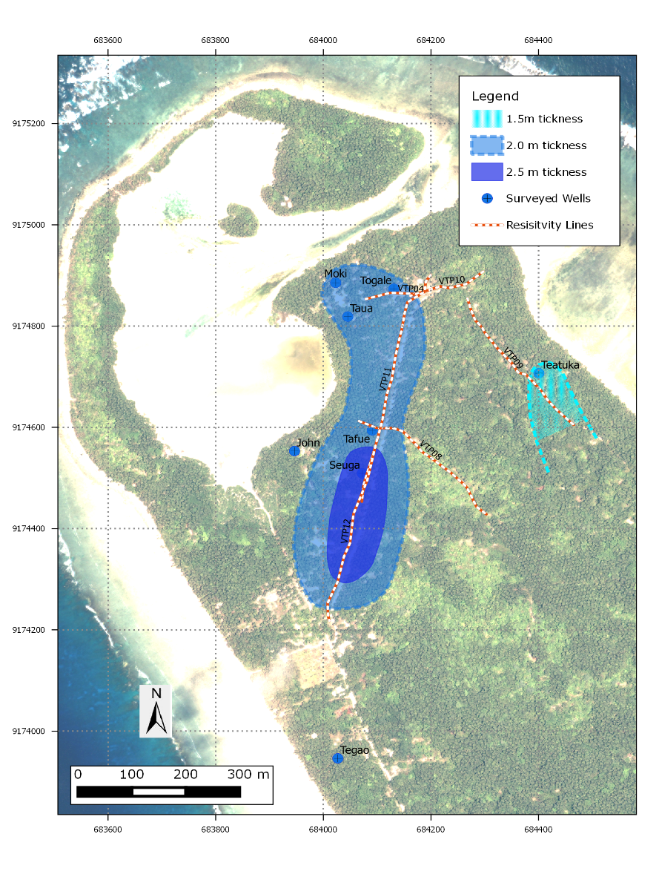
Developing new sources of freshwater
Maintaining water security through innovation
Notes:
New source in Kiribati that could be used for drought conditions and in line with Traditional Knowledge of elders in the community

Slide 22
Climate resilient water security is achievable..
Innovation
Local knowledge
Robust solutions
Collaboration
Replication & upscaling
Maintaining water security through innovation

Slide 23
Maintaining water security through innovation

