Slide 1
Samoa Chamber of Commerce & Industry
PIPSO AGM
Advocacy and Networking
July 2017

Slide 2
Our Vision
The Chamber to lead the empowerment of business potential growth and innovation as a key partner to Samoa’s Private Sector Development.
#PoweringBusinessGrowth

Slide 3
Our Mission
The Chamber as the NPSO to advocate, facilitate and foster sustainable development of the Private Sector through effective leadership and meaningful dialogue

Slide 4
About the Chamber: Samoa’s NPSO
National Private Sector Organization with the support of three partner private sector organizations – WIBDI, Samoa for Real, Business of Salafai
Close to 400 members, predominantly SMEs, with increasing number of private sector organizations (including Samoa Handicrafts Business Association, Savaii Cocoa Farmers Association, Savaiian Tourism Association)
Diversified membership fee structure to encourage broad membership base
Structure and governance:
Chamber Members
Executive Council
Chamber Secretariat
Notes:
The Chamber became the National Private Sector Organization in March 2010, with the support of 3 partner private sector organizations.
The Chamber membership has over 350 members, mainly SMEs, representing various sectors of Samoa’s business community, and also includes other private sector organizations.
The Chamber is governed by a 13-member voluntary Executive Council who are elected on an annual basis. The Secretariat, established in 2010, consists of 4 permanent staff and 2 volunteers.

Slide 5
Structure of the Chamber of Commerce
General Members
Executive Council
Chamber Secretariat CEO
Member Services Manager
Training & Capacity Building Officer
Administration Assistant
Policy Analyst
Assistant Policy Analyst/Web Manager – Trade Officer

Slide 6
Policy Team
Increased representation of private sector issues and priorities to Government with substantial impact (e.g. Labor and Employment Relations Act 2012, waste water tariff, sector plans)
Private Sector Policy Statements
Partnering with government and development partners to conduct research projects (e.g. VAGST study)
Tax Revenue Review Committee
Pacer Plus trade agreements

Slide 7
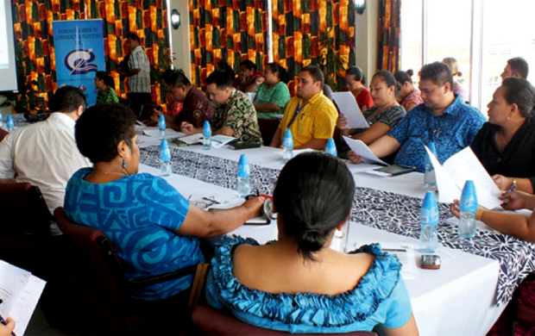
Private/Public Partnership

Slide 8
WINS for the Private Sector
Cessation/Postponement of Govt. projects due to effective advocacy intervention
Changes in Govt. Policy and Legislations
Inclusion of Chamber in all Govt. Consultations for legislative reviews across the board
Removal/Suspension of Govt. Tax increments due to effective advocating and policy submission
Govt. Bodies Changing Board Representation for inclusion of Private Sector/Chamber rep

Slide 9
WINS…. continued 2
Inclusion of chamber secretariat on national steering committees across all Govt. departments
Chamber inclusion in the PSC (Public service Commission ministry)

Slide 10
How Did we Get there? Good Governance
Reform the Chamber –late 90s till now “adaptive change”
Build the Credibility of the Chamber
We set the standard of Integrity and transparency
Regular and Transparent AGMs
On time Filing of Annual Accounts
Audited Financial Statements
Robust Internal Financial Systems – regular reporting to council and stakeholders
Code of Ethics
Constitution Review

Slide 11
How Did we get there? Continued…
Development Young Leaders – Junior Chamber
Inclusion of Wider Business Community
Gender Equality – Women leaders (WEN)
Initiating conversation with Govt.
Policy records - Record of Submissions
Establish Strong and Capable Secretariat
Regular Members meetings
4 year Strategic Plan - Mid year review
Policies and Procedures Manual

Slide 15
Partnership Support
PLP Pacific Leadership Programme ( More inclusiveness for the Private Sector)
Donor support - FAO, ILO etc
Government Support - Grant

Slide 16
Quality Policy Submissions
Policy Analysts
Well researched Policy Submissions
Facts and Evidence Based
Solutions for Govt as well
Realistic
Wholistic benefits for the entire private sector

Slide 17
Collecting Data for Advocacy
Public Consultations
Think Tank – Issues/Industry Specific
High Level Dialogues
Chamber Business Confidence Survey
1/1 Consultations with members

Slide 18
Advocating to Govt.

Slide 19
Communicating to Govt.
Govt. Budget Review
Special Presentations
Representation on Various Govt. Boards and Sub – Committees
Members Meeting Policy Presentation
Quarterly Meetings with Ministers for updates
Initiating Conversation with Govt.
“Written Correspondence always follows face to face meetings”

Slide 20
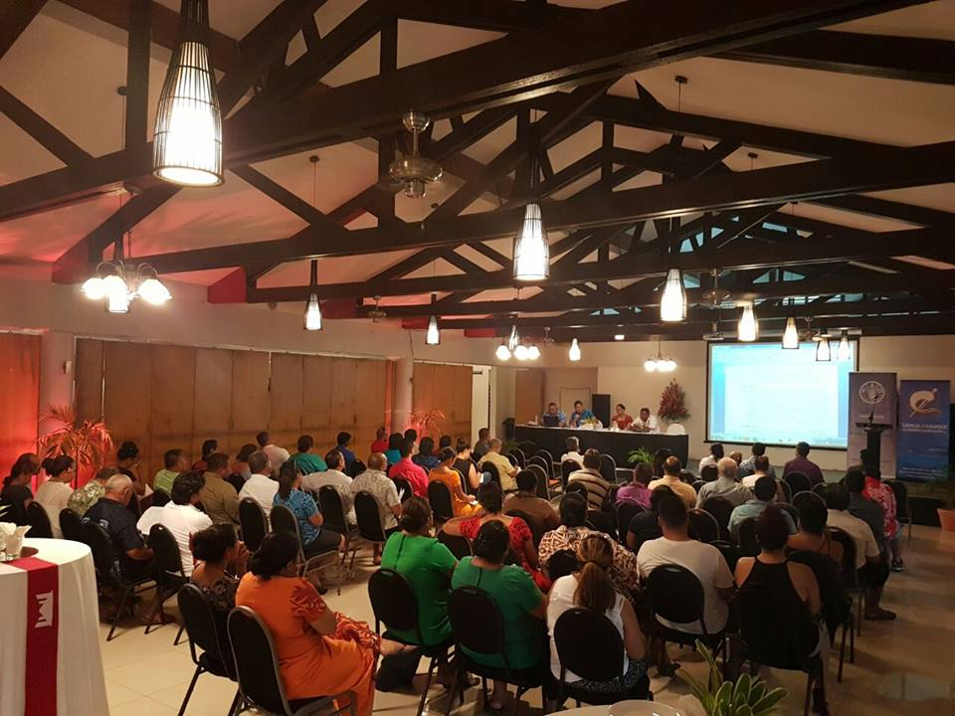
Think Tank

Slide 21
Think Tank Issues
Ports Authority
Customs compliance
Tourism
ICT – Tui Cable
National Ports Closure
Raise in Govt. Tariffs
Foreign Investment act review

Slide 22
Special Meetings 1

Slide 23
Special Meetings 2

Slide 24
Special Meetings 3

Slide 25
Challenges
Finances/Resources – Funding the Think Tanks
Govt. /Fragmented operates in Silos
Adaptive change takes time
Ensure we understand all the issues of the private sector – we don't discriminate regardless of membership status.
Maintain Integrity of the process. Keep the discussions focused and inline with our Policy Submissions. “Wholistic Benefit of all members”

Slide 26
Samoa Chamber of Commerce & Industry
Questions or comments?
FA’AFETAI LAVA
Notes:
Thank you again for the opportunity to present today, we hope that this will lead to a continuing partnership between Chamber and PLP.
If you have any questions or comments on our presentation.

