Slide 1
Code of Conduct Workshop for PIPSO and NPSOs
Nadi, Fiji
25 July, 2017
John Hyde and Luisa Senibulu, UNPRAC

Slide 2
UNPRAC and UNCAC
-UNPRAC at PIPSO 2015 AGM
-Code of Conduct to realise PIPSO Strategic Plan
- UN Convention Against Corruption
Notes:
The UN Pacific Regional Anti-Corruption (UN-PRAC) Project supported by the UN Development Programme (UNDP) and the UN Office on Drugs and Crime (UNODC) has a mandate to engage Pacific Islands private sector organisations and members in the fight against corruption. UNPRAC operates in the 15 Pacific Island States – UNDP and U
NODC.
The Pacific Islands Private Sector Organisation (PIPSO) is the premier private sector representative body in the Pacific Islands region. Its members are comprised of the national private sector organizations of the 14 Pacific Island Forum Countries.
One of PIPSO’s guiding principles in its Strategic Plan 2016-19 is “Integrity: We conduct business with honesty and integrity and making decisions to ensure future stability and sustainability.”

Slide 3
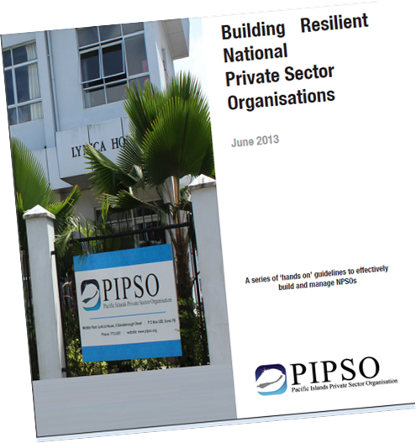
Integrity and PIPSO
In PIPSO’s guiding principles in its Strategic Plan 2016-19 - “Integrity: We conduct business with honesty and integrity and making decisions to ensure future stability and sustainability.”
Notes:
One of PIPSO’s guiding principles in its Strategic Plan 2016-19 is “Integrity: We conduct business with honesty and integrity and making decisions to ensure future stability and sustainability.”

Slide 4
United Nations Convention Against Corruption (UNCAC)
Article 21. Bribery in the private sector
Each State Party shall consider adopting such legislative and other measures as may be necessary to establish as criminal offences, when committed intentionally in the course of economic, financial or commercial activities:
(a) The promise, offering or giving, directly or indirectly, of an undue advantage to any person who directs or works, in any capacity, for a private sector entity, for the person himself or herself or for another person, in order that he or she, in breach of his or her duties, act or refrain from acting;
(b) The solicitation or acceptance, directly or indirectly, of an undue advantage by any person who directs or works, in any capacity, for a private sector entity, for the person himself or herself or for another person, in order that he or she, in breach of his or her duties, act or refrain from acting.
Article 22. Embezzlement of property in the private sector
Each State Party shall consider adopting such legislative and other measures as may be necessary to establish as a criminal offence, when committed intentionally in the course of economic, financial or commercial activities, embezzlement by a person who directs or works, in any capacity, in a private sector entity of any property, private funds or securities or any other thing of value entrusted to him or her by virtue of his or her position.
Notes:
The United Nations Convention against Corruption (UNCAC) is the first legally binding, global anti-corruption instrument. The Convention was adopted by the General Assembly in October 2003 and entered into force in December 2005. To date, 175 countries plus the European Union have become States parties to UNCAC, representing a ground breaking commitment to tackle corruption. I’d like to add that 10 of the 175 state parties are PICs and UNDP and UNODC are now supporting these countries in their implementation and review process.
UNCAC is unique in its holistic approach, adopting prevention and enforcement measures, including mandatory requirements for criminalizing corrupt behaviours. The Convention also reflects the transnational nature of corruption, providing an international legal basis for enabling international cooperation and recovering proceeds of corruption (i.e. stolen assets). The important role of government, the private sector and civil society in fighting corruption is also emphasized.
Article 21. Bribery in the private sector
Each State Party shall consider adopting such legislative and other measures
as may be necessary to establish as criminal offences, when committed
intentionally in the course of economic, financial or commercial activities:
(a) The promise, offering or giving, directly or indirectly, of an undue
advantage to any person who directs or works, in any capacity, for a private
sector entity, for the person himself or herself or for another person, in order
that he or she, in breach of his or her duties, act or refrain from acting;
(b) The solicitation or acceptance, directly or indirectly, of an undue
advantage by any person who directs or works, in any capacity, for a private
sector entity, for the person himself or herself or for another person, in order
that he or she, in breach of his or her duties, act or refrain from acting.
Article 22. Embezzlement of property in the private sector
Each State Party shall consider adopting such legislative and other measures
as may be necessary to establish as a criminal offence, when committed
intentionally in the course of economic, financial or commercial activities,
embezzlement by a person who directs or works, in any capacity, in a private
sector entity of any property, private funds or securities or any other thing of
value entrusted to him or her by virtue of his or her position.
Article 12. Private sector
1. Each State Party shall take measures, in accordance with the fundamental
principles of its domestic law, to prevent corruption involving the
private sector, enhance accounting and auditing standards in the private sector
and, where appropriate, provide effective, proportionate and dissuasive civil,
administrative or criminal penalties for failure to comply with such measures.
2. Measures to achieve these ends may include, inter alia:
(a) Promoting cooperation between law enforcement agencies and
relevant private entities;
(b) Promoting the development of standards and procedures designed to
safeguard the integrity of relevant private entities, including codes of conduct
for the correct, honourable and proper performance of the activities of business
and all relevant professions and the prevention of conflicts of interest, and for
the promotion of the use of good commercial practices among businesses and
in the contractual relations of businesses with the State;
(c) Promoting transparency among private entities, including, where appropriate,
measures regarding the identity of legal and natural persons involved
in the establishment and management of corporate entities;
(d) Preventing the misuse of procedures regulating private entities, including
procedures regarding subsidies and licences granted by public authorities
for commercial activities;
(e) Preventing conflicts of interest by imposing restrictions, as appropriate
and for a reasonable period of time, on the professional activities of former
public officials or on the employment of public officials by the private sector
after their resignation or retirement, where such activities or employment relate
directly to the functions held or supervised by those public officials during their
tenure;
(f) Ensuring that private enterprises, taking into account their structure
and size, have sufficient internal auditing controls to assist in preventing and
detecting acts of corruption and that the accounts and required financial statements
of such private enterprises are subject to appropriate auditing and certification
procedures.
3. 3. ures
as may be necessary, in accordance with its domestic laws and regulations
regarding the maintenance of books and records, financial statement disclosures
and accounting and auditing standards, to prohibit the following acts carried
out for the purpose of committing any of the offences established in accordance
with this Convention:
(a) The establishment of off-the-books accounts;
(b) The making of off-the-books or inadequately identified transactions;
(c) The recording of non-existent expenditure;
(d) The entry of liabilities with incorrect identification of their objects;
(e) The use of false documents; and
(f) The intentional destruction of bookkeeping documents earlier than
foreseen by the law.
4. Each State Party shall disallow the tax deductibility of expenses that
constitute bribes, the latter being one of the constituent elements of the offences
established in accordance with articles 15 and 16 of this Convention and, where
appropriate, other expenses incurred in furtherance of corrupt conduct.

Slide 5
PIPSO & NPSO Code of Conduct
1. A commitment to ethical behavior and preventing corruption will be at the core of our NPSOs and PIPSO.
2. We will not engage in unethical behaviour when dealing with government officials, stakeholders, members, political parties, our own employees and employees of other organisations and businesses.
3. We will report to the appropriate authority any bribery, extortion or solicitation and embezzlement in contravention of the relevant laws and legislations of our countries.
4. Gift-giving issues will be dealt with transparently.
5. Conflicts of interest will be avoided and perceptions of conflicts will be dealt with transparently.
6. Relationships between board members, staff and members will be based on fairness with a commitment to transparent recruiting, merit and training, which avoids any corruption or nepotism.
7. We will protect any data collected against mishandling and fraud, collect personal information only as needed, and respect the preferences of stakeholders, members and staff regarding the use of their information.
8. Embracing free enterprise and mutual support in the spirit of the Sustainable Development Goals, we will operate so that everyone can benefit from vibrant business activity and the ensuring economic growth and stability.
Notes:
8 Simple principles

Slide 6
PIPSO & NPSO Code of Conduct
1. A commitment to ethical behavior and preventing corruption will be at the core of our NPSOs and PIPSO.
This can be achieved through good practices such as:
1.1 Establishing strong political will by the board and the management of the NPSO to combat corruption in the private sector.
1.2 Ensuring that the members, board, management, employees and volunteers have personal ownership of this Code and abide by it at all times.
1.3 Organizing and coordinating anti–corruption training for employees and members.
1.4 Abiding by all written agreements and verbal representations, fulfilling contracts signed and agreements reached and correcting mistakes as quickly as possible.
This is aligned to Sustainable Develoment Goal (SDG) 16, Promote peaceful and inclusive societies for sustainable development, provide access to justice for all and build effective, accountable and inclusive institutions at all levels.
Notes:
One of PIPSO’s guiding principles in its Strategic Plan 2016-19 is “Integrity: We conduct business with honesty and integrity and making decisions to ensure future stability and sustainability.”

Slide 7
PIPSO & NPSO Code of Conduct
2. We will not engage in unethical behaviour when dealing with government officials, stakeholders, political parties, our own employees and employees of other organisations and businesses.
Such unethical behavior includes but is not limited to:
Bribery, which is giving, receiving or promising of money or favors of any kind in order to influence the decision or action of an individual in a position of trust;
Extortion or Solicitation - demanding a bribe, which may be followed by a threat if the demand is refused;
Embezzlement - theft or misappropriation of funds and/or assets belonging to an NPSO/PIPSO by an employee/member of the NPSO/PIPSO;
Laundering proceeds from illegal activities - hiding, concealing, covering up the beginning, source, position, movement or ownership of a property while being fully aware that the property is a proceed of crime.
Notes:
This is fully aligned to SDG 16.

Slide 8
PIPSO & NPSO Code of Conduct
3. We will report to the appropriate authority any bribery, extortion or solicitation and embezzlement in contravention of the relevant laws and legislations of our countries.
The receipt of gifts or favours by staff and officeholders of NPSOs from stakeholders can be seen as improper inducement. Gifts and favours must not be solicited. Gifts of money must never be accepted. Reasonable small tokens [below US$20] and hospitality may be accepted provided they do not place the recipient under any obligation, are not capable of being misconstrued and can be reciprocated at the same level. Any offer of gifts or favours of unusual size or questionable purpose should be reported to the CEO of the NPSO immediately.
Notes:
This is also aligned to SDG 16 and Goal 10, Reduce inequality within and among countries

Slide 9
PIPSO & NPSO Code of Conduct
4. Gift-giving issues will be dealt with transparently.
4.1 Gifts Register - Gifts and entertainment that are given or received should be recorded in a gift register and reported to the Board of the NPSO. Each NPSO and PIPSO needs to adopt a written gifts policy.
4.2 Entertainment - may only be offered to stakeholders in the course of business provided it is reasonable and modest and neither influences the recipient’s objectivity nor could be construed as a means to make the recipient feel obliged to act in accordance with the wishes of the NPSO.
4.3 Donations to political parties and charitable organisations may be arranged on the condition that it is transparent and in accordance with existing laws and legislations of the country; it does not influence the recipient’s objectivity and should not be interpreted as a means to make the recipient feel obliged to act in accordance with the wishes of the NPSO.
Notes:
This is aligned to SDG 10 and SDG 16.

Slide 10
PIPSO & NPSO Code of Conduct
5. Conflicts of interest will be avoided and perceptions of conflicts will be dealt with transparently.
While many people in small Pacific countries have interests in common which would usually not lead to conflicts of interest, full transparency is achieved by staff and members declaring any potential issues of personal interest and interests of immediate and extended families that may directly affect the operations of the NPSO to the CEO of the NPSO (for staff) and Chair (for board members and the CEO).
Notes:
This aligned to SDG 10, SDG 12 (relating to transparent procurement) and SDG 16.

Slide 11
PIPSO & NPSO Code of Conduct
6. Relationships between board members, staff and members will be based on fairness with a commitment to transparent recruiting, merit and training, which avoids any corruption or nepotism.
6.1 Human Resources - NPSOs are encouraged to formulate Human Resource policies that outline proper, efficient, fair and transparent recruitment, promotion, training, performance evaluation and remuneration processes for staff that will avoid corruption and nepotism.
6.2 Finance And Accounting - NPSOs must establish and maintain appropriate, accurate and transparent financial records and reporting mechanisms following the relevant accounting and financial reporting standards both locally and internationally. NPSOs should strive to conduct annual audits of their financials to prevent corruption.
Notes:
This section is very much aligned with SDG 8, Promote sustained, inclusive and sustainable economic growth, full and productive employment and decent work for all, and also SDG 5, Achieve gender equality and empower all women and girls, and Goal 10, Reduce inequality within and among countries; SDG 12, Ensure sustainable consumption and production patterns, includes a “Target 12.7 Promote public procurement practices that are sustainable, in accordance with national policies and priorities”.

Slide 12
PIPSO & NPSO Code of Conduct
7. We will protect any data collected against mishandling and fraud, collect personal information only as needed, and respect the preferences of stakeholders, members and staff regarding the use of their information.
This relates to the confidential nature of the private details of members being provided for a specific use and any survey information which is collected, including data being fed into national statistical plans.
Notes:
This is aligned to SDG 10 and SDG 16 and SDG 17 (Target 17.18 relating to confidential data).

Slide 13
PIPSO & NPSO Code of Conduct
8. Embracing free enterprise and mutual support in the spirit of the Sustainable Development Goals, we will operate so that everyone can benefit from vibrant business activity and the ensuing economic growth and stability.
This is aligned to SDG8, SDG9, Innovation and Infrastructure, SDG 11, Make cities and human settlements inclusive, safe, resilient and sustainable, SDG 12, Ensure sustainable consumption and production patterns, (which includes a “Target 12.7 Promote public procurement practices that are sustainable, in accordance with national policies and priorities”) and SDG 16.
Notes:
This is aligned to SDG 10 and SDG 16 and SDG 17 (Target 17.18 relating to confidential data).

Slide 14
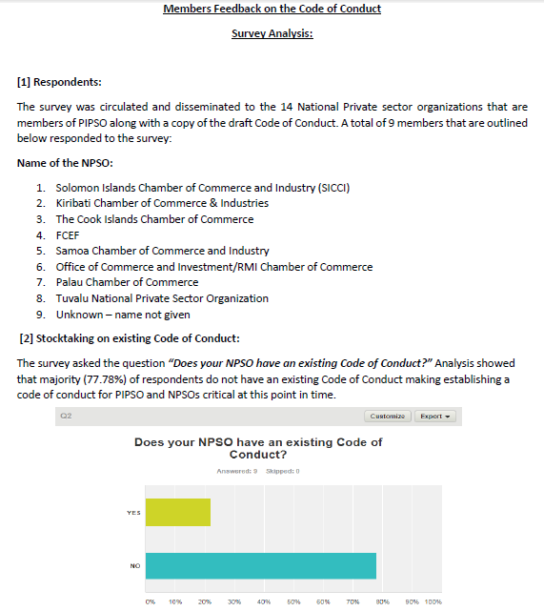
Feedback from NPSOs
Notes:
Responses from 9 NPSOs. 2 have Codes, 7 do not.

Slide 15
Feedback from NPSOs
Notes:
Analysis showed that most respondents agree and strongly agree to the 8 key principles outlined in the Code of Conduct.
Analysis showed that 88.89% of respondents said yes with the remaining 11.11% saying no that the code is inadequate for PIPSO and NPSOs to adopt.
On elaborating the reason for saying that the code was inadequate, the respondent said that the code:
✓ Does not mention anything on ‘enforcement’ of the code of conduct.
✓ Should demarcate between Board and Organization needs to clearly laid out to avoid micro managing of operation...CEO must be given full autonomy to run the business based on Board approved policies and strategic direction

Slide 16
Group discussion
Any key issues need to be addressed prior to our small groupwork?
eg Gifts register; Statement of Commitment
Notes:
Annexes: Statement of Commitment
Analysis showed that 88.89% of respondents said yes with the remaining 11.11% saying no that the code is inadequate for PIPSO and NPSOs to adopt.
On elaborating the reason for saying that the code was inadequate, the respondent said that the code:
✓ Does not mention anything on ‘enforcement’ of the code of conduct.
✓ Should demarcate between Board and Organization needs to clearly laid out to avoid micro managing of operation...CEO must be given full autonomy to run the business based on Board approved policies and strategic direction

Slide 17
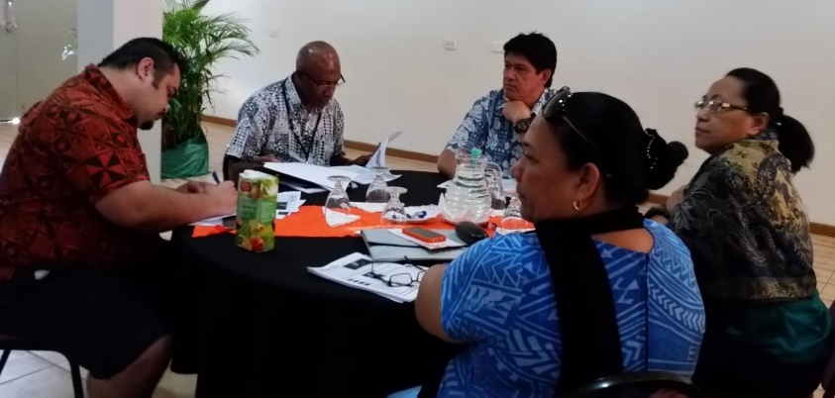
Next steps: small groups on implementation/review of your NPSO Code of Conduct;
Producing a training handbook – what do you need?
Reporting back
Notes:
Analysis showed that most respondents agree and strongly agree to the 8 key principles outlined in the Code of Conduct.
Analysis showed that 88.89% of respondents said yes with the remaining 11.11% saying no that the code is inadequate for PIPSO and NPSOs to adopt.
On elaborating the reason for saying that the code was inadequate, the respondent said that the code:
✓ Does not mention anything on ‘enforcement’ of the code of conduct.
✓ Should demarcate between Board and Organization needs to clearly laid out to avoid micro managing of operation...CEO must be given full autonomy to run the business based on Board approved policies and strategic direction

Slide 18
Template 1:
Statement of Commitment
Notes:
Analysis showed that most respondents agree and strongly agree to the 8 key principles outlined in the Code of Conduct.
Analysis showed that 88.89% of respondents said yes with the remaining 11.11% saying no that the code is inadequate for PIPSO and NPSOs to adopt.
On elaborating the reason for saying that the code was inadequate, the respondent said that the code:
✓ Does not mention anything on ‘enforcement’ of the code of conduct.
✓ Should demarcate between Board and Organization needs to clearly laid out to avoid micro managing of operation...CEO must be given full autonomy to run the business based on Board approved policies and strategic direction

Slide 19
Template 2:
Gifts
Register
Notes:
Analysis showed that most respondents agree and strongly agree to the 8 key principles outlined in the Code of Conduct.
Analysis showed that 88.89% of respondents said yes with the remaining 11.11% saying no that the code is inadequate for PIPSO and NPSOs to adopt.
On elaborating the reason for saying that the code was inadequate, the respondent said that the code:
✓ Does not mention anything on ‘enforcement’ of the code of conduct.
✓ Should demarcate between Board and Organization needs to clearly laid out to avoid micro managing of operation...CEO must be given full autonomy to run the business based on Board approved policies and strategic direction

Slide 20
Template 3:
Monitoring compliance with your Code

Slide 21
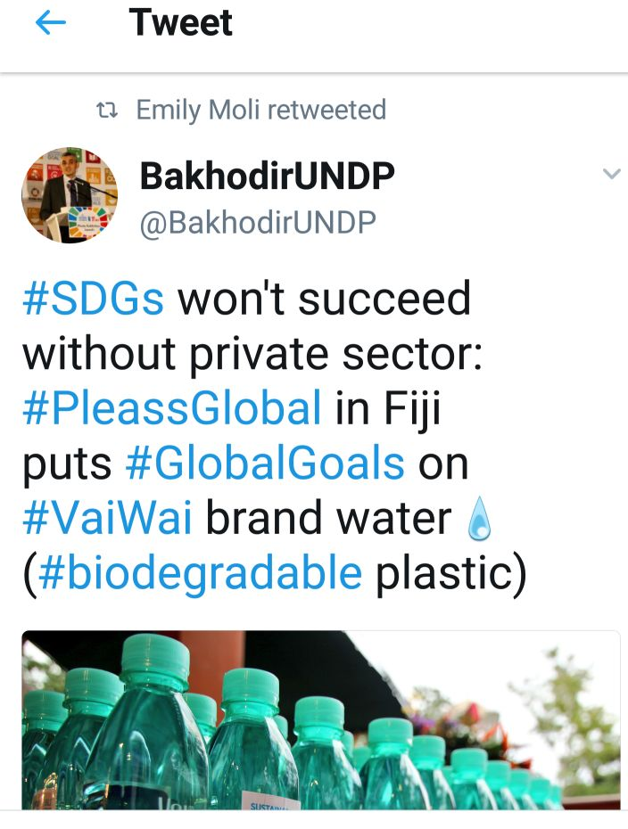
Template 4:
What are the SDGs?

Slide 22
Get involved in your country’s monitoring
of the Post-2015 Goal on Good Governance
SDG Goal 16: Promote peaceful and inclusive societies for sustainable development, provide access to justice
for all and build effective, accountable
and inclusive institutions at all levels
Goal 16 TARGETS:
16.4 by 2030 significantly reduce illicit financial and arms flows, strengthen recovery and return of stolen assets, and combat all forms of organized crime
16.5 substantially reduce corruption and bribery in all its forms
16.6 develop effective, accountable and transparent institutions at all levels
The Myworld survey with 7.4m responses found that `an honest and responsive government’ is among the top four priorities of ordinary people.
Notes:
Australia, Netherlands and United Kingdom
6 Mar 2014, Open Working on Group Sustainable Development Goals, OWG session 9 3 – 5 March 2014 Accountable and Effective Institutions
“Accountable and effective institutions are at the heart of the social contract between the state and its citizens, and both an outcome and enabler of development. Citizens want governments that are capable and responsive and able to deliver on their commitments. The Myworld survey found that `an honest and responsive government’ is among the top four priorities of ordinary people. “
The Myworld survey with 7.4m responses found that `an honest and responsive government’ is among the top four priorities of ordinary people
GOPAC parliamentarians should work to ensure that when their national governments and parliaments adopt their priority national Sustainable Development Goals and targets, that Goal 16 is included along with the anti-corruption relevant targets.

Slide 23
Thankyou!
For further information, please contact: Luisa Senibulu Governance Programme Associate (UNDP) Suva, Fiji Email: luisa.senibulu@undp.org John Hyde UNDP Anti-Corruption Consultant Suva, Fiji Email: gopacau@gmail.com

