Slide 1
AGRI-TOURISM: MEETING VISITOR DEMANDS
Meeting visitors demands – what can and should be done better in agribusiness to support the industry.

Slide 2
Linking Tourism and Agriculture
Agriculture plays a vital role in the tourism & hospitality industry
Food is part of the visitor experience
High quality food, every day of the year essential for hotels, lodges, resorts and restaurants
Food purchasing bill of tourism is usually very high, however very little is seen spent locally
Common problems of sourcing products locally are well known: inadequate quality, reliability, or volume of produce, further exacerbated by poor transport, lack of communication and information between supplier (local farmers) & purchasers (e.g. hoteliers)
Other problems faced by hoteliers include poor handling & storage

Slide 3
Factors influencing strength & type of linkages between tourism & Agriculture
Demand Related Factors | Supply Related Factors | Marketing & Intermediary Factors
The type of accommodation/restaurant/cafe with respect to ownership, size & class | Physical limitations | Marketing & infrastructure constrains
What stage of growth our tourism industry is in (maturity) | Entrenched production (e.g plantation crops for export | Supply does not match demand
The type of tourist | Quantity & quality of products | Spatial patterns of supply
Promotion of our local cuisine | High prices of locally produced food
 | Technological & processing limitations

Slide 4
Strengthening linkages- what can be done
Introduce high end products for tourist consumption not just producing for domestic market.
Promotion of a local cuisine in restaurants/hotels that utilizes local supply.
Farm Tours/stays- sell experience based on farms/agribusiness to gain visitor appreciation of local produces.
Establish partnerships between Farmers’ Associations and Hoteliers to ensure market consistency and security.
Support proper labelling with nutritional content information and attractive packaging.

Slide 5
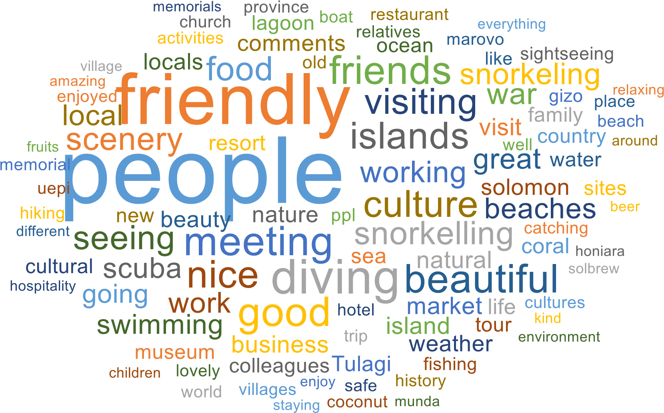
Visitor Highlights Word Cloud (IVS, 2015-2016)

Slide 6
Business Opportunities
Farm stays, farm to table meals, farm camps
Farm Demonstrations
Farm tours
Festivals & seasonal festivals ( pineapple festival, coconut festival etc…)
Cook offs/baking contest with locally grown ingredients etc…
Hosting events/special occasions: wedding, anniversaries etc…

Slide 7
We also need to strengthen, improve and link existing products to our tourism industry:
coffee (Isabel Province, Malaita Province),
Cocoa (Guadalcanal, Makira etc…)
Coconut (Soaps, oils etc…)
Beef, pork, chicken etc…

Slide 8
Conclusion
The agricultural sector would become more important in the future when S.I Tourism continues to grow and develop
The challenges that are mentioned in this presentation are considerable, yet if we work together to ease some of these barriers and meet the commercial needs and customer tastes, the Tourism Industry can significantly increase its contribution towards economical development

