Slide 1
Supporting Local Agribusinesses to Enhance their Competitiveness

Slide 2
Overview
-PHAMA
-Work in Solomon Islands
-Agribusinesses Context
-Cocoa: Agribusiness Case Study
-Way Forward

Slide 3
What is PHAMA?
Objective
Increase economic development of 6 Pacific Islands Countries through increased exports from productive sectors - agriculture, fisheries and forestry
Scope
Supporting existing agribusinesses and industries to meet technical requirements for export markets; Priorities guided by industry
Issues
Improving market access
Maintaining/protecting existing markets
Seeking new market access

Slide 4
PHAMA in Solomon Islands
Priority to improve and maintain existing market access
Key sectors: Cocoa, Sawn timber, Sea Food, Coconut, Horticulture
Approach: Private Public Partnership through Industry facilitation – ‘Industry Working Groups’ to identify priorities and manage market access issues
Initiatives are industry driven and based on commercial principles

Slide 5
PHAMA in Solomon Islands – Agribusiness Context
PHAMA support for agribusinesses in Solomon Islands:
Certification
Food Safety e.g. HACCP
Product Quality Expectations
Legal requirements overseas
Key Challenges:
Market Awareness
Business & Finance Management
Skills to interact well with overseas customers
Transport Costs

Slide 6
PHAMA in Solomon Islands – Agribusiness Context
Existing challenges & positive outcomes associated with maintaining and improving existing markets (as opposed to creating new markets)
Export market issues also apply to domestic markets
Still, small countries like Solomon Islands will always need an export focus due to the relatively small size of domestic markets e.g. you can’t sell cocoa in Honiara for bulk consumption (this may change over time as the economy develops and hopefully there is greater investment and local processing)

Slide 7
PHAMA in Solomon Islands – Agribusiness Context
Agribusinesses Potential: Capable Local Producers and Available Markets (examples)
1. ‘Fruit Basket’
-Group of farmers on West Guadalcanal with capacity to deliver fresh produce
-Predominantly expatriates in Honiara who will pay premium prices for quality & useful service
-Gap: need someone to facilitate some ‘linkages’ and to provide some guidance/support early on (PHAMA stepped in; now consistent delivery of service each Wednesday)
2. Coffee
-Local cafes would easily absorb the entire national production at good prices, if producers were able to explore the opportunity, make arrangements and consistently deliver a good product.

Slide 8
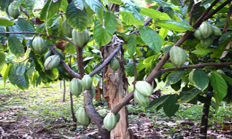
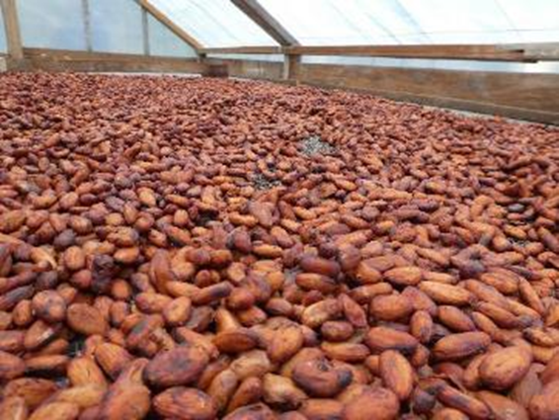
Case Study: Cocoa – Agribusiness in Solomon Islands
Important rural industry – 20,000 households involved in production
Export-oriented, no domestic processing
Supply chain:
Smallholder production
Fermentation and drying
Sale to aggregators
Export of dried beans

Slide 9
Cocoa in Solomon Islands
Export of approx. 5,000 tonnes per year, value SBD$100m
16 exporters
Solomons represents 0.001% of world cocoa production
Based on average 2016 cocoa price (NY ICE)

Slide 10
World cocoa markets
Bulk market
4.2 million tonnes bought per year
Prices set against two international cocoa exchanges (Singapore and London)
Fluctuating prices
Boutique market
Higher value market, established in last 10 years
1,500 tonnes bought per year
Bean to bar approach. Pricing is more consistent with emphasis on quality and relationships.

Slide 11
Solomon’s Cocoa in 2013
Challenges
1. Lacking a Diversified Customer Base (Single bulk market)
Entire trade from Solomons went to one Australian-based wholesaler
Sales arrangements - pre-financing to exporters tied them to lower prices.
2. No Standard Operating Procedures (Quality issues)
Moisture levels & smoke-taint of Solomons cocoa limited scope for improving pricing.
No price incentive to improve quality; poor quality reduces competitiveness
3. Limited market awareness
Low market understanding limiting capacity for competitiveness
4. Business Definition
Limited understanding of the product offered; unable to compete
5. Lacking Innovation (only product was smoky beans; only one bulk market)

Slide 12
PHAMA’s work
Objective: develop a boutique market in the Solomon Islands and increase value in the bulk market
Bulk Market:
-increase competition
-improve terms of trade
Boutique Market:
-increase sales
-improve quality
Approach: Focus on the commercial end of the supply chain (export pathway)
-Direct engagement with international buyers and chocolate makers, and support to exporters to deliver on sales opportunities
-Partnership with RDP/MAL, CEMA, ADRA

Slide 13
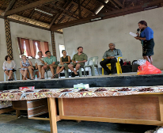
PHAMA’s work
1. Industry facilitation
The cocoa Industry Working Group – exporters/farmers, SIG, other stakeholders
Forum for consultation, collaboration, identification of issues and prioritisation for support
Funding of a Cocoa Industry Advisor dedicated to the cocoa industry

Slide 14
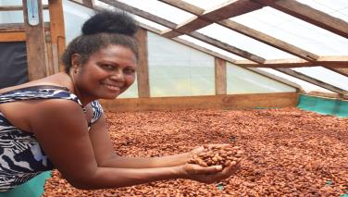
PHAMA’s work
2. Improve product quality and testing
CEMA quality testing laboratory
Solar driers and storage sheds for growers
Technical materials e.g. quality kits to exporters with moisture meters, cocoa grinders and quality posters
Provide trainings on international standards of quality assurance

Slide 15
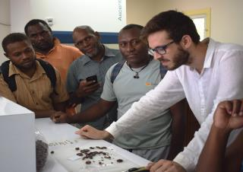
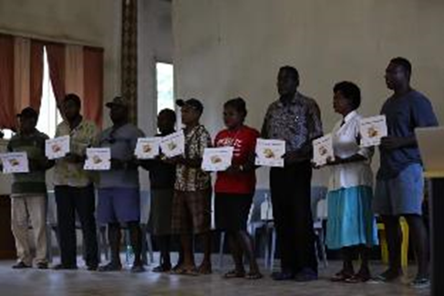
PHAMA’s work
3. Market awareness and linkages
Introduced new bulk market buyers to exporters
Trade visits to bring buyers to Solomons (and PNG and Vanuatu)
Chocolate week cocoa competitions
Entries into international trade events e.g. Cocoa of Excellence Awards

Slide 16
PHAMA’s work
4. Enhancing exporter capacity
Connecting growers/exporters to buyers, and assisting exporters to deliver consignments
Funded pre-shipment samples to potential new buyers (free brokerage service)
Developing business plans, draft contracts and invoices with new exporters
Support to improve accounting (in-depth financial analysis for individual businesses) and inventory management

Slide 17
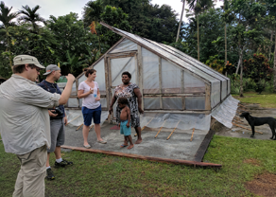
Solomons cocoa in 2017
Outcomes:
1. Established boutique market for Solomons cocoa
Grown from zero in 2015 to 20mt in 2017
Value SBD$3.9m (didn’t exist pre-PHAMA)
Buyers in Australia, NZ and EU, USA
Improved pricing (100%); Farmers are receiving $30/kg compared to bulk price of $10/kg
2. International recognition
Solomon cocoa on the world cocoa map
3 Solomon Island chocolate bars winning awards at the recent UK Chocolate Awards in June 2017 & US Northwest Chocolate Festival (Gold Award)

Slide 18
Solomons cocoa in 2017
3. Increased value for bulk cocoa
New buyers introduced to exporters have paid (on average) 12% above previous contract terms
50% of exporters now selling to different bulk buyers
Increase to industry value by SBD$5m (with no change to the production)
4. Improved industry coordination
Collaboration among growers and exporters to meet demand e.g. establishment of Cocoa Solar Drier Association
Industry working group as forum to continue development of the sector

Slide 19
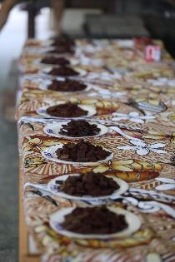
The future for Solomon Islands Agribusinesses
Focus areas for stakeholders:
1. Markets (Awareness & Linkages)
Changing international markets and exporters must be equipped to be able to
participate competitively
2. Capacity Building
Business Management and Planning
3. Production
Meeting technical expectations for quality and consistency
Replantation
Adaptation to impacts of climate change
4. Value-adding
Scope for local sales of products e.g. chocolates to cruise ships and airport
5. Freight Costs
Freight charges hinder exporters from competing with regional neighbors

Slide 20
Conclusion
PHAMA’s support in enhancing competitiveness in agribusinesses in Solomon Islands is through protecting/maintaining existing market access & seeking new markets
Still much work to be done and in terms of the scope, there will be a gap when PHAMA leaves
Potential for agribusinesses to competitively participate in markets exist
To tap into this, further support must be targeted on:
Focus on full agricultural supply chains, including markets and logistics
Practical support to agribusinesses to sell to new markets
Focus on improving quality in order to increase returns to producers

Slide 21
Thank you

