Slide 1
Solomon Islands National Roundtable Workshop - Promoting Nutritious Food Systems in the Pacific Islands
FAO Solomon Islands
Solomon Islands National Roundtable Workshop

Slide 2
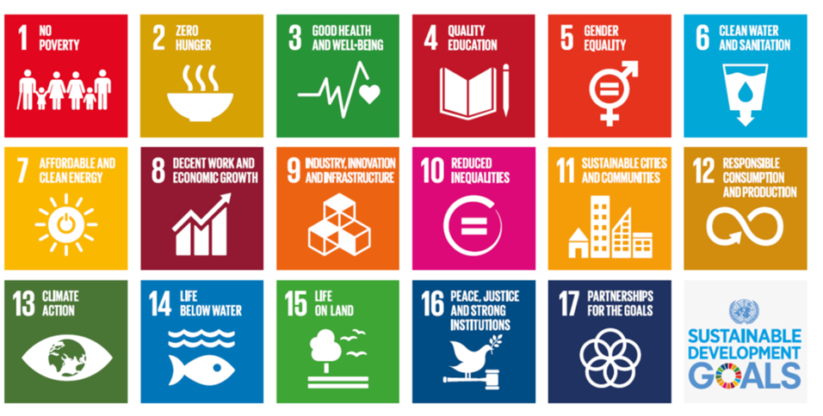
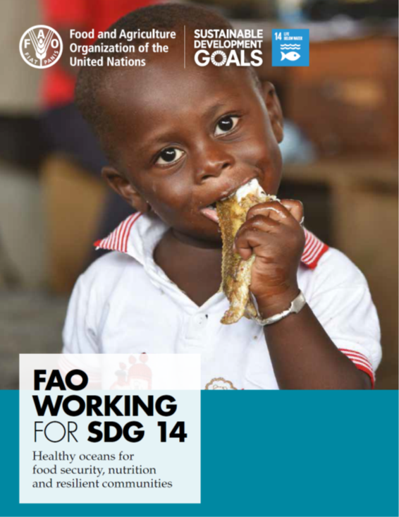
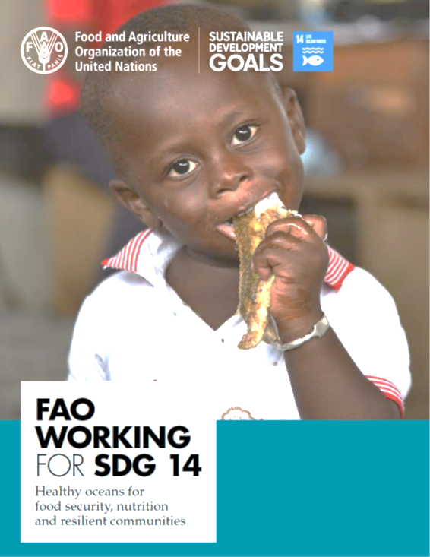
FAO Priorities for the Pacific 2018-2022
  Developed through national consultations
  The basis of FAO Pacific Multicountry Programme Framework (CPF)
Solomon Islands National Roundtable Workshop
Notes:
Two over-arching documents serve to frame the context of the work of FAO in the Pacific: the SIDS Accelerated Modalities of Action (SAMOA) Pathway which was adopted at the Third International Conference on Small Island Developing States (SIDS) in Samoa in September 2014; and the Framework for Pacific Regionalism which establishes processes and principles to guide a deeper regionalism to help create “a region of peace, harmony, security, social inclusion, and prosperity, so that all Pacific people can lead free, healthy, and productive lives” .
FAO support to the PICs is through the FAO Technical Cooperation Programme (TCP). The TCP provides assistance in all areas pertaining to FAO’s mandate and competence. To date, projects have been funded for a total value of about USD 1.5 billion globally. These short-term, catalytic projects are driven by the demands and priorities of member countries, addressing critical gaps in hunger and malnutrition eradication, sustainable production, rural poverty reduction more efficient and inclusive food chains and building resilience to crisis. TCP projects catalyse change, foster capacity development and assist countries in mobilizing resources, in line with the Country Programming Frameworks agreed to with governments. These short-term, catalytic projects are driven by the demands and priorities of member countries, addressing critical gaps in hunger and malnutrition eradication, sustainable production, rural poverty reduction more efficient and inclusive food chains and building resilience to crisis. TCP projects catalyse change, foster capacity development and assist countries in mobilizing resources, in line with the Country Programming Frameworks agreed to with governments.
The CPF supports the implementation of key national policy frameworks and has also been guided by relevant regional framework documents which include: (i) the Framework for Action on Food Security in the Pacific: Towards a Food Secure Pacific, in particular Theme 3 (Enhanced and sustainable production, processing, marketing , trading and use of safe and nutritious food); (ii) the 2015 Regional Roadmap for Sustainable Pacific Fisheries; and (iii) the Framework for Resilient Development in the Pacific: An Integrated Approach to Address Climate Change and Disaster Risk Management (FRDP) 2017-2030. In line with the Pacific Leaders Gender Equality Declaration adopted by Pacific Island Forum Leaders in 2012 and reaffirmed in 2015, gender is mainstreamed throughout the CPF.
So, what does FAO support to countries and regional organizations in the Pacific related look like?
I will touch on activities related to fisheries and represented by FAOs Blue Growth Initiative. So, let me start by touching on the Blue Economy and FAOs Blue Growth
shortly after the Blue Economy was launched, FAO followed with the Blue Growth Initiative in 2013. Blue Growth is FAOs approach to support implementation of the Blue Economy. As a technical specialized UN agency in food and agriculture, Blue Growth maps to FAOs food and agriculture mandate and our UN comparative advantage.
In 2016 at the FAO Conference, FAO Members recognized that the five interlinked strategies of the Blue Growth Initiative, which combine policy and institutional reform with on-the-ground action, offers long-term prospects for driving sustainable resource management of the fishery and aquaculture sectors, allowing economic growth and food security to be reconciled with conservation of aquatic resources.
Turning to the SDGs, these are the first Member State-led global development push in history, laying out specific objectives for countries to meet by a given timeframe. FAO is the proposed ‘custodian’ UN agency for 21 SDG indicators, across SDGs 2, 5, 6, 12, 14 and 15. As custodian agency, FAO can support governments to set national priorities and targets, engage all actors concerned in national policy processes and dialogues, contribute to innovative partnerships contribute to mobilizing resources in support to national SDG efforts.
FAO believes that achieving the SDG targets is foremost. And that careful alignment of the Blue Economy and Blue Growth with the SDGs can accelerate progress can act as a catalysts to support / facilitate what countries strive for.

Slide 3
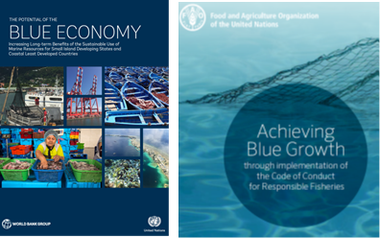
The FAO Blue Growth Initiative:
To secure the potential of the oceans, lagoons and inland waters through responsible and sustainable approaches that reconcile economic growth and food security with the conservation of aquatic resources
FAO and Pacific Fisheries
BLUE GROWTH
Economic Growth
Conserve Aquatic Resources
Food Security
Solomon Islands National Roundtable Workshop
Notes:
FAOs technical assistance to Fisheries is closely aligned to the Blue Economy and FAOs parallel program titled the FAO Blue Growth Initiative.
The Blue Economy concept is based principally on 2 pillars: Firstly a multi-sectoral approach to managing key areas including sustainable fisheries, ecosystem health, and pollution. Secondly collaboration across nation-states and across the public-private sectors, on a scale that has not been previously achieved.
Shortly after the Blue Economy was launched, FAO followed with the Blue Growth Initiative in 2013. Blue Growth is FAOs approach to support implementation of the Blue Economy. As a technical specialized UN agency in food and agriculture, Blue Growth maps to FAOs food and agriculture mandate and our UN comparative advantage.

Slide 4
The FAO Blue Growth Initiative:
Based on FAOs Code of Conduct for Responsible Fisheries and all supporting principles applicable to conservation, management and development of fisheries
Solomon Islands National Roundtable Workshop
Notes:
The Code of Conduct for Responsible Fisheries was drafted, negotiated, and adopted by FAO member countries to serve this purpose. It served as the basis for the development of the Ecosystem Approach to Fisheries and Aquaculture. The Code
recognizes the nutritional, economic, social, environmental and cultural importance of fisheries and aquaculture, and the interests of all those concerned with the fishery sector.
The CODE, is now the backbone of all FAOs work in the fisheries sector.

Slide 5
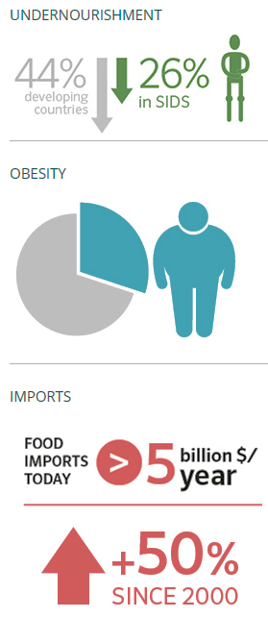
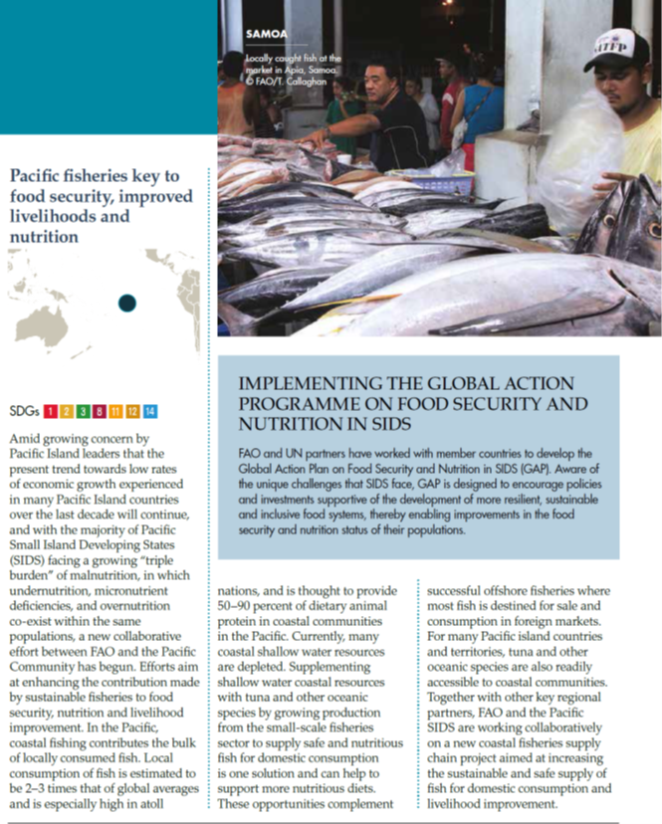
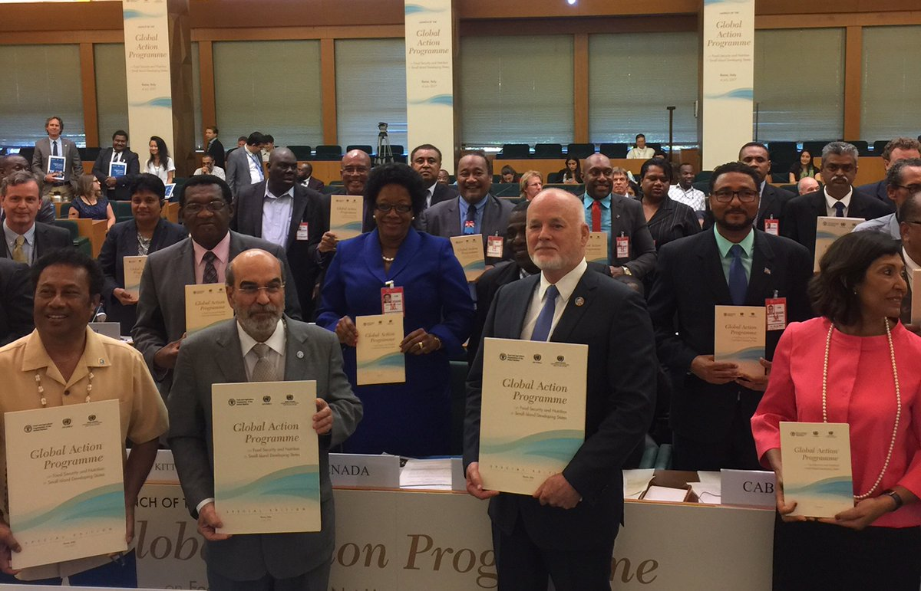
Food Security & Nutrition SIDS
S.A.M.O.A. PATHWAY – A GLOBAL ACTION PROGRAMME ON FOOD SECURITY AND NUTRITION FOR SIDS
Notes:
Turning to food security and nutrition in SIDS. Equally as important as Ocean Health is Human Health, and the two are often linked. Pacific Health Leaders have called for multi-sectoral approaches to address the increase in food and nutrition related health problems. Paragraph 61 of the SAMOA Pathway calls on FAO to facilitate the development of a food security and nutrition action programme.
FAO assistance in the Pacific region will be focused on three common areas of interventions to deliver the following outputs:
(i) evidence-based recommendations developed and promoted to incentivize the production and consumption of safe and healthy food;
(ii) sustainable and climate-smart practices promoted to help build resilient agriculture, fisheries and forestry production systems; and
(iii) food control and business practices identified and promoted to facilitate efficient agri-food value chains that provide safe, nutritious and affordable food.
Safe and healthy food production and consumption
FAO technical assistance will focus on
on cost effective and manageable measures, using innovative data collection and reporting tools as appropriate to the country context, for food security and nutrition data collection, analysis and dissemination.
to build capacity to strengthen food and nutrition policy frameworks to incentivize the domestic production and consumption of safe, healthy food from terrestrial and aquatic environments.
to raise awareness and promote healthy eating habits through nutrition education and information
Depending on national context and specific identified needs, FAO technical assistance will support the planning, targeting, feasibility assessment, design and monitoring for pilot school food and nutrition interventions
Turning to food security and nutrition in SIDS. Equally as important as Ocean Heal is Human Health. Pacific Health Leaders have called for multi-sectoral approaches to address the increase in food and nutrition related health problems. The 2014 SIDS Meeting in Samoa identified need to develop and implement Accelerated Action to address food and nutrition crises facing Small Island Developing States including: (i) the need to reduce STUNTING that exceeds 20% in children in 5 of the poorest SIDS, (ii) reducing the estimated 33% OBESITY in Caribbean countries; (iii) reduce the disproportionately high rates of obesity in women which is twice as high as in men; and (iv) significantly reduce the estimated 75% of all adult deaths in the Pacific attributed to non-communicable diseases.
Paragraph 61 of the SAMOA Pathway calls on FAO to facilitate the development of a food security and nutrition action programme. The Global Action Programme OR GAP on Food Security and Nutrition in SIDS launched during the 40th session of FAO Conference, in July 2017, is a multi-partner programme developed jointly by FAO, the United Nations Department of Economic and Social Affairs (UNDESA) and the Office of the High Representative for Least Developed Countries, Landlocked Developing Countries and Small Island Developing States (OHRLLS).
The GAP recognises the need for a more integrated, multi-stakeholder approach to address the unique, but diverse food security and nutrition challenges faced by SIDS and to support their efforts towards the 2030 Agenda. Because SIDS are blessed with plentiful ocean resources, it is logical that SIDS fisheries are the glue that binds the blue economy, blue growth and SDGs together. Transition to robust Sustainable, resilient food systems that support healthy diets and nutrition will require greater emphasis on supporting / strengthening coastal communities engaged in small scale fisheries so that they enhance their contributions to domestic food production and supply through involvement in oceanic fisheries in a safe and efficient manner.

Slide 6
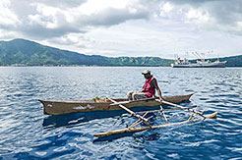

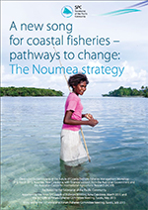
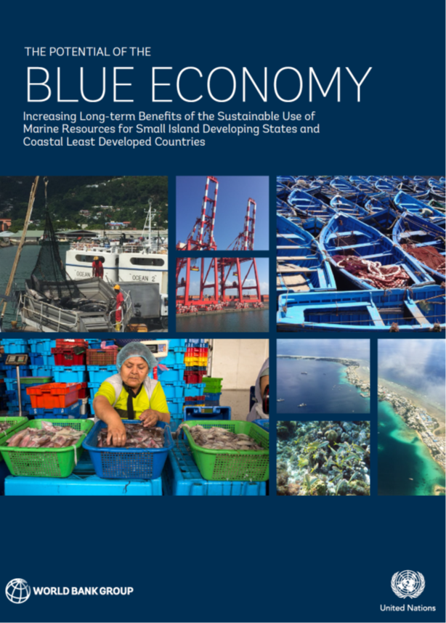
FAO Support to
Securing Sustainable Small-Scale Fisheries in the Context of Food security and Poverty Eradication
Voluntary Guidelines for Securing Sustainable Small-Scale Fisheries in the Context of Food security and Poverty Eradication
Concordance with “The New Song for Coastal Fisheries: Pathways to Change”
Solomon Islands National Roundtable Workshop
Notes:
As changes in the availability and quality of natural resources, due to degradation, depletion and/or impact of climate change can significantly compromise food security in PICs, FAO technical assistance will focus on helping countries to build policy, legal, regulatory and institutional frameworks that provide the right incentives for environmentally sound and resilient development, and strengthening national capacities for the sustainable management and use of fisheries and biodiversity resources to underpin ecosystem services, store carbon, improve climate resilience and ensure food security and sustainable livelihoods.
As a major source of animal protein across the region and a source of income for the small-scale sector, particularly women, coastal and inshore resources are particularly important; but traditional shallow water resource are under threat from over exploitation, habitat degradation as well as from the impacts of pollution, natural disasters and climate change. Migrating small scale effort into nearshore deep water for oceanic species can provide alternative livelihood opportunities for coastal communities and make available additional safe protein sources for the growing and urbanizing populations. In selected countries and working with other active partners,
FAO technical assistance in the Pacific Region will focus on
strengthening the enabling environment, reviewing and strengthening sustainable management practices and, where appropriate, exploring and piloting new models for the coastal fishery resource management and development.
cost effective and manageable measures, using innovative data collection and reporting tools as appropriate to the country context, for primary sector data collection, analysis and dissemination
Training will also be provided to build capacity for results-based management, including strengthening monitoring frameworks in the fisheries sector
FAO will continue to support food security cluster coordination and preparedness, capacity building and policy development for disaster risk reduction in the agriculture sectors. Support will be directed to enhancing early warning systems and better forecasting – linked to a realistic set of adaptation options appropriately packaged for dissemination – to improve small scale fisheries planning and preparedness. Assistance will also be provided for building post-disaster rapid assessment capacity, including in the use of smart-phone based data collection tools to provide quick and efficient methods for data capture and sharing
To facilitate development of the small-scale fisheries sector, FAO technical assistance will be provided to support professionalization, pilot innovative, safe, fit for purpose Low Impact Fuel Efficient (LIFE) harvesting technologies, such as Fish Aggregating Devices, enhance uptake of quality fish handling and preservation techniques and improve business management skills of entrepreneurs.
Support in adapting and enhancing existing programs to support community based management
Assessing contributions of FADs to food security and livelihoods with regional partners
Support to emergency response

Slide 7
FAO support to eliminate IUU Fishing
A binding Instrument to combat Illegal Unreported and Unregulated Fishing - The Port State Measure Agreement
REDUCING ILLEGAL, UNWANTED AND UNREGULATED FISHING
Solomon Islands National Roundtable Workshop
Notes:
Concerns over IUU fishing led countries to develop a binding instrument to prevent and deter Illegal, Unreported and Unregulated fishing. As Secretariat to the FAO Committee on Fisheries (COFI), FAO facilitated this process and is now providing capacity development to support implementation of the Port State Measures Agreement to combat IUU fishing
FAO assistance will specifically address illegal, unreported and unregulated (IUU) fishing issues, including building capacity to implement the Port State Measures Agreement (PSMA) through the revision of legislation as may be necessary, institutional strengthening (including strategic action plans) and knowledge building and skills development for managers and inspectors.
In addition, FAO will also support effective implementation of global, regional and sub-regional arrangements for conservation and management of tuna fisheries through partnering with regional and inter-regional organizations, including the Pacific Island Forum Fisheries Agency (FFA), SPC and the Western and Central Pacific Fisheries Commission.
So, what does FAO support to countries and regional organizations in the Pacific related to the Blue Economy / Blue Growth look like? I will touch on a few activities.
Concerns over IUU fishing led countries to develop a binding instrument to prevent and deter Illegal, Unreported and Unregulated fishing. As Secretariat to COFI, FAO facilitated this process and is now providing capacity development to support implementation of the Port State Measures Agreement to combat IUU fishing. In this region, Australia, New Zealand, France, USA, Palau, Tonga, Vanuatu have acceded to or ratified the agreement. FAO is supporting countries to assist with effective implementation of the agreement.

Slide 8
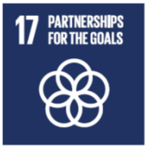
Thank You
FAO Solomon Islands
Solomon Islands National Roundtable Workshop

