Slide 1
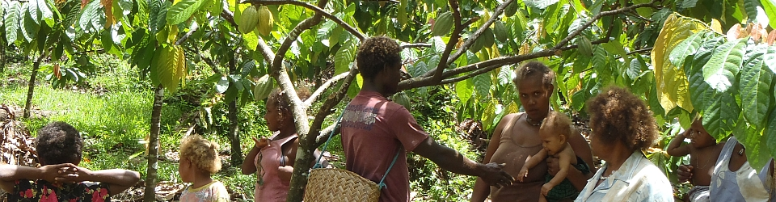
Food Security in Solomon Islands
Nichole Georgeou
Director, Humanitarian and Development Research Initiative (HADRI)

Slide 2
Research
Two studies
Qualitative research (workshops) in Savo on food and human security issues re trade to HCM: hp://ro.uow.edu.au/lhapapers/2090
Quantitative research (surveys) in HCM about supply and sales with vendors and customers
Gender analysed through participation (men/women) and impacts on gender relations

Slide 3
Savo Sunset Lodge
Field Sites:
Panueli (45 Households)
Lemboni (<20 HH)
Paibeta (30 HH)
North

Slide 4
Savo Island
Geographic & Political
Volcanic — geothermal potential (last erupted 1840s), but also sulphur in some water
Fecund and Fertile “everything grows”
Population: 3,000 — 6 tribes
Matrilineal land inheritance
Chiefs — House of Chiefs (politics patrilineal)
One former Prime Minister (Sir Allan Kemakeza)
Copra plantations until 1990s
Intensive market integration from 2000s
Production for Market

Slide 5
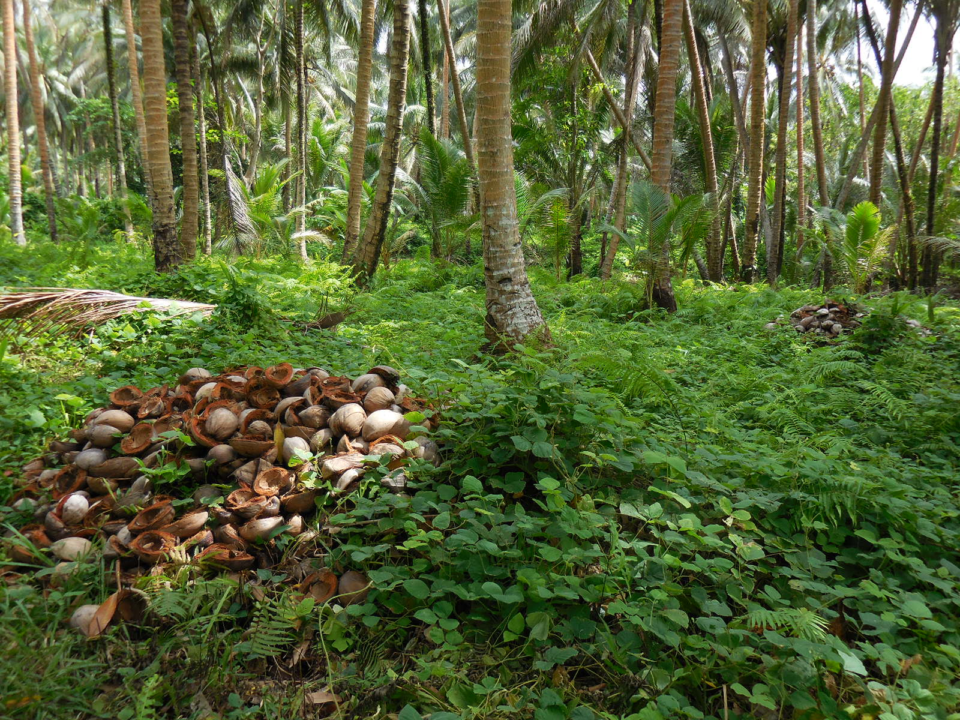
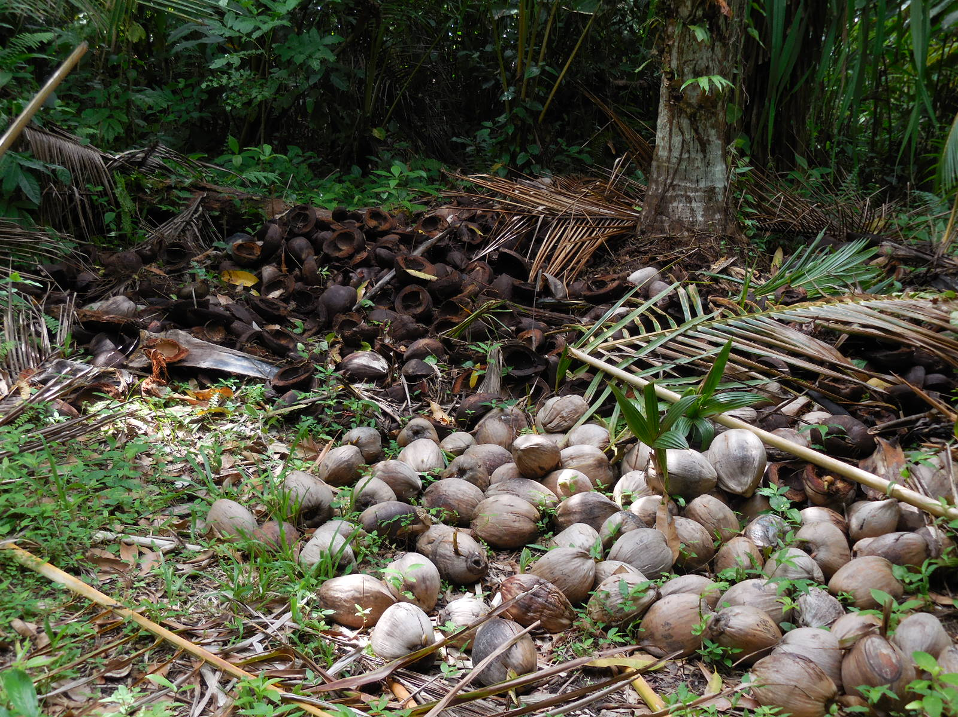
Agriculture + trade previously focused copra (mostly by men)
Copra price = $100 SBD/bag
(AUD $15.30)
1 bag = 100 kg of dried copra
Boat no longer comes to Savo

Slide 6
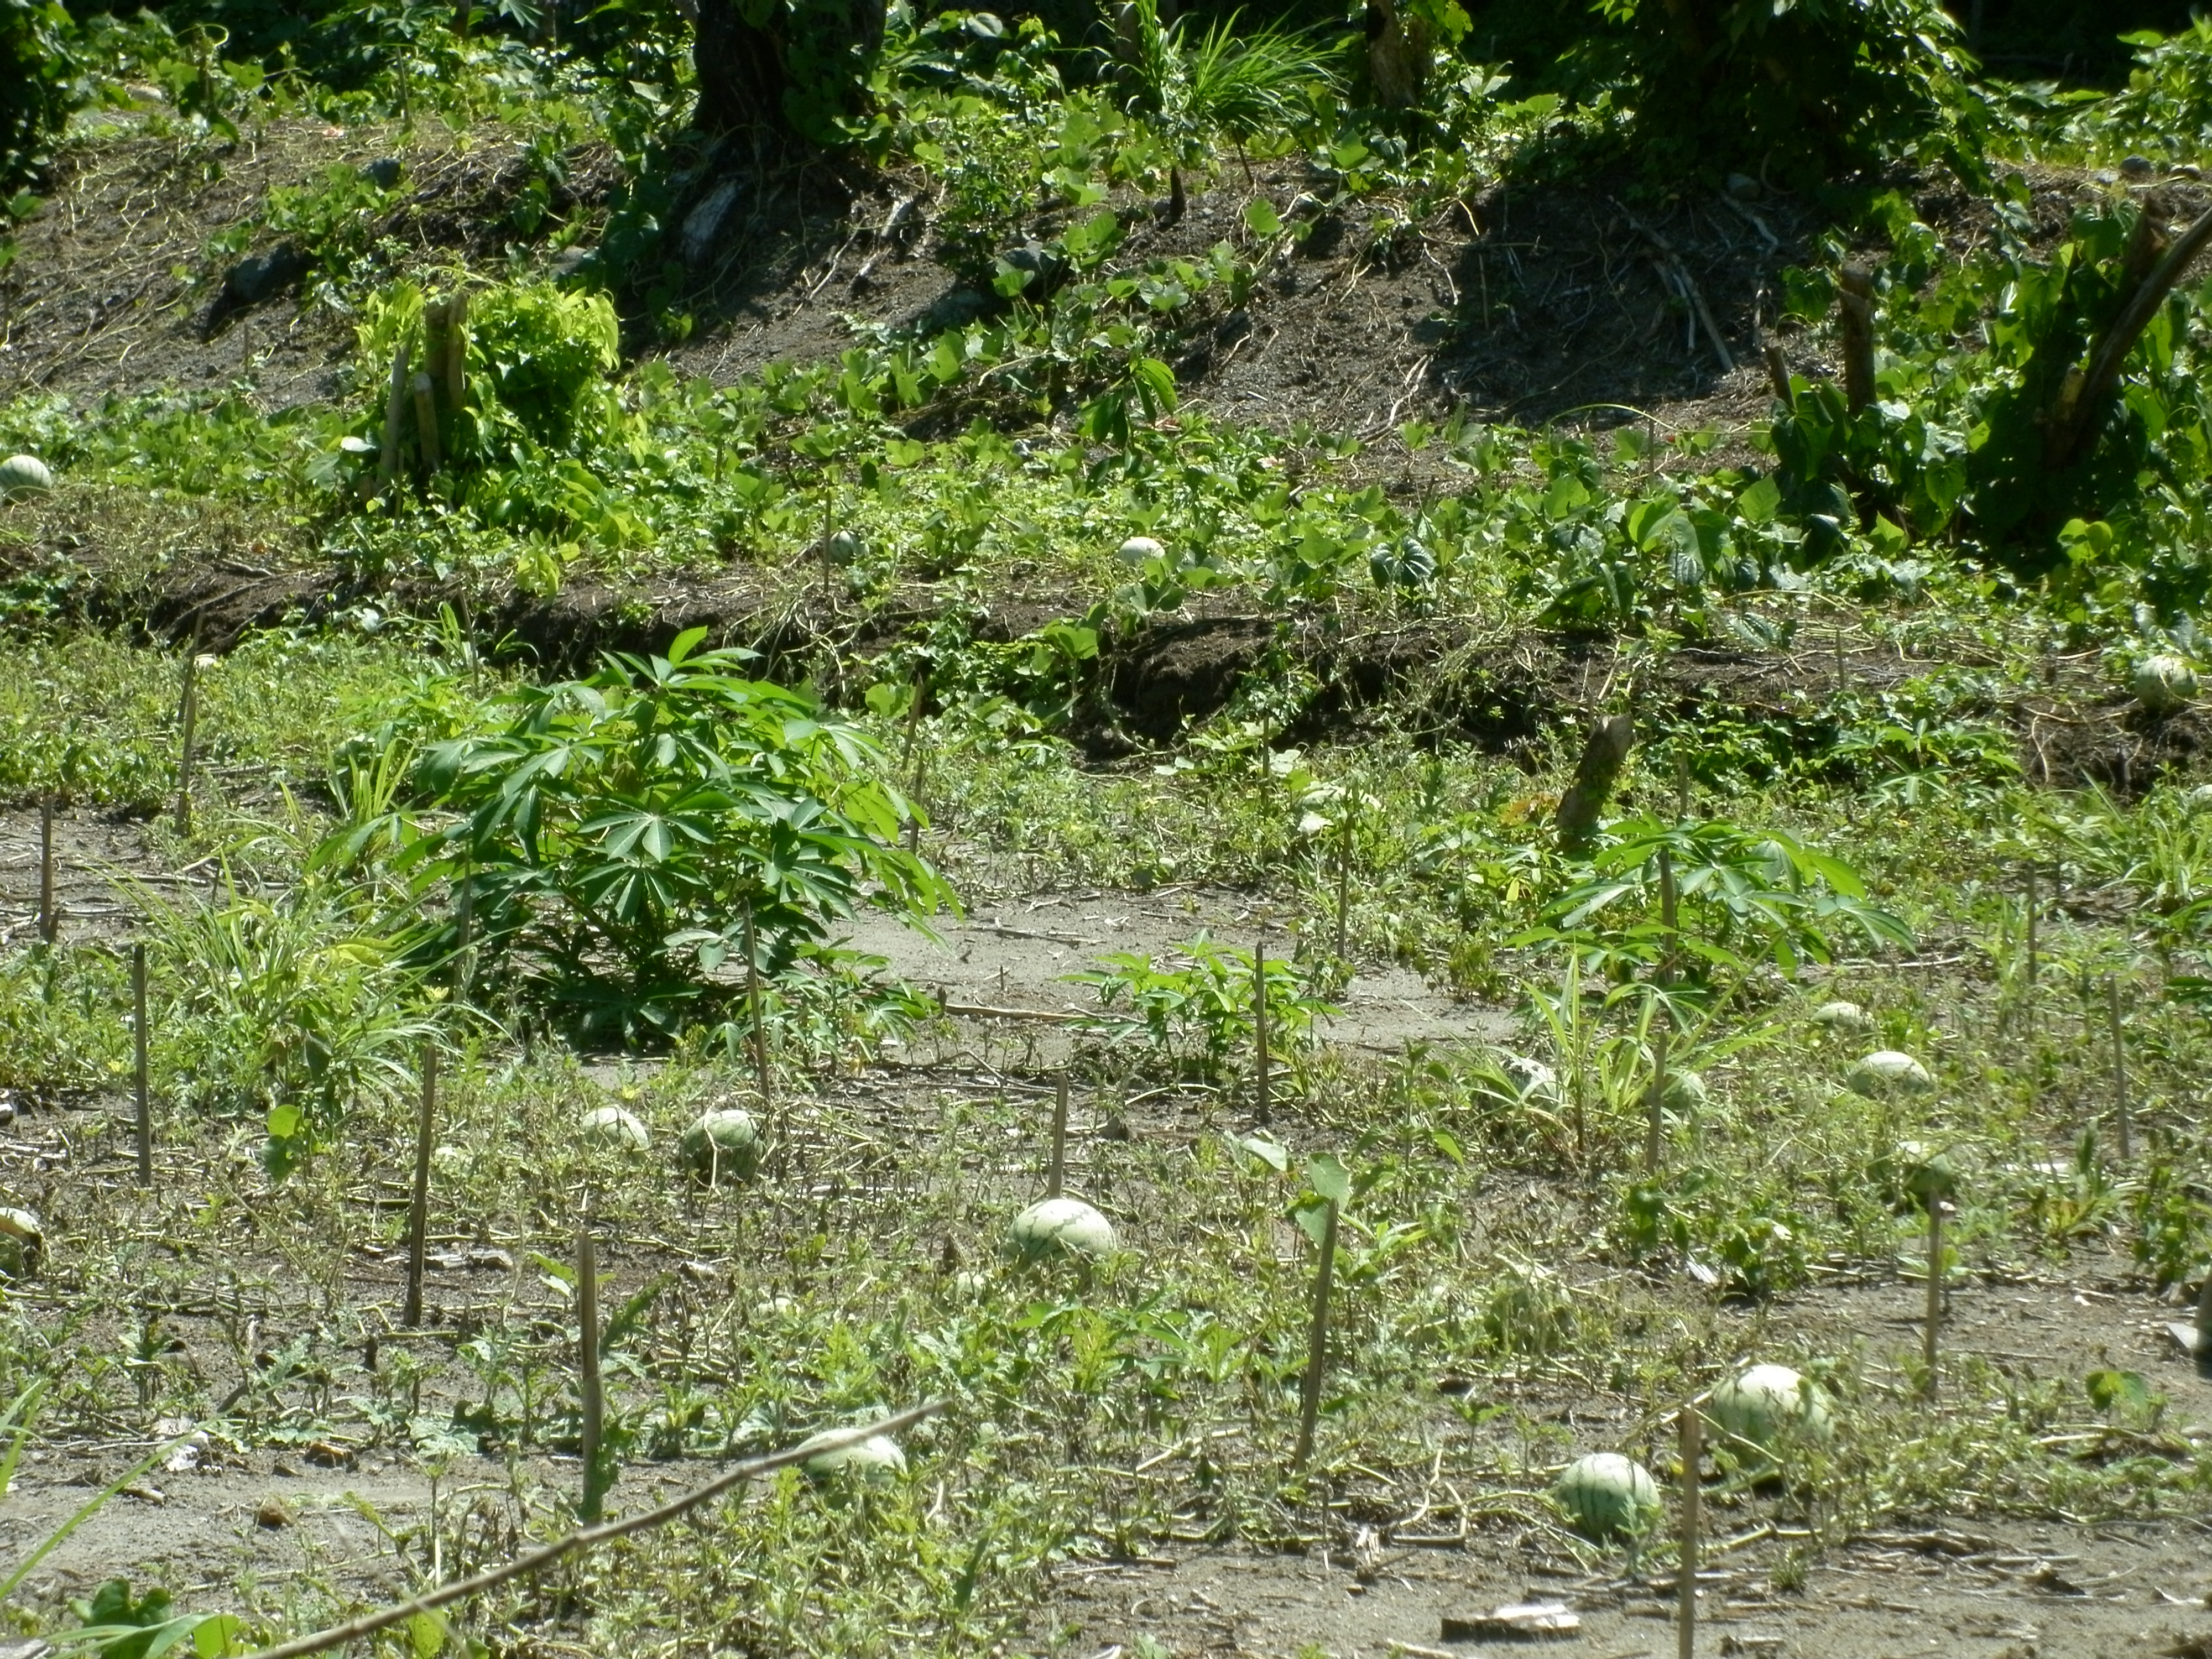
The new crop…. Melon
(up to $100 per melon at market, men more involved than other kinds of produce)

Slide 7
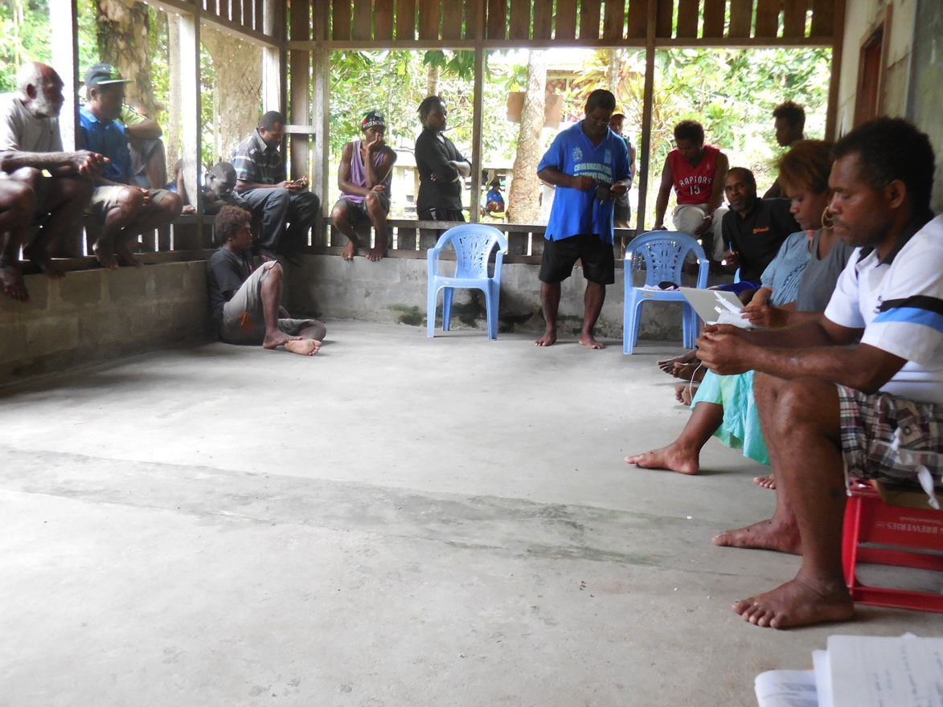
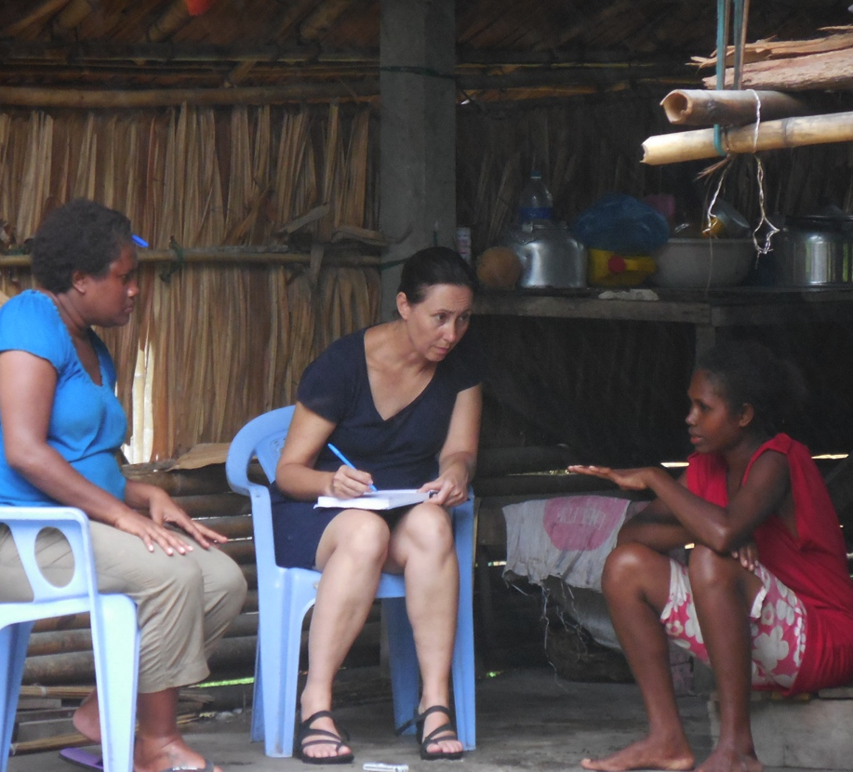
Focus Groups & Interviews – Men, women, youth
Need for Cash
Market products (rice $250-300 20kg bag, noodles, beer -$250 case, clothing, household goods)
School Fees, funerals, fuel
Market Production:
Melon ($60-100 per unit); Peanut (20kg/$500-600)
Cassava, Fruits/Vegetables ($5-10/bunch)
Copra ($100/100kg)

Slide 8
Main Issues Identified
Production costs:
  Fertilizers , seeds $150-270 (Taiwan)
Transport costs:
  No wharf (OBMs only) → Boat hire ($1000-1500/crossing, dependent on relations with boat owner)
  Rough seas and loss of cargo
Sale costs
  Market presence (2 weeks) stall hire OR sell to ‘black market’
  Theft and violence (women do selling)
Gender roles
  Women doing most gardening and selling
  Men transport networks & higher value items (e.g. melon)
Returns can be minimal ($200 for crop of peanuts/melon)
  Strategies to maximise profit
    sell direct
    alternative markets

Slide 9
Savo Pilot Study: conclusions
Production for market is increasing
Panueli
  "pipol karrange fo market” but other sites less integrated
  Strong influence of Paramount Chief Kemakeza (monopoly on boat supply)
Issues: poor conditions at HCM, threats to security (particularly for women), use of profits (+ gender and money in family), locations of sale apart from HCM.
Integration with needs of Honiara market society
(produces food supply to Honiara)
Next Steps: Map Value Chains from main production areas of foodstuffs

Slide 10
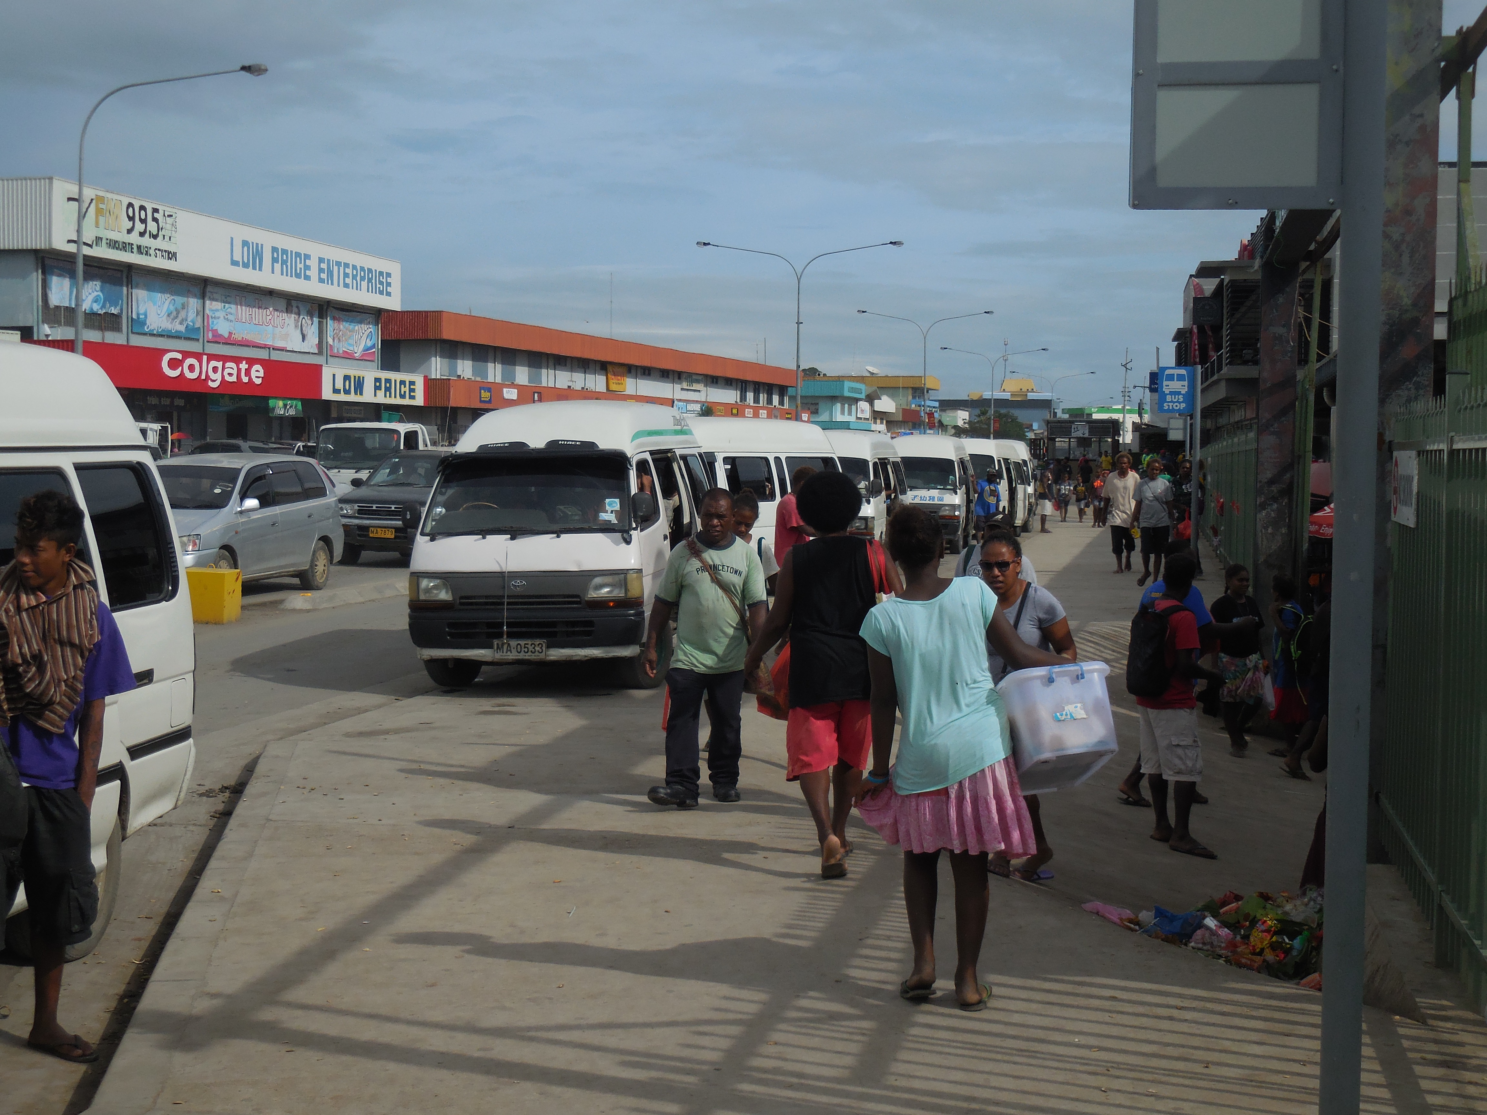
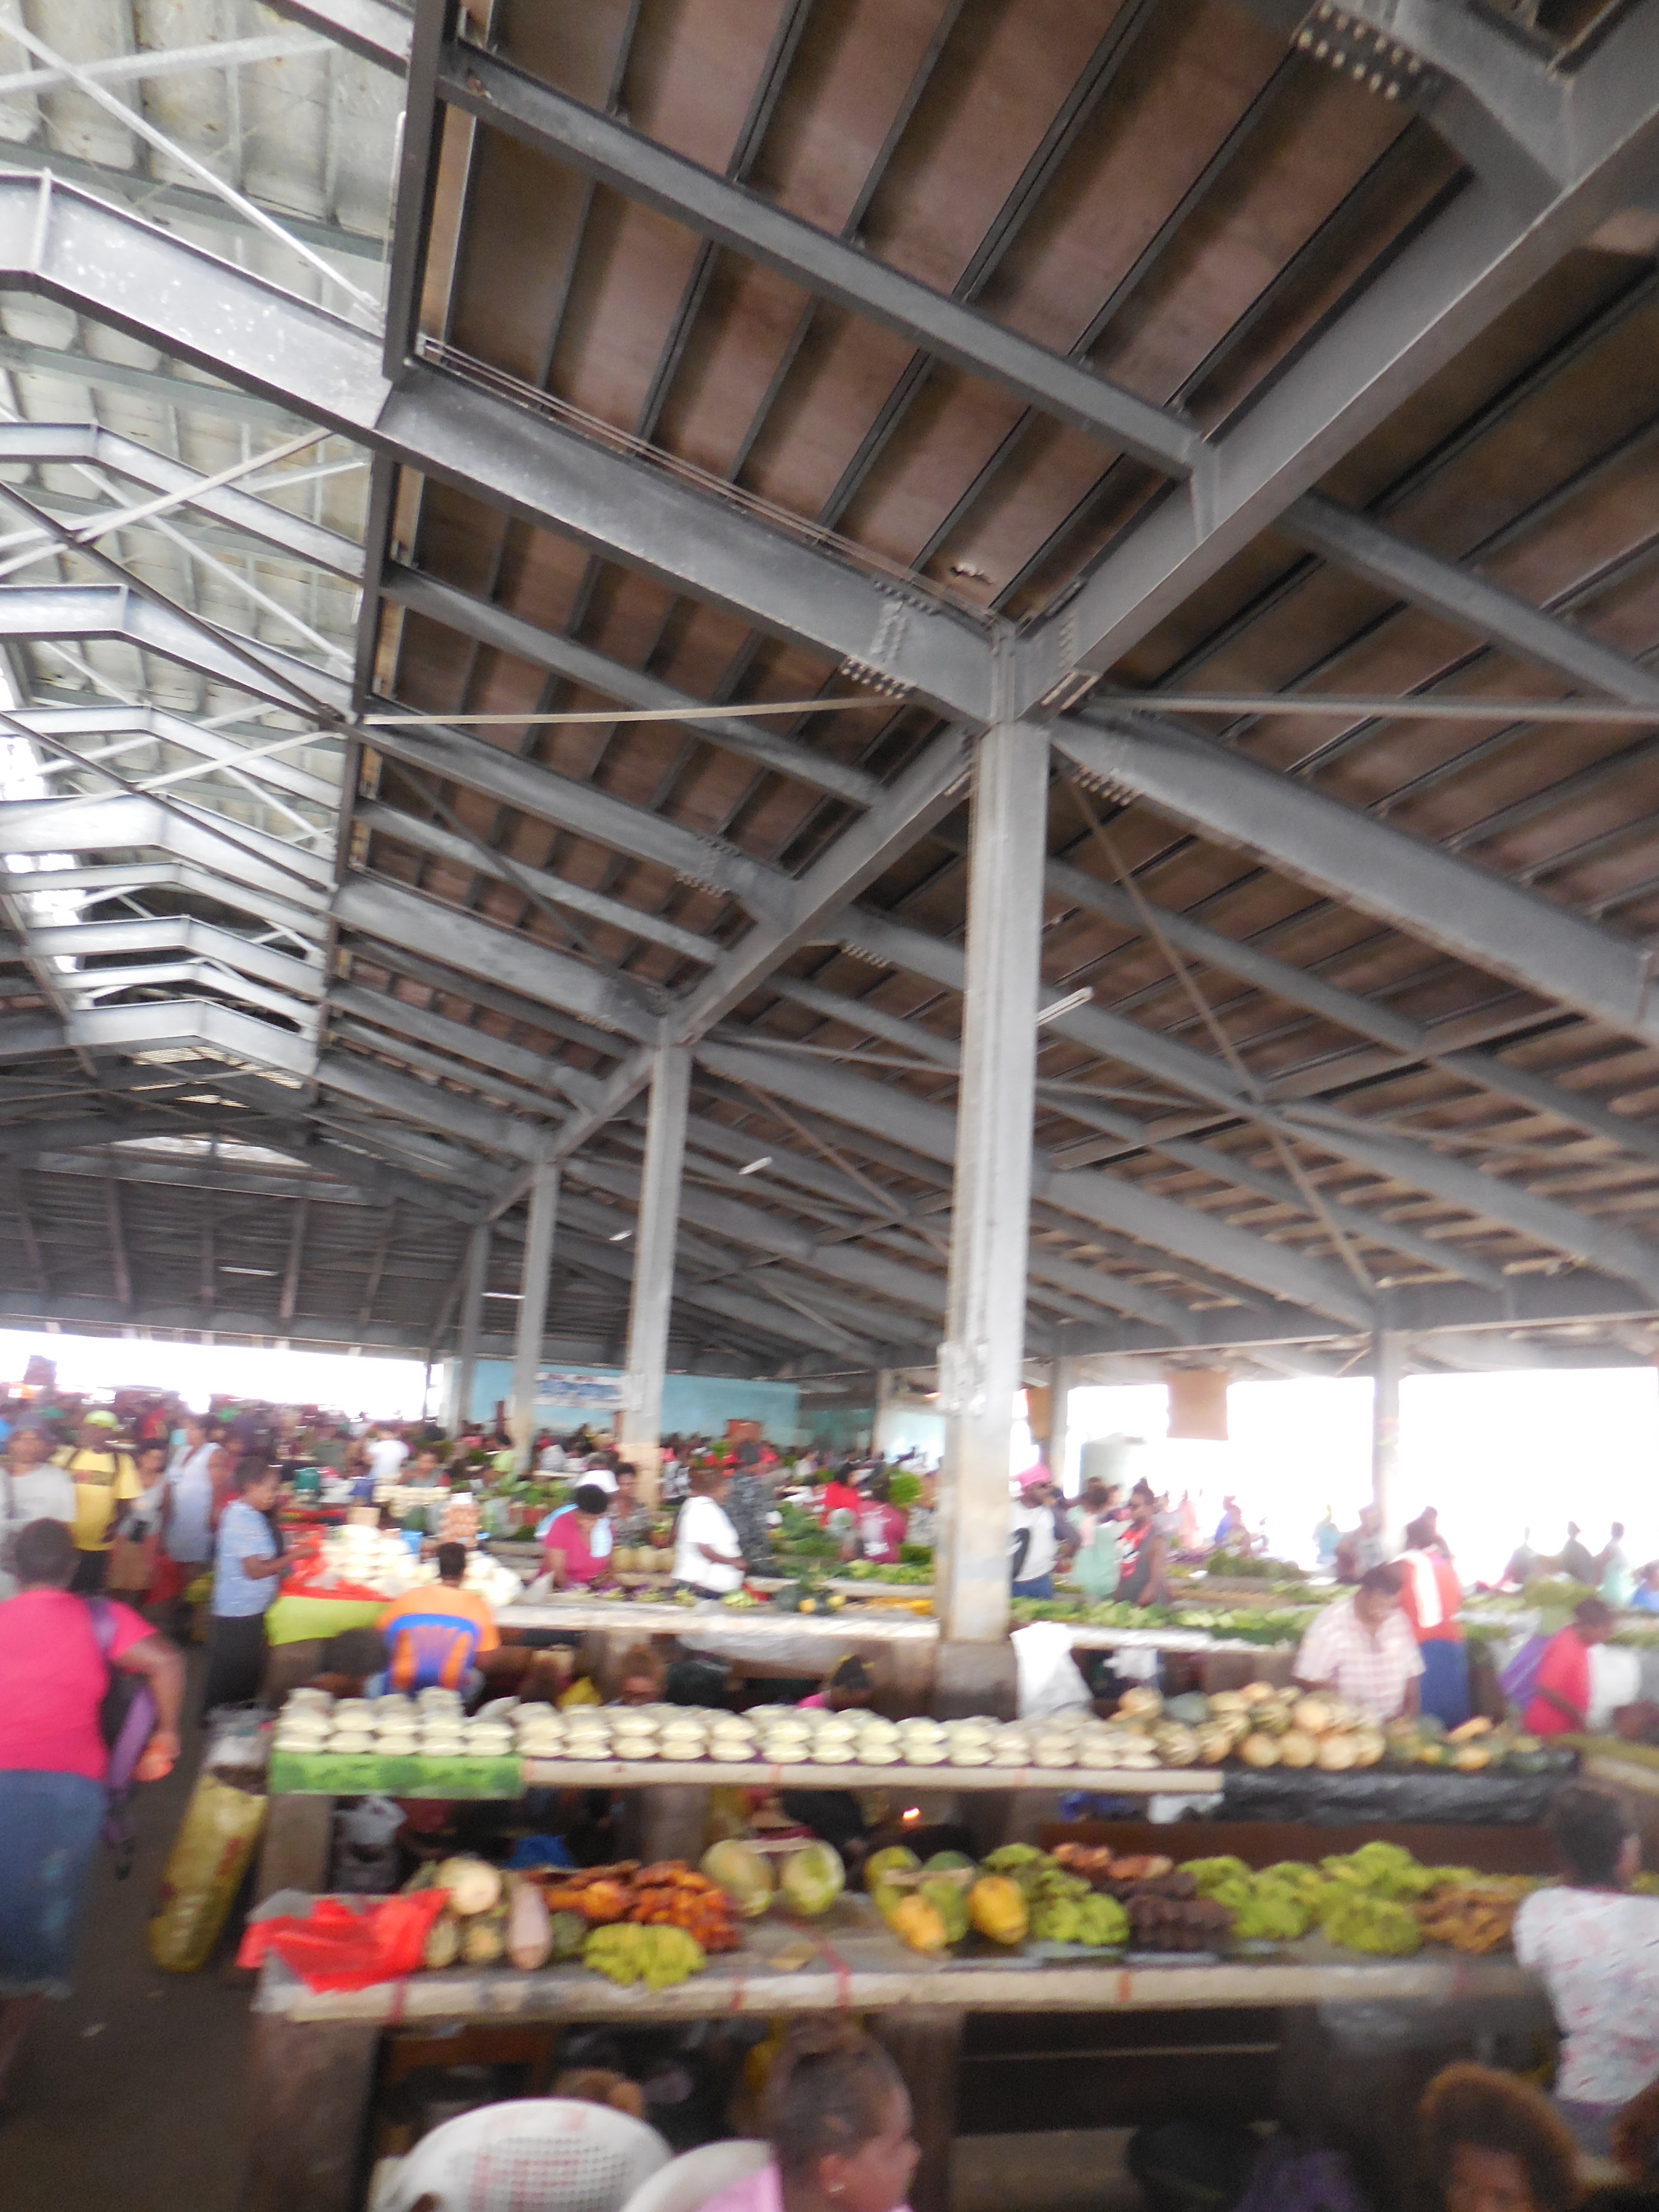
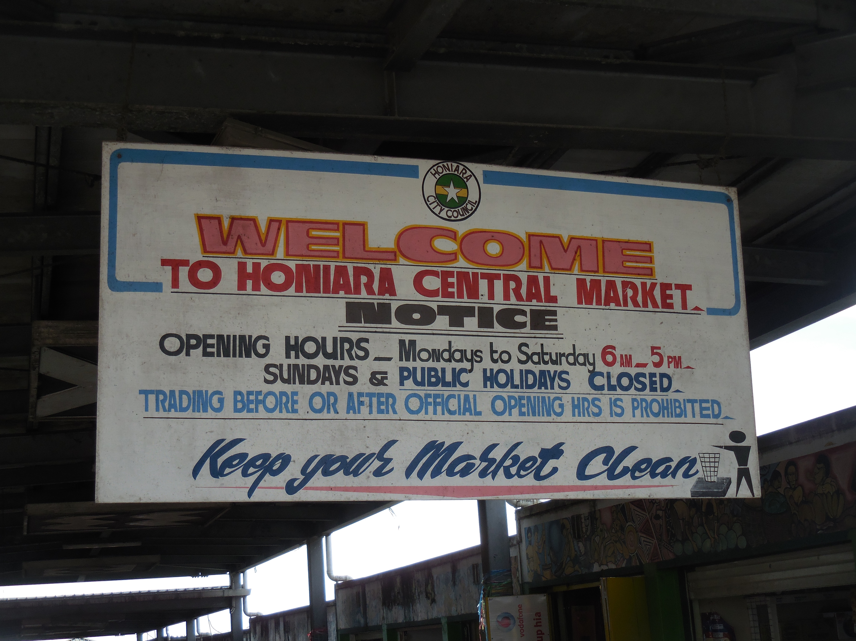
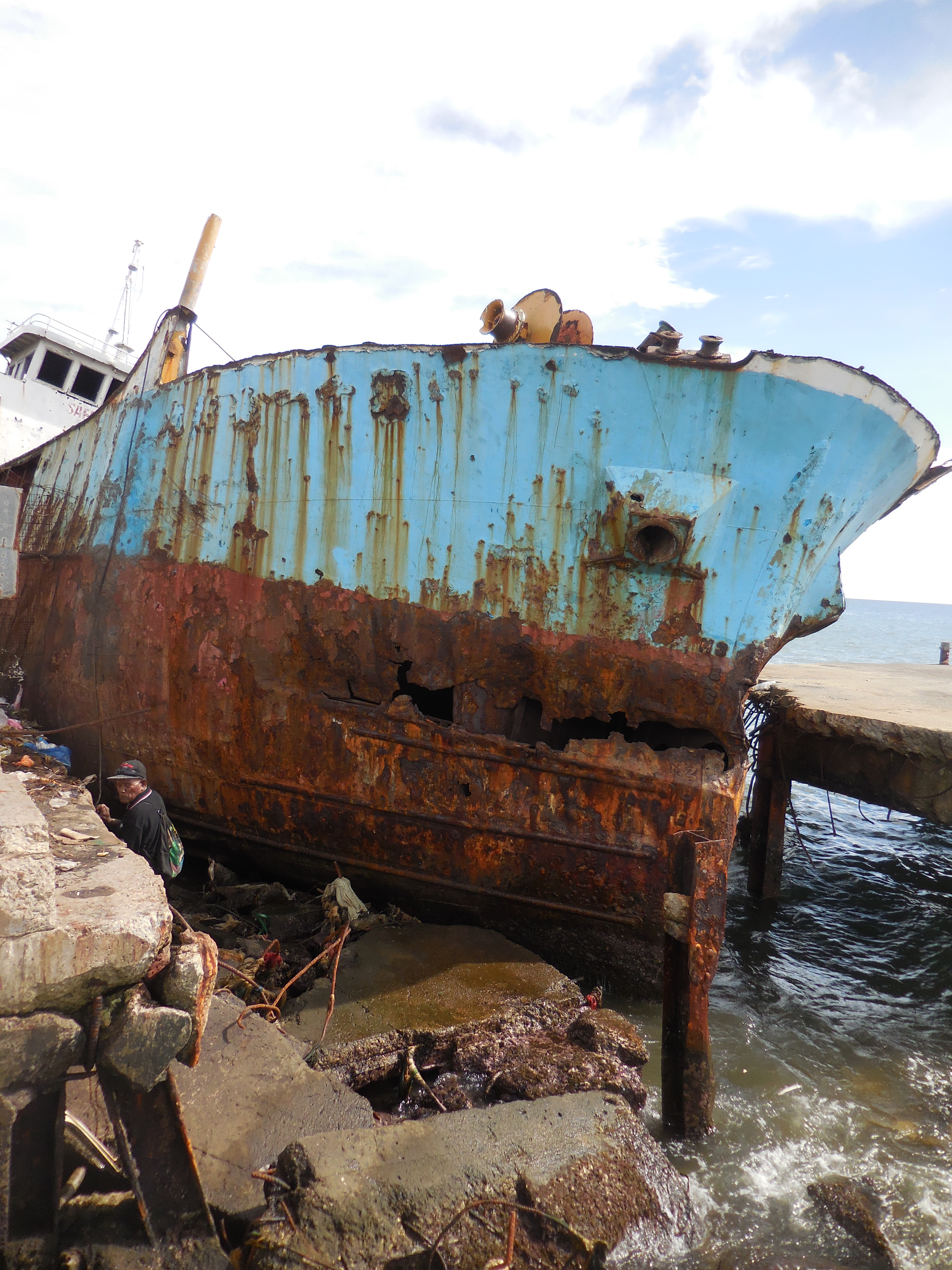
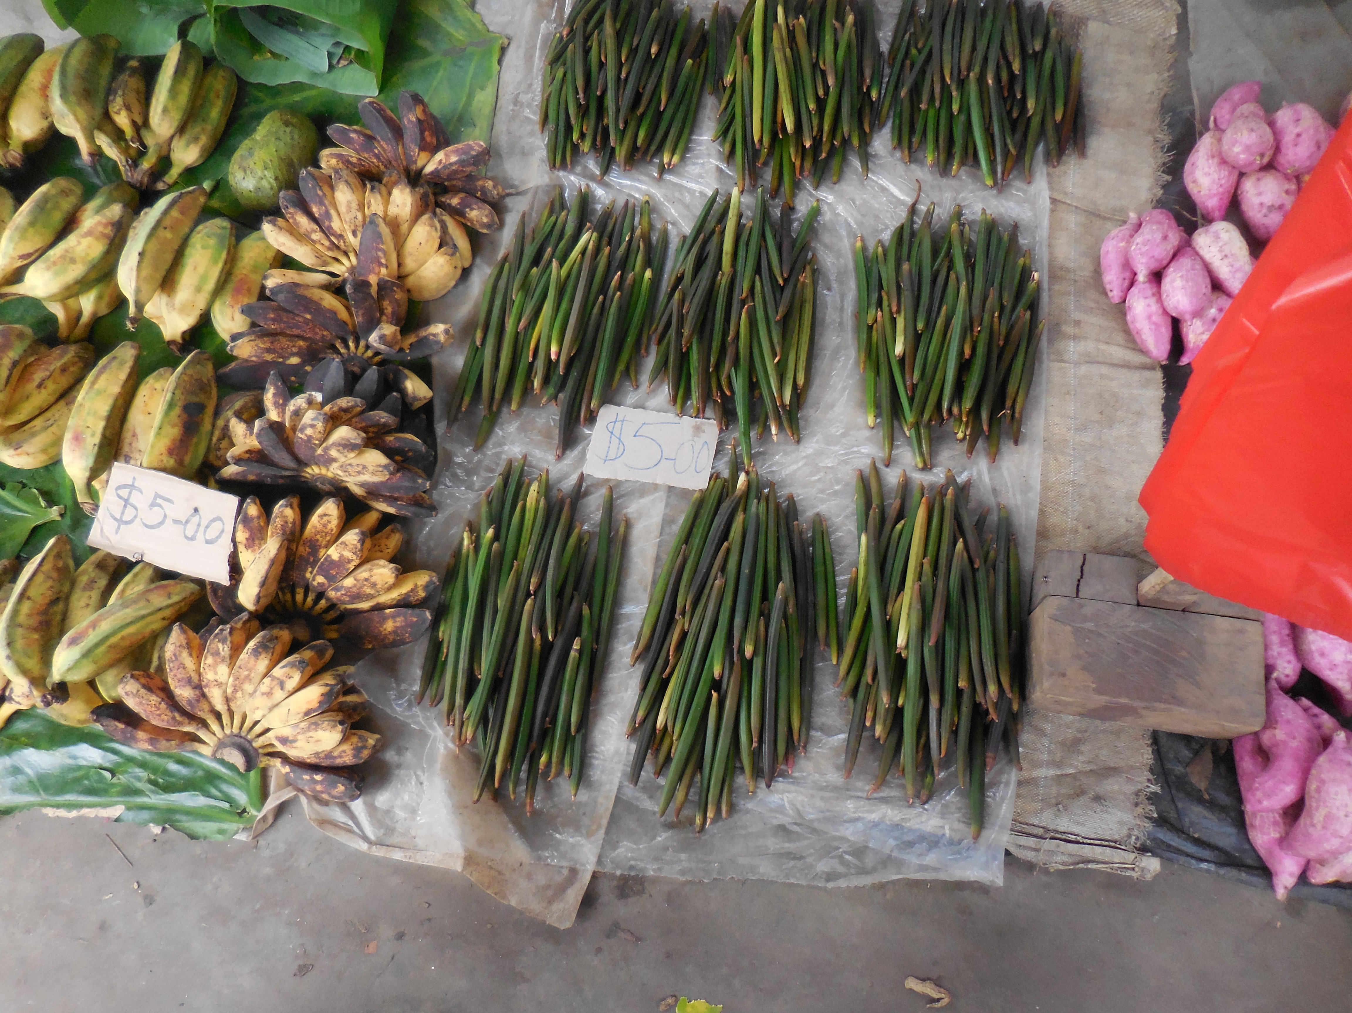
2. Current Study of HCM:
Food Stresses
Population increase (85,000-100,000) 29% increase since 2000
Dislocation from food gardens (migration)
Widespread underemployment and unemployment
Honiara Central Market
7 days a week
1200-1500 stalls
often 2000 + vendors
Resellers (“blackmarket”)
12% of food from Savo —
(UN Women baseline survey)
(Portal: Interdisciplinary IR
Georgeou/Hawksley 2017)

Slide 11
Data collection
Vendor Survey
  3 months
  Every Friday
  Four enumerators rotating through the market
  23-30 surveys each per day
  150 data entry boxes
  Building up a geospatial view of food production
  Geospatial view of food transportation
  Gender analysis
Consumer Survey
  7 days (week 10)
Initial Data Analysis 30 June-18 August (another month to come)

Slide 12
Vendors at HCM (N=705)

Slide 20
Some pointers
Most vendors are growers – markets important space for farmers
Most vendors are married women – more information about family needs & impacts useful
Gender and agriculture interventions should be informed by value chain studies
Gender an issue not just at site of production/producer but transport, market space, export etc
Agriculture & markets important spaces for women, however, influence over conditions poor & decision makers at HCC etc rarely female
Sales at market do shift gender relations in the family in positive and negative directions – useful interventions? e.g. banking & savings deficits

Slide 21
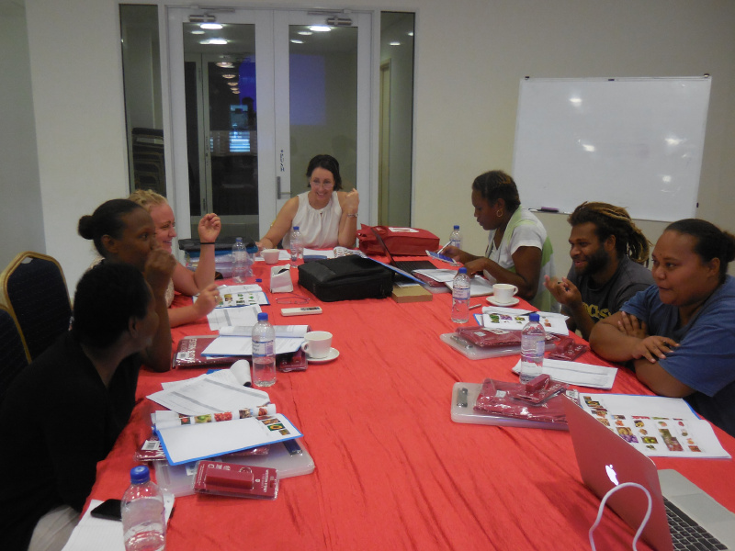
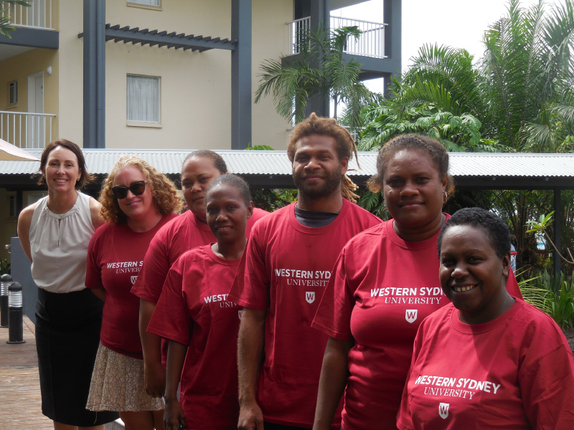
Thank you
Lead Researcher: Dr Nichole Georgeou Local Research Coordinator: Dr Anouk Ride
University of Western Sydney Research Consultant
N.Georgeou@westernsydney.edu.au anouk.ride.com@gmail.com

