Slide 1
Food Crops Value Chain- Addressing bottle-necks, markets and business opportunities : KGA Perspective
Presentation by Moses Pelomo (KGA Chairman) at the PIPSO Solomon Islands National Roundtable Workshop: Promoting Nutritious Food Systems in the Pacific Islands.
17-28 September 2017 at Honiara, Solomon Islands

Slide 2
Outline of presentation
1. Introduction to Kastom Gaden Association (KGA)
2. KGA approach to promoting of Food Security, Nutritious Food Systems and Livelihood
3. Key KGA Activities relating to Food Security and Livelihood from 1995-2016
4. New Approach 2017 and beyond
5. Key Challenges associated with Food Security and livelihood
6. Bottle-necks, markets and business opportunities
7. Way Forward

Slide 3

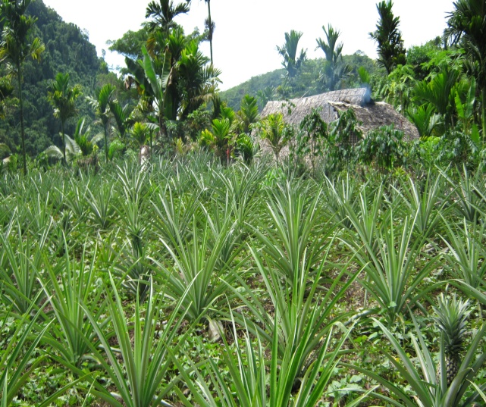
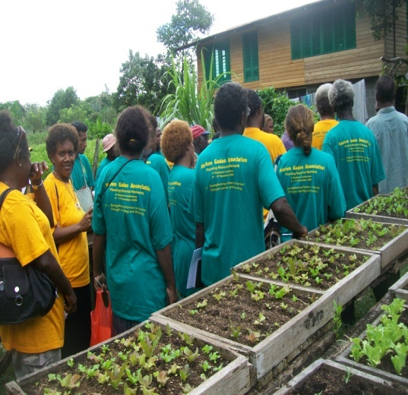
KGA
WHO WE ARE!
KGA is a Solomon Islands Based Non-government organization (NGO). It provides training and assistance in community food security and sustainable livelihood development at grassroots level throughout Solomon Islands.

Slide 4
1. Introduction to KGA
KGA is a national NGO established in 1995 by late Joini Tutua
Now has over 5,540 financial members spread throughout the nation- most are rural farmers
It currently has 13 affiliated community based organisations
Board of Trustees and Management
Other National partners- MAL, MHMS, SINU, MEHRD-RTC Association
Regional Partners- PIFON, POETcom, NARI (PNG), SPC
Support from Dev. Partners- DFAT, JICA, EU, UNDP, FAO, IFAD, CTA and others

Slide 5
Our Local CBO Partners

Slide 6
KGA Overall Philosophy
>>>HEALTHY SOIL >>>
>>>HEALTHY GARDENS >> >
>>> HEALTHY FOOD >>>
>>> HEALTHY PEOPLES >>
>> >HEALTHY NATION

Slide 7
2. KGA Approach to promoting Food security and Livelihood
Encourage members and their families to use traditional knowledge, skills and innovations to establish sustainable gardening practices that will provide increased productivity
Encourage family members to consume more nutritious local kaikai
Facilitate and increase capacity of rural farmers to link with markets so that surplus production from gardens earn sustain livelihood

Slide 8
3. Key KGA Activities relating to Food Security and Livelihood from 1995-2016
Promoted the use of good traditional farming practices
Promote Organic farming practices
Adaptation of appropriate new organic farming practices
Promote conservation and planting of indigenous food crops (root crops, fruits & nuts and vegetables
Promote healthy families and village environments
Promote sharing of knowledge, skills and planting materials

Slide 9
3. Key KGA Activities relating to Food Security and Livelihood from 1995-2016 (Cont.)
Promotes the consumption of nutritious local food
Organise Food Diversity Fairs (eg. Banana, Yam, Pana etc)
Establish bulking sites for local food crops
Distribution of imported seeds and exchange of local food crop planting materials
Established 13 Demonstration plots mainly on Guadalcanal after the Flash Flood of 2014
Establish special demo plots for nutritious food crops in association with rural hospitals (Aitofi, Kirakira, Sasamungga, Lata & Munda)

Slide 10
3. Key KGA Activities relating to Food Security and Livelihood from 1995-2016 (Cont.)
Conduct Training on organic and sustainable farming systems
Conduct Climate Change related mitigation and adaptation gardening system
Provide POETcom certification for Organic Certification based on PGS system
Promote “King Crops” system to venture into semi-commercialisation
Through affiliation with PIFON strengthen Farmer Organisations (FO) and capacity building formation and management
Encourage Fos to establish marketing linkages through PGS
Encourage and establish “Savings Clubs” and Financial Literacy training
Continued advocacy in line with its overall aims

Slide 11
4. New KGA Approach, 2017 and beyond
Continued advocacy but increased facilitation for members to increase their capacity to improve consumption of more nutritious local kaikai and income generation
Prioritise efforts in fighting NCD and other nutritional disorders with collaborations with stakeholders
KGA to venture into income generation activities to sustain its own operations
More diversified funding sources including SIG, Development Partners, private corporations
Strengthen partnership linkages and collaborations particularly with SIG and its agencies
Enter into J/V with potential members/partners where viable business opportunities are identified
More efforts to build the capacity of women, youth and others of special needs

Slide 12
5.Key challenges associated with Food Security and Livelihood
Food Security
Food Security (Cont.)
Low consumption of more nutritious local kaikai
More nutritious crop varieties no longer planted or maintained
Local kaikai more expensive at the urban markets compared to imported alternatives
Lack of awareness of the value of local kaikai
Rural people eat more imported food
Local kaikai are more perishable
Low value-adding for local kaikai
Young people prefer imported food
Younger generation are not making gardens
Increase NCD and other malnutrition
Over-cooked local kaikai –esp at schools and institutions

Slide 13
5.Key challenges associated with Food Security and Livelihood (Cont.)
Livelihood (income-generation)
Livelihood (income-generation)
Local raw products very expensive
Unreliable supply
Consumers prefer imported substitute to local product
Lack Post-harvest knowledge
Lack of appropriate technology for processing /value-adding
Lack of finance for capital investment and working capital
Packaging and labelling issues
Food safety issues
Export market access issues
More intra competitive value chain palyers

Slide 14
6. Bottle-necks, markets and business opportunities
Identifying marketable products/produce and market linkages
Un-reliability and consistent supply
Appropriate technologies for value-adding
Financial access and management
General inadequate infrastructure (transport, telecommunication, manufacturing, support services, utilities etc)

Slide 15
6. Bottle-necks, markets and business opportunities (cont.)
Many informal enterprises
Weak trading/marketing partnership
Wantok system
Rural village producers are multi-opportunists and are not specialised in any particular crop
Little collaborative efforts along the value-chain

Slide 16
Way Forward (Food Security and Nutrition)
Continue promotion of Organic farming practices
Work with MHMS and Rural Hospitals on NCDs and Malnutrition
Work with MAL and MHMS to identify more nutritious food
Develop contemporary recipes that includes more local kaikai
Encourage hospitality industry to use more local food in their recipes
Build capacity of boarding schools and institutions cooks to improve their cooking skills for more nutritious meals
Plant indigenous nuts and fruits in schools and institutions to supplement diet

Slide 17
Way Forward (Food Security and Nutrition) (cont.)
Promote “SLOW FOOD” instead of “fast food”- eg. KGA Board has decreed that it will only be served “Bone bone Food” (roasted root-crops and fish and coconut drinks) for its Board meeting lunches!
Continue to identify, collect, bulk and re-distribute good nutritious local kaikai
Research/analysis into unknown nutritional value of traditional food crops, nuts, fruits and greens
Policy for school canteens and food sales at schools not to have too much imported items
Educate young generation on the KGA vision of “Healthy soil > Healthy garden> Healthy Food > Healthy People > Healthy nation

Slide 18
Way Forward (Livelihood)
Start small by adding value to food items that are readily available
Target local markets by conducting simple market research
Establish market linkages through PGS system
Contract Farming
Minimised processing to maintaining nutritional value of food (see examples in following slides)

Slide 19
Potential simple village enterprises
Enterprise 1: Dried Nuts and Fruits
Enterprise 2: Root- Crop Flour
Enterprise 3: Value-added Root Crop Flour
Enterprise 4: Dried Fish
Enterprise 5: Solar Drying Technology

Slide 20
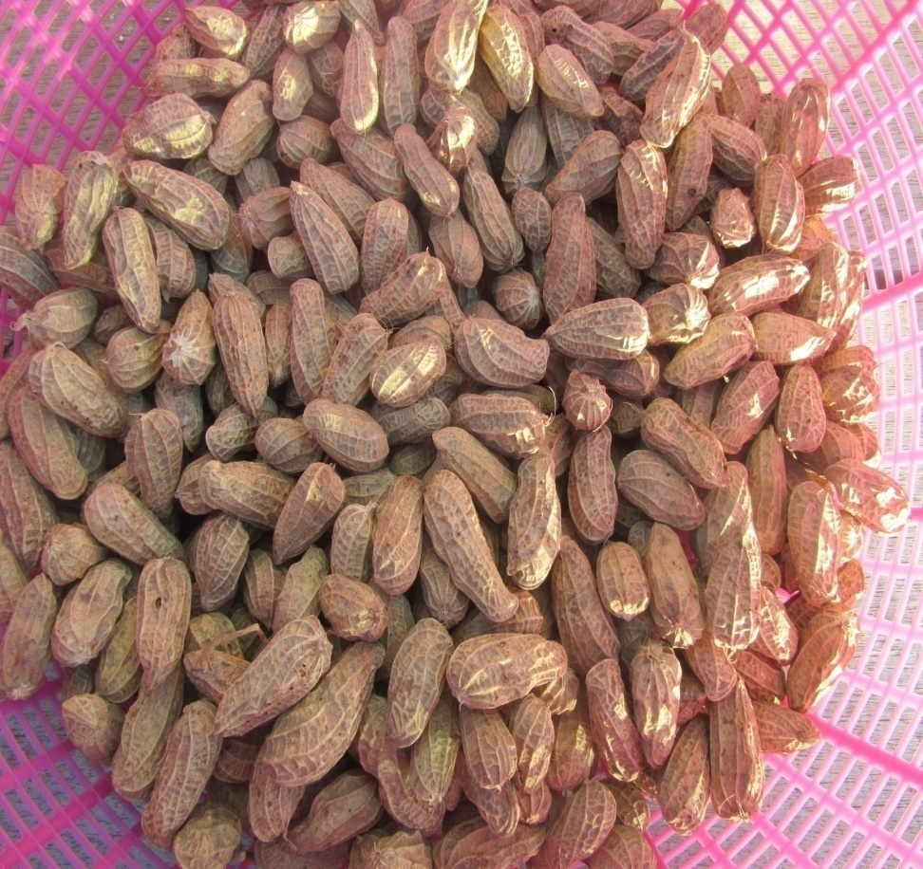
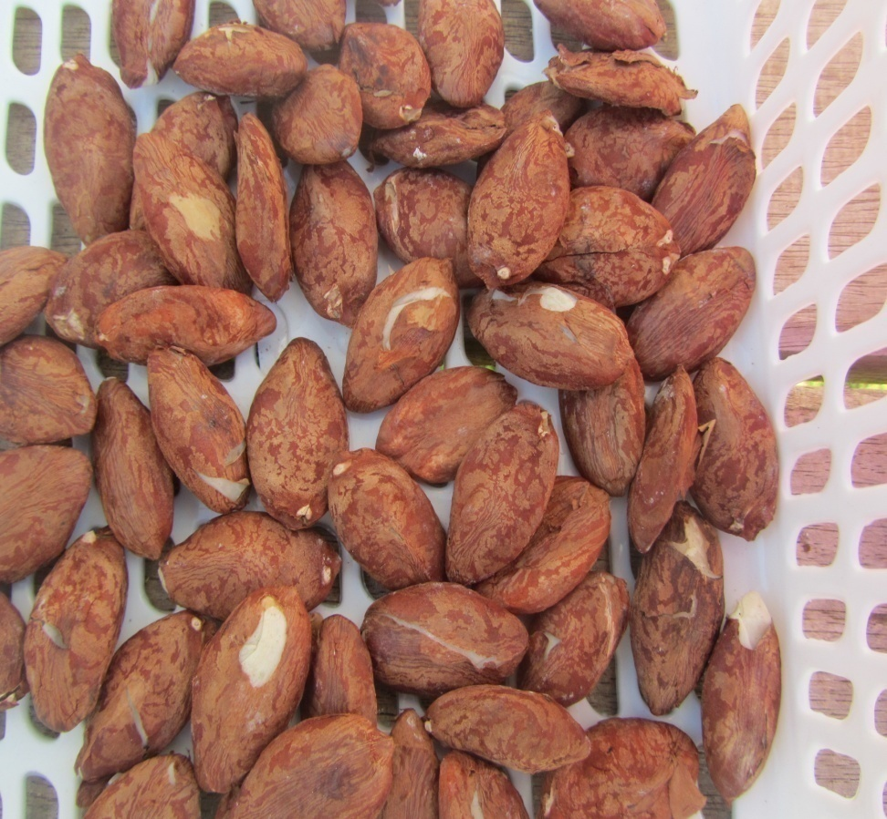
Enterprise 1: Dried Nuts (i)-(Peanut and Ngali nuts)

Slide 21
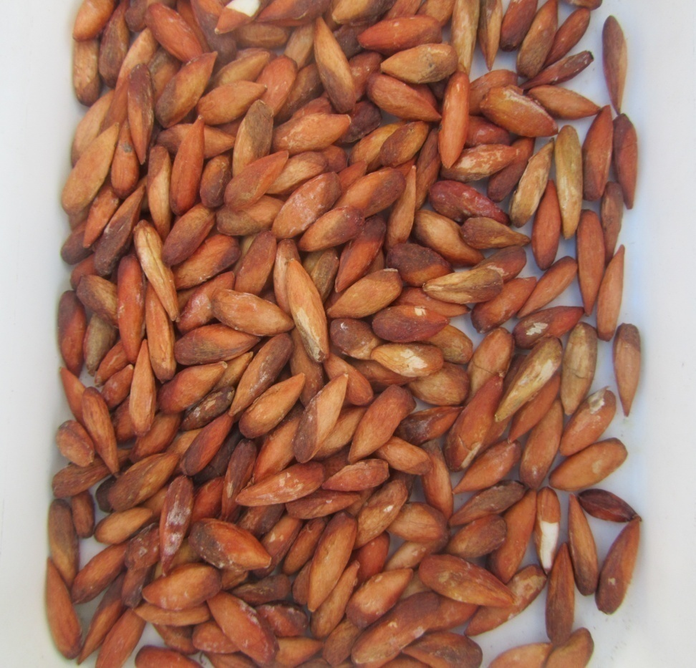
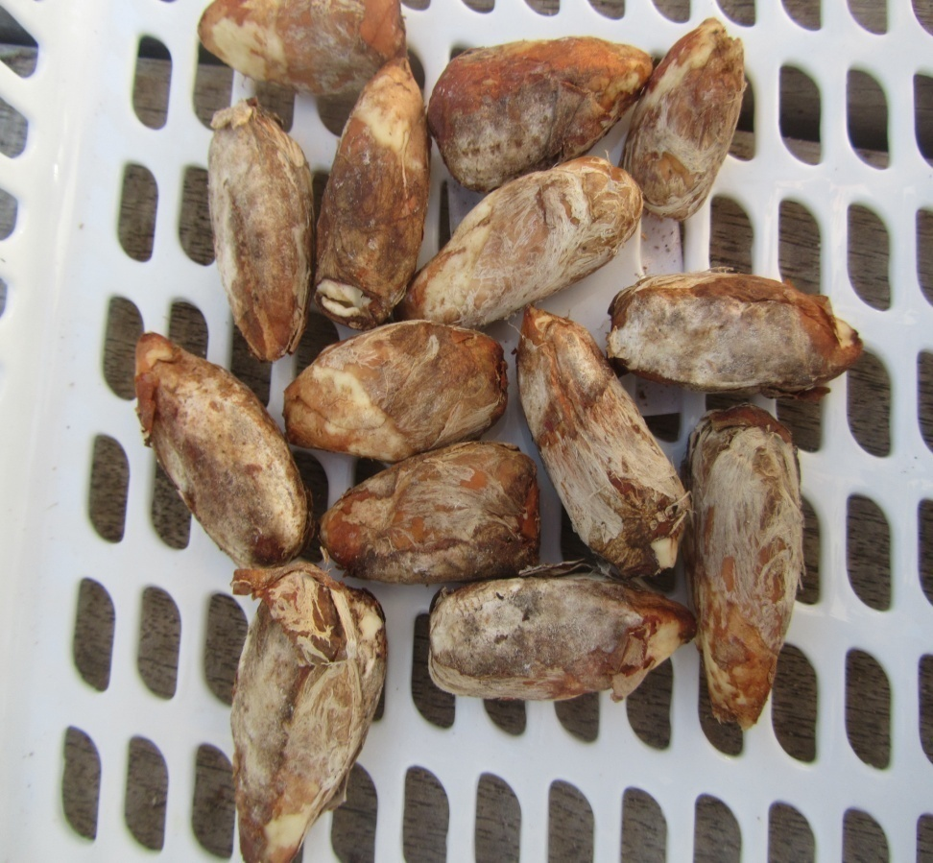
Enterprise 1: Dried Alite nuts (ii) (Beach and Bush) Cont.

Slide 22
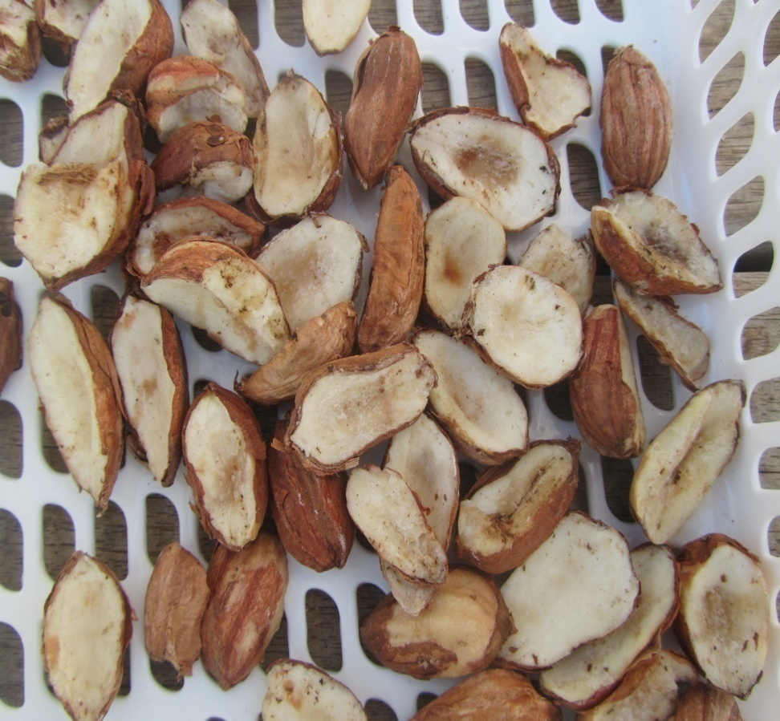
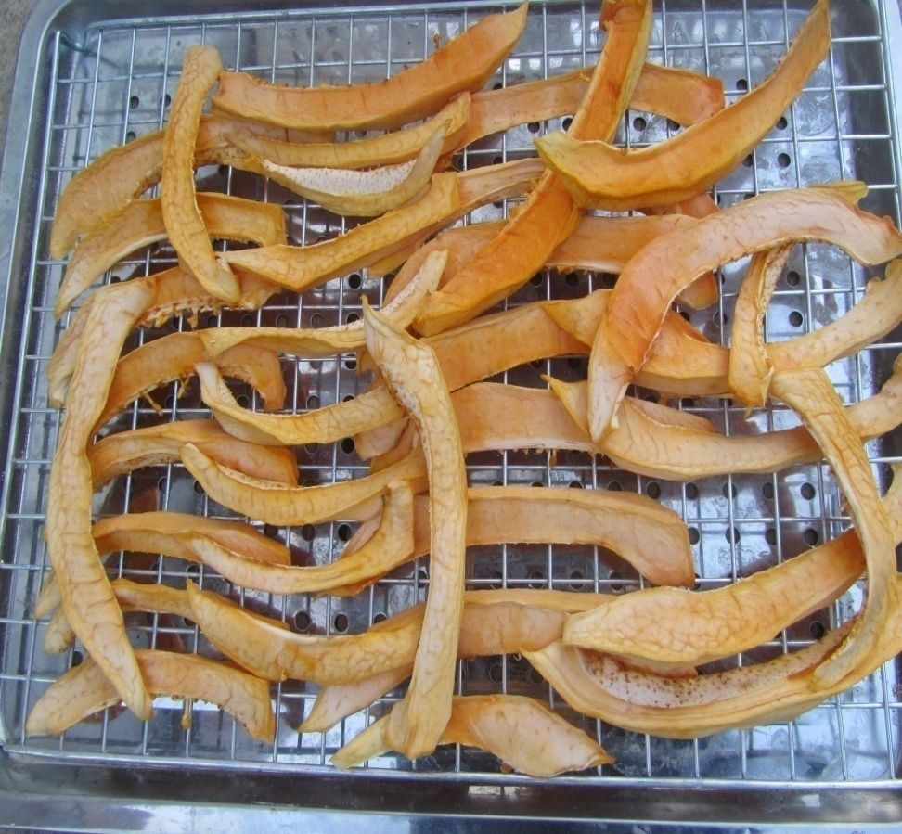
Enterprise 1: Dried and Fruits(iii)-(Cut-nut and Pawpaw) Cont.

Slide 23
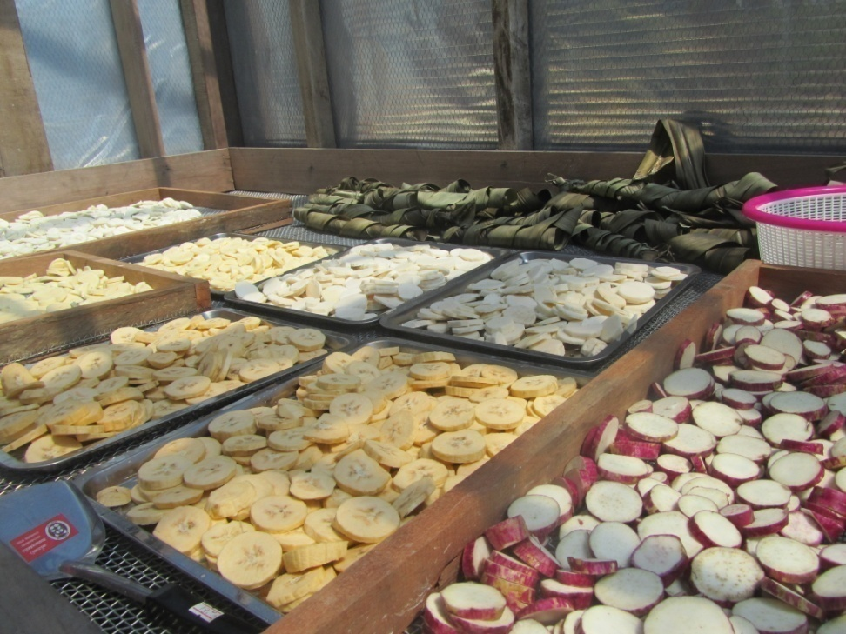
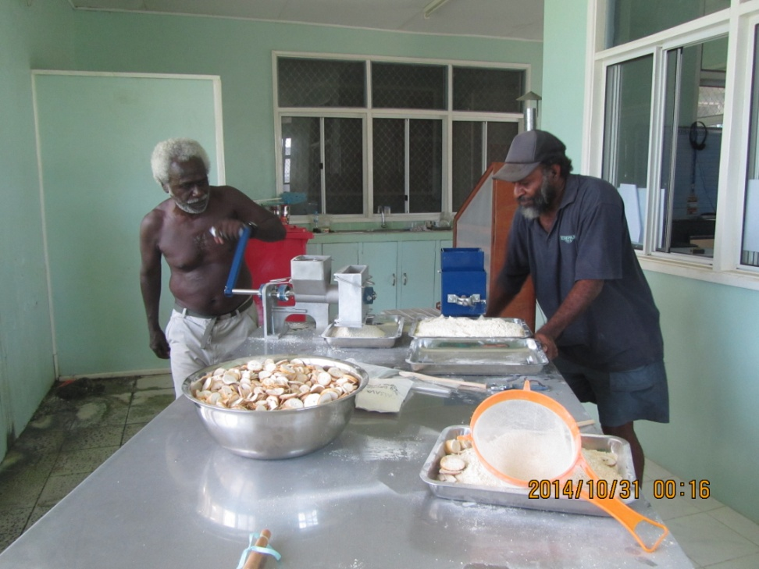
Enterprise 2: Root Crops Flours (i) drying and grinding

Slide 24
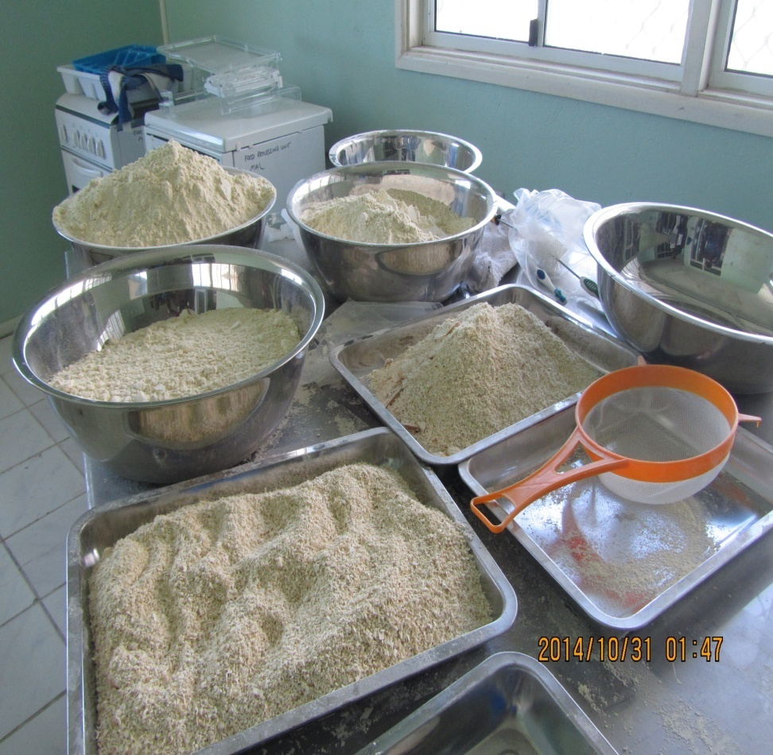
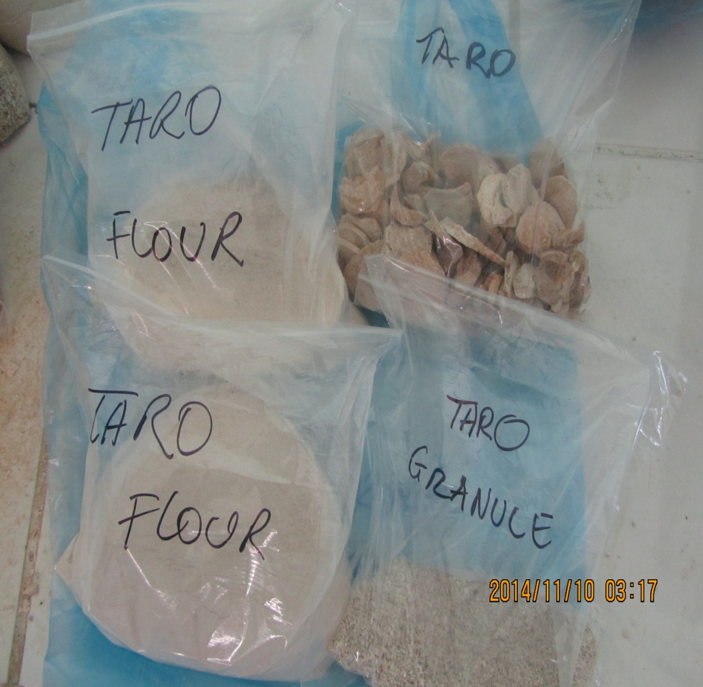
Enterprise 2 :Root Crops Flours (various) Cont.

Slide 25
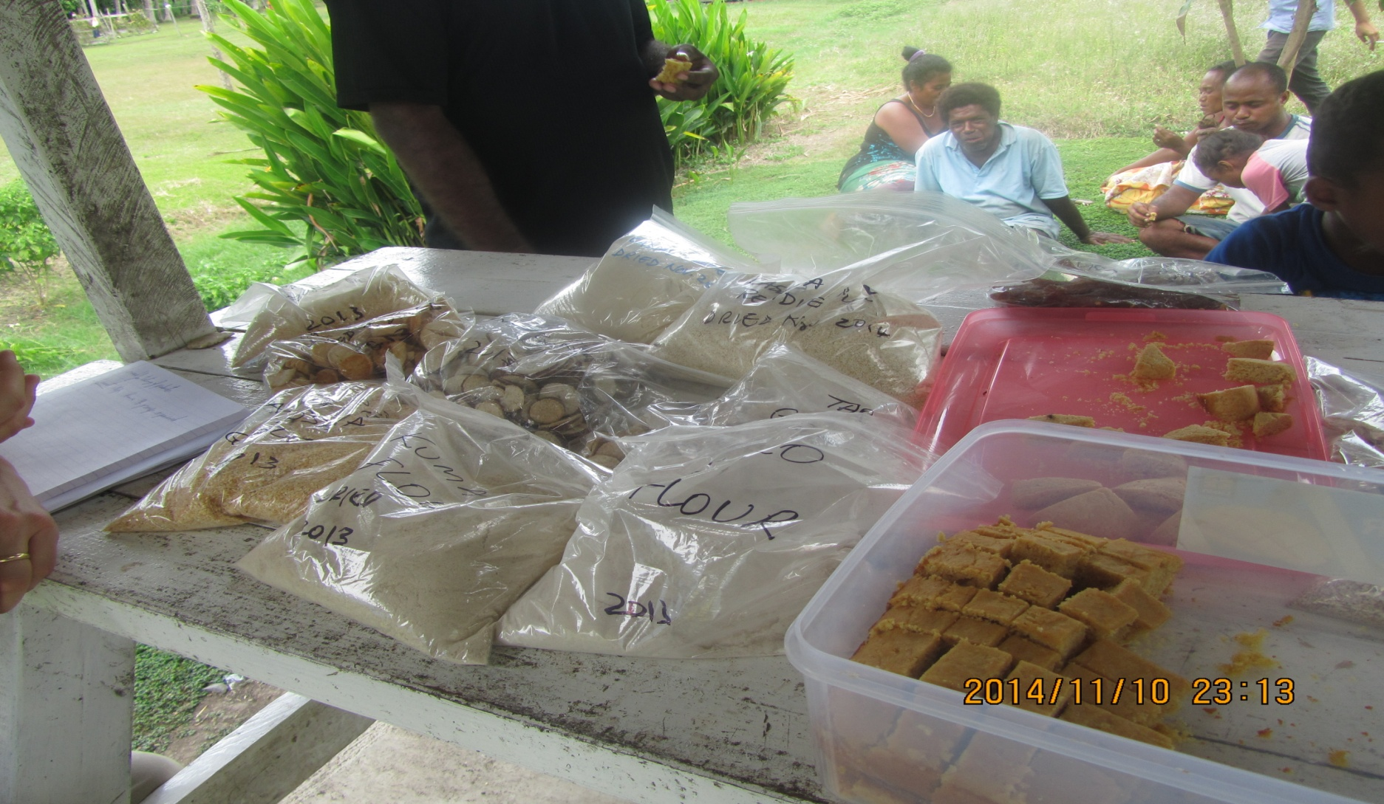
Enterprise 3: Value added Root crop Flour

Slide 26
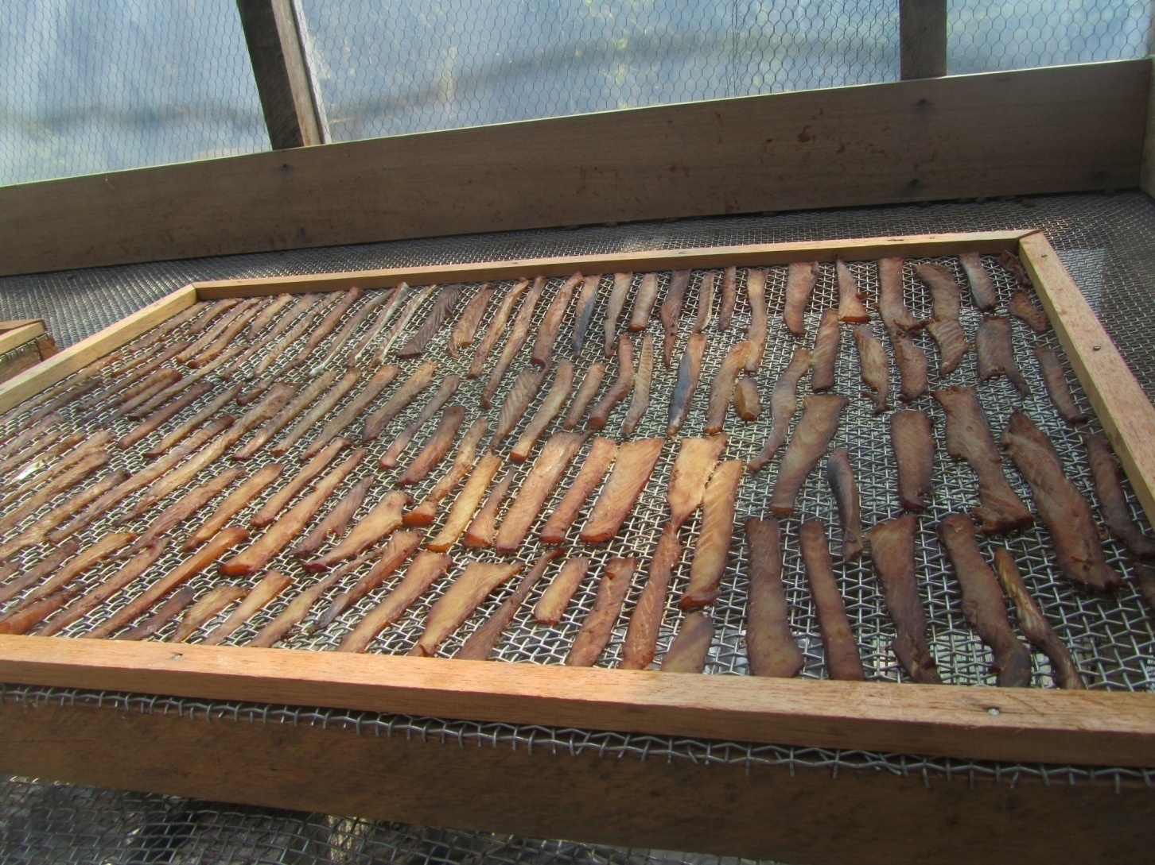
Enterprise 4: Dried Fish

Slide 27
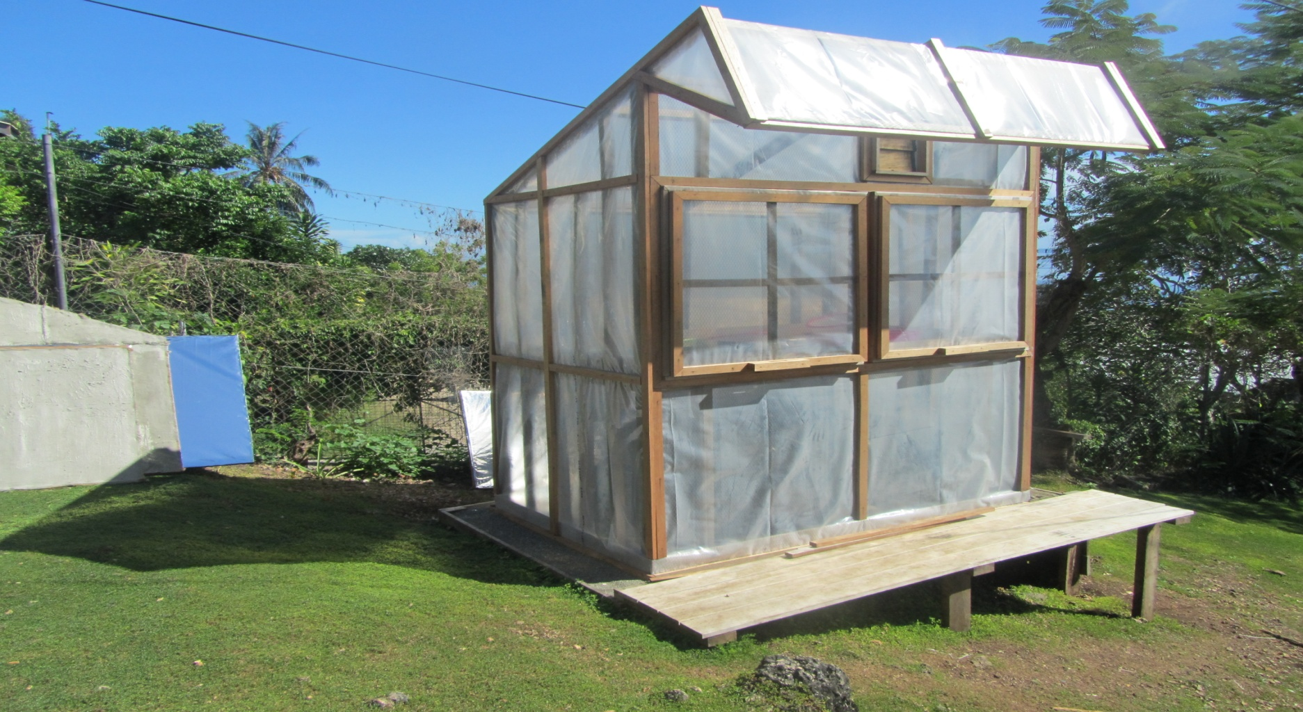
Enterprise 5: Solar drier for Food

Slide 28
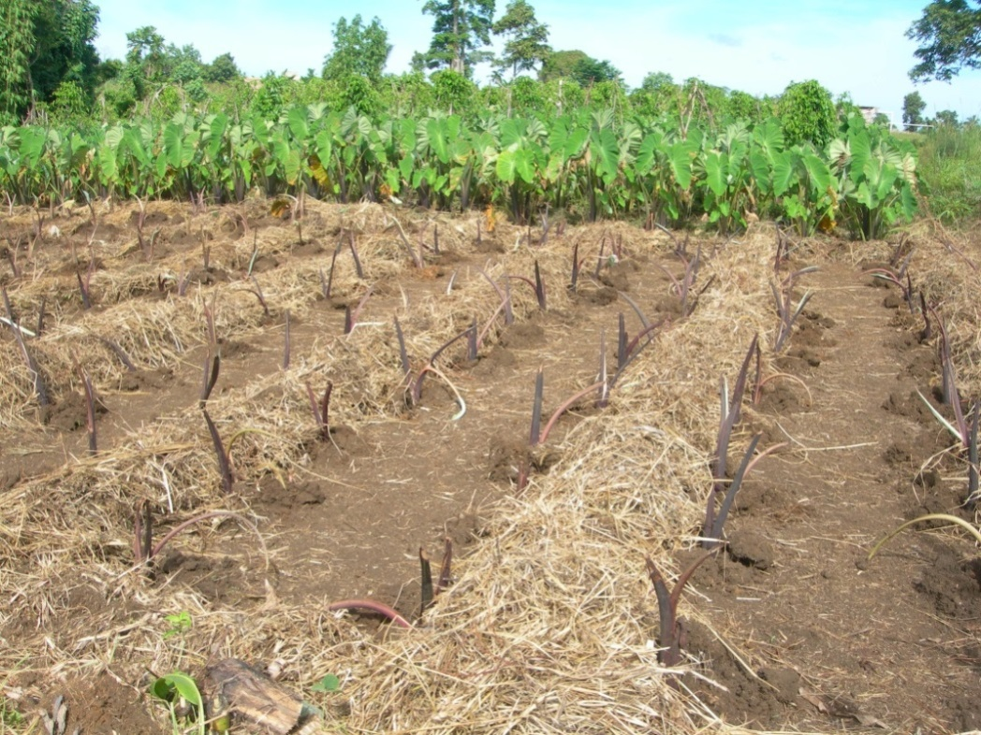
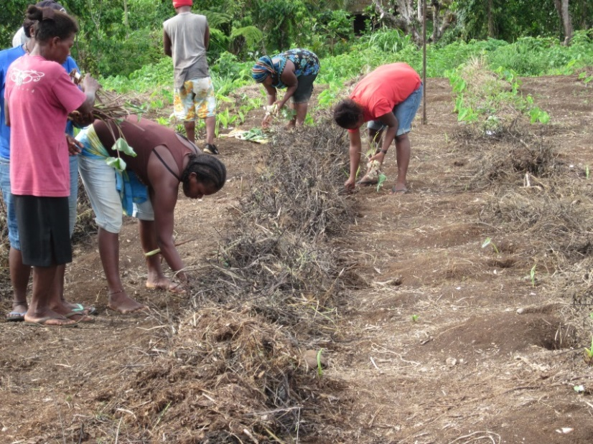
Cont…….
Promote sustainable farming system – Alley cropping – Compost, mulching etc
KING CROPPING

Slide 29
TANGIO TUMAS- THANK YOU

