Slide 1
Enabling mechanisms to support value chain development, women’s & youth agribusiness, and supporting nutritional development
Hika Joseph
Deputy Coordinator-Provincial – Youth@Work Program
The Pacific Community – SPC, Solomon Islands
28th September 2017

Slide 2
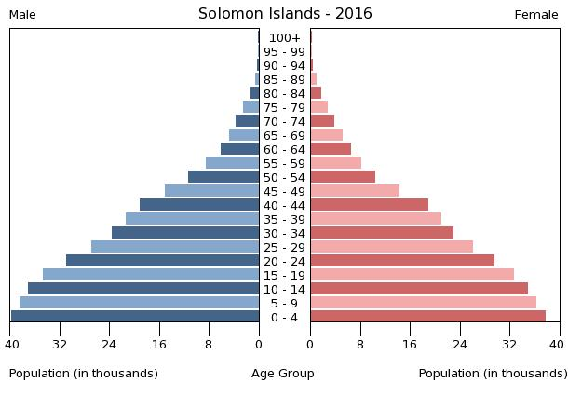
Solomon Islands
80 % of Solomon Islanders live in rural areas (Census, 2009)
Engage in subsistence farming
60% of population under the age of 25
10,000 enter job market each year,
only 400 jobs available (ILO report)

Slide 3
Solomon Islands - Youth Issues:
High Unemployment
Inadequate vocational skills training opportunities
Lack of Government support for youth oriented activities
Lack of youth participation and involvement
Alcohol & Substance abuse
Crime and Juvenile Delinquency
Climate change and Environment

Slide 4
Back ground Youth@Work – Solomon Islands
The Youth@Work (Y@W) programme is a response to high youth unemployment and lack of opportunities for youth.
Funded by Australian Government and Queen Young Leaders Grant
Managed by SPC
Commenced in 2012
Government Partners:
Ministry of Women, Youths, Children and Family affairs,
Ministry of Commerce, Industry, Labour and Immigration,
Ministry of Culture and Tourism,
Ministry of National Unity, Reconciliation and Peace

Slide 5
Youth@Work Objectives
The Objective of the Young Entrepreneurship Component is: increase Young Entrepreneurs ability to start and run a sustainable, profitable enterprise on their own.
Target
Target: 17 to 29 years old, equal number of female and male, youth with disability & youth released from correctional centres

Slide 6
Y@W Model
Step 1
Y@W awareness
Assessments
Step 2
Trainings
Step 3
Community Service
Soft skills
Step 4
Business Training
Procurement of materials
Business start-up
Monitoring & Follow up support
10 weeks of community development activities
Technical
Link: https://www.youtube.com/watch?v=jl21TnOGM98

Slide 7
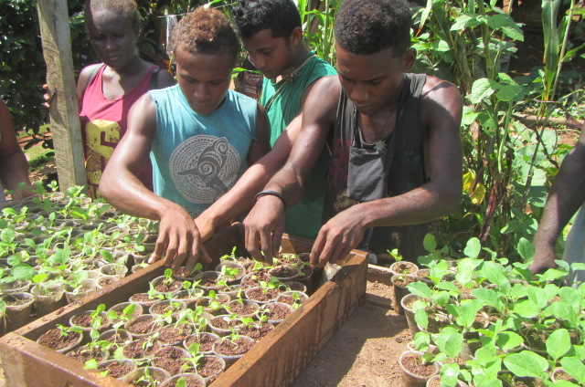
Key Achievements
300 small scale business up and running since 2014 in rural areas
10% are doing Agricultural small scale businesses such as piggery, poultry and crop farming

Slide 8
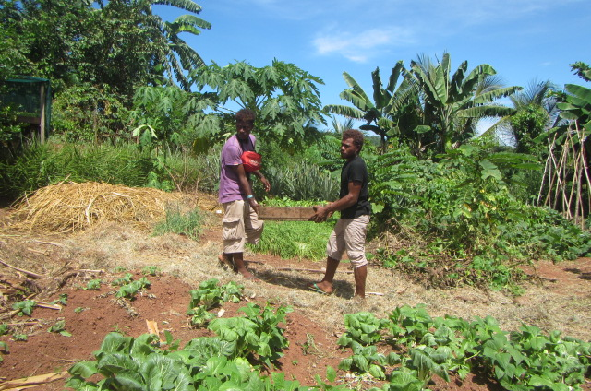
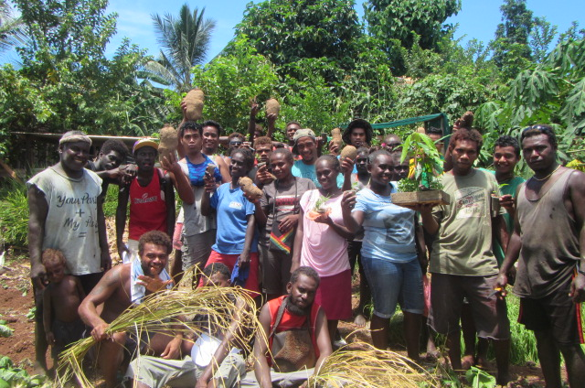
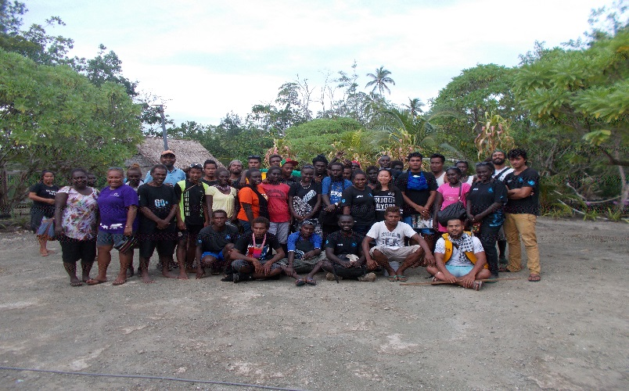
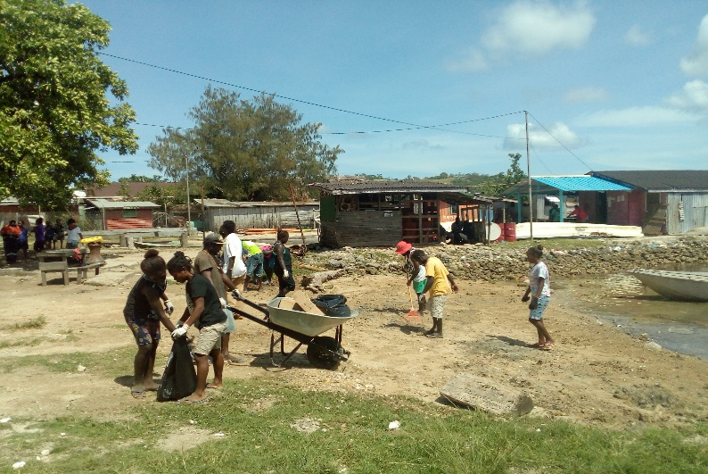
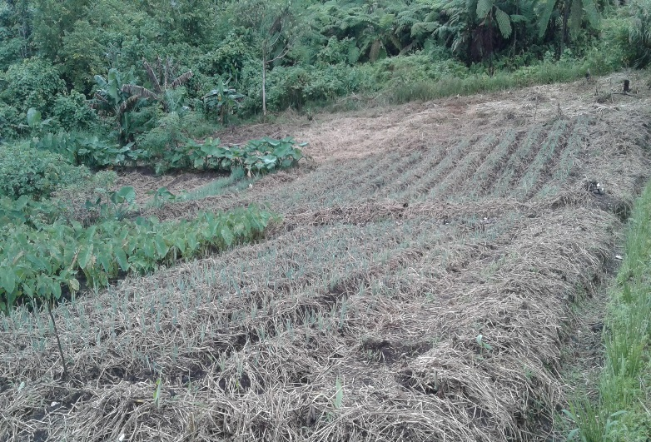
Youth@Work in Picture

Slide 9
Challenges:
Young people are not motivated to engage in agricultural activity
Access to market and lack of basic infrastructure
High cost production compared to imported products. Example cost of raising and bring local poultry product is higher then imported poultry.
Limited market
General perception of young people that farming is a dirty job and its for old people
Lack of information and capacity to deal with challenges
2. Lack of advisory / practical training support from relevant stakeholders in established rural office due to limited or lack of financial resources
3. Access to other opportunity is limited

Slide 10
Way Forward
We need innovative and creative ideas to make agriculture attractive for youth
Change youth’s perspective of agriculture
Working with youth should be an objective of all stakeholders
Invest in youth led/run agriculture businesses

Slide 11
Conclusion
Solomon Islands has 80% of its population as rural dwellers
60% are under the age of 25
High rate of Youth Unemployment and less opportunities
Youth@Work encourages youth to venture into Agriculture as a sustainable businesses
All relevant stakeholders should work together to boost Agribusiness

Slide 12
Thank you

