Slide 1
National Forum on Agriculture & Nutritional Security
Brief introductions by all attendees & names on cards
SINU Presentation of Rapid Scan – Becker, Joshua, Tavoa
SIG reps: specific comments on the draft rapid scan
NGO reps: specific comments on the draft rapid scan
Donors & Other’s: specific comments on the draft rapid scan
General Q & A and comments about food and nutritional security programs in Solomon Islands.
Evaluation of the forum – please complete and return forms

Slide 2


Building the Evidence Base for the
Agriculture-Nutrition Nexus: A
Rapid Country Scan of Policy & Practice in the Solomon Islands
Dr. Dusti Becker, Dorothy Tavoa, & Leeroy Joshua
School of Natural Resources & Applied Sciences

Slide 3
SINU Presentation
Nutritional health challenges in the Solomon Islands
Some agriculture-nutrition nexus concepts
Aims of the Rapid Scan & Sponsor
Methods
Results
  SIG National Policy on Food and Nutritional Security
  SIG Ministry Programs – MAL & MHMS
  NGOS & others
SINU Team’s Conclusions
Questions we still have

Slide 4
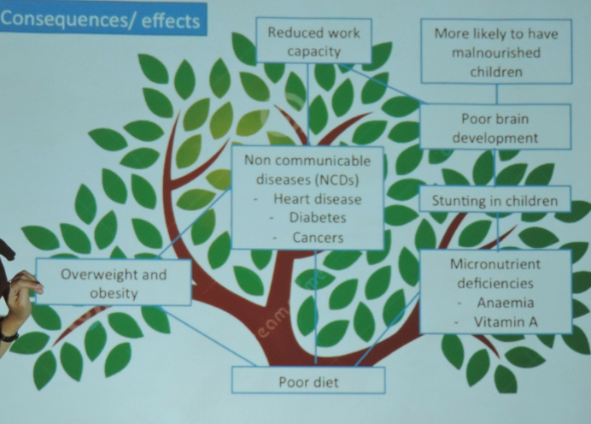
Bad nutrition = poor health
33% of children under 5 years are malnourished
49% of children under 5 are iron-deficient (anemic)
44% of mothers in the Solomon Islands are iron-deficient
93.6 % of islanders consumed less than the recommended 5 servings of fruit and vegetables
67% of Solomon islanders are overweight, 33% are obese, and diabetes affects 13.5% of the population (SIG, WHO, 2010, WVIS 2015)

Slide 5
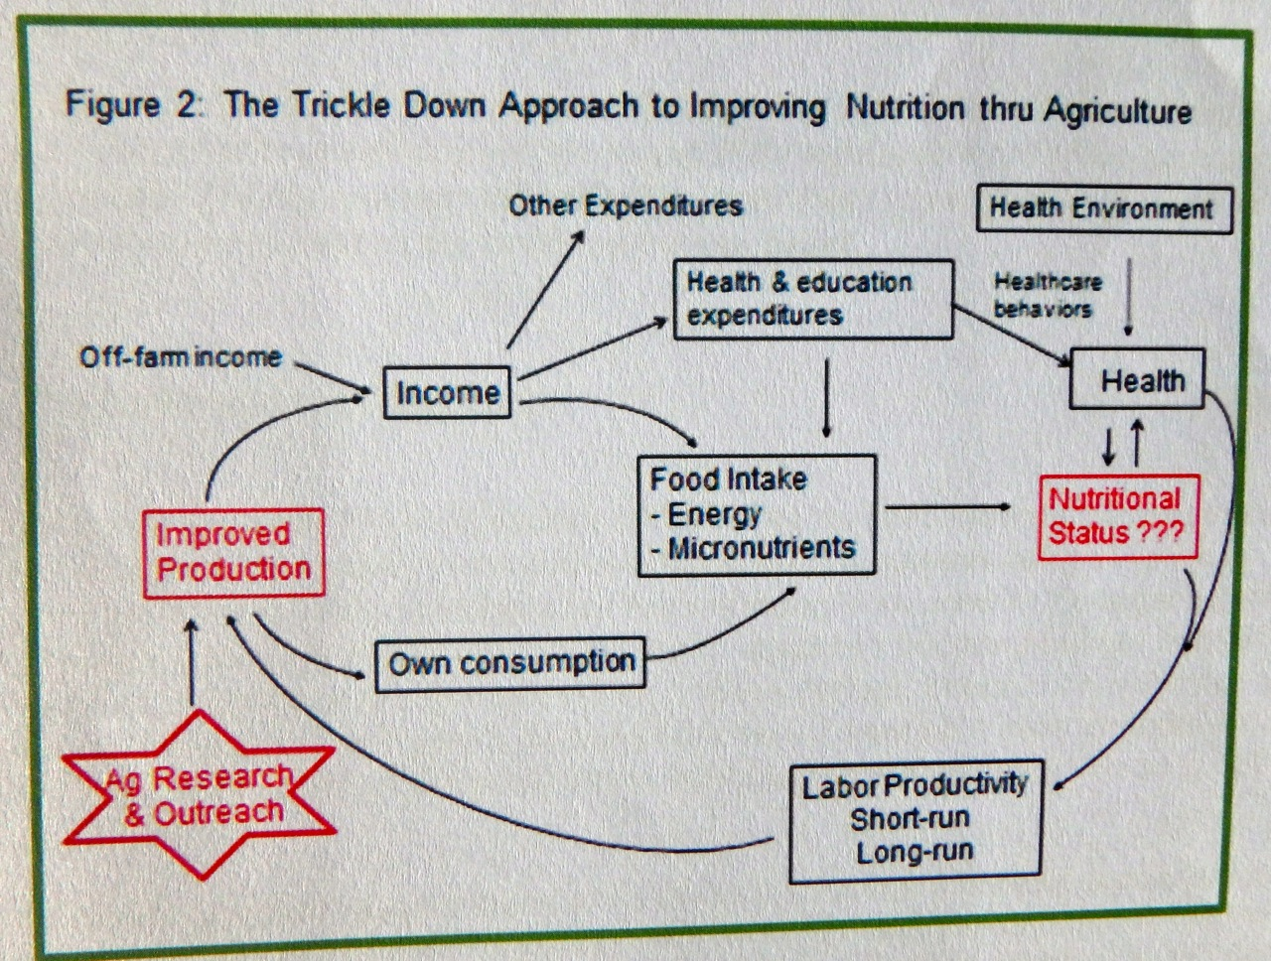
Agricultural-Nutritional Nexus typical thinking…
Chung, K. 2012. An introduction to Nutrition-Agriculture Linkages. Research Report 72E. Ministry of Agriculture. Mozambique

Slide 6
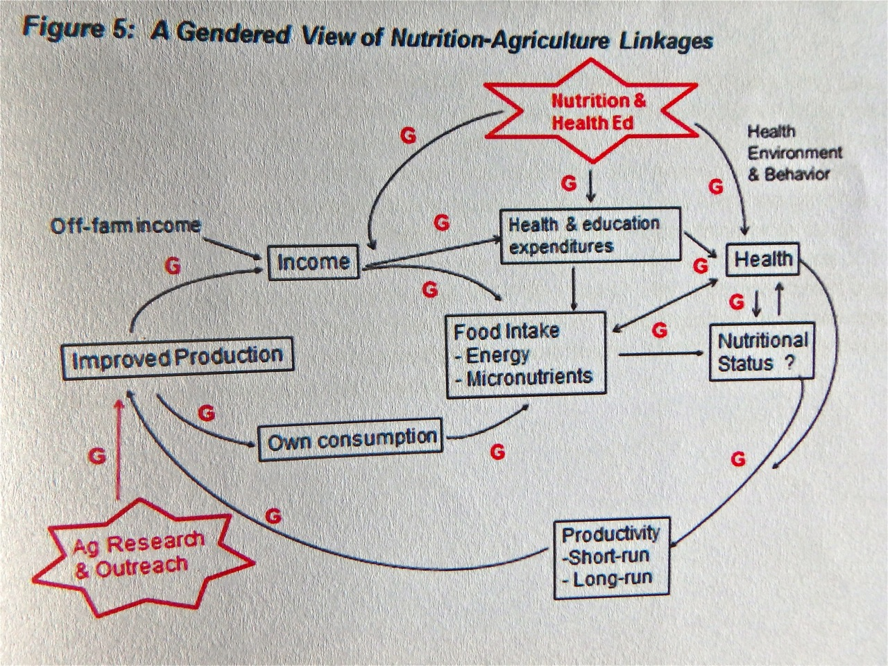
Agricultural-Nutritional Nexus but it is usually more complicated than that…
People sell fruits and vegetables to buy noodles and rice, for example.
Do men, women, or both drive
such decisions? Why?
Coconut News: there is a
perceived “Wealth
Status” associated with
buying imported foods.
Chung, K. 2012. An introduction to Nutrition-Agriculture Linkages. Research Report 72E. Ministry of Agriculture. Mozambique

Slide 7
Rapid Scan Goals & Sponsor
Review SIG Food Security, Food Safety, and Nutrition Policy
Who is doing what? Summarize current & recent projects and interventions.
Part of an international review process:
Technical Centre for Agricultural and Rural Cooperation (CTA) - a joint international institution of the African, Caribbean and Pacific (ACP) Group of States and the European Union (EU).
CTA Mission - to advance food and nutritional security, increase prosperity and encourage sound natural resource management in ACP countries.

Slide 8
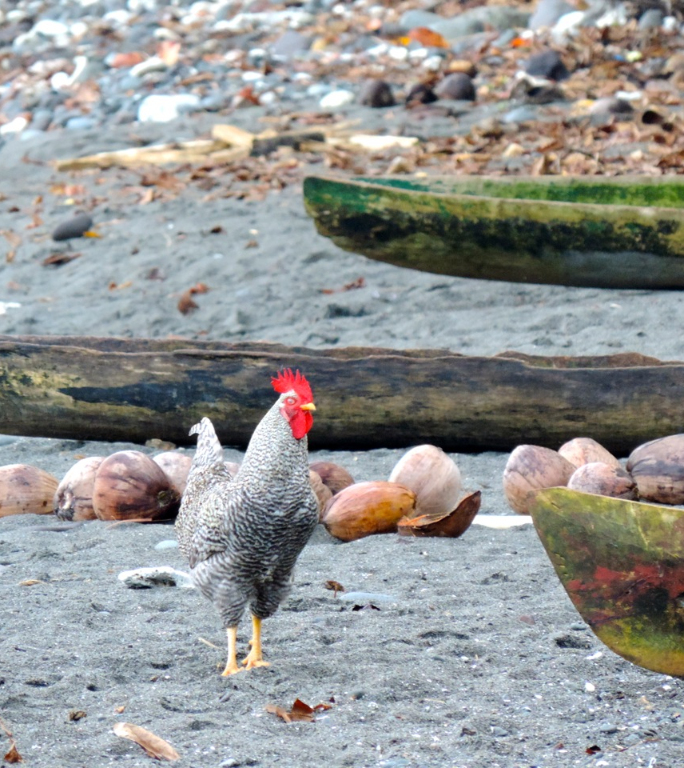
Some Guiding Questions
Are the targeted beneficiaries of food and nutritional security projects appropriate?
Are food and nutritional security projects linked to SIG policy?
Do food and nutritional security projects include monitoring and SMART* indicators?
Are funding levels appropriate?
* Specific Measurable Achievable Relevant Time-bound

Slide 9
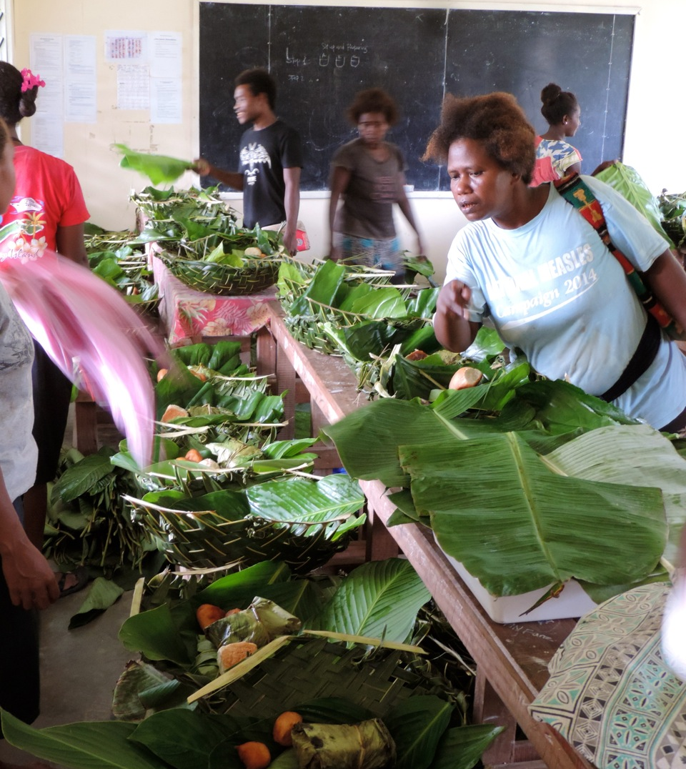
Methods
Identify key Ministries and NGOS in AG-NUT NEXUS
Design survey instrument (Appendix 1)
Conduct interviews and online research
Review policies
Summarize types of projects
Evaluate findings
Food sale “fundraiser” for high school in Ngela Islands

Slide 10
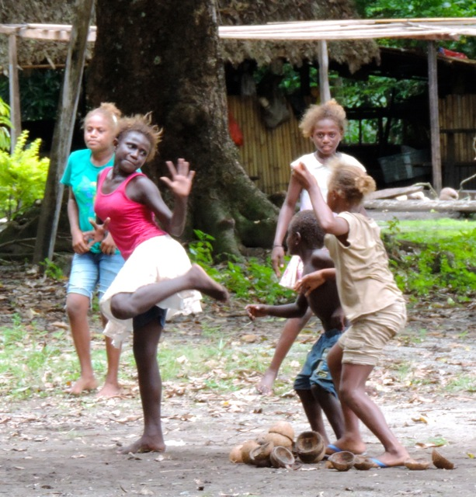
Results
SIG Policy (2010-2015): “Spot on”
1. Protect the health and nutritional status of Solomon Islanders with attention to reducing:
a. under-nutrition, stunting, and wasting in infants and young children.
b. anemia (iron-deficiency) in children and women.
c. overweight adults and children (mainly an urban issue).
d. non-communicable diseases (NCDs) in adults and children.
2. Promote and use sustainable agriculture and fisheries production for food security and economic development
3. Facilitate trade in safe and healthy food.
4. Increase capacity to respond in a timely manner to emergencies that adversely affect food security, food safety, and nutrition.
* MAL, MHHS, & MFMR mandated to work together to do these things.
Healthy kids with energy to play creatively

Slide 11
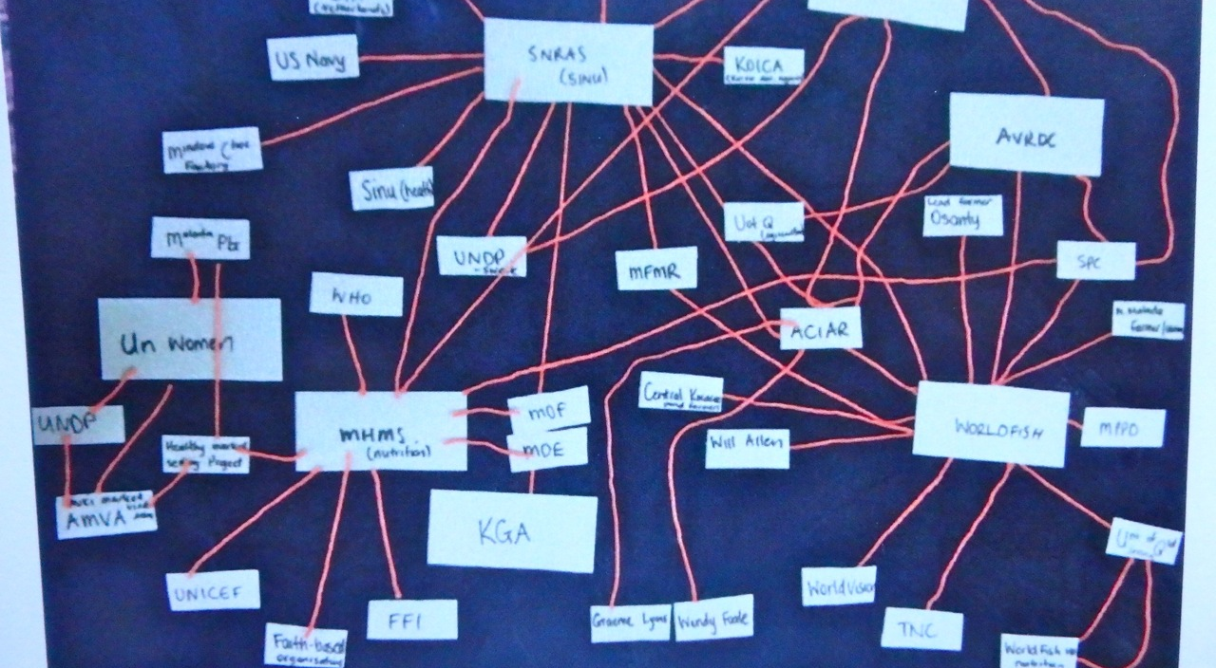
Organizational LINKAGES
KGA MAL WORLDFISH WORLDVISION AVRDC UNDP WHO MFMR OXFAM KOICA LIVE & LEARN MHMS SPC ACIAR WWF TNC CEMA UQ UNICEF VOIS BLO MERE SOL UN WOMEN SINU
Notes:
We interviewed the groups in Red, are and work with blue groups, investigated online or by pers. Comm. the others.

Slide 12
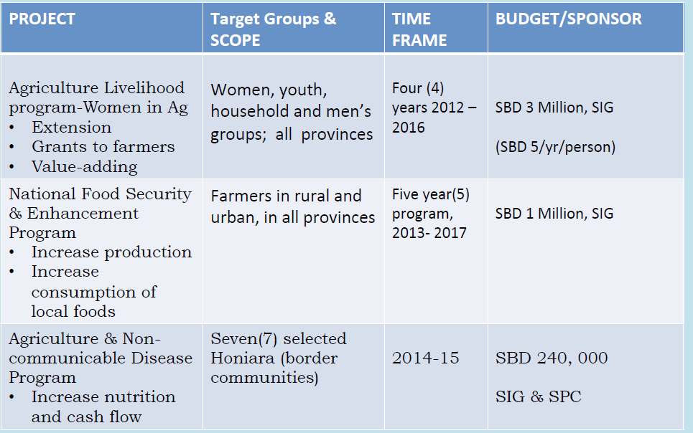
What is MAL doing?

Slide 13
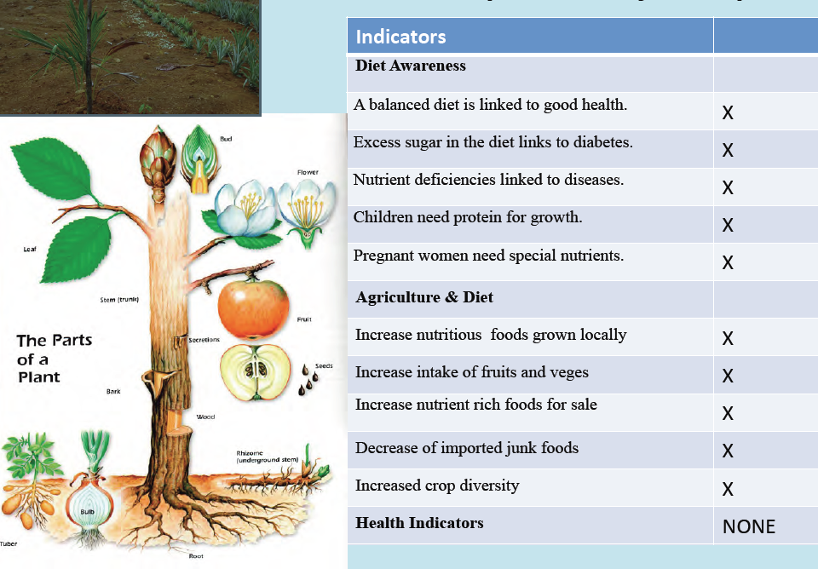
MAL –EXPECTED IMPACT

Slide 14
What is MHMS doing?
PROJECT | SCOPE | TIME FRAME | BUDGET/SPONSOR
Go Healthy Solo Kids | Eight HCC schools (Honiara) | Since 2014 & to expand | USD6-7000/yr, DFAT, SIG, SPC, ROC
IYCF & GA* | Children under 5 years and under | Past 6 yrs and to continue | USD25,000/yr/DFAT, SIG, UNICEF
Flour & Rice Fortification (Iron, folic acid & zinc) | Whole population, and anyone buying rice & wheat flour | 2015-16 | AUD300,000 project ter /DFAT, SIG, UNICEF
* Infant & Young Child Feeding; and Growth Assessment

Slide 15
MHMS Monitoring & Indicators
INDICATORS |  | INDICATORS
Diet Awareness |  | Health
A balanced diet is linked to good health. | X | Healthier weights (babies) | X
Excess sugar in the diet links to diabetes. |  | Healthier weights (children) | X
Nutrient deficiencies linked to diseases. | X | Healthier weights (adults) | X
Children need protein for growth. | X | Fewer diabetes cases | X
Pregnant women need special nutrients. |  | Declines of stunting | X
Agricultural |  | Declines of anemia | X
Increase in nutritious foods grown locally |  | Less illness cases | X
Increased intake of nutrient rich “protective” foods (fruits & veges) | X
Increase in nutrient rich foods for sale
Decrease in use of imported foods | X
Increased crop diversity
Notes:
Impact of interventions on diet awareness, agricultural practices that improve nutrition, and health indicators according to interviewees of NGOs and Ministries

Slide 16
Interviewed NGOs

Slide 17
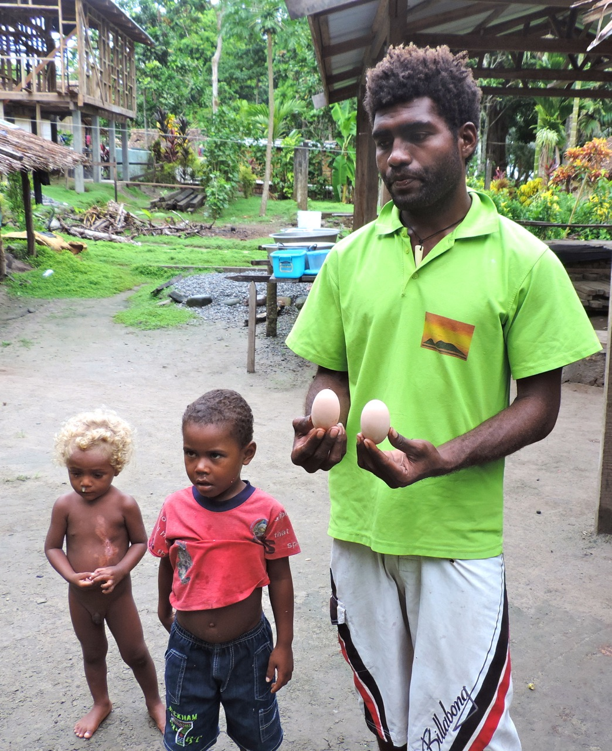
Monitoring & Indicators – Diet Awareness
Selling megapode eggs on Savo island.

Slide 18
Monitoring & Indicators – Agricultural

Slide 19
Monitoring & Indicators – Health

Slide 20
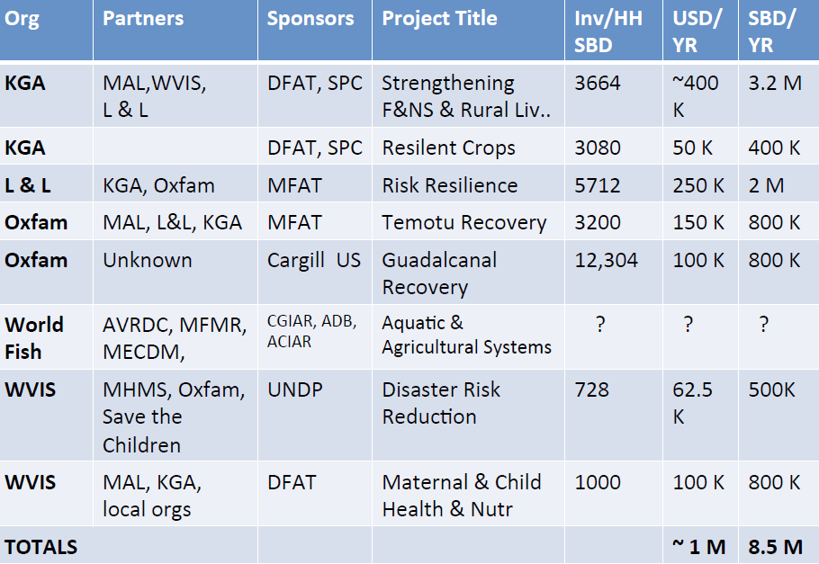
NGO Project Summaries

Slide 21
What is working well & what is not?
SIG Policy guidelines seem excellent.
Ministries and NGOs are working together.
Appropriate groups are targeted in projects.
SIG Funding seems low compared with NGOs.
Why?
Programs and Monitoring need to be more holistic
AG → Health response
Not enough people are reached.

Slide 22
Notes: NGO Rep Comments
Guadalcanal communities have been over-impacted by projects, are less engaged, more demanding, and driven to bargaining - “spoiled by donors”
“Agricultural materials and funds were often taken by men in the community and were not necessarily used for/by the target group”
“Sustaining community engagement, instability of community committee members, and island logistics also created challenges for the program.”
“Projects need to provide more outreach about agriculture directly to mothers.”

Slide 23
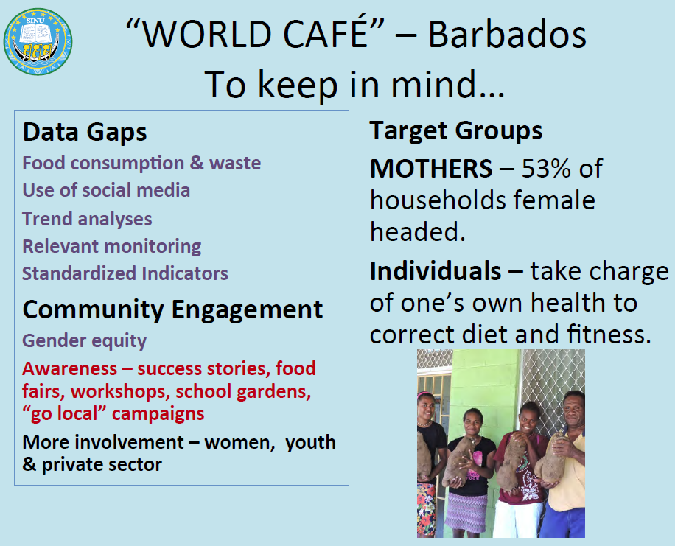

Slide 24
Tagio tumas

