Slide 1
PIPSO RoundTable Workshop
27 – 28 September 2017
MINISTRY OF AGRICULTURE
AND LIVESTOCK
“Modernising the Agriculture Sector and addressing Nutrition, NCDs, and Food Security”

Slide 2
Presentation
Intro
Agriculture & Food Security
Agriculture & livelihoods
Agriculture: Challenges & vulnerabilities
Agriculture: Opportunities for agribusiness
Organisational restructuring
Hem nomoa

Slide 3
Introduction
Growing Agriculture –
The country just celebrated two significant events, which to some extent had some bearing on the contributions made by the agriculture sector to the economy. RAMSI had been with us for the last fourteen years providing the sense of security and bringing back law and order, and creating an environment, which enabled the sector to recover and flourish after the devastating conflict. But mind you, agriculture was quite resilient during this period, and especially the subsistence sector for food security and the smallholder sector, which continue to function enabling cocoa and copra exports to take place despite the difficult circumstances.
The current focus of the Agriculture Sector is two pronged. One deals with food security and supporting a vibrant subsistence sector. The other focuses on economic activities including commodities development for exports, export base expansion, import substitution, and facilitation of regulatory mechanisms for export and market access.

Slide 4
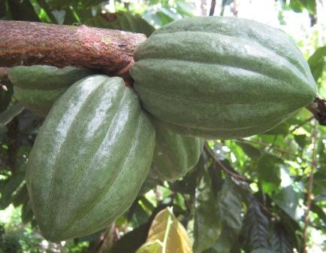
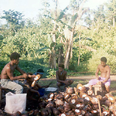
PRE INDEPENDENCE –
Coconut plantations occupied most of the flat agricultural lands in the country since 1800s. Coconut plantations were established by Planters in Western Province, Malaita, Isabel, Central, and Makira/Ulawa Province. The Planters were producing copra to grow the Commonwealth then. As it were, 1,000 years leases were made with the Colonial Administration. Copra and cocoa became the main primary export commodities.
A little later palm oil became the third agriculture product to be exported from British Solomon Islands Protectorate.

Slide 5
POST INDEPENDENCE
After Independence, these plantations were given back to government. Government in turn handed the plantations to the “original” landowning groups to develop, under the Land Purchase Cooperatives scheme. Unfortunately, this scheme fail to perform as expected and all fail in the end. The sad thing is that all these former plantations are abandoned and not maintained. Government has since sought Partners to revitalise these resources. Over the last thirty years, copra, cocoa, and palm oil remains the main primary products exported. Some downstream processing has taken place in the coconut industry where coconut oil and virgin coconut oil are now part of the value-chain.
Niche markets for cocoa secured.
The products for export have increased:
        Copra
        Coconut oil
        Coconut cake
        Virgin coconut oil
        Cocoa beans
        Crude Palm Oil
        Palm Kernel/ kernel oil
        Kernel cake
        Root crops - cassava
        Nuts
        Kava

Slide 6
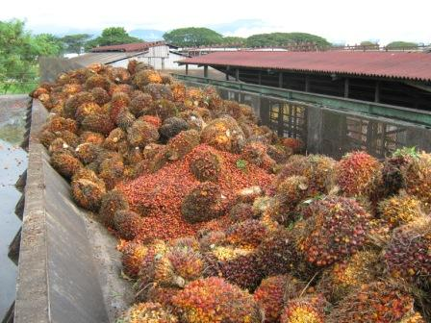
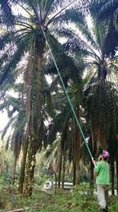
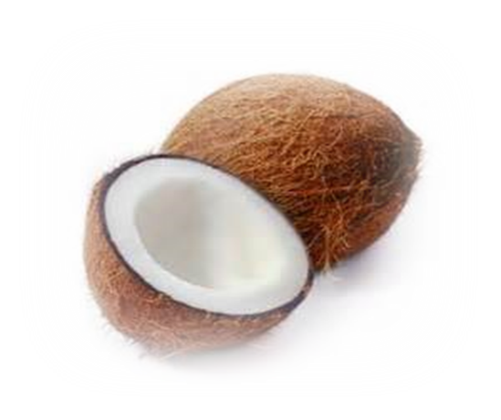
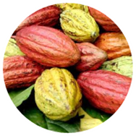
Over the last decade or more, partnerships had been forged in order to develop the agriculture sector.
Kokonut Pacific SI, Solomon Tropical Products, C-Corp Ltd, Solomon Islands Copra Exporters, and others continue to partner with Solomon Islands farmers to continue growing the Agriculture sector. There are potential opportunities out there in plantations development, downstream processing, value-adding, and so on.
Programmes such as RDP and PHAMA made a lot of difference in production and market access.
The other sub-sector which had not had much private investment is the horticulture industry, the livestock, and food processing.

Slide 7
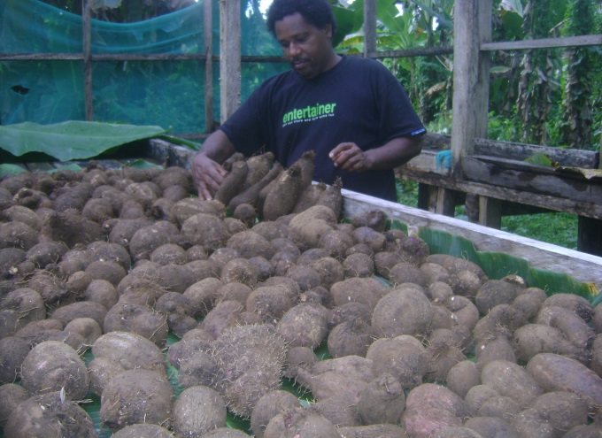
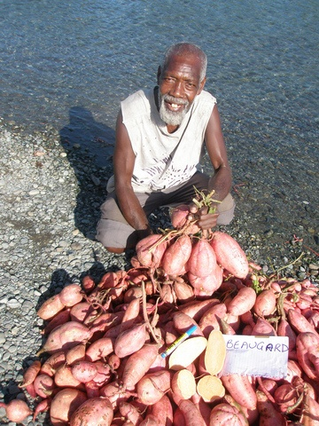
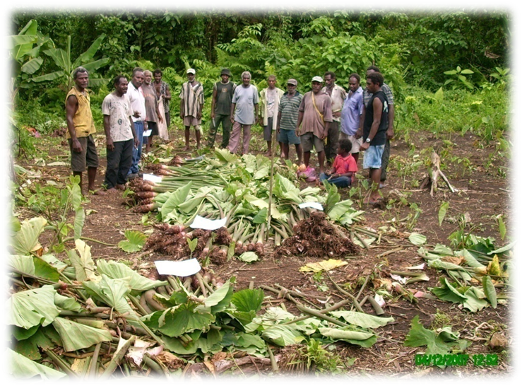
Growing Agriculture & Food Security
Food security and supporting a vibrant subsistence sector:
  Ministry provides Direct assistance to farmers, schools and Associations to deal with food security challenges
  Improved planting material and technologies tested and recommended to farmers.

Slide 8
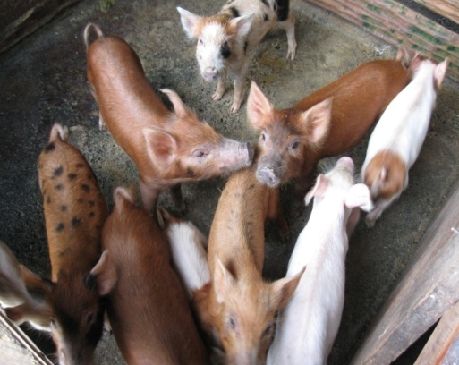

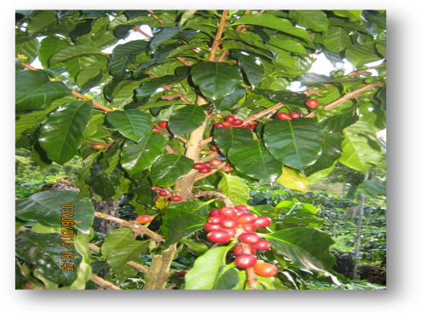
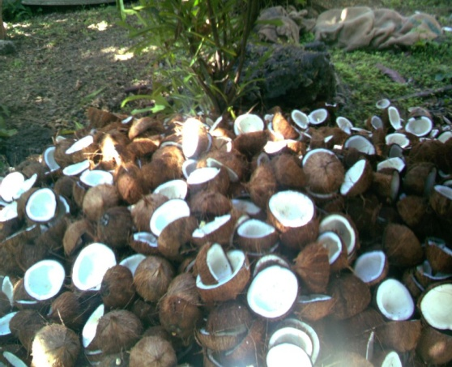
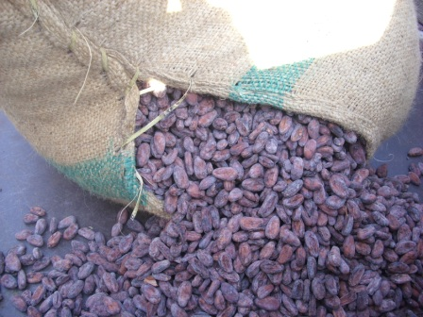
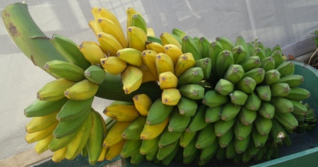
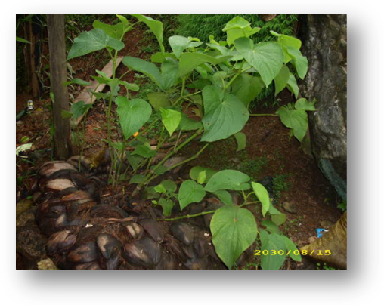
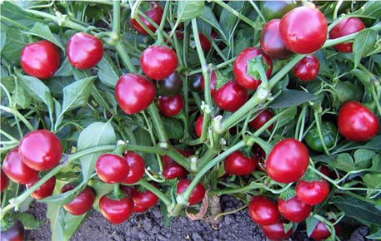
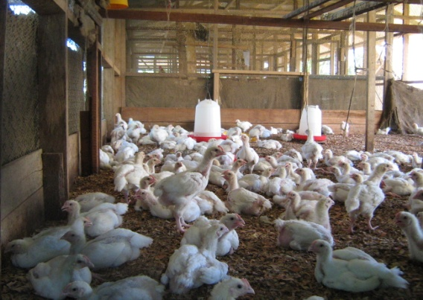
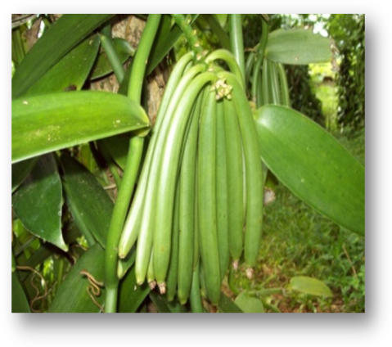
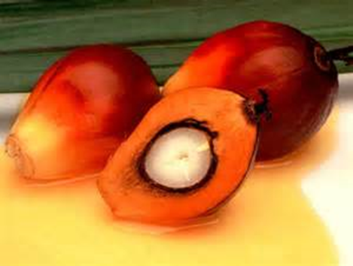
Growing Agriculture & Livelihoods
DOs & DON’Ts
FLORICULTURE
PIGS
Dos: The Ministry under its ongoing programmes supports the development of these sub-sectors:
COCONUT
COFFEE
COCOA
FRUITS
VANILLA
KAVA
POULTRY
OIL PALM
CHILLI

Slide 9
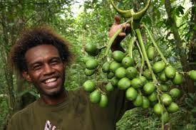
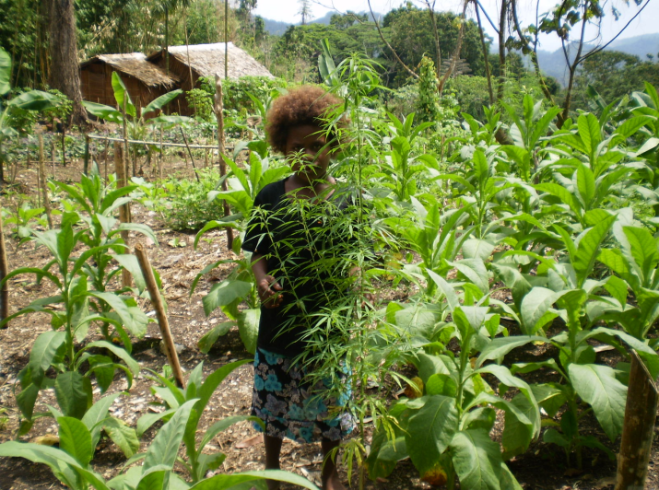
Growing Agriculture & Livelihoods
DOs & DON’Ts
DON’TS: - For health reasons these crops are not encouraged to be grown:
Beetlenut
- Tobacco
- Marujuana

Slide 10
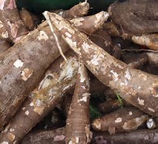
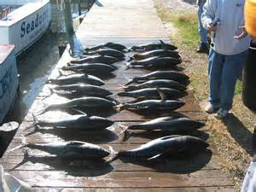
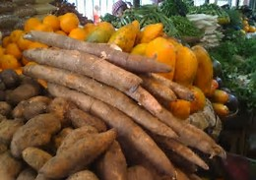
Agriculture: nutrition and NCDs
Nasinol Lokol Kaikai Framework- Policy framework
National Food Security, Food Safety, and Nutrition policy
Kaikaim Lokol Kaikai Billboards
Famas Kona Radio programme
Partnering to address nutrition and NCDs- SIG, NGOs, DPartners
Fruits and vegetables development- TTM
Small Livestock development Policy

Slide 11
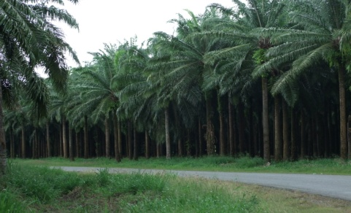
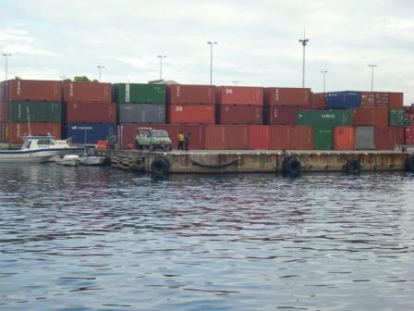
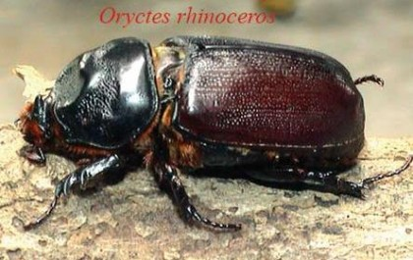
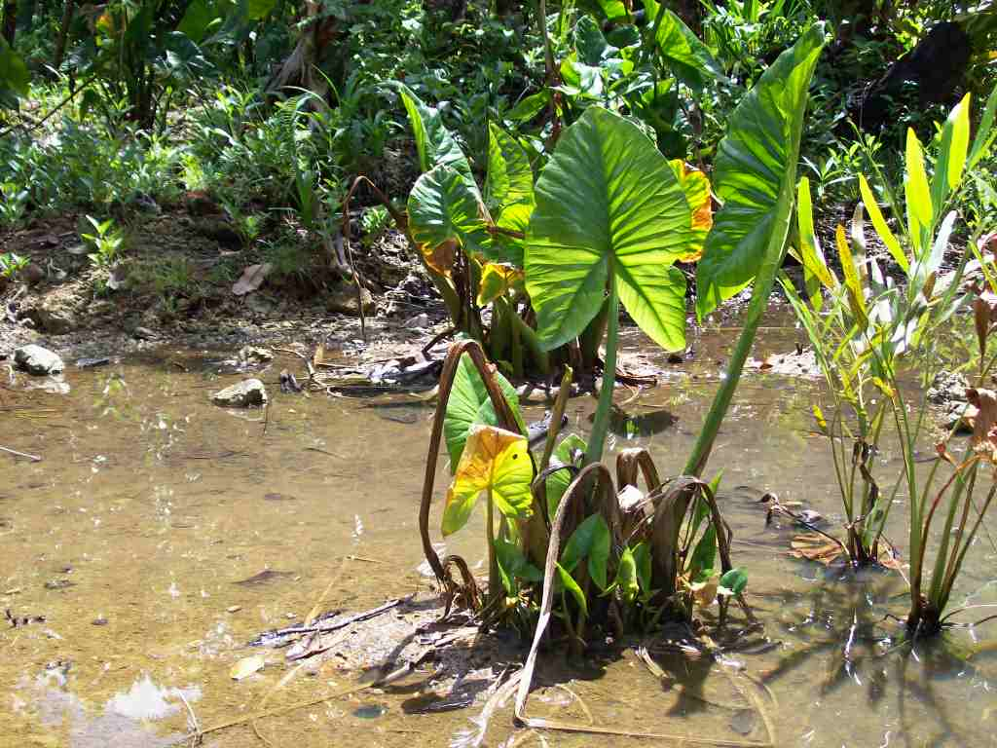


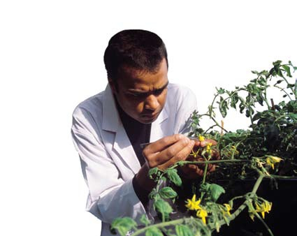
Challenges & Vulnerabilities
Climate change
Invasive pests
Natural disasters
Price fluctuations
Land tenure
Lack of credit
Lack of critical infrastructure
Lack of research infrastructure

Slide 12
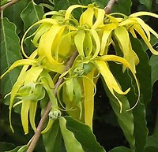
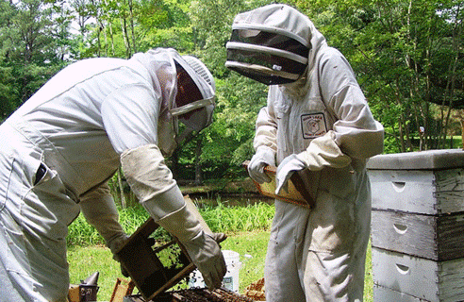
Opportunities for agribusiness
Agri-tourism
Organic by default
Innovations –
  Teak ‘n’ Coffee – Farming systems
  Farm registration –customary land
  Value-adding
  Downstream processing
  Marketing
  Export – fresh produce

Slide 13
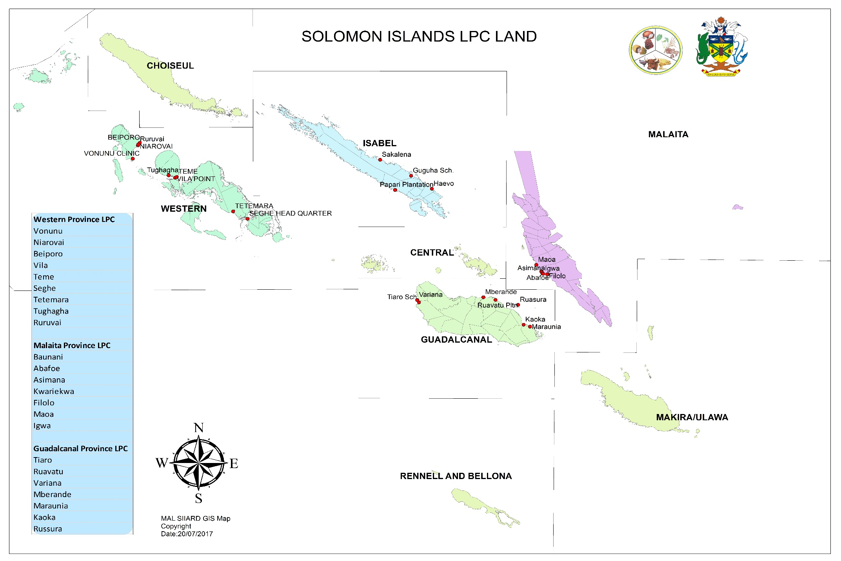
Opportunities for agribusiness
 | PROVINCE | No. of LPCs
1 | Guadalcanal | 7
2 | Malaita | 7
3 | Isabel | 7
4 | Western | 12
5 | Choiseul | 2
 | Total | 35

Slide 14
Opportunities for agribusiness
AGRICULTURE OPPORTUNITY AREAS (AOAs) OF SOLOMON ISLANDS
PROVINCE | Area in sq. km | Potential ranking | % of total AOA
Guadalcanal | 746 | 1-6 | 21.4
Central | 42 | 1 | 1.5
Isabel | 90 | 1-3 | 2.3
Malaita | 536 | 1-3 | 15
Western | 1,398 | 1-5 | 52.2
Makira/ Ulawa | 200 | 1-3 | 6.5
Temotu | 138 | 1 | 4.0
Choiseul | 153 | 1-4 | 4.4
Total | 3,438 sq. km

Slide 15
ORGANISATIONAL RESTRUCTURING
“Strengthened Services through Industry and Market Linkages”
Industry and market focus
Pave the way for improved working relations with the private sector
Improve the efficiency and effectiveness of MAL
The management role strengthened to achieve ongoing service improvement, maximum quality and effectiveness, and improved efficiency as in the private sector

Slide 16
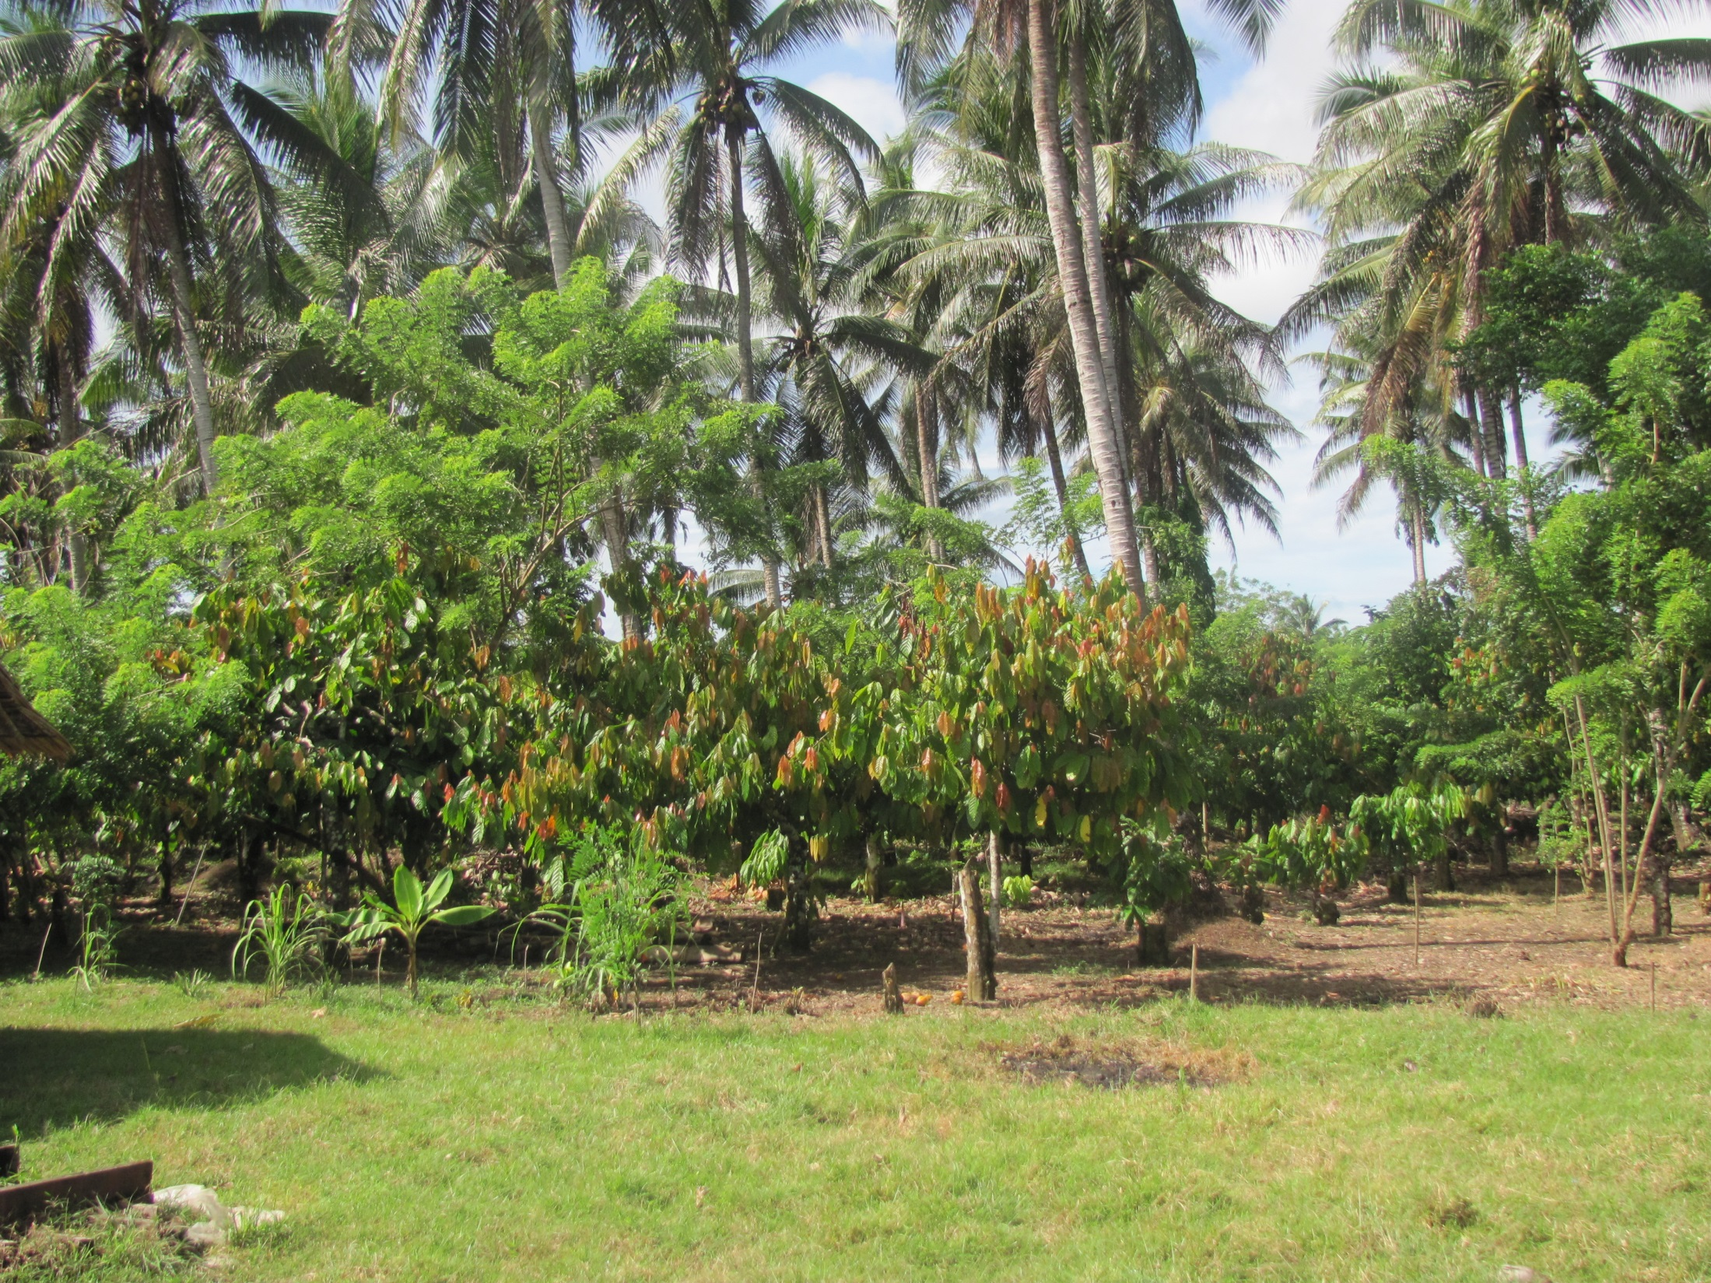
Thank you
That’s it – Hem nomoa

