Slide 1

Regional Support to Build Capacity of Value Addition of Products and Food Certifications
Apiame Cegumalua
Project Manager
HACCP Aust. Fiji Ltd

Slide 2
TOPICS
1.0 Introduction
2.0 Build Capacity of Value Additions of Products
3.0 Build capacity on Food Certifications

Slide 3


1.0 Introductions
What we promote to tourists - our unspoilt paradise !

Slide 4


White sandy beaches and friendly island smiles

Slide 5
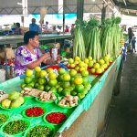
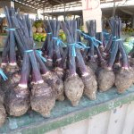
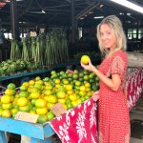
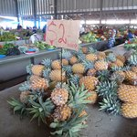
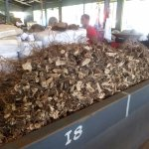

The greatest opportunity to taste our nutritious Pacific food? :
-
Visitors should be encouraged to experience
the local foods, fruits, introduced to local
cuisine and experience the island food
preparation

Slide 6
1.1 Tourism and Agriculture
are two critical industries in many Pacific economies
provide and increase new income opportunities:
- growth for the value chain actors serving the tourism markets.
- increase domestic agriculture earnings
- for new markets and product development
- to develop visitor attractions,
- marketing of local produce and production techniques
- create new use which lead to distinctive tourism destination brands,
Strengthening the linkages between the two industries results in sustainable economic growth
Notes:
- offers opportunities to develop visitor attractions, and distinctive tourism destination brands, through the creative use and marketing of local produce and production techniques

Slide 7
AGRI TOURISM IN THE PACIFIC
Covers a wide variety of :
- recreational, educational and
- other leisure activities and services
provided by farmers/or entrepreneurs and experienced by consumers who value the activity or service they receive and seek it out.
The three general classifications of agritourism activities:
i) on-farm – e.g. Vees Organic Farm (Fiji)
ii) food-based – e.g. FRIENDS / Community or villages (Fiji)
iii) and heritage activities e.g. Levuka in Fiji
Notes:
Will concentrate on the first two : On farm and food based agritourism

Slide 8
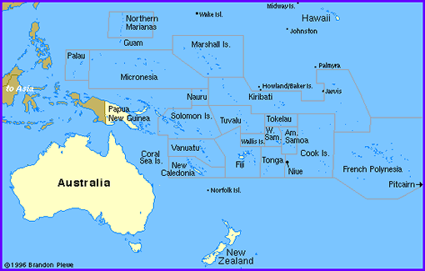
2.0 Build Capacity for Value additions
Influenced by: Customer demand | Environmental factors | Available technology
The Need
- remote location
- increase dependence on imported
food commodities
- poor shipping services
- seasonality –high losses
- poor post harvest practices
- import substitution -
- lack of appropriate packaging,
materials and storage facilities
- market demand and prices
- insufficient knowledge and awareness

Slide 9
Build Capacity for Value additions
Abundance of Fruits , vegetables, seafood and our root and tuber crops is a major sources of energy in the developing countries
- to contribute significantly to the increased income generation and
nutritional well being
Need to identify and promote high quality food for consumption through value adding
Promoting nutritious food to hotels, lodges and resorts and the sourcing of this crop from local producers and processors can generate greater investment in local production and substantial gains .
Notes:
Increase high quality for tourists but with increasing NCSDs as well in our country
Promoting nutritious food to hotels, lodges and resorts, to homes and schools as well not only promoting good health and reducing NCDs but also the sourcing of this crop from a bigger part of local producers and processors can generate substantial gains and generate greater investment in local production.
Promoting nutritious food to hotels, lodges and resorts, not only promoting good health and reducing NCDs but also the sourcing of this crop from a bigger part of local producers and processors can generate substantial gains and generate greater investment in local production.
The root and tuber crops : utmost importance for the world food security
major sources of energy in the developing countries the staple food for hundreds of millions of people.
these crops are expected to contribute significantly to the increased income generation and nutritional well being of people in the next decades.
There are many opportunities to improve traditional uses of root crops and introduce it into a wide range of new food particularly in the rapidly urbanizing societies of the developing countries

Slide 10
2.1 Value Additions of Products
Opportunities : to improve traditional uses of our food crops and introduce it into a wide range of new food lines
BUT Our Tropical climate and poor harvesting methods and transportation does
not support longer storage life after harvest.
Alternatives : a) developing Cold Storage chain facilities – expensive
b) - Preservation
Notes:
Opportunities to improve traditional uses of our food crops and introduce it into a wide range of new food particularly in the rapidly urbanizing societies of the developing countries
Our Tropical climate does not support longer storage life of these crops.
Preserves them by slowing down the natural processes of decay caused by microorganisms, enzymes in the roots, or other factors such as heat, moisture and sunlight.
Changes them into other form of foods that are shelf table, tasty, attractive and add variety to the diet. Processors can use their skills to develop safe, attractive products that consumers want to eat. By doing this successfully, they are able to earn an income.

Slide 11
Value additions of Products
Preservation methods : slows down the natural processes of decay caused by microorganisms, enzymes in the food, or other factors such as heat, moisture and sunlight food exposed to.
Adding value - changes the fresh produce into other form of foods that are shelf table, tasty, attractive, light and add variety to the diet.
Processors can use their skills to develop safe, attractive products that consumers want to eat and earn income.

Slide 12

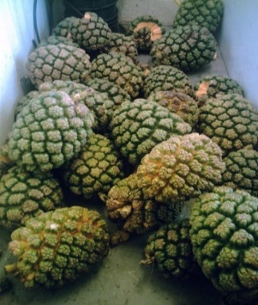
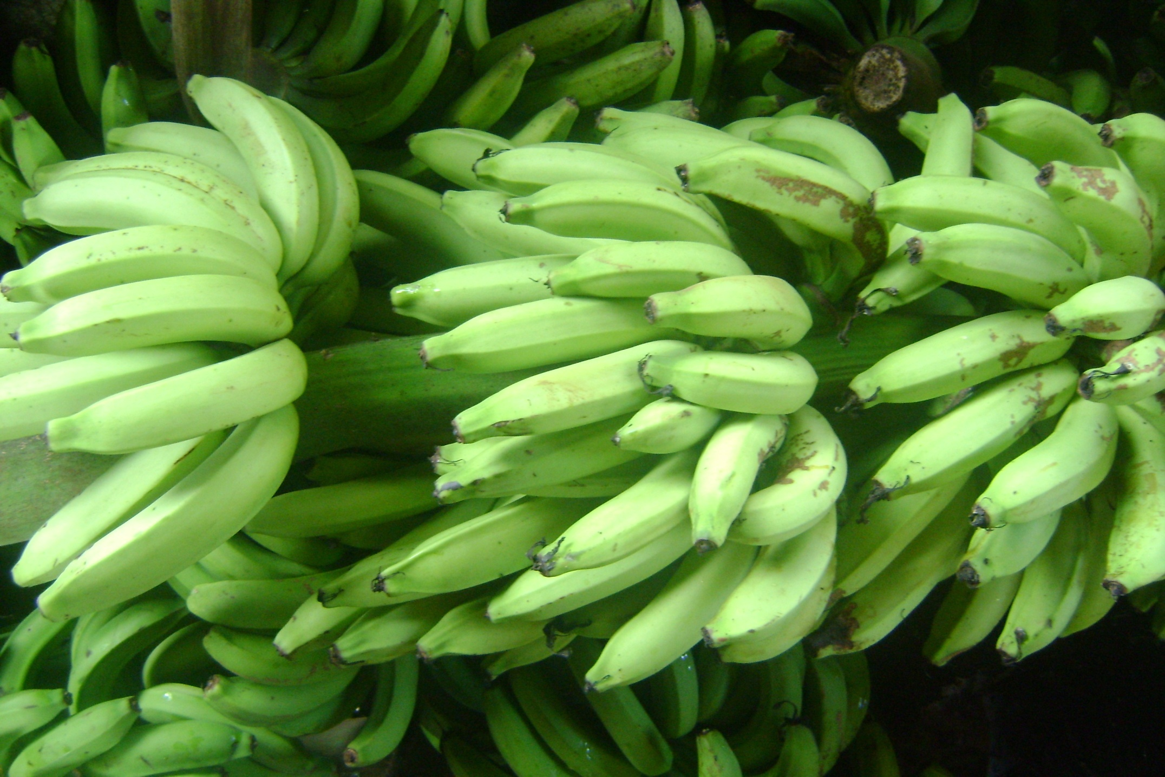
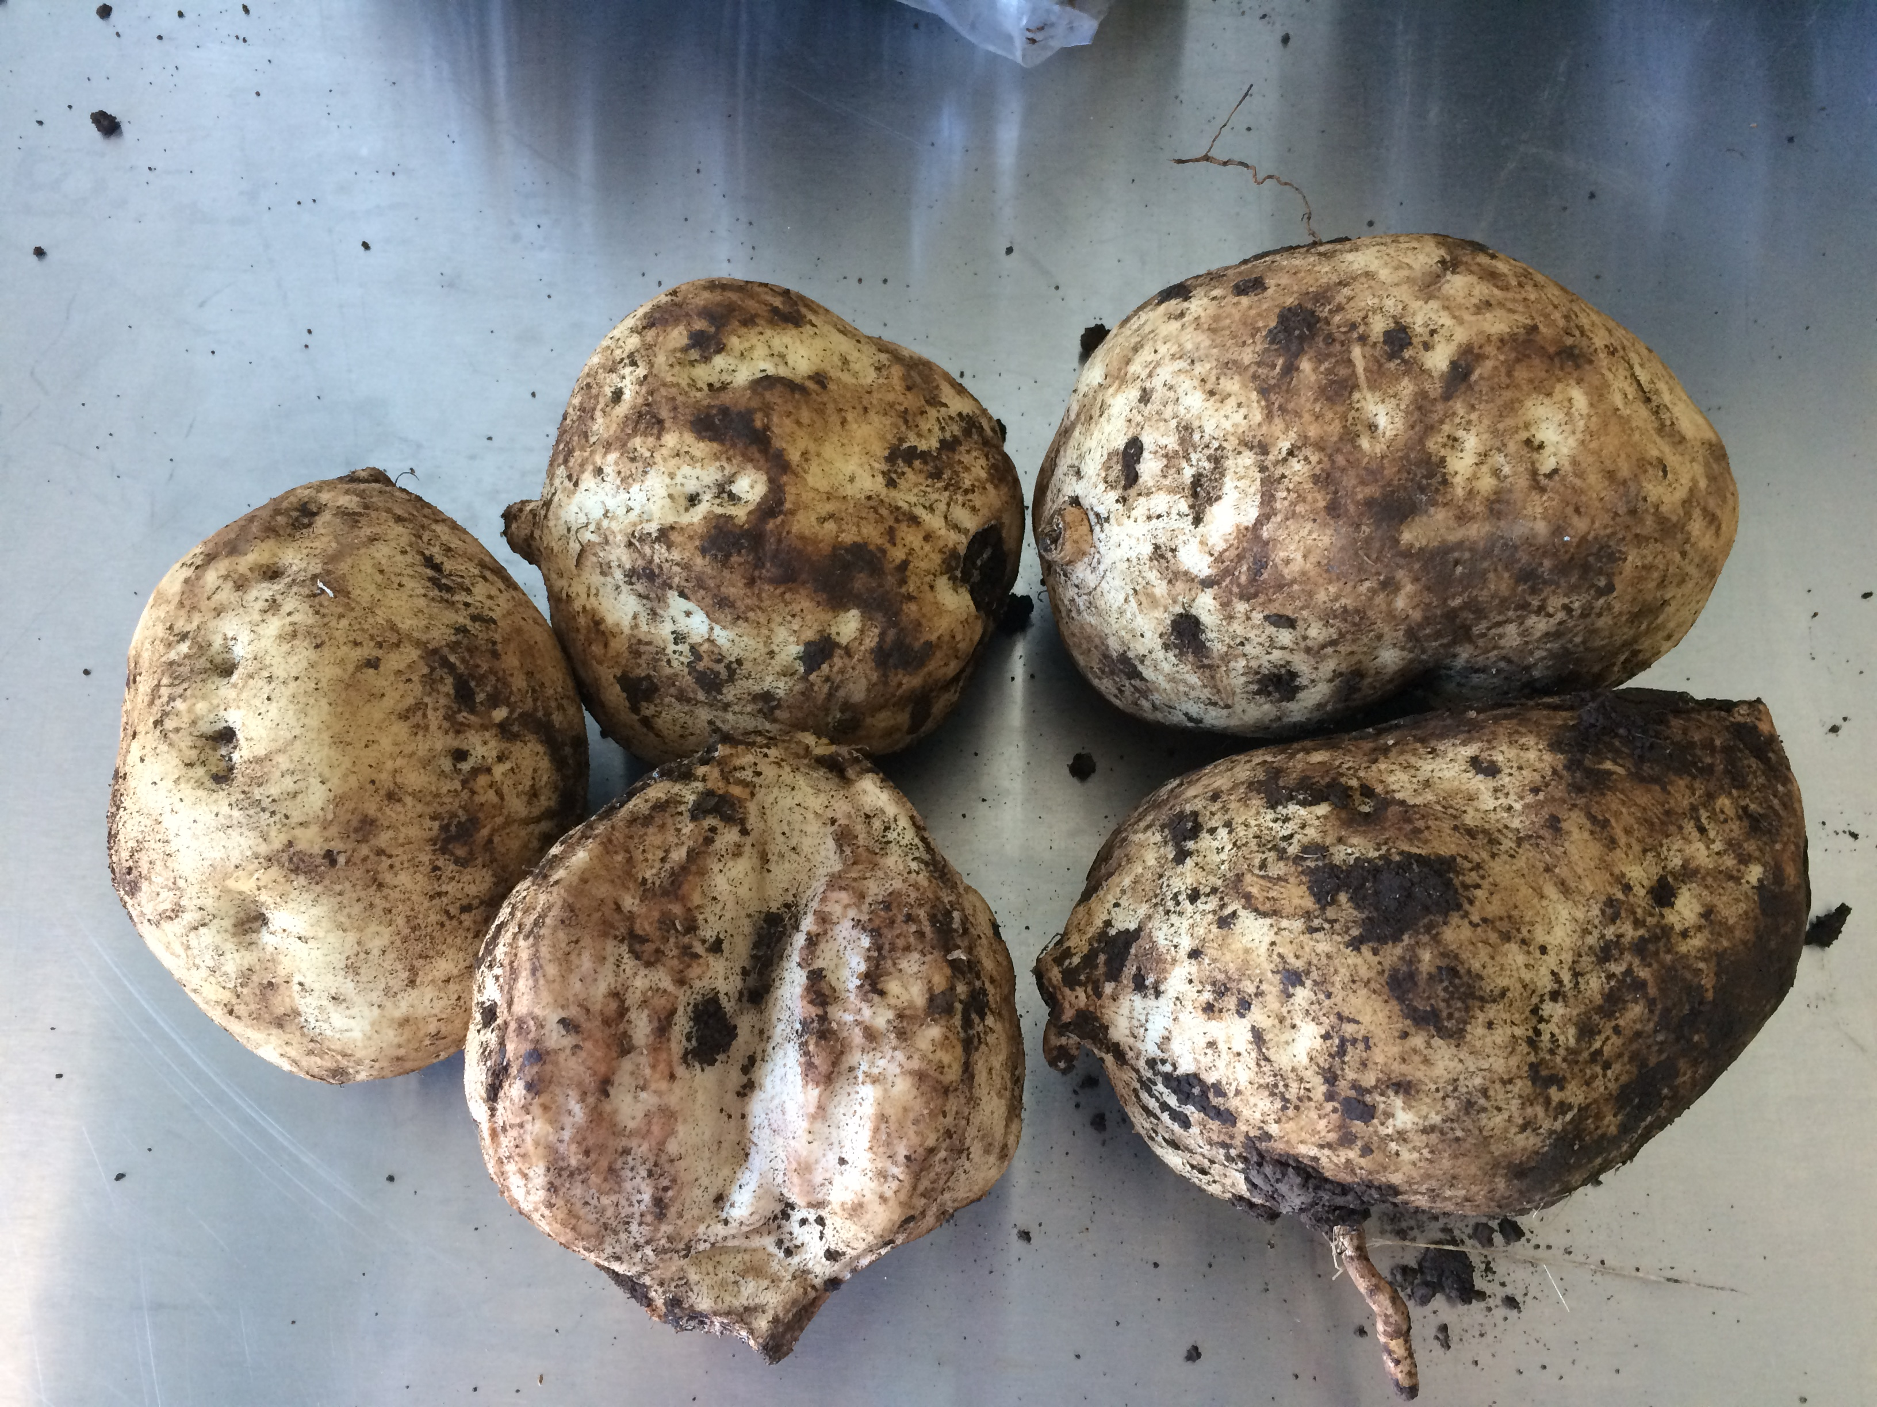
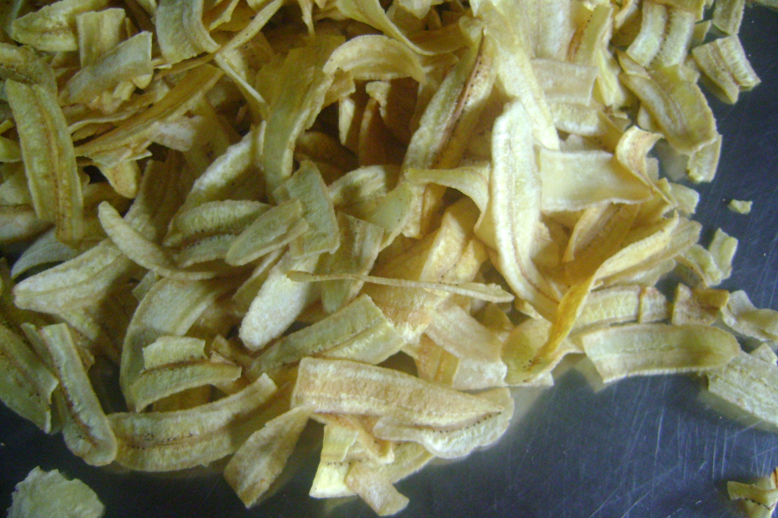
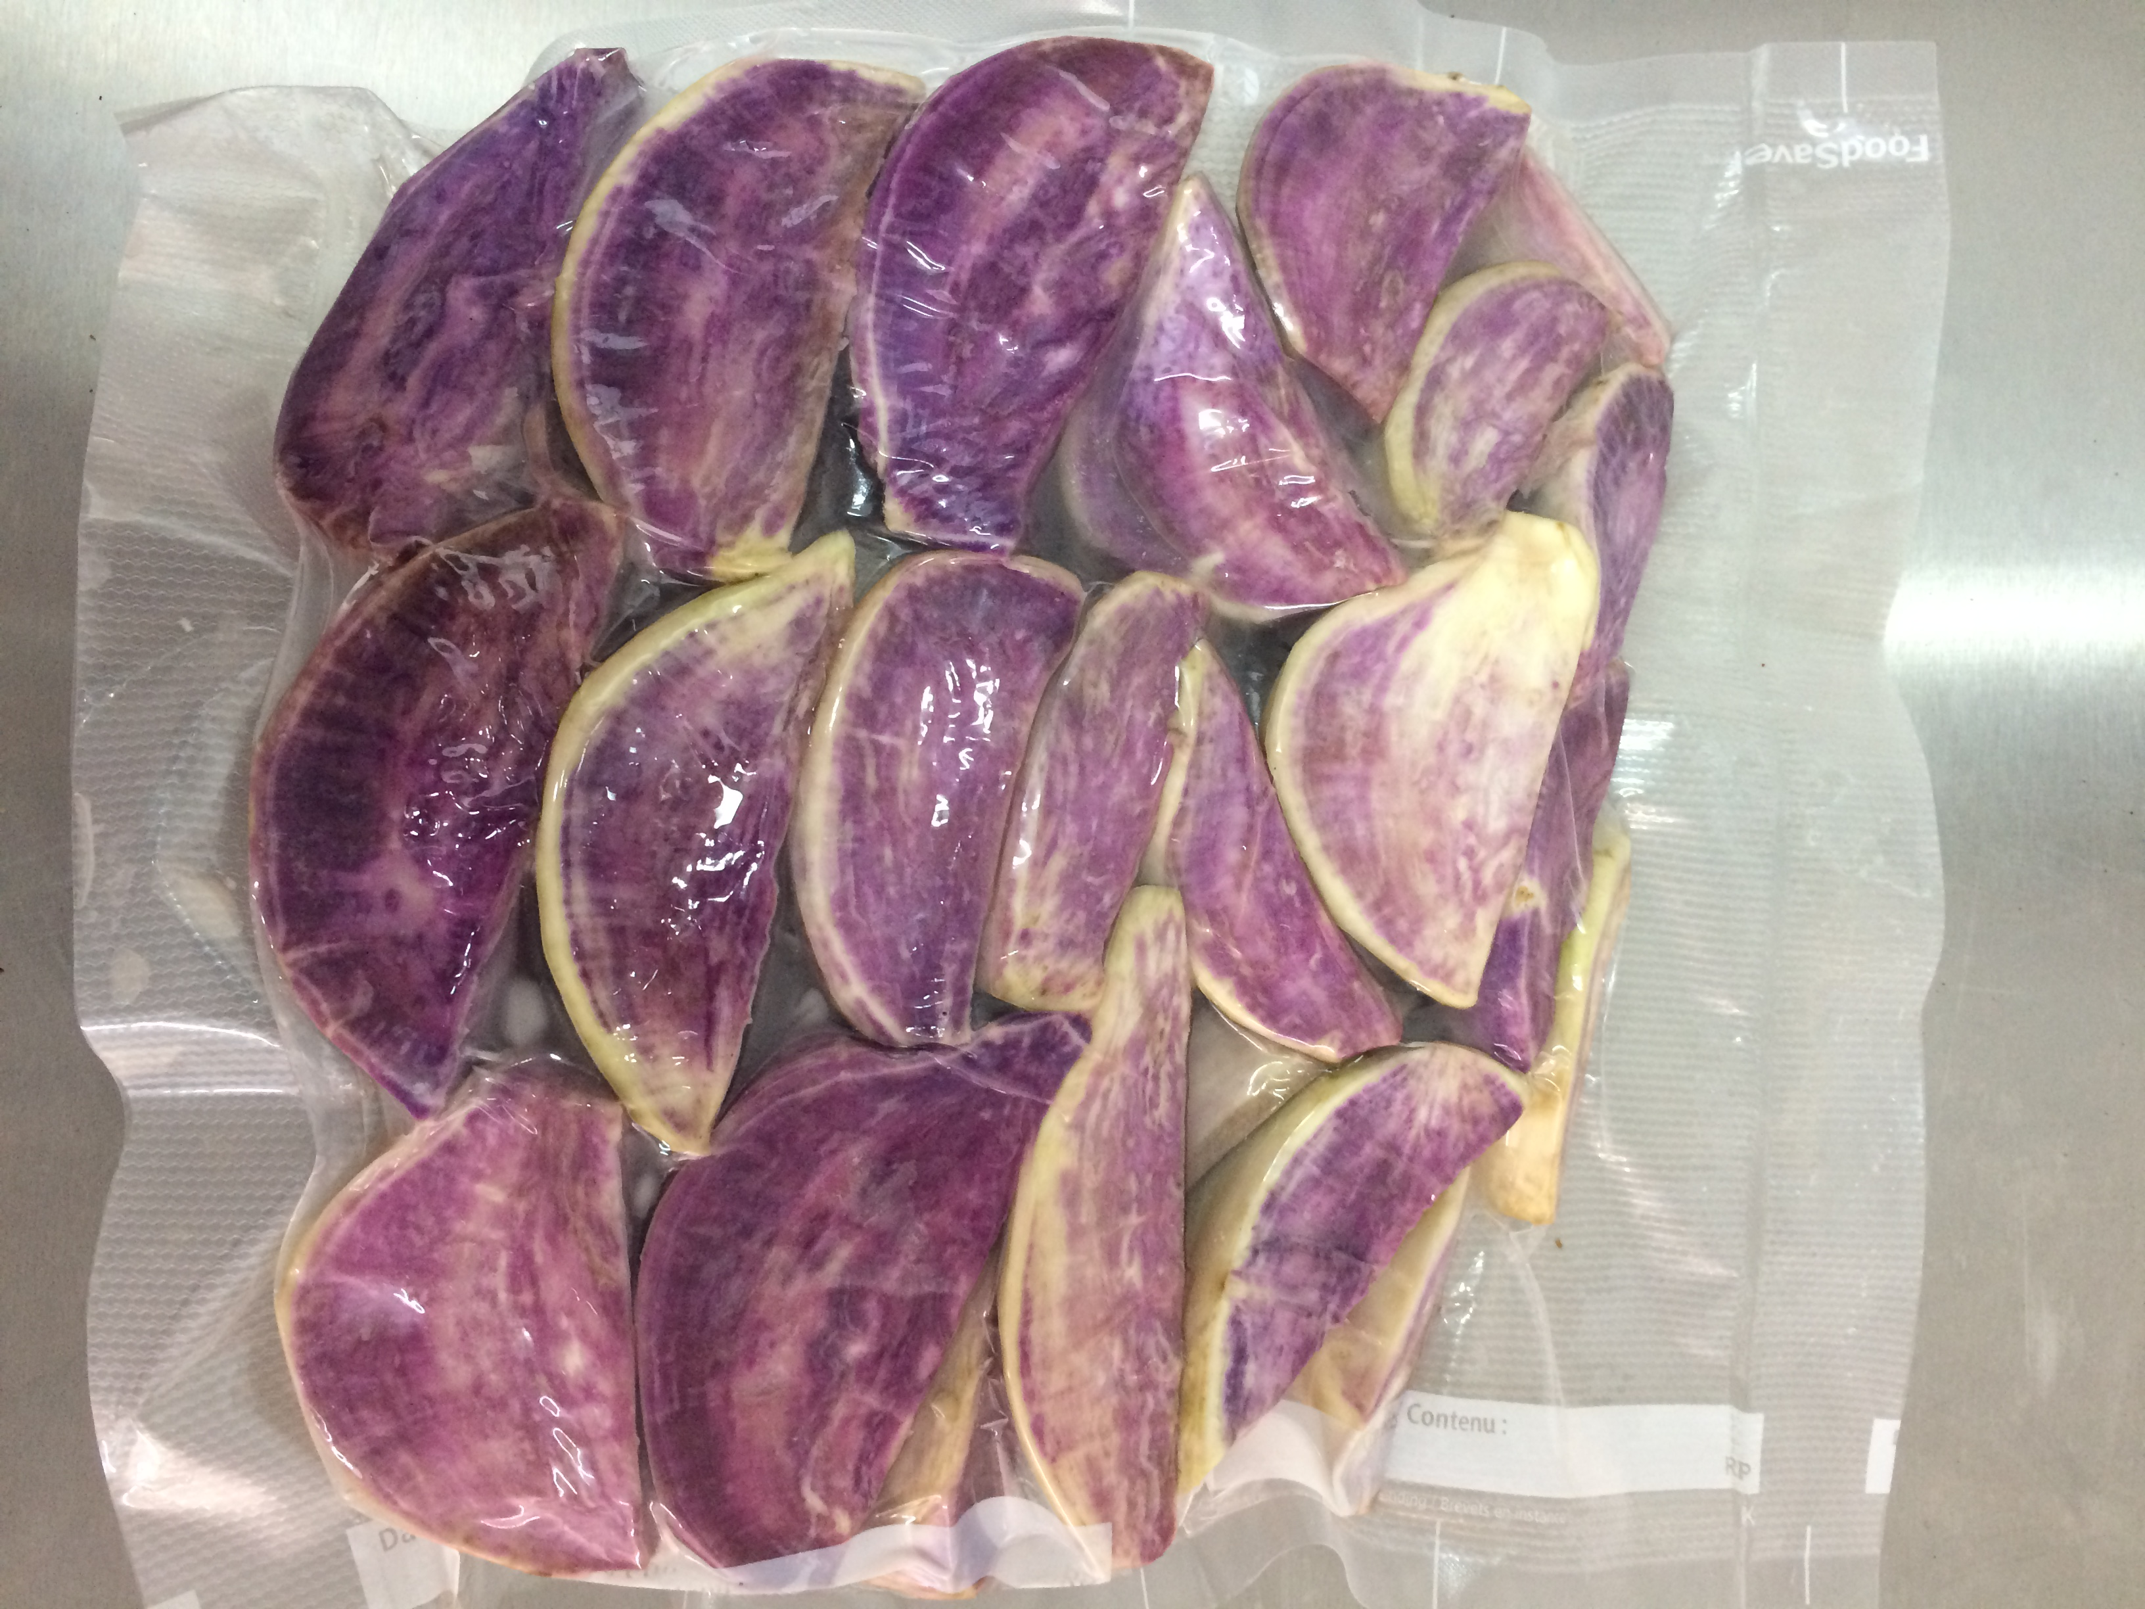
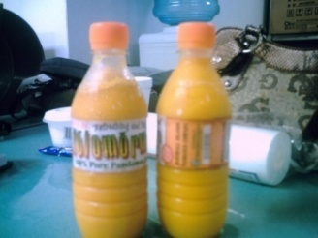
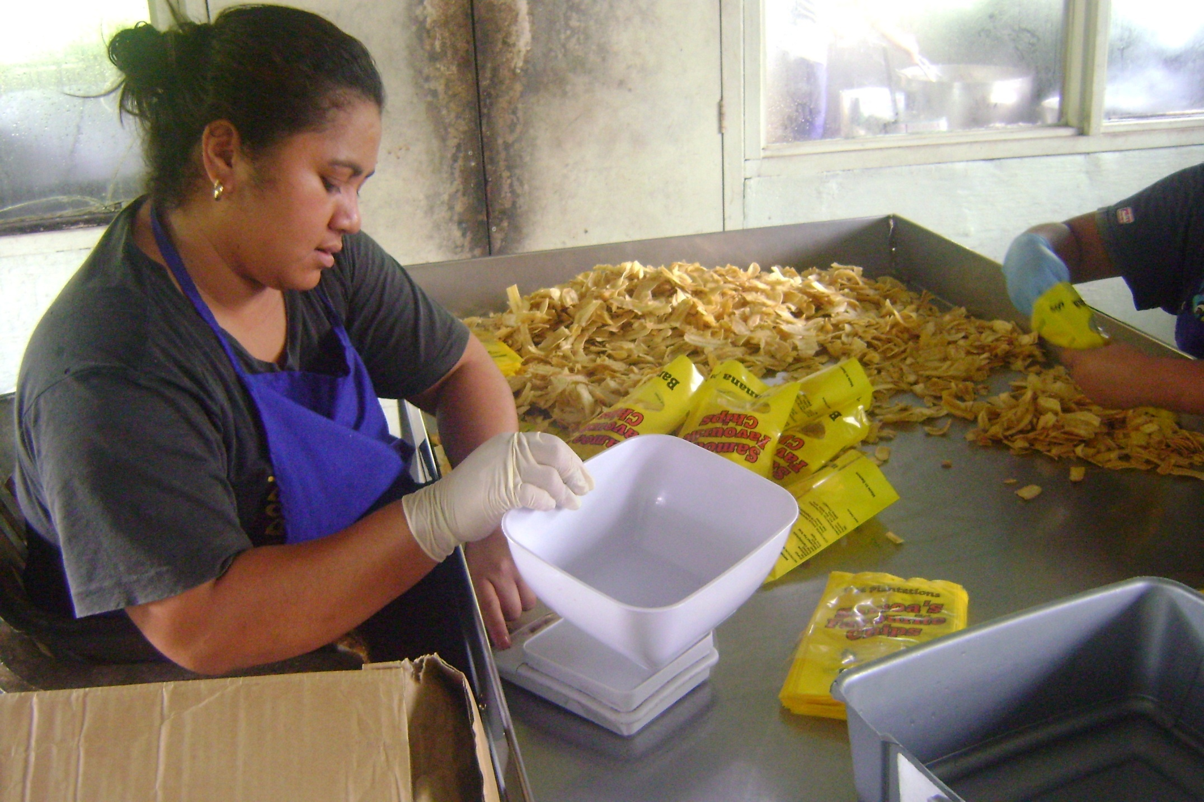
Product opportunities
A)
B)
C)

Slide 13
Value Additions od food products
Need for processing or preservation - to maintain the supply during the year and in particular to preserve for periods when supplies are low.
The challenges of shifting food habits and sourcing from local suppliers need to be addressed in a way that meets commercial needs and customer preferences and ensure compliance with food and safety requirement
Notes:
The main types of root crops and tubers in Pacific countries are cassava and taro , yam and kumala . Processing these root crops and tubers is intended to do two things:
Preserves them by slowing down the natural processes of decay caused by microorganisms, enzymes in the roots, or other factors such as heat, moisture and sunlight.
Changes them into other form of foods that are shelf table, tasty, attractive and add variety to the diet. Processors can use their skills to develop safe, attractive products that consumers want to eat. By doing this successfully, they are able to earn an income.
Products that can be produced from Kumala are : Snacks or chips, Fries, Flour, frozen pieces, jam , ice cream flavours, etc

Slide 14
3.0 Building Capacity on Food Certification
Agritourism offers new opportunities to diversify and increase income.
“ BUT “
the opportunities for the farm also “introduces new risks and legal obligations”
The safety risks must be “identified and properly managed” in order to
minimize the potential for injuries, illnesses and financial losses.
Agritourism enterprises must provide “safe food” and “healthy environment “ for customers and employees

Slide 15
Tourist market demands
With increase number of tourist visitors:
Maintaining consistency of supply is required
There is an increase on:
a) emphasis of quality and Safe Food Production
b) the Responsibilities of farmers and agritourism operators to produce safe food.

Slide 16
Food safety Incidents
A. Food Poisoning Incidences in Fiji
    Feb 28, 2018
  A) Romantic Fiji holiday turns sour for Aussie couple
  https://www.news.com.au/travel /fiji
B) Food poisoning day 1, robbed days 6.. All in all a wonderful trip.
  19 July 2010 – Hilton Fiji Beach Resort & Spa
  My wife and I plus our two kids came here after going to the intercontinental last year. Hoping for a better experience we decided to give this place
C. Food Poisoning in Other countries other than Fiji
Death-dealing meat: Food poisoning by bloody chicken
  DR SUSHIL K SHARMA
  7 August, 2018, 12:12 pm
  ttps://www.news.com.au/travel/...fiji.../173db0b7d437e103be6881a264555

Slide 17

3.1 The Law : Employer’s Responsibilities
Must be aware of our country’s food legislation
Management and owners must be aware of
Food Safety Regulations
The Food Safety Act
HACCP Codex Standards
Local Regulations
Industry Standard.

Slide 18
Legislation
Produce/ Food Must be Safely Produced
Skills in Food Hygiene
Food Safety Systems - HACCP based.
Good Hygiene practices to be established and followed
Standards to be followed.

Slide 19
Legislation Key concepts
To produce food safely:
Premises must be clean and cleanable
Premises must be free of Pests
Manufacturing processes must be under control
Equipment must operate appropriately
Transportation and packaging used must be clean
Cross contamination potential must be eliminated.

Slide 20
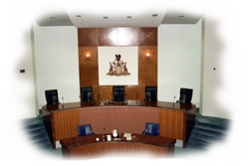
Key Legal Responsibilities -– The Employee
Two Main Areas :
Due Diligence: - DOING THE RIGHT THING
Doing something or allowing something to happen to the food that may harm someone is a criminal offence and prosecutable under the law.
Food Borne Illness- You are not allowed to work as a food handler if you are affected by a food borne illness.
If you work as a Food Handler and you are sick you are breaking the law . If the employer allows you to work when you are sick then he is breaking the law.

Slide 21
3.2 Demand and responsibility
CONSUMER
SAFETY
INDUSTRY
PUBLIC HEALTH

Slide 22
The 5 “Business Jeopardy Areas”
Agri tourism Operators to consider :
Worker safety
Food Safety
Quality
Environment
Productivity

Slide 23
3.3. HACCP Aust Fiji Ltd :
FOOD Safety Support for the Region
Since 2004 – SP Brewery and Heineken PNG
Fiji since 2010
Part time Local technicians started in 2014
2015 - responded to the demand
- HACCP Australia Fiji Limited – Established 2015
- Api Cegumalua – February 2017

Slide 24
HACCP Australia Fiji Ltd.
Benefits:
  Local Company and provide Support for our Clients
  Training can be provided in local languages
  International Support of approx. 20 Food technologists in our group with extensive international HACCP development and auditing experience.

Slide 25
HACCP Aust Fiji : Support Partners
PIPSO – signed a MOU in 2016
PHAMA -Pacific Horticulture Agricultural Market Access
MDF – Market Development Facility
SAME –Samoa Manufacturing Enterprises (SAMOA)
MAF offices in Tonga, Solomon, Samoa, Fiji
Min of Trade and Commerce – Tonga

Slide 26
Develops Food Safety Program : HACCP
HACCP, or Hazard Analysis Critical Control Point, is a common sense approach to controlling food safety hazards.
Systematic and preventive approach that addresses biological, chemical and physical hazards through out the supply chain, rather than through end-product inspection and testing.
It is a Risk Management Strategy based on Identification, Assessment and Control

Slide 27
How do we manage RISK
Identify
Hazards linked to the issue
Assess
Risks of those hazards from high to low
Control
By removing, isolating, systems or protection

Slide 28
HACCP SCOPE
Food establishments can use HACCP to ensure safer food products for consumers
HACCP is not a zero risk system, and is not a stand alone program, but is just one part of a larger system of control procedures that must be in place in order to be effective
HACCP will assure consumers that industrial foods meet pre-determined standards, and that corrective actions are in place if those standards are not met

Slide 29
HACCP is internationally recognized
Codex Alimentarius Commission : work includes
- Guidelines for the application of the Hazard Analysis
Critical Control Point (HACCP) system,
has become the reference for international food safety requirements.
Today HACCP is synonymous with food safety.

Slide 30
The Complete HACCP SyStem
Hygiene
Auditing
Training
HACCP
Cleaning
and Sanitation
Pest
Control
Vendor
QA
Recall

Slide 31
HACCP Aust. Fiji - WORK IN THE PACIFIC
COUNTRIES | HACCP CERTIFIED | ACTIVITIES
FIJI | 28 Certified | Products ranging from Produce packhouses, Processing factories, Kava processing, Phamaceuticals, butcher, Hotel, Packaging Companies, turmeric, ginger, Warehouses, Chocolates, Pest Control, Noni Tea, Copra Millers, Fruit Pulp, Herbs, Fiji Sugar Corporations, etc
PNG | 7 Certified | Products ranges from Brewery, Coffee and Seafood
SAMOA | 8 Certified | Products range: water, meat processing, chicken, organic VCO and Tumeric, poultry eggs, Noni Juice, MAFF Packhouses, Mobile Abbatoir
TONGA | 7 Certified | Products ranging from VCO, Marine products , Agriculture produces MAF Packhouses, papaya and Taro, squash,
SOLOMON | 4 Certified | Products: Coconut Bio Energy, VCO, Ngali Nuts,
TOTAL:
54 COMPANIES

Slide 32
Contacts: To get Assistance
David Haberfield Director / Project Manager - FIJI HACCP Australia (Fiji) Limited (FIRC) 15-0344 (Mobile FIJI +679 869 6152) - when in Fiji from June 2016 M Australia +61418691516) E: david.haberfield@haccp.com.fj
Head Office No. 3 Ridgewest Building 1 Ridge Street NORTH SYDNEY NSW 2060 P +61 2 9956 6911 F +61 2 9956 7313 www.haccp.com.fj
Apiame Cegumalua Project Manager - Fiji M +679 928 1492 E Apiame@haccp.com.fj Proudly based in SUVA Fiji Islands https://www.linkedin.com/in/apiame-cegumalua-b4856816

Slide 33
ADDITIONAL INFORMATION
VINAKA VAKALEVU

Slide 34
HACCP Australia Fiji Limited – Services Summary
Food Safety Programs – development & implementation
CCP Food Safety Monitoring Systems (HACCP Lite)
Auditing and certification
Training
Consultancy
Vendor Quality Assurance or Supplier Management Systems
Certification of Food Safe Equipment, Materials
Food Safety Bulletins
Non GMO (genetically modified organisms) Certifications.

Slide 35

CCP Food Safety Monitoring Systems (HACCP Lite)
Specifically designed for Restaurant and Catering operations.
Simplified and focussed systems
  Make training and implementation easier.
  Supported by a simplified manual
On line manual also available
Electronic documents and records systems also available

Slide 36
Food Safety Programs – development & implementation
Systems have been developed across all industries and food types.
  Agricultural and Farm based including meat, vegetables, seafood, Dairy
  Manufacturing, fermented foods and Beverages
  Warehousing and distribution
  Restaurant Catering and hospitality
  Non food Support industries and packaging
Proven Systematic approach to system development and implementation
  HACCP systems - needs analysis, documentation development & implementation
  HACCP systems training
  HACCP Systems Auditing & Certification
  HACCP System Reviews, and continuous improvement

Slide 37
CCP Food Safety Monitoring Systems
(HACCP Lite)
Specifically designed for Restaurant and Catering operations.
Simplified and focussed systems
  Make training and implementation easier.
  Supported by a simplified manual
On line manual also available
Electronic documents and records systems also available

Slide 38


Slide 39
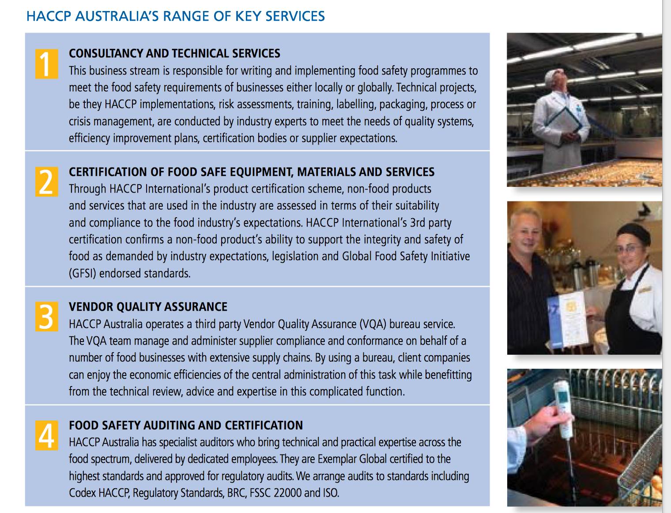

Slide 40
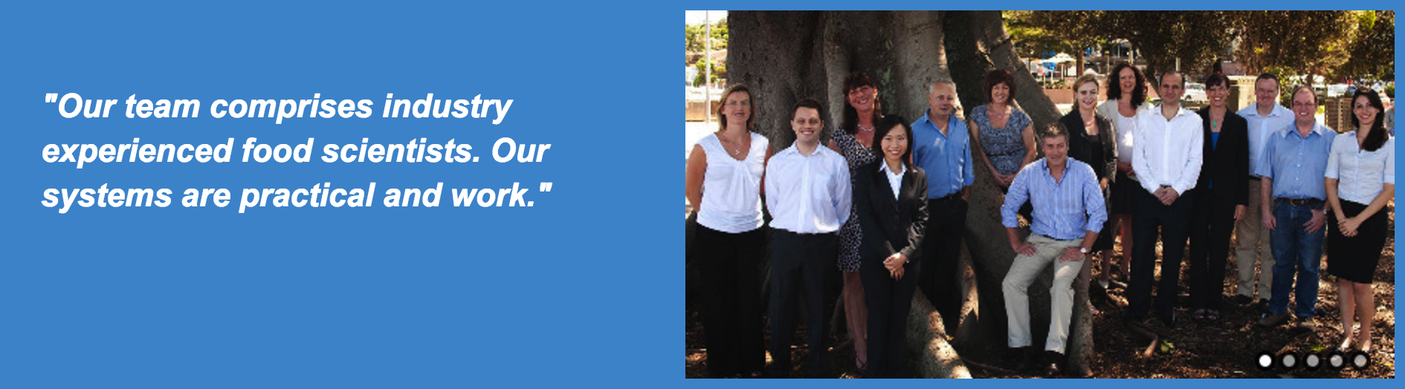


Slide 41
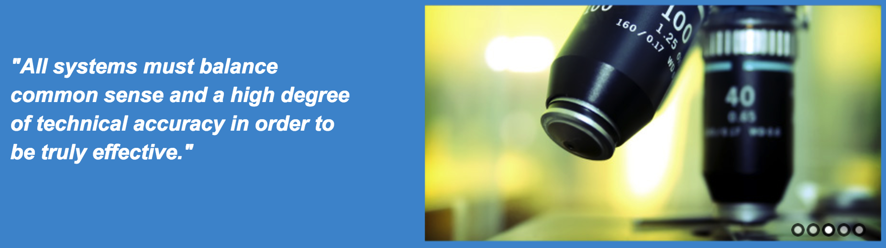

Slide 42
Auditing and certification
Certification to International Codex Standard
  HACCP - Codex Alimentarius Alinorm 97-13A
Qualified – RABQSA Exemplar – Auditors
  Considerable experience and capability across all food sectors and industries
Our practical and common sense approach to food safety auditing is a feature of our highly qualified staff
  Excellent support from HACCP Australia Team members

Slide 43

Training
Training is the life blood of ensuring that our clients understand and implement HACCP in the correct manner.
Excellent interactive training is provided with every system implementation including Taylor made training
Additional Training also available for the following
  HACCP Training at all levels
  GMP & Hygiene Training (Glitterbug Training)
  Cleaning & Sanitation
  BRC or ISO 22000 Training on request

Slide 44
Consultancy
All Food industry Consulting available
  Food Label development and compliance analysis
  Product Recall
  Expert Witness and litigation
  Process plant design / Retail Fit out design
  Legislative interpretation, Listeria consultancy
  Process and manufacturing troubleshooting
  Microbiological interpretations
  Other consultancy work we are commissioned for includes;
  • Risk Management
  • Sensory Evaluation, Shelf life extension, Product Development
  • Building / factory layout design & approval sign-offs
  • Quality Assurance systems

Slide 45
Vendor Quality Assurance or Supplier Management Systems
HACCP Australia now operates a third party VQA Administration scheme on behalf of our client organisations handling the compliance of suppliers in key expectations and manage corrective action requests and close-outs
Assists organisations to manage their Supply chain
  Supplier specifications
  Supplier Audits
  Performance reporting

Slide 46
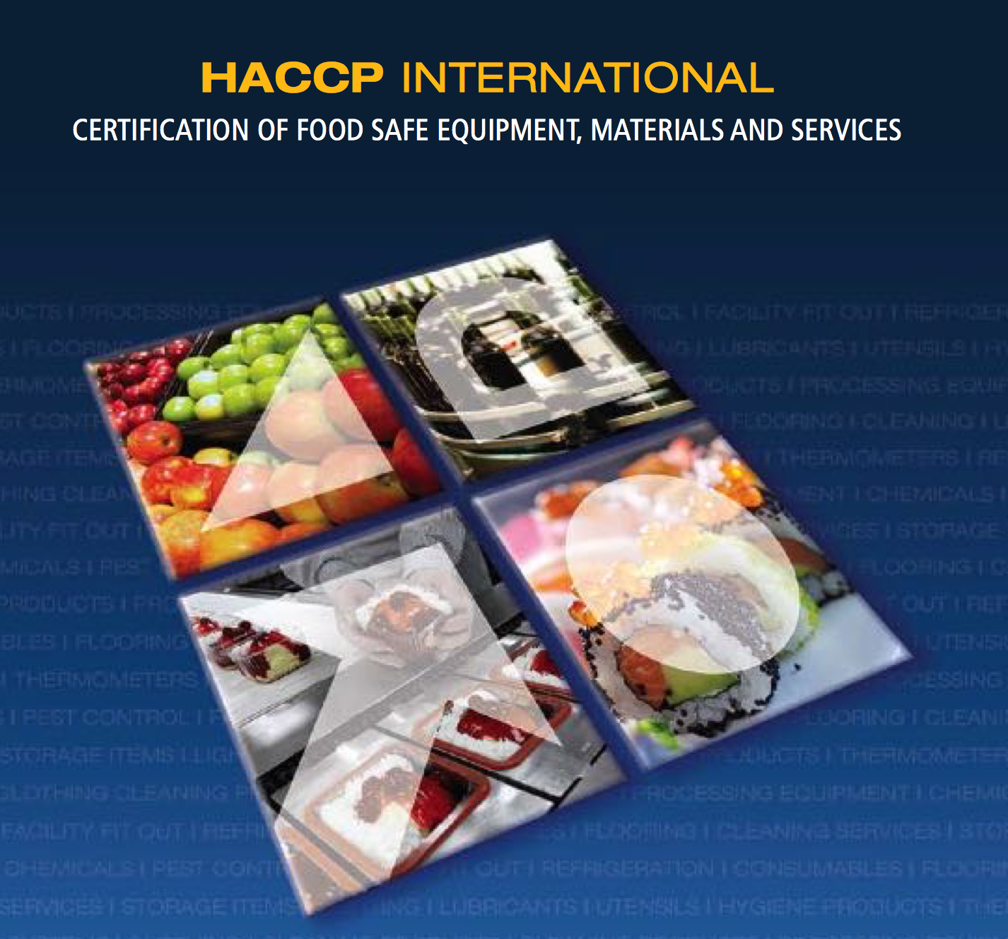
Certification of Food Safe Equipment, Materials
HACCP Australia has developed and internationally recognised brand for the Certification of Equipment and Services to the food industry.
As shown by the extensive list on our web site http://www.haccp.com.au/non-food-certified-endorsed-suppliers/
  World leading companies
  Allows food industry to have confidence in Endorsed products
  Systematic approach and methodology

Slide 47

Certification
branded

Slide 48

Mark for Certification

Slide 49

Food Safety Bulletins
Free professional ‘Food Safety Bulletin’
HACCP implementation and food safety risk management to international matters of food safety.
Endorsed suppliers of materials and services to the food industry are also featured in this publication
See full details at and download your free Bulletin including back issues http://www.haccp.com.au/bulletins/

Slide 50


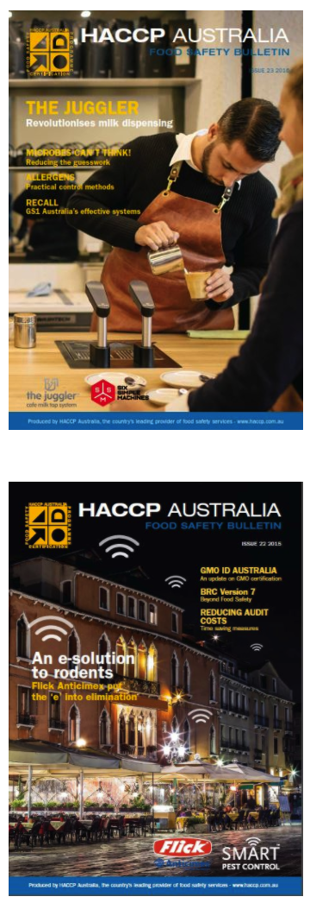
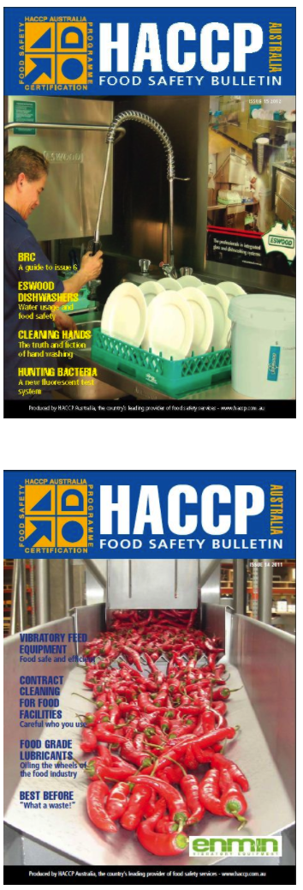


Slide 51

Non GMO (genetically modified organisms) Certifications
GMO-ID Australia is a food-science based consultancy that specialises in non-GMO identity preservation and administration of Non-GMO standards.
See full information at http://www.gmoid.com.au/

Slide 52
Contacts:
David Haberfield Director / Project Manager - FIJI HACCP Australia (Fiji) Limited (FIRC) 15-0344 (Mobile FIJI +679 869 6152) - when in Fiji from June 2016 M Australia +61418691516) E: david.haberfield@haccp.com.fj
Head Office No. 3 Ridgewest Building 1 Ridge Street NORTH SYDNEY NSW 2060 P +61 2 9956 6911 F +61 2 9956 7313 www.haccp.com.fj
Apiame Cegumalua Project Manager - Fiji M +679 928 1492 E Apiame@haccp.com.fj Proudly based in SUVA Fiji Islands https://www.linkedin.com/in/apiame-cegumalua-b4856816

Slide 53
VINAKA
Thank You
Apiame Cegumalua
Ph +679 9281492
apiame@haccp.com.fj/ acegumalua@gmail.com

