Slide 1
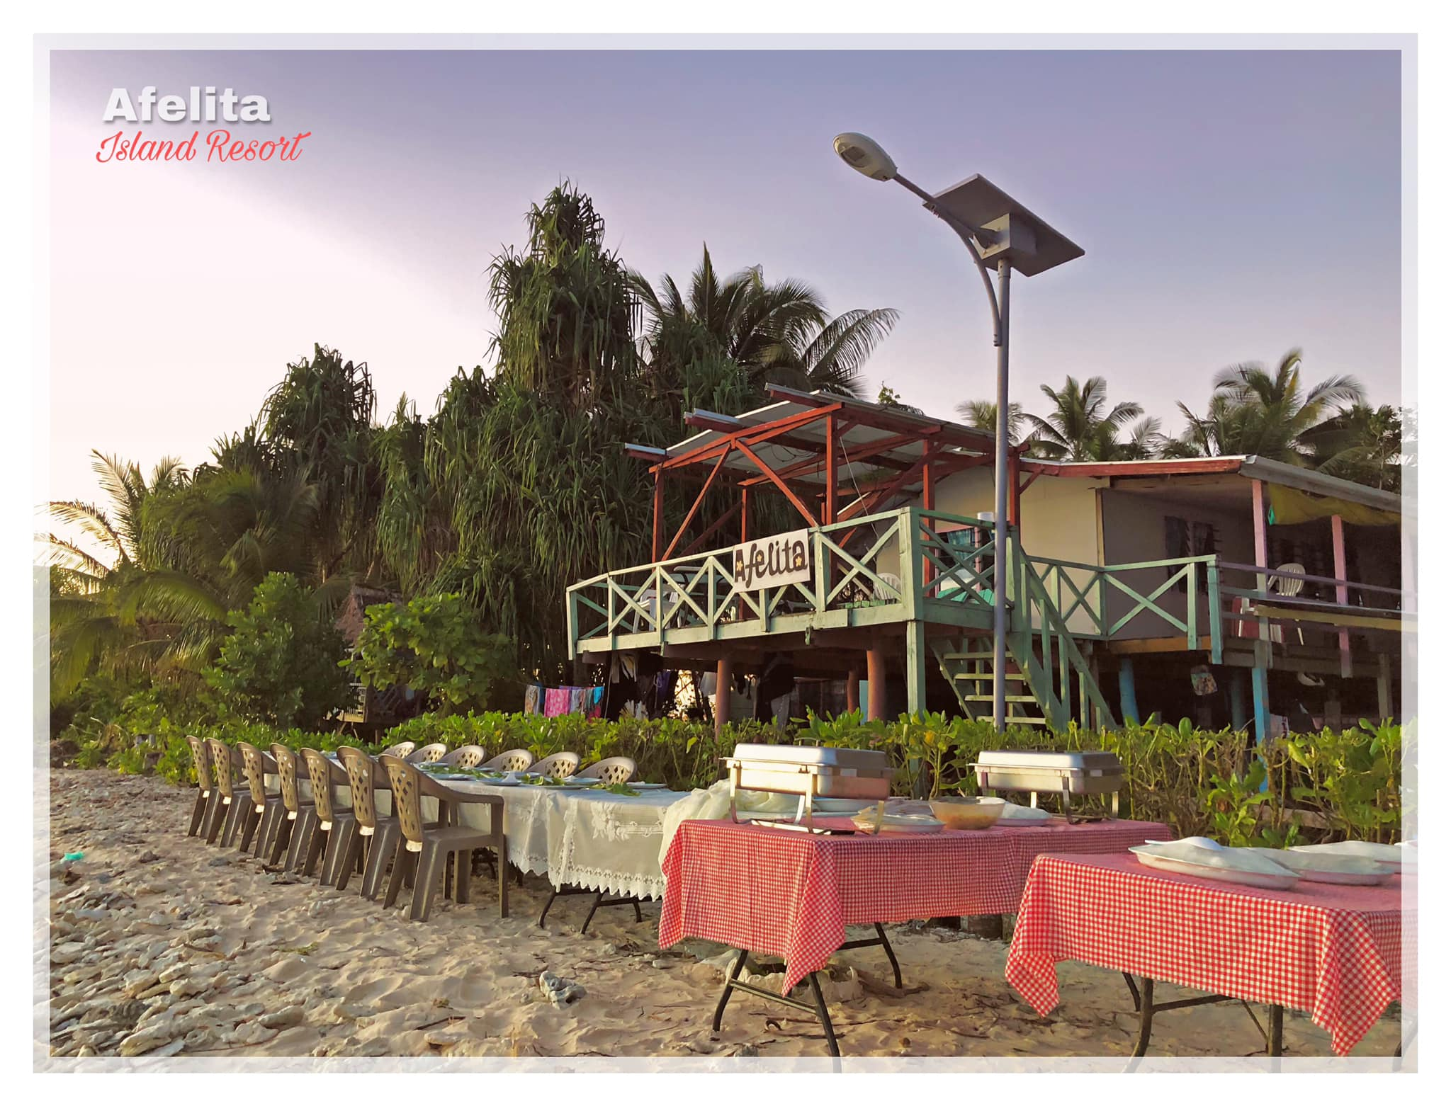
AFELITA ISLAND RESORT
Promoting quality food supplies to the tourism sector in Tuvalu
Presented by Lita Pita

Slide 2
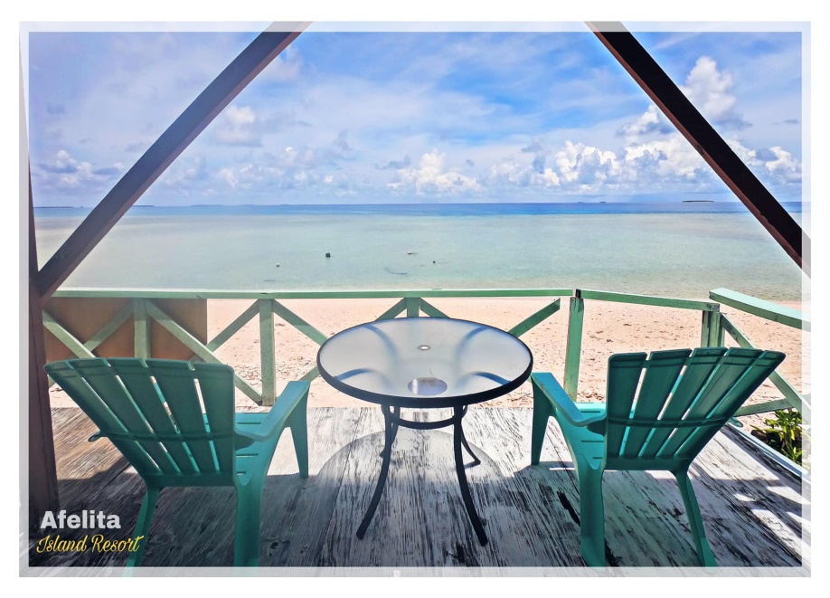
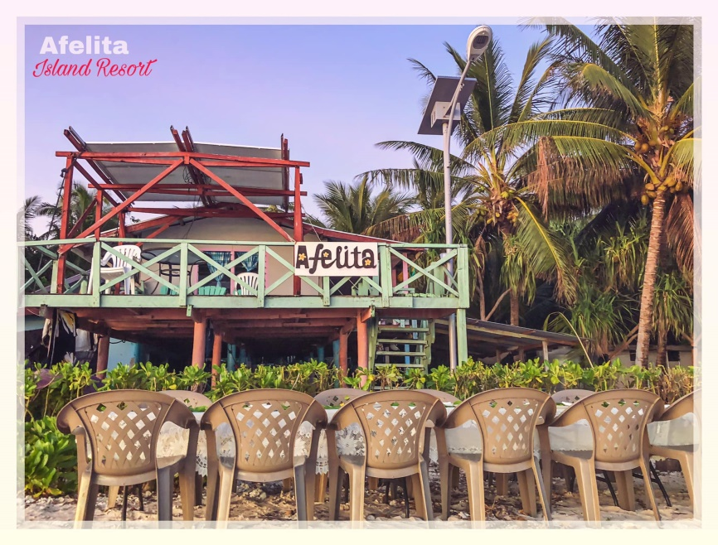
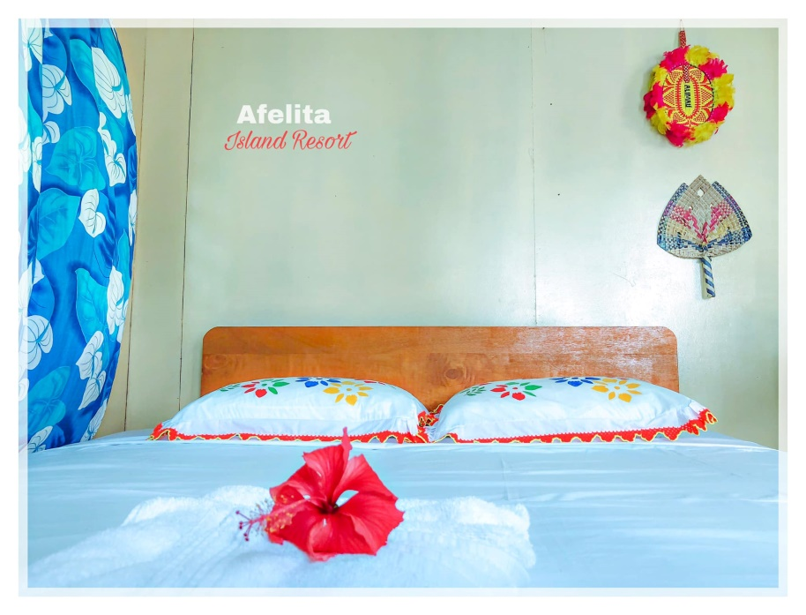
Afelita Island Resort

Slide 3
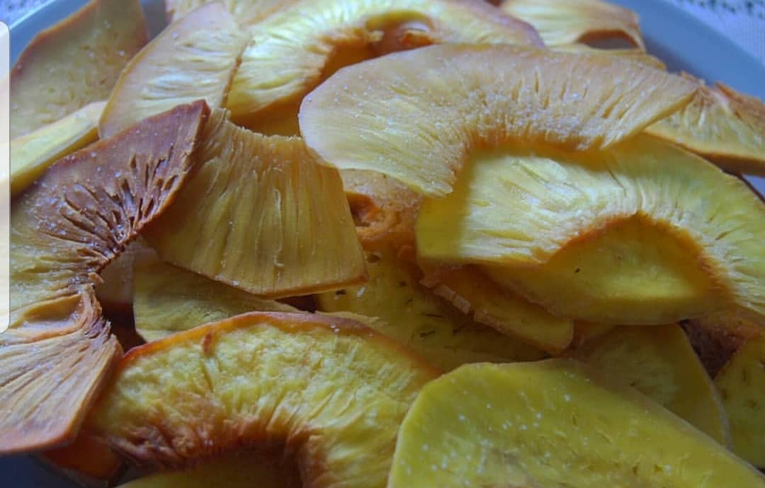
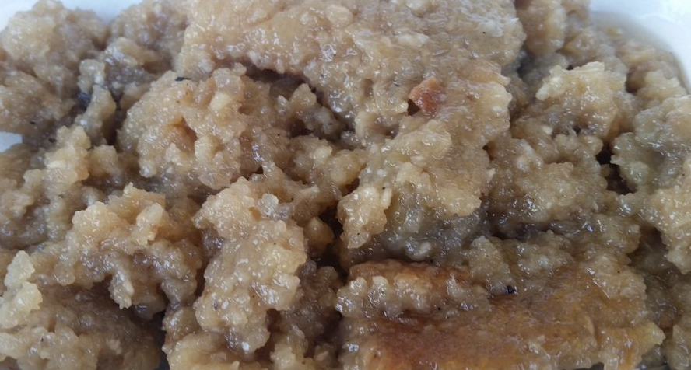
Food supply
Agricultural products (Raw) -pumpkin -fresh vegetables -coconuts -breadfruit -bananas (processed food) -fekei utanu -solomei -falifu mei

Slide 4
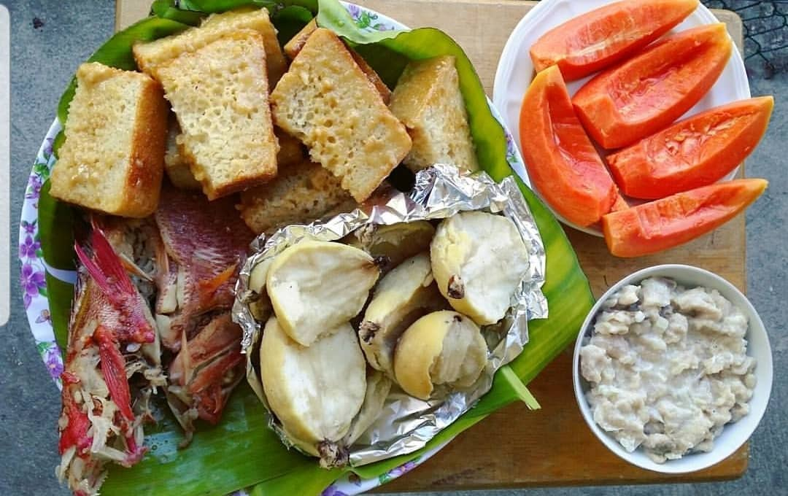
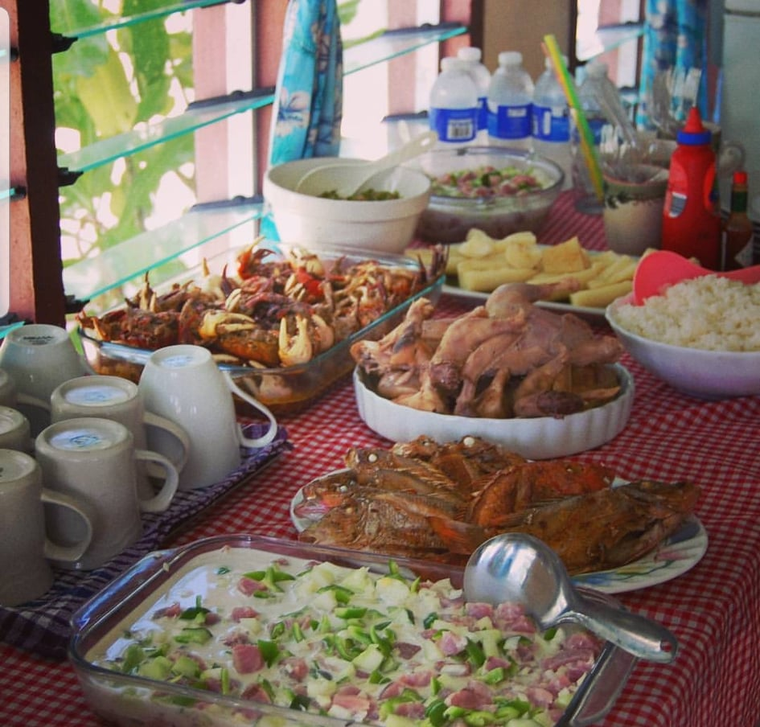
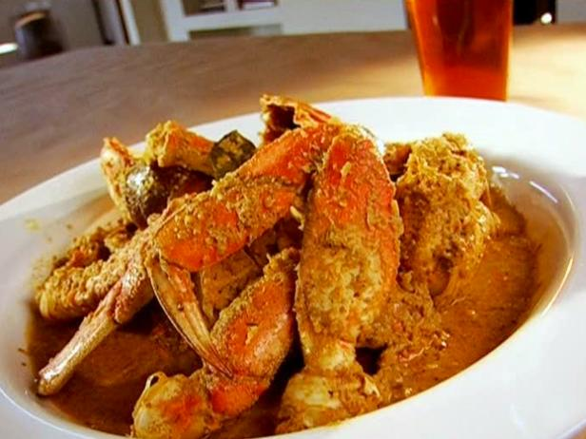
Food supply cont
Fisheries products -fish -lobsters -crabs

Slide 5
Challenges and recommendations
Inability to supply own vegetables on the island due to poor soil
Power shortage affects food storage Commitment of suppliers Lack of skilful chefs (quality food is the outcome of a skilful cook/chef)
Expert advice and help
Bigger generator and freezer
Identify and keep committed ones
Short term attachment

Slide 6
Challenges and recommendations
Remoteness of the island
Bad weather –quality and delivery of food
Build in hidden cost to charges
Have food supply on the island

Slide 7
Conclusion
A consistent and quality supply of agricultural and fisheries products in Tuvalu to the tourism sector is important.
The ability of a business (chef) to turn simple food into a fine-dining experience is equally important as well.
Local produce = fresh, quality and cheap YOU CAN’T GO WRONG WITH LOCAL FOOD

