Slide 1
APTC3:
An Enabling Coalition for Pacific Technical Vocational Education & Training (TVET) Reform
16/10/2018

Slide 4
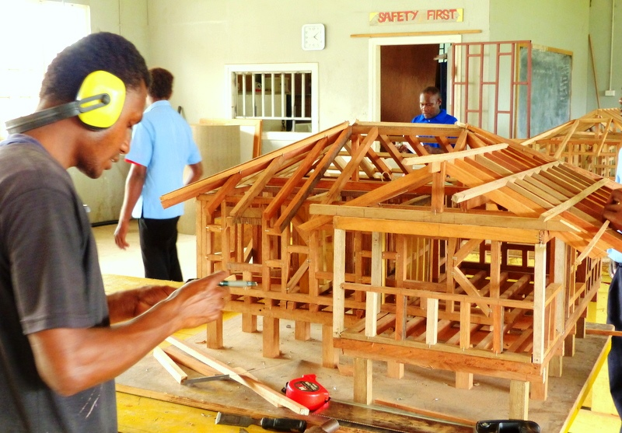
APTC in Phase 3
 Who We Are
 APTC3 Goal, Purpose and Outcomes
 APTC3: What’s Different

Slide 5
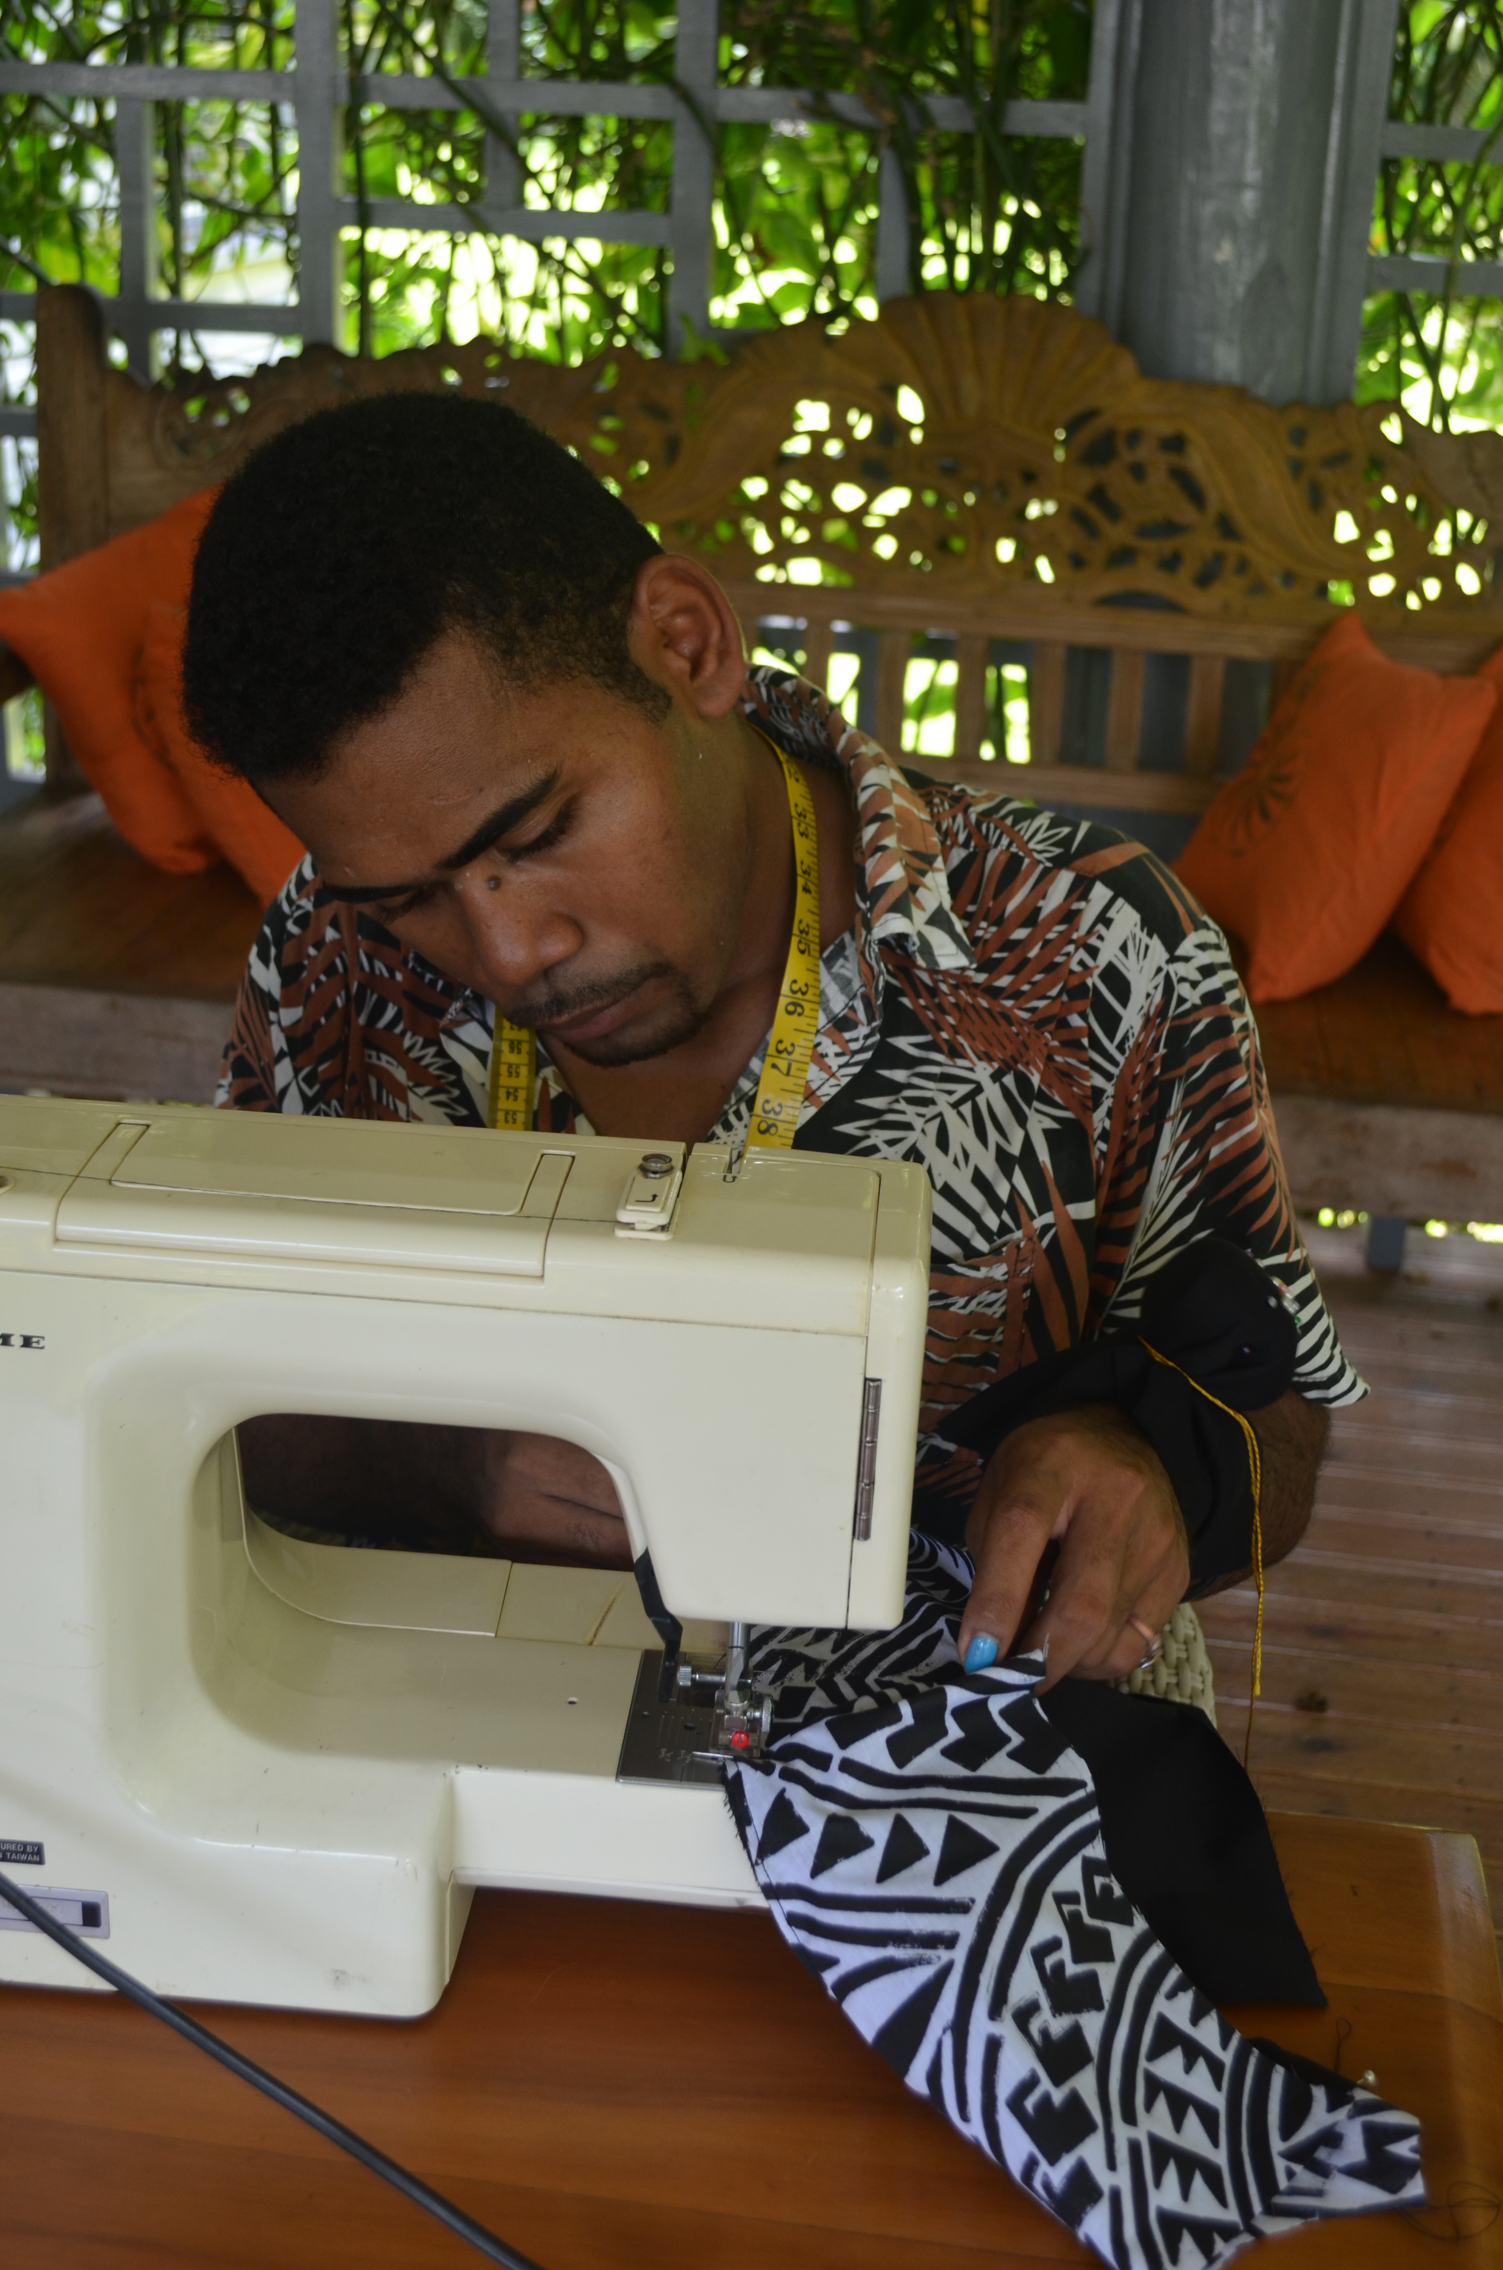
Who We Are
 The Australia Pacific Training Coalition is Australia’s flagship program for
training excellence, helping Pacific Island citizens to be economically empowered by gaining Australian skills and qualifications for a wide range of vocational careers.
Supported by the Australian Government
APTC is managed by TAFE Queensland
(RTO 0275)
Notes:
APTC is Australia’s largest regional program. Current funding stands at AU$ 32 million every year for the next four years with the possibility of an extension for another 4 years.
On 9 August 2018, former Australian Foreign Minister Julie Bishop announced the launch of APTC 3

Slide 6
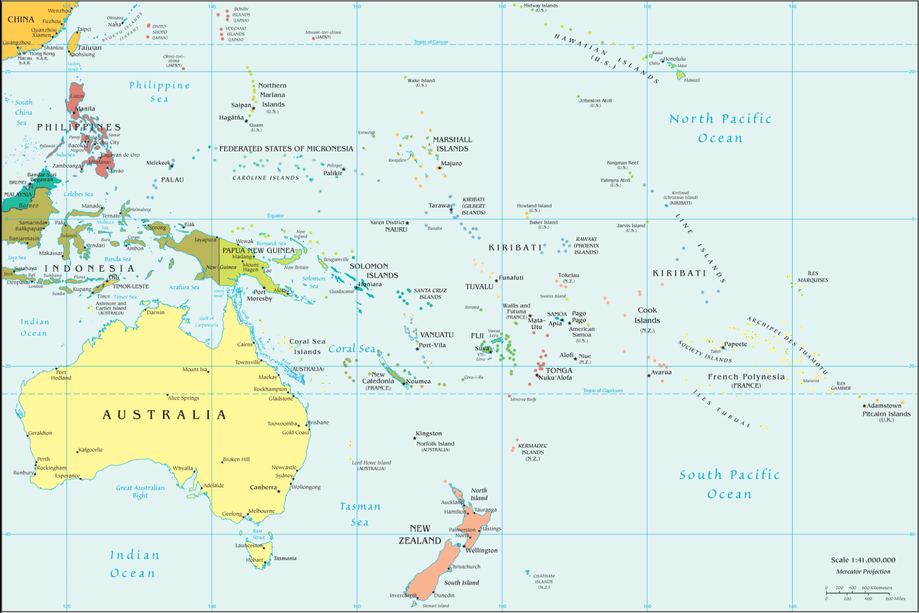
Where we are Fiji, PNG, Solomon Islands, Samoa, Vanuatu, Tonga, Kiribati, Tuvalu, Nauru
Campus
Campus
Campus
Campus
Campus & RHO
Notes:
In this new phase, APTC will operate in 9 countries in total: Fiji, Kiribati, Nauru, PNG, Samoa, Solomon Islands, Tonga, Tuvalu and Vanuatu.
Six states (Cook Islands, Tokelau, Federated States of Micronesia, Niue, Palau and Republic of the Marshall Islands) will have access to APTC training places, either fully or partly subsidised, but APTC will not conduct in-country marketing activities or seek to identify in-country demand for skills.
We often talk about the Pacific as though it is one country. It is many countries:
- There are different cultural nuances, norms, forms of leadership and governance.
APTC has had the privilege of operating in, learning with and partnering across the Pacific region for the past ten years.

Slide 7
Our Goal, Purpose and Outcomes
 APTC3 GOAL
A more
SKILLED
INCLUSIVE
and
PRODUCTIVE
WORKFORCE enhances
PACIFIC PROSPERITY

Slide 8
Our Goal, Purpose and Outcomes
 APTC3 Outcomes
 Improved employment outcomes for graduates
 Increased co-investment in skills training
 Quality TVET provision demonstrated by selected TVET partners

Slide 9
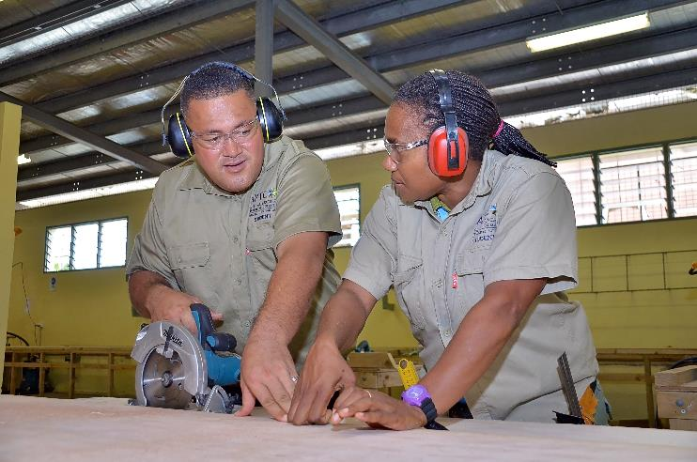
APTC3: What Is Different
 APTC is establishing a TVET Systems
Strengthening Platform to support and incentivise
TVET reform initiatives by APTC’s partners.
Notes:
APTC is establishing a TVET Systems Strengthening Platform (TSSP) to support and incentivise TVET reform initiatives by APTC’s partners.
The TSSP will be part of the APTC toolkit for TVET reform, alongside carefully brokered partnerships and investments – financial and non-financial. The TSSP will integrate into our broader work and relationships, and will not be utilised as a stand-alone grants scheme.
The TSSP is currently in its design phase and to be fully operational by no later than June 2019.
We are looking for new and innovative ways to support the Pacific’s own TVET systems and to encourage more investment into skills.
***On financial commitments for Pacific Skills Partnership and TVET Systems Strengthening Platform, emphasise that these initiatives are about committing to collaborate with stakeholders in alignment with regional and national priorities. Collaborations and investments will be carefully brokered, including both financial and non-financial contributions.

Slide 10
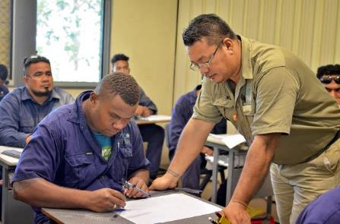
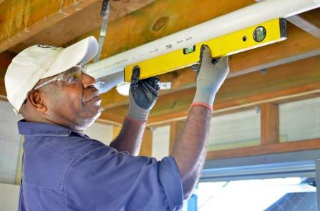
APTC3: What is Different
 We are renewing our emphasis on labour mobility.
 We are designed to ensure ‘net skills gain’ for the Pacific.
 Aligning activities with national and regional policies on labour mobility.
 Seeking and strengthening links to Labour Market Analysis, and feedback
from graduates and employers.
 Working through partnerships with national and regional stakeholders.
Notes:
We are renewing our emphasis on labour mobility with the ultimate goal of a net skills gain for the Pacific.
APTC is doing this by working with TVET providers, industry and stakeholders to support Pacific Island citizens in their journey from training to national and international labour markets – earning valuable experience abroad, and contributing to growth and innovation at home.
APTC training for labour mobility will be managed carefully to support developing the skills in demand in regional and international labour markets where it is clear that increased labour mobility options will enhance economic development and contribute to Pacific growth and development.
To this end we are also exploring intra-regional opportunities as well as labour mobility potential outside the region.
Increased labour mobility options provide opportunities for Pacific Island citizens to gain valuable experience working abroad, to help fill each other’s labour shortages, and to bring new skills and experience back to their own labour markets to foster innovation and growth.
We are designed to ensure ‘net skills gain’ for the Pacific.
Aligning to national and regional policies, APTC training continues to make national training needs paramount, including for net skills gain at national level.
We are sharpening the way we gather and analyse industry and employer needs by consolidating data sources for analysis of labour market demand – both nationally and for labour mobility. We are enhancing our planning, monitoring, evaluation and learning processes to ensure we are producing the evidence to support the benefits of labour mobility.
As a coalition, we are re-invigorating existing partnerships and brokering new ones, as this must be a collective effort.

Slide 11
APTC3: An enabling coalition for Pacific TVET reform
We welcome the opportunity to collaborate inclusively in furthering the skills agenda of Pacific Island Countries.
As we continue APTC’s brand for quality, we will also harmonise with other DFAT projects and to share ideas and resources to improve opportunity for all.
Notes:
As mentioned in APTC’s approach to supporting locally and Pacific led skills development, we recognise that this must be a collective and collaborative effort.
We welcome the opportunity to collaborate with diverse stakeholders on TVET reform and we give our full commitment to seeing the whole Pacific region benefit from a skilled, inclusive and productive workforce that enhances Pacific prosperity
We give our full commitment to gender equality, social inclusion and recognising the unique vulnerabilities of Pacific Small Island States.

Slide 12
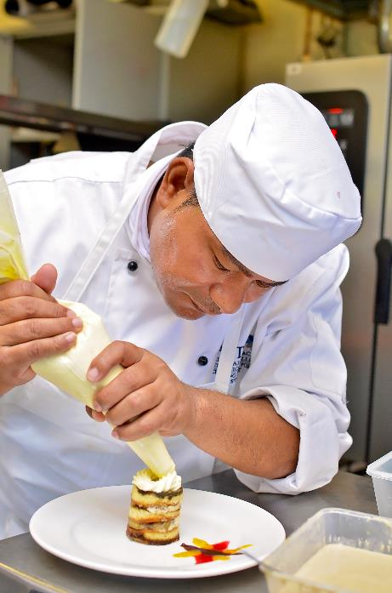
Delivery to date
 To date, we deliver:
Automotive & Electrotechnology
Building & Construction
Childcare, Community Services, Health
Business & Management
Education & Training
Hospitality, Cookery & Tourism
Fashion, Design & Technology
43
INTERNATIONALLY
RECOGNISED COURSES
Notes:
Training is based primarily on feedbacks from industries, private sector and key stakeholders
This year, APTC is embarking on a labour market assessment to ensure that we are current and relevant in the development of training packages
We are exploring with local industries, private sectors, NGOs and community groups on opportunities for trainer and student placements on traditional food practices, food sources and production

Slide 13
Delivery to Date
 12,800+
TOTAL GRADUATES
41% FEMALE
99% STUDENT SATISFACTION RATE
98% EMPLOYER SATISFACTION RATE

Slide 14
Numbe of Graduates- Hospitality; Cookery
FIJI

Slide 15
We are taking actions…
Advocating for TVET as a credible career pathway
Revisiting delivery of Cookery/Hospitality at Pacific Fusion
Trainer and student placements in support of pacific food/culinary tourism
Supporting national/regional frameworks (E.g. FHEC, SPC)
Labour market assessment
Ongoing engagements
Pacific Skills Summit- June 2019

Slide 16
QUESTIONS??
Vinaka…

