Slide 1
Initiatives in Trade, Tourism and Agriculture Ideas for AgriTourism
John Magnifico

Slide 2
Through The Years A Brief Overview of My Experience
1995
Telecommunications Transformation
Digitisation of the Australian Telephone network.
2000
Operational Transformation
Transformation of Telecommunications to support the growth of the Internet.
2007
Call Centre Transformation
CTI technology and advance routing for home based and offshore Agents. Applications of Big Data and Analytics.
2014
Cyber Security Transformation
Digital Identity applications for Security. Application of Robotics Process Automation (RPA)
AI, Machine Learning.
Speech Recognition Automation
Automated 1,000,000 calls each day. Displaced 5,000 contact centre staff.
RFID and Advanced Visualisation
Expertise with Business Intelligence and what was later to be called IoT.
Digital Transformation
Digital Identity solutions for Gov’t and Business – Digital First, Omni channel, connected experiences.
Digital Transformation of Pacific
Established Pacific based operations in Pacific. Assist in the Digital Transformation of Pacific placing People before Profits.
1998
2004
2010
2017

Slide 3
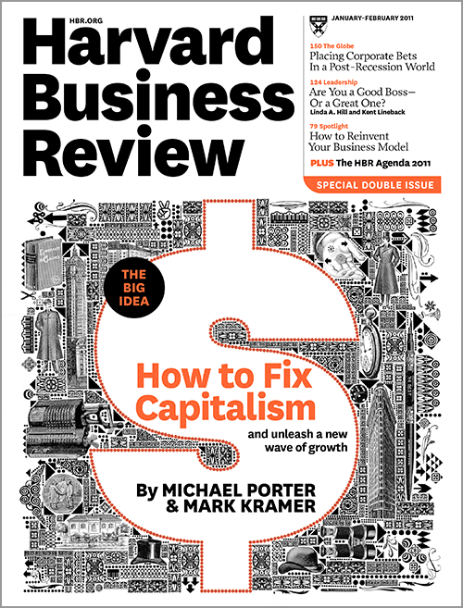
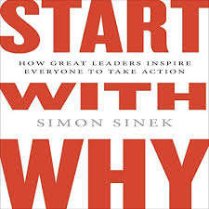
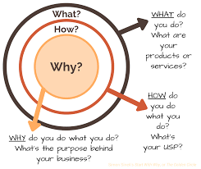
People Before Profits Shared Value and a Sense of Purpose
Laurence Fink, the founder and chief executive of the global investment firm, BlackRock
“A Sense of Purpose”
“Companies must benefit all of their stakeholders, including shareholders, employees, customers, and the communities in which they operate.”
Everyone has a WHY. Your WHY is the purpose, cause or belief that inspires you.
Over 6 years ago, Harvard’s Michael Porter and FSG’s Mark Kramer made the bold statement that shared value — the idea that the purpose of a company is to achieve both shareholder profit and social purpose — would “reinvent capitalism.” They encouraged companies to go beyond CSR (corporate social responsibility) and integrate social impact into companies’ competitive strategy.
Source: https://techcrunch.com/2018/03/25/a-6-trillion-wake-up-call-for-the-tech-industry/
Notes:
Laurence Fink, the founder and chief executive of the global investment firm, BlackRock, and was delivered as a letter to the CEOs of the world’s largest companies.
“A Sense of Purpose,” the letter informed business leaders that driving record profits is no longer enough to garner BlackRock’s support. Companies must also positively contribute to society, or in Mr. Fink’s words, “Companies must benefit all of their stakeholders, including shareholders, employees, customers, and the communities in which they operate.”
Jack Welch – Originally was a supporter
So many executives today still live by the old management adage, companies are in business to maximize shareholder value. In doing so, they put profits before people, rather than the other way around. Ironically, in the 1970s, Jack Welch was a huge proponent of that adage, but within the last ten years he has renounced it, calling it “the dumbest idea in the world” and saying:
Shareholder value is a result, not a strategy. Your main constituencies are your employees, your customers, and your products. Managers and investors should not set share price increases as their overarching goal. Short-term profits should be allied with an increase in the long-term value of a company.
Read more at https://www.business2community.com/human-resources/put-people-profits-01999459

Slide 4
What I Have Learnt Top 3 Lessons Over The Last 20 Years
Leadership Leadership with strong character, empowerment and purpose.
Agility Finding problems, fix them quickly, and learning is important.
Innovation Knowledge is a commodity. The best ideas should “win” not the best opinions.
Notes:
Talk ab
CBA AML
Project was too late
Project was not the solution
Agility and Innovation was required
out how CBA was too big and not Agile

Slide 5
Top 10 Emerging Technologies of 2017 World Economic Forum
Selected by WEF’s Expert Network and Global Future Councils in collaboration with Scientific America and its Board of Advisors. Each technology was chosen for its potential to improve lives, transform industries and safeguard the planet.
Source: World Economic Forum - https://www.facebook.com/worldeconomicforum/videos/10154545182216479/
Notes:
PLAY VIDEO
Selected by WEF’s Expert Network and Global Future Councils in collaboration with Scientific America and its Board of Advisors. Each technology was chosen for its potential to improve lives, transform industries and safeguard the planet.
The experts were also looking for indications that the technologies have reached a level of maturity that would enable widespread take-up in the coming 3 to 5 years.

Slide 6
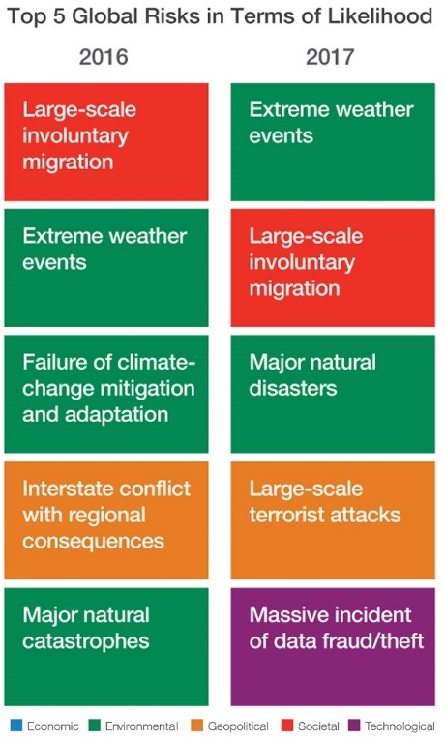
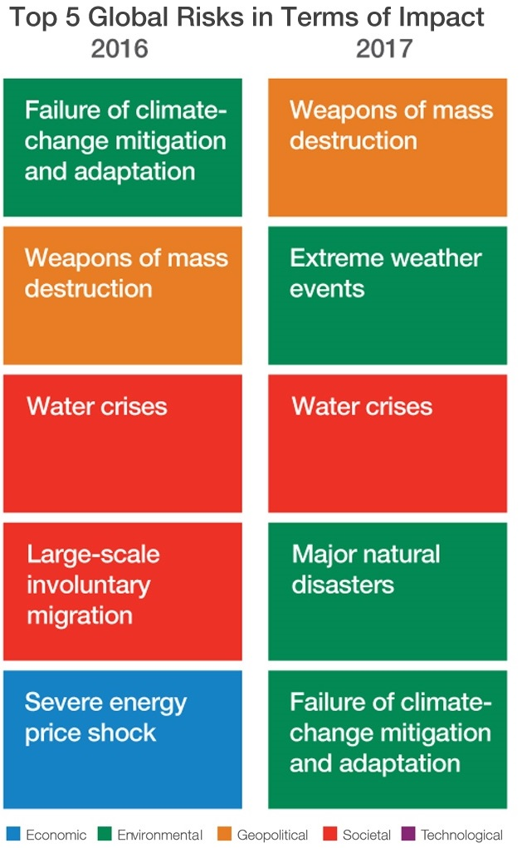
Top 5 Global Risks 2017 World Economic Forum
Notes:
Now let’s look at the risks and then apply this to the theme of 2020 Challenges
The Global Risks Report 2017 features perspectives from nearly 750 experts on the perceived impact and likelihood of 30 prevalent global risks as well as 13 underlying trends that could amplify them or alter the interconnections between then over a 10-year timeframe.

Slide 7
The Challenges We Are Focused On Challenges Affecting Us to 2020 and Beyond
Water
Global
Fiji
According to the World Health Organisation over 2 billion people are drinking contaminated water
Fiji transports drinking water to the outer islands. Many villages in the interior do not have drinking water

Slide 8
The Challenges We Are Focused On Challenges Affecting Us to 2020 and Beyond
Food Agility
Global
Fiji
According to the UN, by 2050, we will require over 70% more food to feed an estimated 9.6 Billion
Fiji has an Agriculture Trade deficit of
$451 million FJD

Slide 9
The Challenges We Are Focused On Challenges Affecting Us to 2020 and Beyond
Resilience
Global
Fiji
Extreme weather and natural disasters are both in the Top 5 Risks.
AON estimates economic losses to date are $7.26 trillion FJD
ADB estimates that the loss from Tropical Cyclone Winston amounted to $1.42 billion FJD (~31 % of GDP)

Slide 10
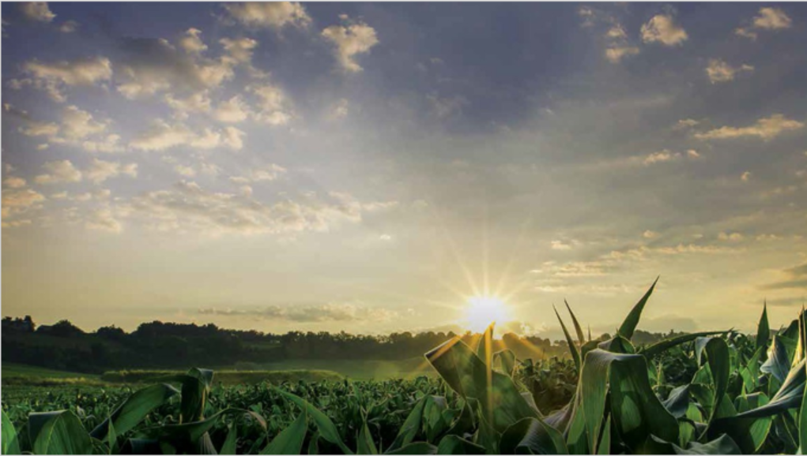
Innovation
For
Fiji Agriculture
Innovation
For
Pacific Agriculture
Next Generation Field Management System
Digital Agriculture Platform

Slide 11
Future of Farming Digital Agriculture
Notes:
PLAY VIDEO
End to End sensing is available, but at the moment it is cost prohibited for small acre farms. However Remote Sensing is a solution.

Slide 12
Top 10 Emerging Technologies of 2017 Precision Farming (Digital Agriculture)
Digital Agriculture
Source: World Economic Forum - https://www.weforum.org/agenda/2017/06/these-are-the-top-10-emerging-technologies-of-2017/

Slide 13
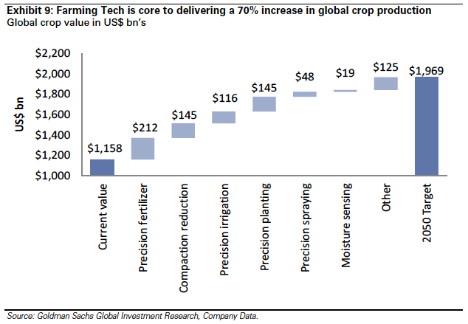
Global Insights and Predictions Technology is the enabler to increase production & efficiency in agriculture
Australian Agriculture Target 67% Production Growth By 2030
The National Farmers’ Federation (NFF) recently held its first meeting with the new Agriculture and Water Resources Minister, David Littleproud. In this meeting the NFF emphasised the goal for agriculture to be a $100 billion industry by 2030. ¹
Digital Technology Can Boost Australian Agriculture Value by 25% per annum or $20.3 Billion
The impact that unconstrained digital agriculture may have on the Australian economy was estimated by modelling potential productivity gains arising from the application of digital technology. The size of the productivity gains modelled were determined using assumptions of the potential of digital agriculture to lead to more efficient and higher value production and sale of Australian agricultural produce. ²
1 - http://farminstitute.org.au/ag-forum/is-a-100b-target-for-agriculture-ambitious-enough
2 - http://farminstitute.org.au/CampaignProcess.aspx?A=Link&VID=34216594&KID=214061&LID=980880

Slide 14
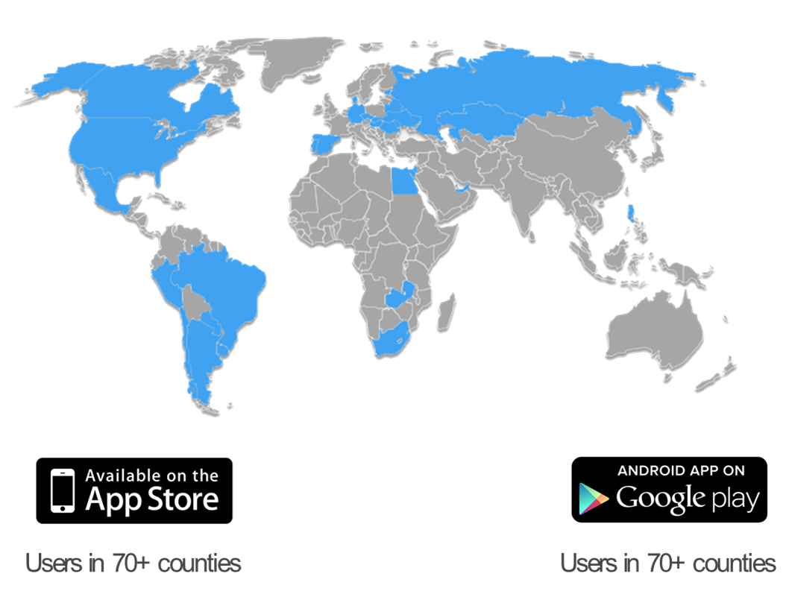
Digital Agriculture Platform Technology Overview
CROPSOLVED
CROPSOLVED
CROPSOLVED
Crop Health Crop conditions in close to real-time mode and yield forecast
Operations Use Crop Health information to plan your Operations
Telematics Perform your planned Operations in the most efficient way
Global monitor over 24 million acres in 40 Countries
Key Global Customers

Slide 15
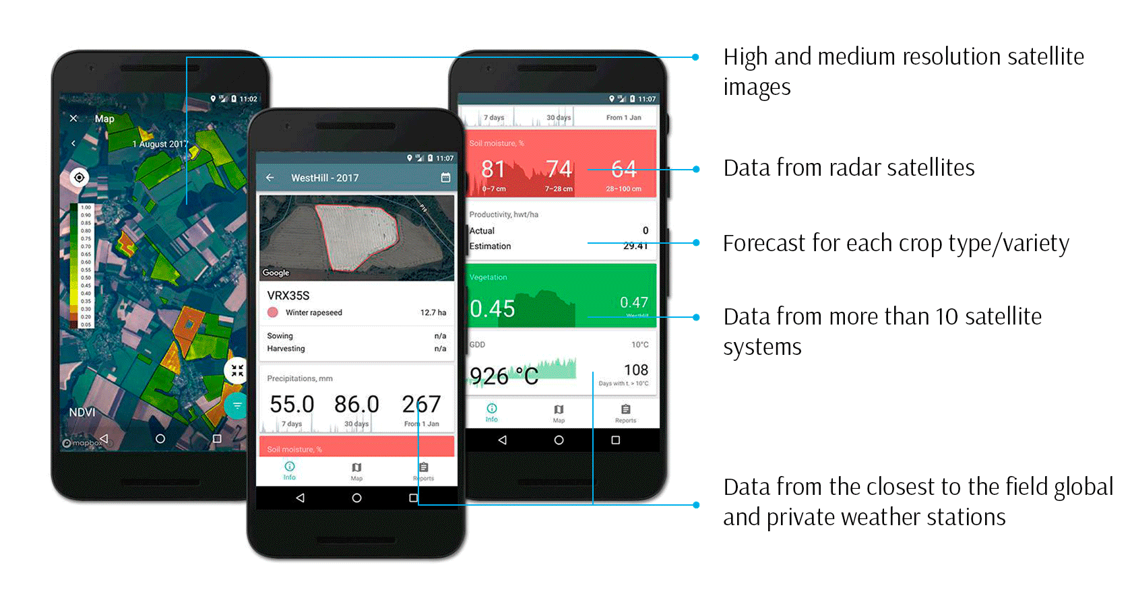
Digital Ready App Access field-to-field information anywhere on any device

Slide 16
Key Features Extended Information About Crop Health for Each Field in One Place
Field history Vegetation, precipitation, soil moisture and weather history for up to 10 years | Alerts Weather, vegetation and forecast alerts | Vegetation map Vegetation map of all your fields | Precise weather Precise weather and weather forecast for each individual field is updated hourly and available for the week ahead | Soil Moisture Soil moisture on different depth layers
Report Productivity, vegetation, scouting, slopes and other reports | N-deficit N-deficit control for each field and each part of the field | Scouting Focus your attention directly to problem areas on fields | Soil Tests Soil tests of all your fields in a map | Harvest forecast Forecast starting from the fourth week of active vegetation

Slide 17
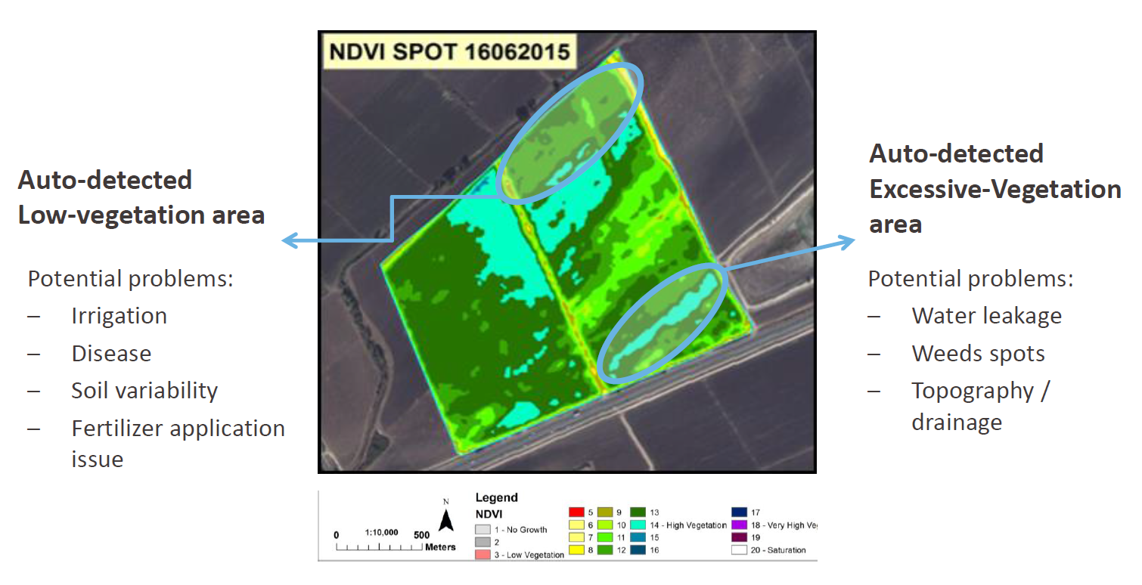
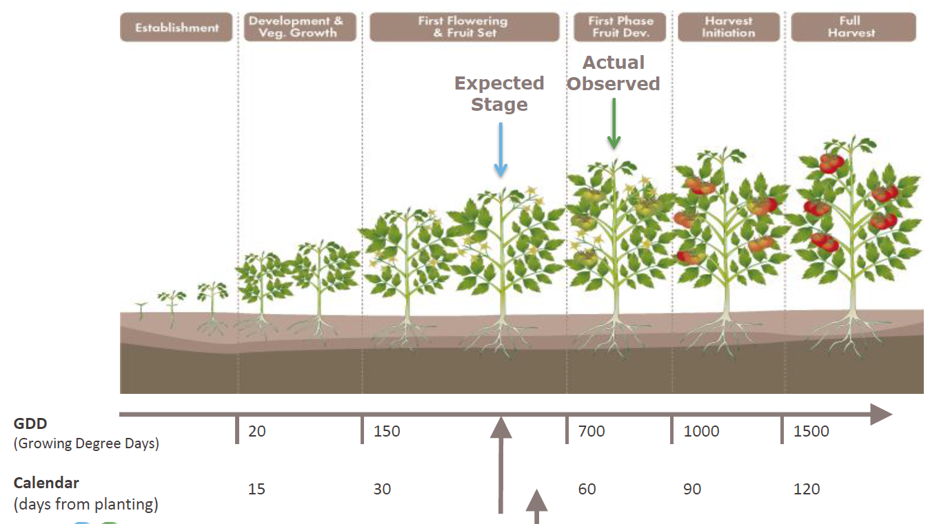
Digital Agriculture For Pacific Solved Operations Centre
Expert Teams
Solved Operations Centre
Centre of Excellence
Digital Agriculture
Irrigation Practise Management
Horticulture
Soils and Disease
Agriculture Stakeholders
Research and Universities
Education
Program Management and Governance
Innovation Council
Solved Operations Centre
People
Technology
Processes
Agriculture Best Practices
Drip Irrigation
Using Digital Agriculture, Pacific can be a Global example on how to build an economically viable and sustainable agricultural enterprise. By leveraging a Digital Agriculture Platform (DAP) that facilitates remote monitoring of agricultural land and enables its users to efficiently plan and carry out agricultural operations, Pacific will become the South Pacific’s benchmark.

Slide 18
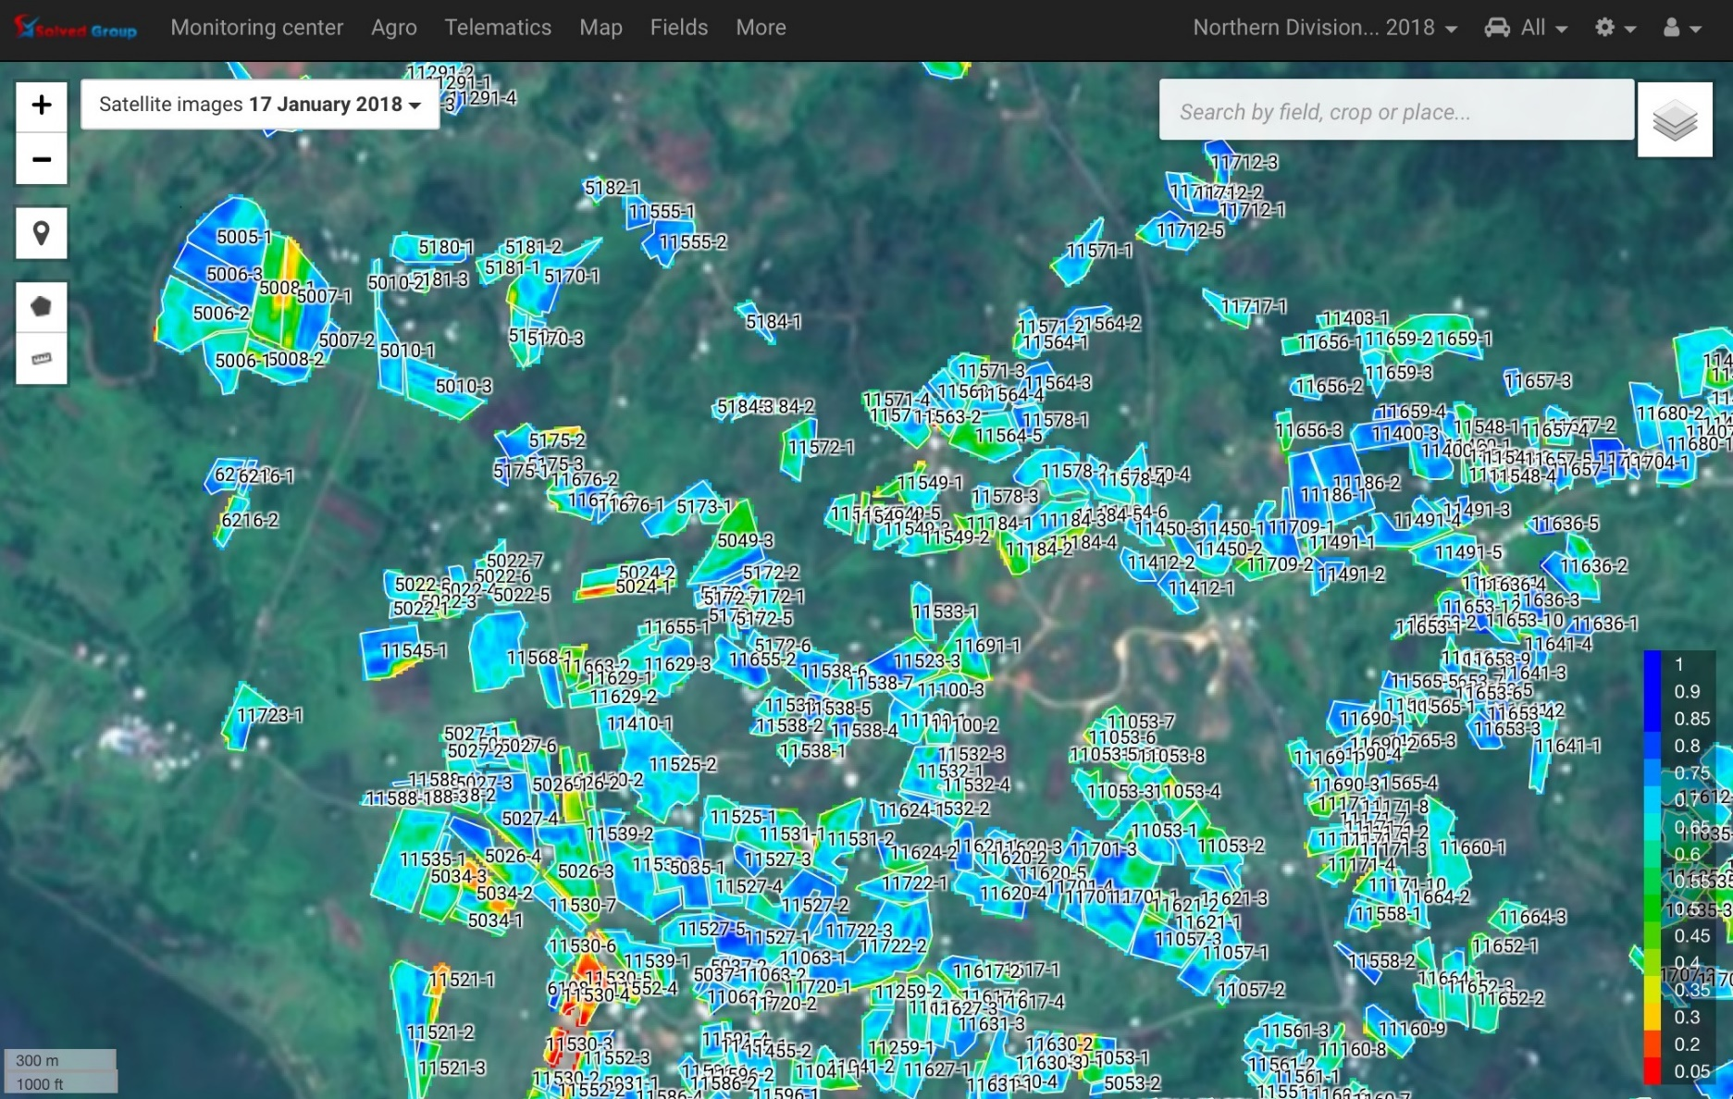
Solved Operations Centre Snapshot From Our Monitoring Dashboard
The Solved (Pacific) Operations Centre (SOC) is currently monitoring over 4,000 hectares.
The image on the left is a snapshot of over 500 farms in the West of Pacific. The Colour indicates the Vegetation Index (Growth).
Provide Feasibility Data for Investors prior to Land acquisition.
Provide operational farms with regular, near real-time, productivity reports.
The Data can be used for Disaster Management and Biosecurity teams to investigate impacts and deploy resources optimally.
Data is also used by insurance providers to determine insurance premiums for Agriculture insurance.

Slide 19
What Information Is Available Provide Near Real-time Information About Crop Conditions
Identify non-performing fields
Low biomass
>5% slope
Low humidity
Detect Fraud
Crop mismatch
Area mismatch
Input /operation mismatch
Forecast yield
Yield estimate
Harvest mismatch
Agri-operations control
Crop rotation
Operations control
Data is available within 24hrs after an image is processed

Slide 20
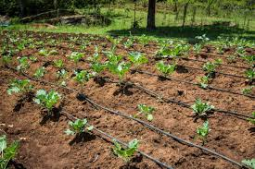
Micro - Irrigation
And
Monitoring

Slide 21
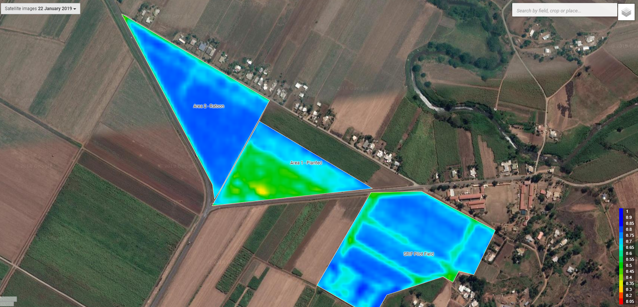
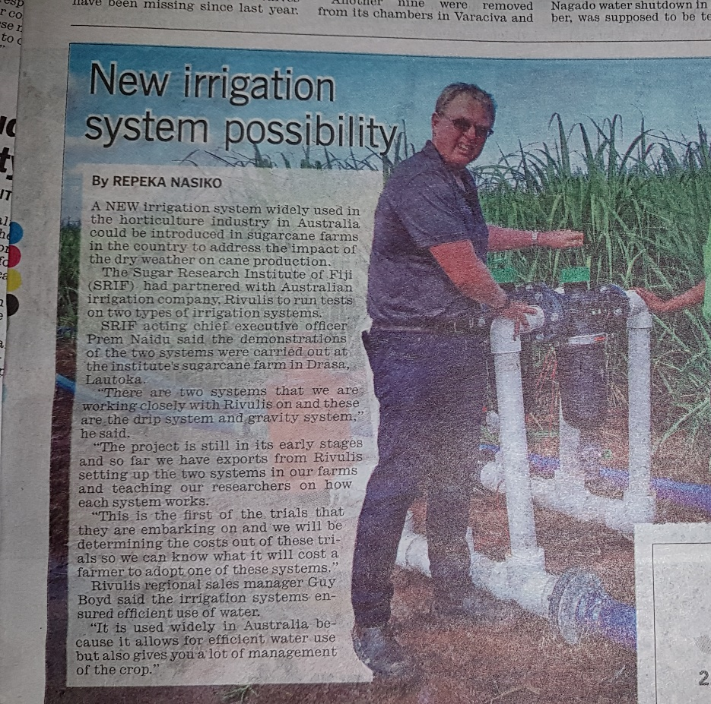
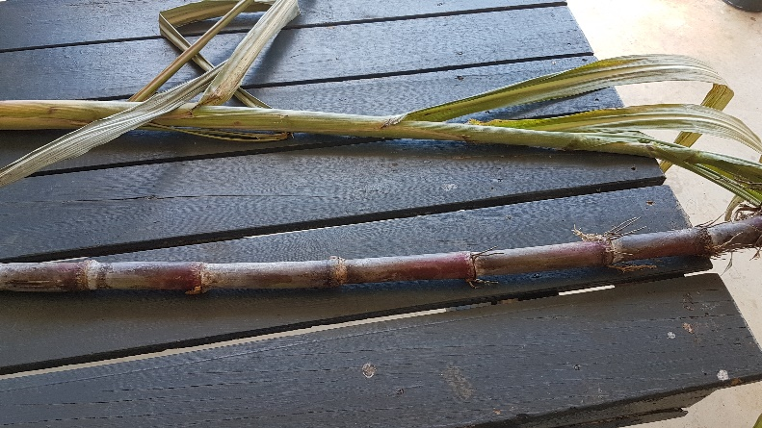
Micro Irrigation and Monitoring Other Initiatives

Slide 22
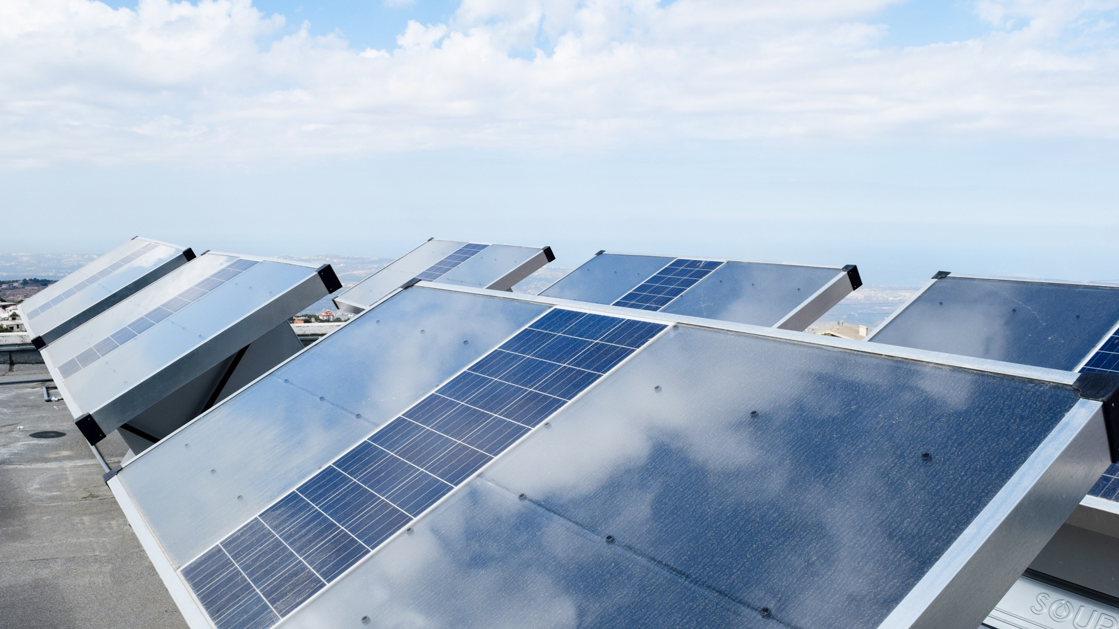
Climate Resilient and Renewable Drinking Water for Pacific

Slide 23
Top 10 Emerging Technologies of 2017 Harvesting Clean Water from Air
Hydropanels
Source: World Economic Forum - https://www.weforum.org/agenda/2017/06/these-are-the-top-10-emerging-technologies-of-2017/

Slide 24
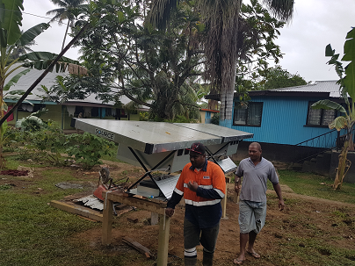
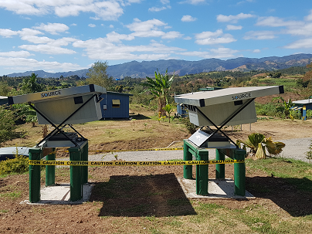
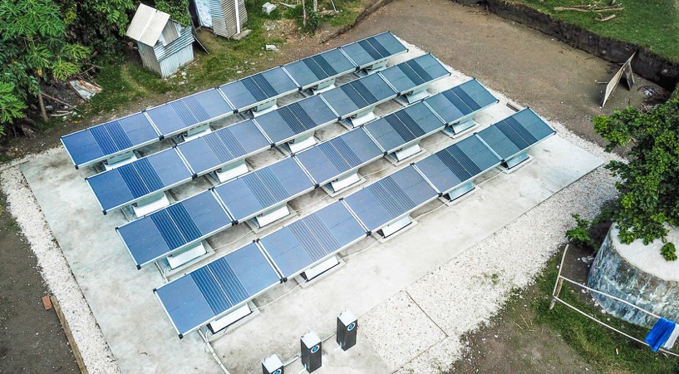
Sustainable Drinking Water for The Pacific Other Initiatives
Yavusania Village – Nadi, Fiji
Koroipita Model Town – Lautoka, Fiji
Petros Primary School - Tanna, Vanuatu

Slide 25
Installed on 5 Continents
Africa, Asia, Australia, North America, South America
In over 13 Countries
Australia, Ecuador, India, Indonesia, Jordan, Lebanon, Mexico, Philippines, South Africa, United Arab Emirates, United States, Vanuatu, Fiji
HydropanelsAround the Globe
Making Water in Diverse Climates
From the arid Sonoran Desert to the humid equatorial jungle

Slide 26
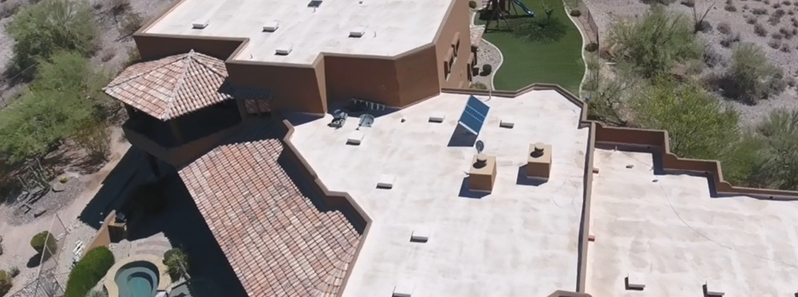
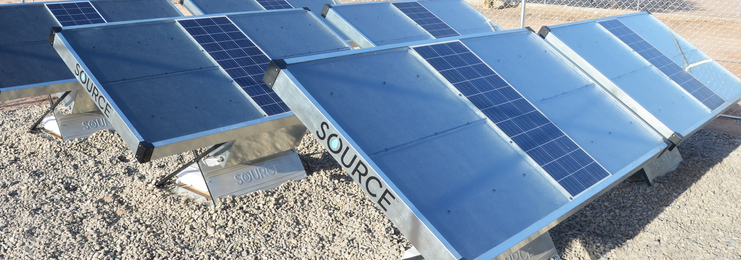
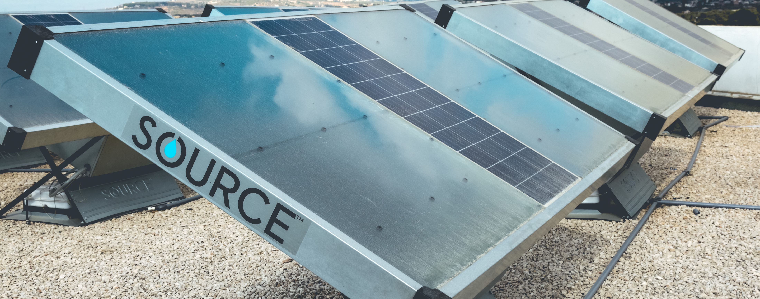
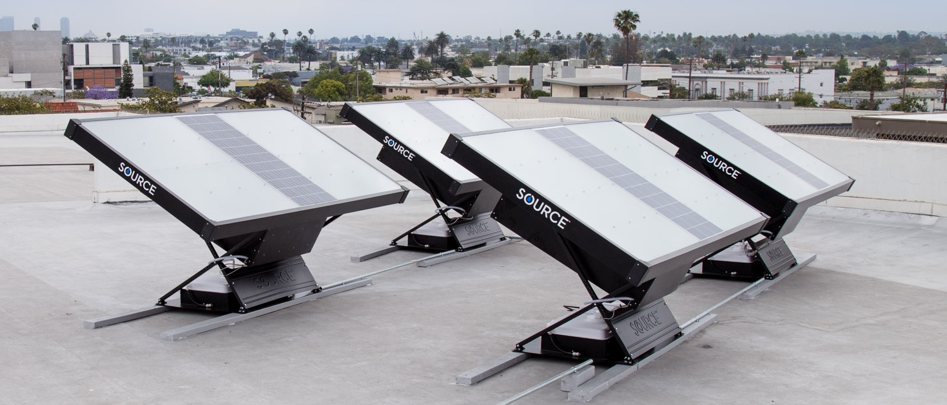
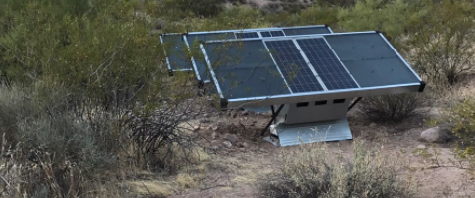
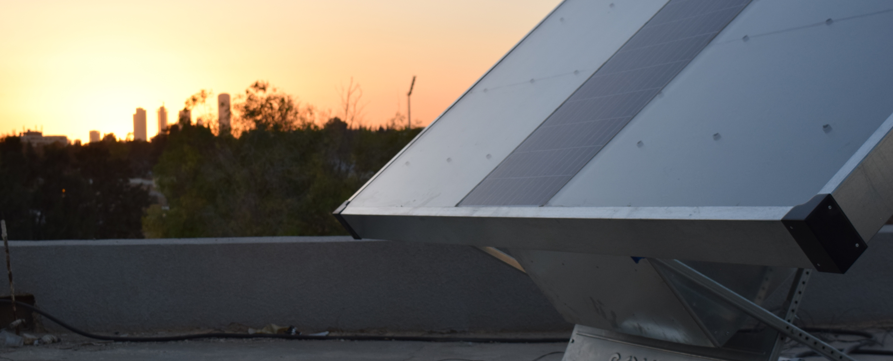
Applications of Hydropanels
Luxury
Schools
Disaster Relief
Child Care
Single Family Homes
Offices
Wildlife
Senior Living
Government

Slide 27
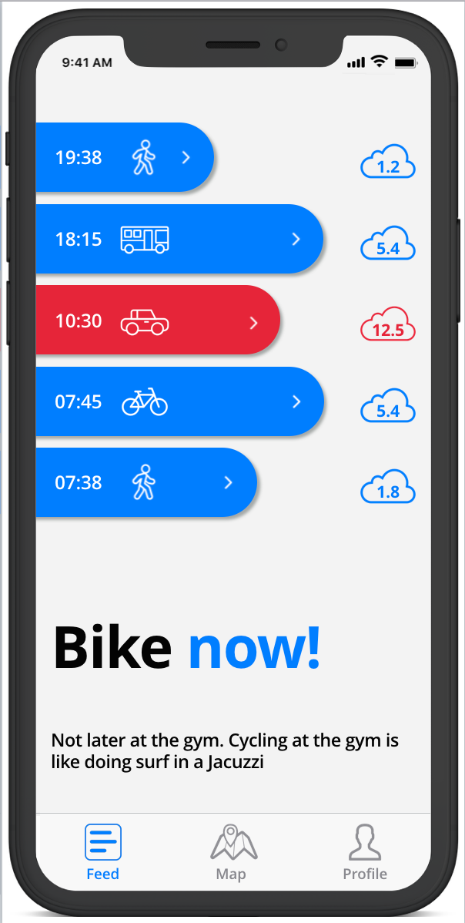
New Sustainability App
How green is your commute?
Notes:
We are currently trialling a new sustainability App for Pacific. This should be available by the time of the conference is on so we could demonstrate the live version. Find out what your sustainable mobility is worth! When you share a car, bike, walk, or use public transport. You are avoiding CO2 emissions and earning credits. Turn your credits into rewards and discounts with this application.
1 kg of CO2 every 7 km - This is the average emission of a car in urban traffic. In Europe, 150 million vehicles emit 1 million tons of co2 into the atmosphere every day
CO2 credits - Gives you credits for every kg of avoided CO2: choose how you get around and find out what your sustainable mobility is worth.
Certified CO2 - The only platform in the world that allows you to truly contribute to reducing the emission of greenhouse gases. ISO 14064 Certified
Carpooling - The App makes carpooling super easy! Offer a ride or find the ride you need. More passengers mean more credits: 4 credits each for 2 passengers, 5 credits for 3, and 6 credits for 4 (per km).
Public Transport - The amount of CO2 you avoid depends on the type (train, bus) and the fuel (gasoline, natural gas, electricity). that’s why the credits you earn are based on an average: 4 per km

Slide 28
Top 10 Emerging Technologies of 2017 Sustainable Design for Communities & Deep Learning
Deep Learning
Sustainable Apps
Source: World Economic Forum - https://www.weforum.org/agenda/2017/06/these-are-the-top-10-emerging-technologies-of-2017/

Slide 29
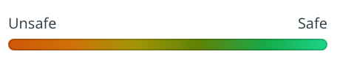
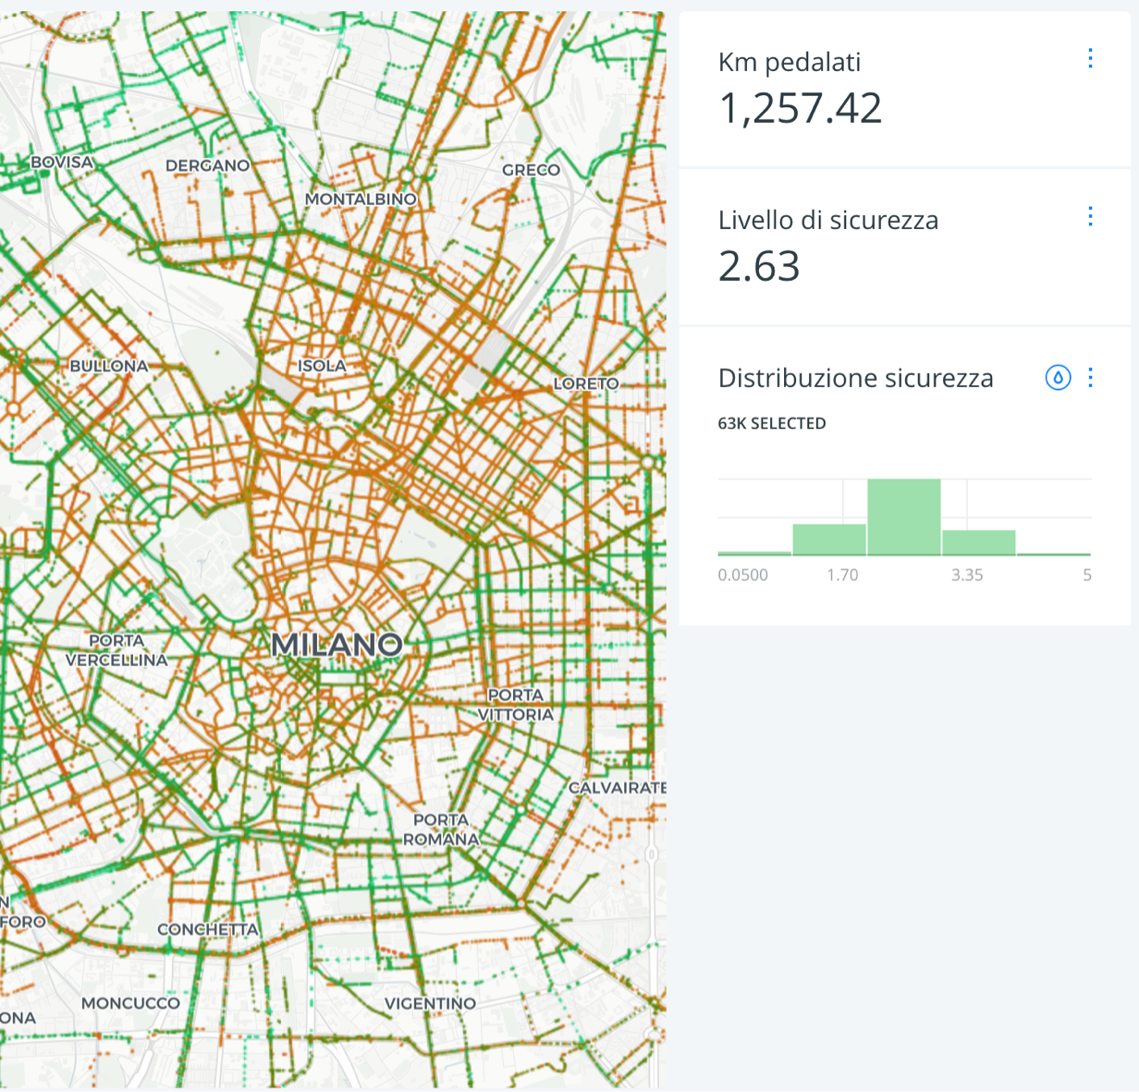
Sustainability App Other Initiatives
Check out the power of the crowd
20 biggest Italian cities have mapped their streets in order to improve safety of cyclists
How green is your commute?

Slide 30
Thank You
John Magnifico
Solved (Fiji) Pte Ltd
+679 837 5953
john@solvedgroup.com

