Slide 1



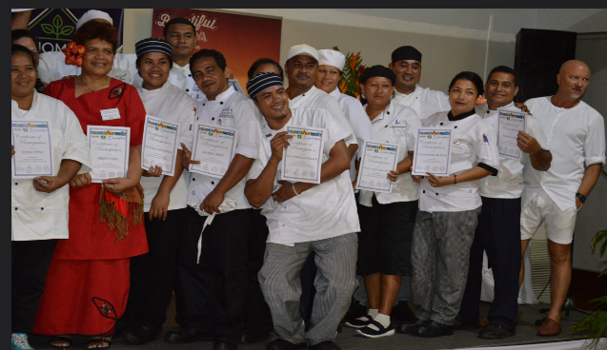

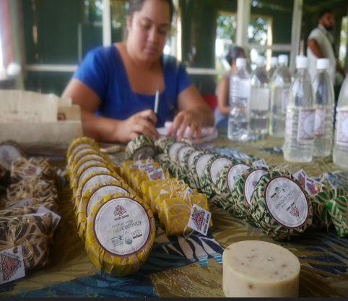

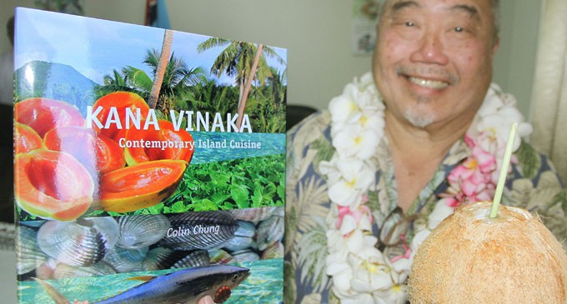
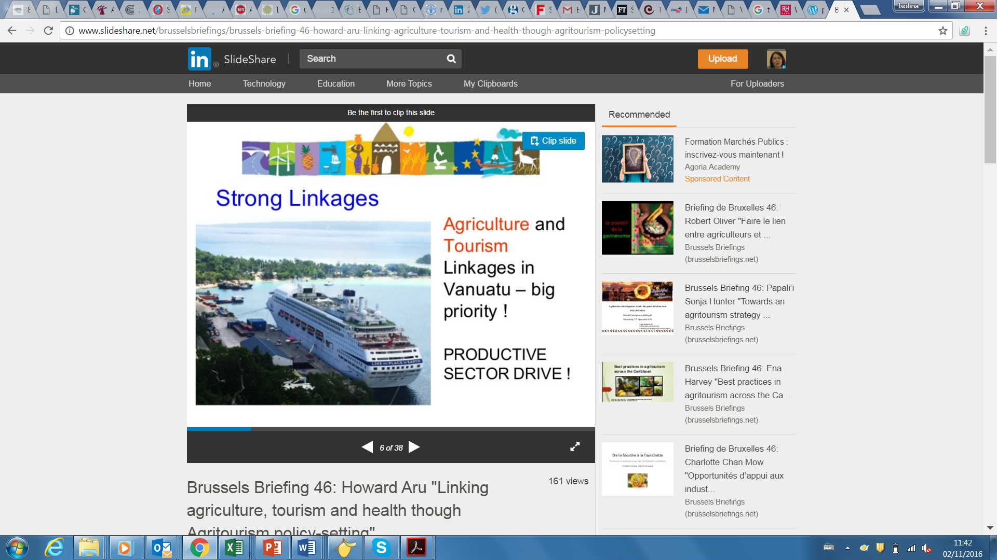
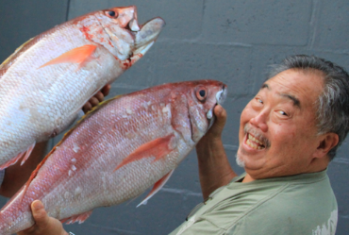






.
Promoting Agritourism Development in ACP Small Island Developing States (SIDS)
Fiji, 1-2- April 2019

Slide 2
Background
Agriculture and Tourism (Trade/Health) are key economic sectors in most of SIDS and promoting linkages between the two leads to employment creation, higher incomes for value chain actors and revenues for Governments
Travel & Tourism are booming sectors and the islands need to diversify their economic base
Hotel industry needs to be sensitised to increase local sourcing
Farmers need capacity to meet food safety and quality standards, consistency of supply, product development and branding. Clusters for supply
Increased numbers of new and regular visitors should mean: (i) economic development of the region; (ii) increased income and revenues for value chain actors, smallholders and rural communities; (iii) promotion of quality local fresh and processed products; (iv) branding of the region as a food destination.
Notes:
Travel & Tourism generated US$7.6 trillion (10% of global GDP) and 277 million jobs (1 in 11 jobs) for the global economy in 2014. Check latest figures
Pacific: • 43% growth in Pacific cruises over 3 years, 22% in local cruises
Generated $US 640 million pa to S Pacific in direct expenditure
Cruise industry carries approximately 21 million passengers • Cruises have grown by 7 percent per annum since 1990 • 23 new ships being delivered between 2013 and 2016 (all larger than 100,000 tonnes)

Slide 3
Food tourism: a sector in expansion
Food expresses local cultural heritage and connects tourists with a destination’s landscape and unique way of life. Travellers today: more experienced, more leisure time and income and looking for new experiences
Cuisine important to quality of holiday Dining is consistently ranked in the top three favourite tourist activities: 25% - 35% of tourist expenditure is on food
Food tourists have significant economic effects in the supply chain
Work needed on the perception of quality of farm commodities. Regular farm visit by representatives of the hospitality industry key to bridge and strengthen commercial linkages and community engagement between farmers and hotels
Promotional and educational campaign to help elevate the value of local farm commodities & reshape the market perception of quality of local farm produce
Notes:
http://chefs4dev.org/

Slide 4
Promoting food tourism: next steps
Strengthening Chefs associations
Caribbean Culinary Alliance launched in August 2017. Regional Culinary Association planned in the Pacific
Promoting more use of local food in big resorts through alliances with chefs ad business agreements with those markets
Train the next generation of young chefs
Awareness raising to increase local consumption and demand through media, TV programmes on local food and cuisine…
National/regional food festivals led by the public and private sector
Build the supply capacity in quantity and quality of farmers and processors
Knowledge sharing of best practices across ACP

Slide 5


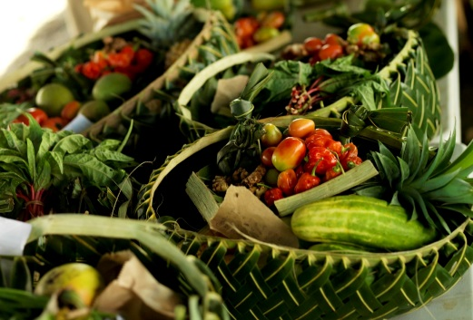
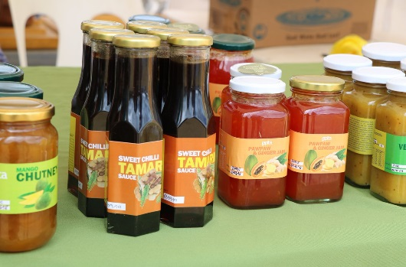
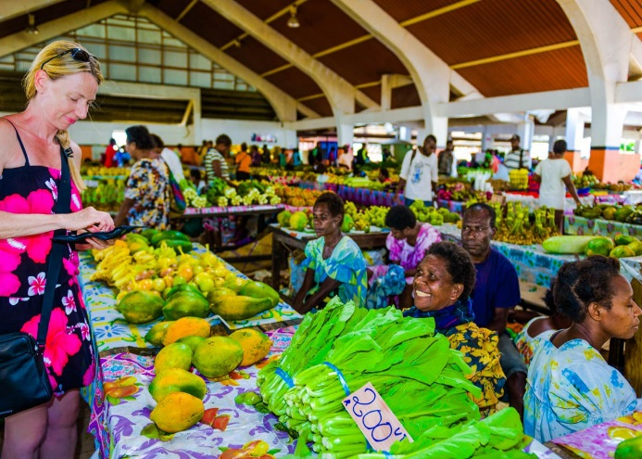

Progress in the Pacific region
CTA, PIPSO, SPC organised two Pacific Agribusiness Fora in Fiji & Samoa: recommended design agritourism policies. 2015-2016
Eight consultative national Policy setting workshops organised in Vanuatu, Samoa, Solomon Islands, Fiji, Tonga, Tuvalu, Cook Islands, Kiribati which led to concrete policy measures and identification of PPPs. Workshop for PNG planned.
At Pacific Week of Agriculture, agritourism priorities presented to the Pacific Tourism Ministers meeting. Training sessions of chefs
Agritourism embraced in the region as a key sector. Various projects already supported by Governments or partners.
a
Notes:
Details will be provided in countries presentations. partners ICT support (WIBDI) linking producers to markets through mobile apps
business case developed with Joe’s Farm (Fiji major supplier of fresh and processed farm products) aggregating farmers and their production

Slide 6
Recommendations to the Pacific Agriculture Ministers Meeting on Agritourism
Enhance harmonisation of agriculture, trade and tourism policies
Support increased sourcing of fisheries and seafood by the tourism industry
Develop a Pacific branding strategy in the global tourism market
Upscale chefs’ trainings to address local sourcing & promotion of Pacific cuisine
Develop new markets, such as Spa and Wellness which will support the local food industry (coconut, fetau, essentials oils) and contribute to diversification
Strengthen the capacities of value chain actors in accessing technology, capital and business support services
Expand training on branding, product labelling and marketing
Promote sound PPPs and investments into technology (processing facilities, transport and infrastructure development) with a regional dimension
Accelerate trainings on food safety standards and certification for farmers, processors & food safety inspectors (regional dimension
Regional expansion of business fairs targeting the tourism market is also central to enhancing opportunities for the private sector.

Slide 7
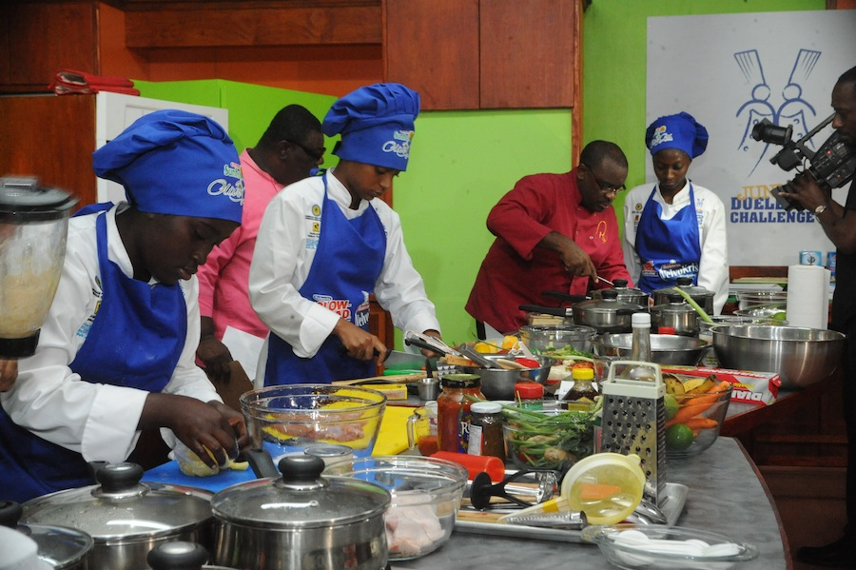


Progress in the Caribbean region
2 Caribbean Agribusiness Fora.
10 companies trained in HACCP
11 successful agritourism business models analysed in 5 countries
Caribbean Culinary Alliance (2017) annual fair, trainings, TV programme
Major private sector groups (Busha Browne) serving tourism markets
Agritourism by CARICOM
Agritourism policy support: Barbados, St Vincent & Grenadines, Suriname, Jamaica, Grenada,
St Lucia
a
Notes:
Companies: Seasoning Marinades/spice blends, sauces and preserves. Frozen staples (sweet potato, cassava, breadfruit). Spices powders.
Virgin coconut oil, fish and seafood ; processed vegetables; Canned, bottled, baked and frozen fruits; frozen sweet potato, cassava, dasheen and plantain cubes, chunks, wedges and scallops. frozen coconut water and fruit juices; frozen cassava and sweet potato fries

Slide 8
Progress in the African region
Agritourism policy development in Mauritius, Madagascar, Seychelles and Cape Verde. Fundraising proposals developed with those four governments.
A regional agritourism strategy will be designed for end 2019 building upon the work at national level.
2018 Launch of a pilot in Cameroun with PROPAC and the Association of Chefs of Cameroun (15 out of membership of 52 major hotels and restaurants) to source cassava from a women’s cooperative. After a market study with the 15 hotels and restaurants, currently training the women in food safety and acquisition of technology in packaging and labelling.
Africa has an expanding market but also a growing middle class who could make a difference if they were supporting local food production.
Youth and ICTs as well as urban agriculture.
Notes:
Seychelles : perception of quality of farm commodities;
The need to improve marketing of local produce.

Slide 9
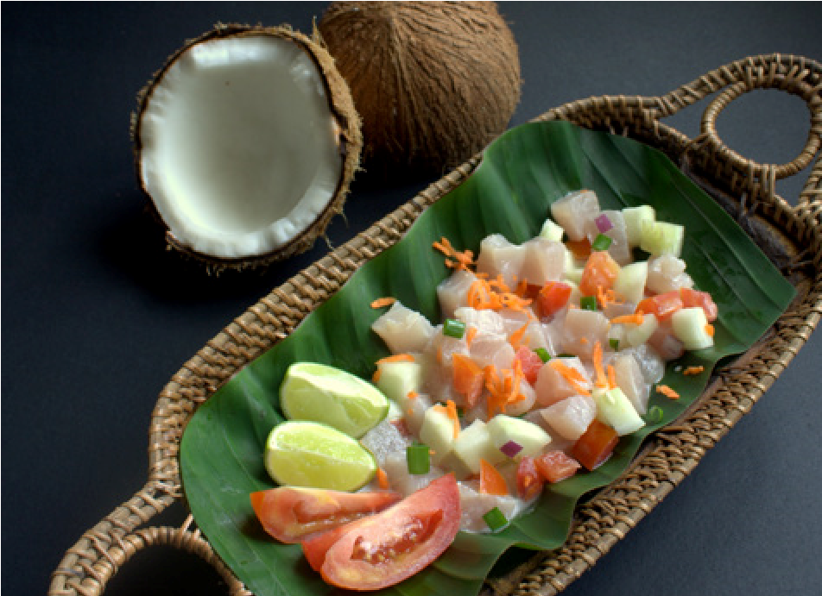
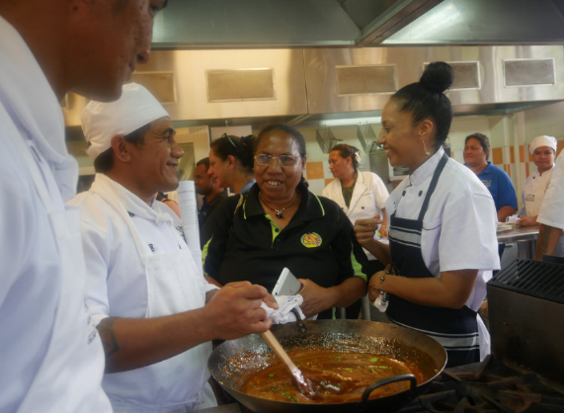

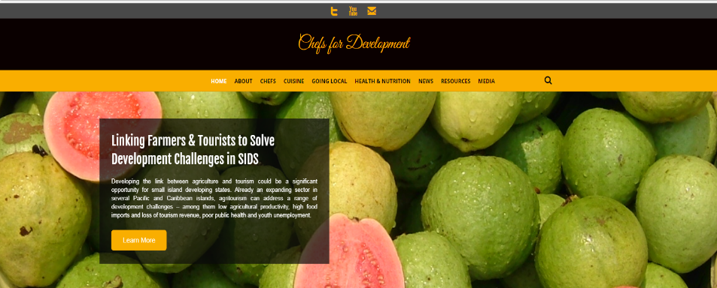
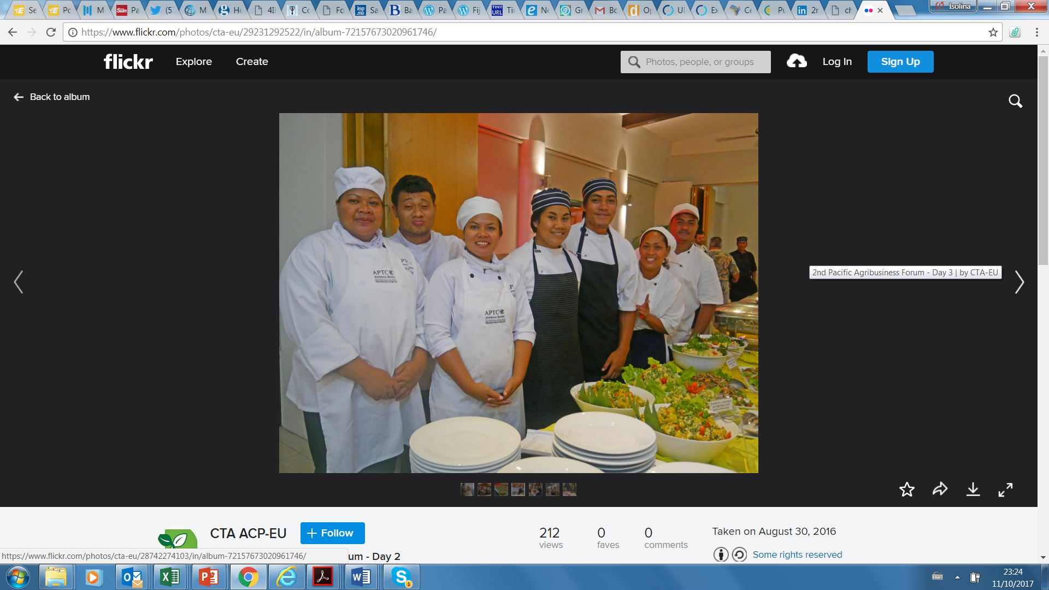
Branding the region as a quality food destination : the role of Chefs
Sensitising local chefs to the use of local products, closer linkages with farmers groups and promotion of local cuisine are key to capturing the tourism market.
http://chefs4dev.org

Slide 10
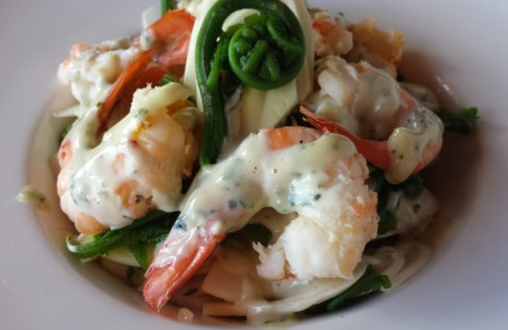
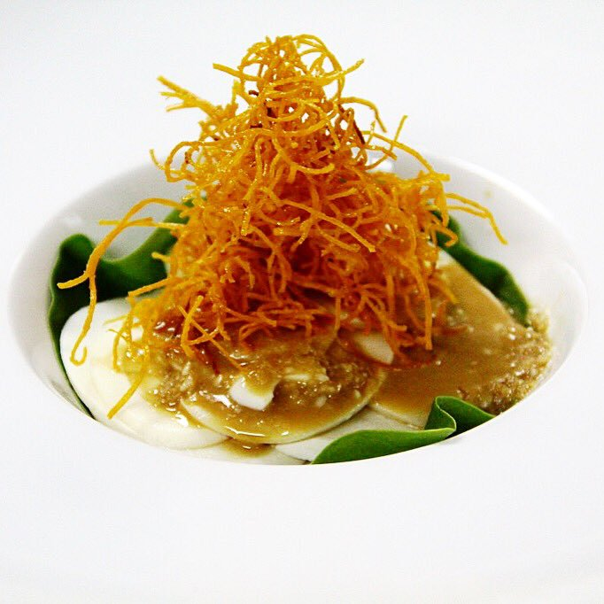
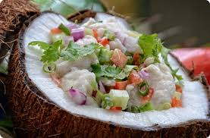

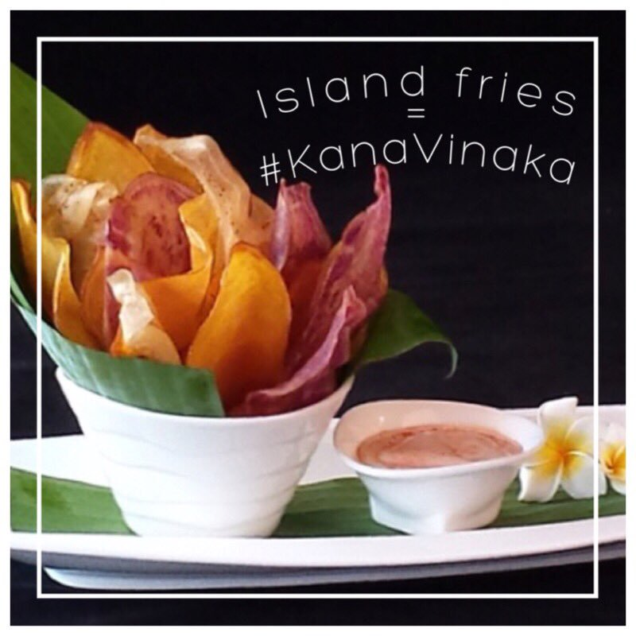
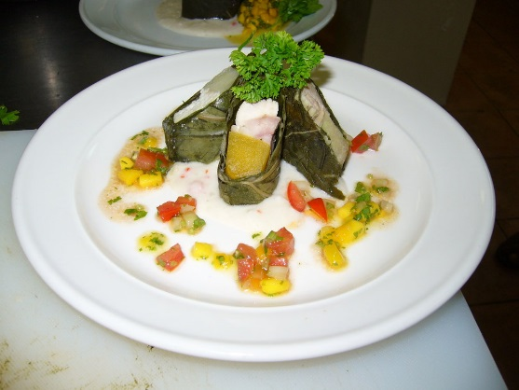

The recipe cook book Kana Vinaka, written by chef Colin Chung, emphasises the importance of including Fijian-grown produce in menus. A Memorandum of Understanding has just been signed between the Ministry of Agriculture and Colin, to create awareness to Fiji’s bountiful produce and how it can be used in contemporary and appetising ways in producing local dishes. It will be used for educational purposes in schools.

Slide 11
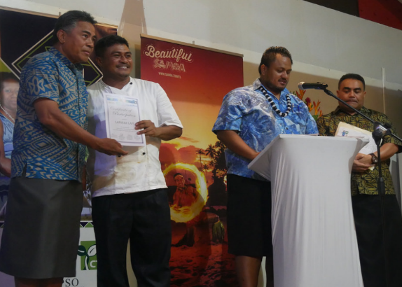
    .
    Thank you
Chefs4Dev site and

