Slide 1
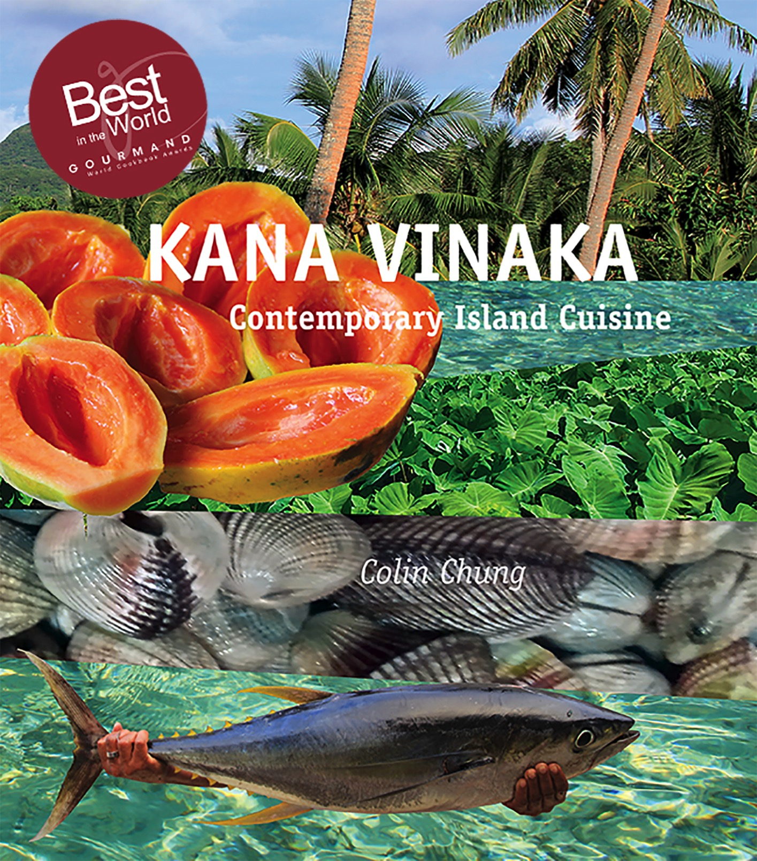

Slide 2
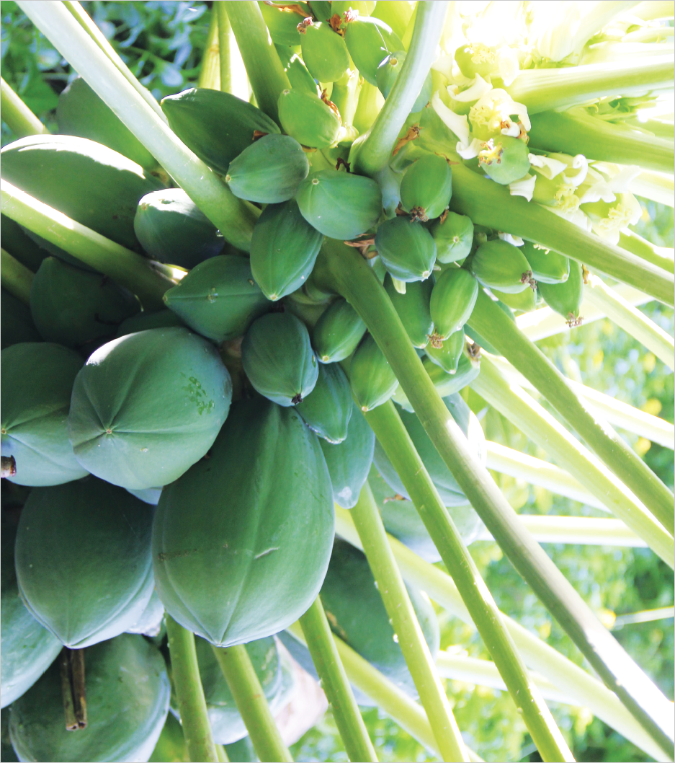
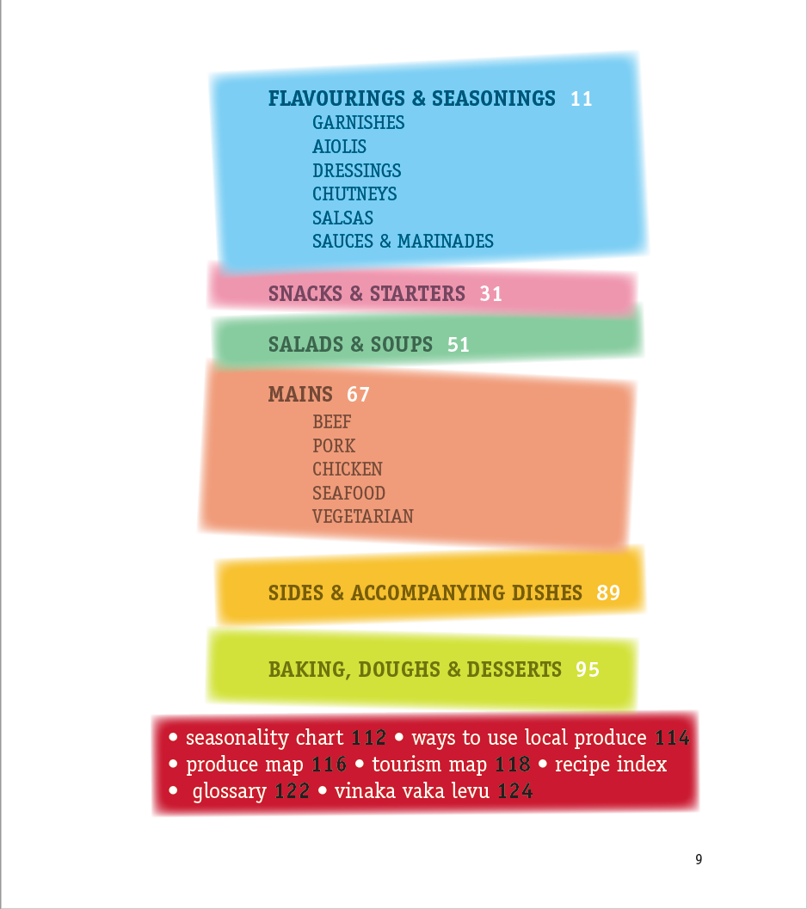

Slide 3
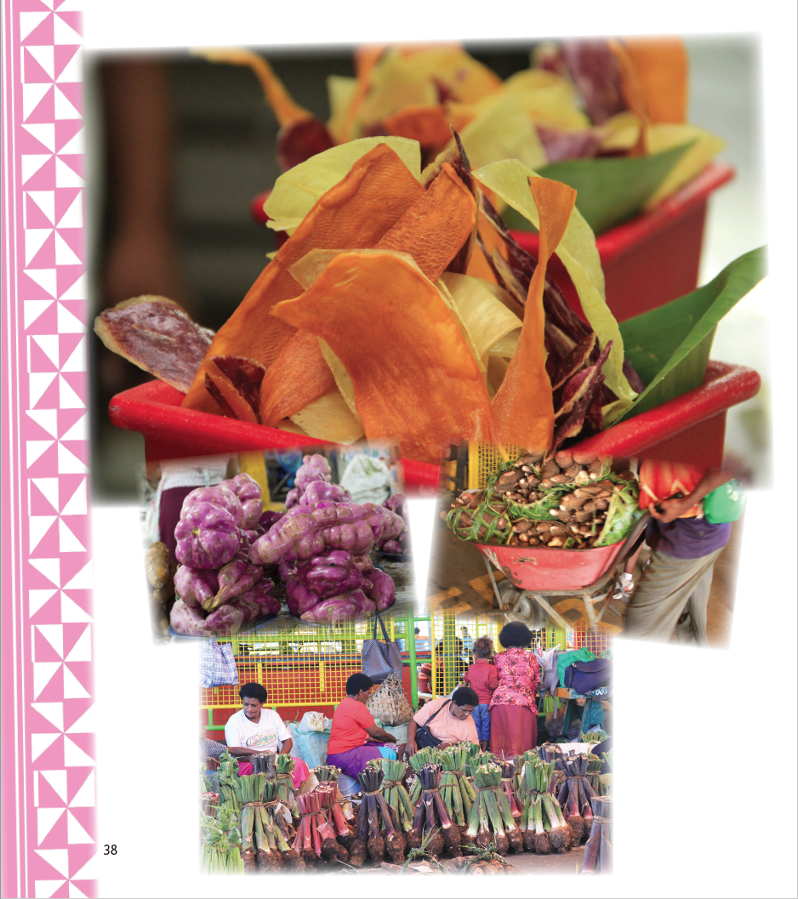
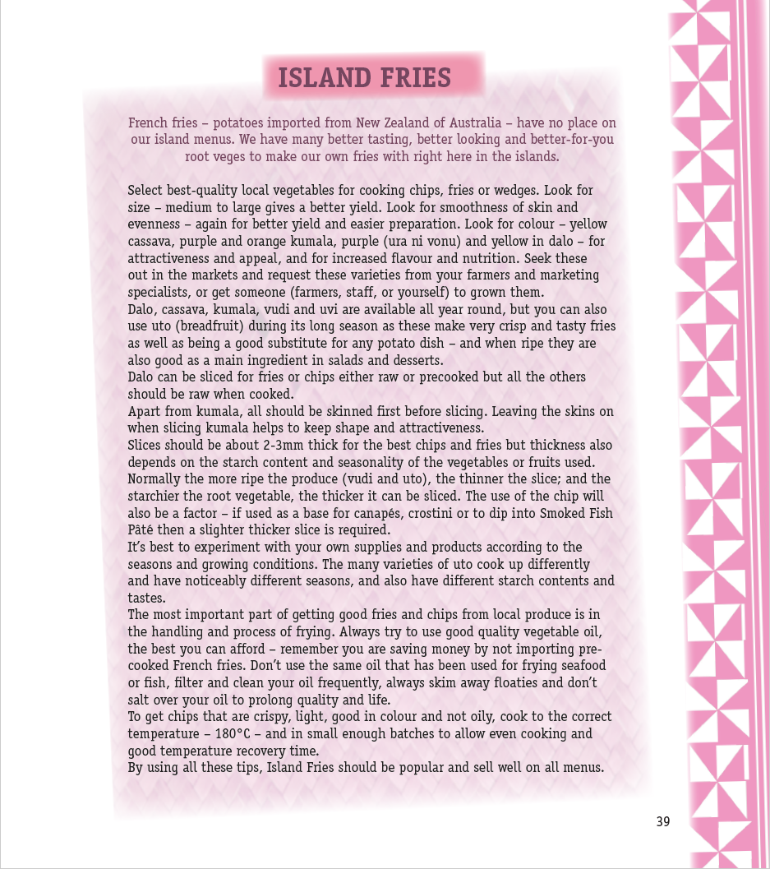

Slide 4
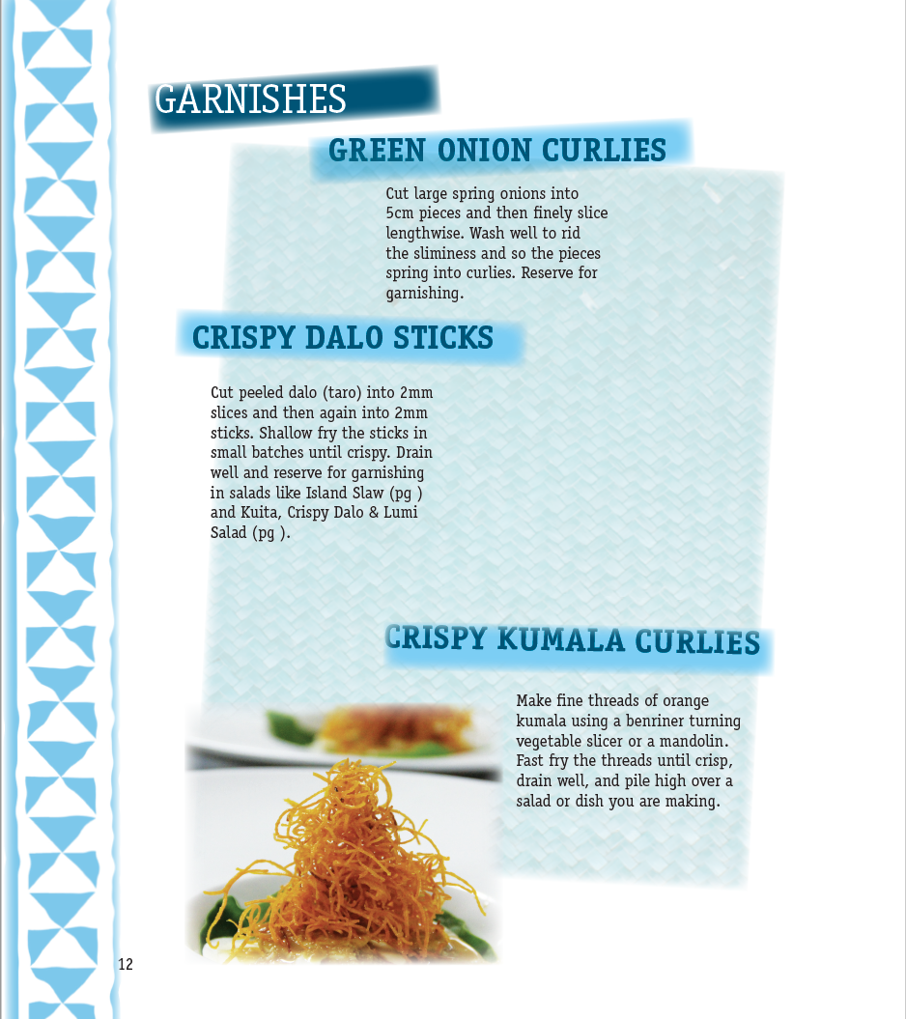
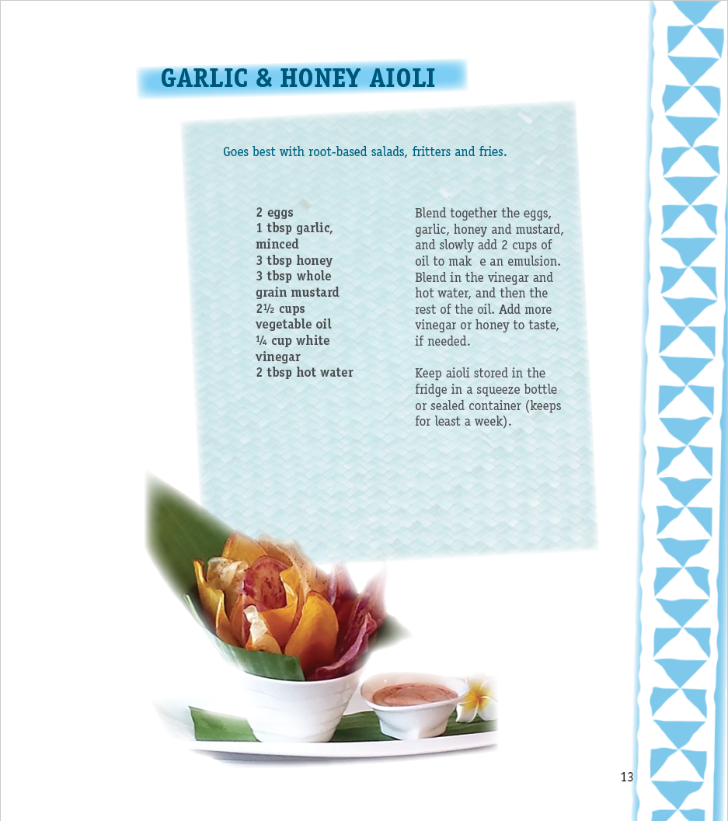

Slide 5
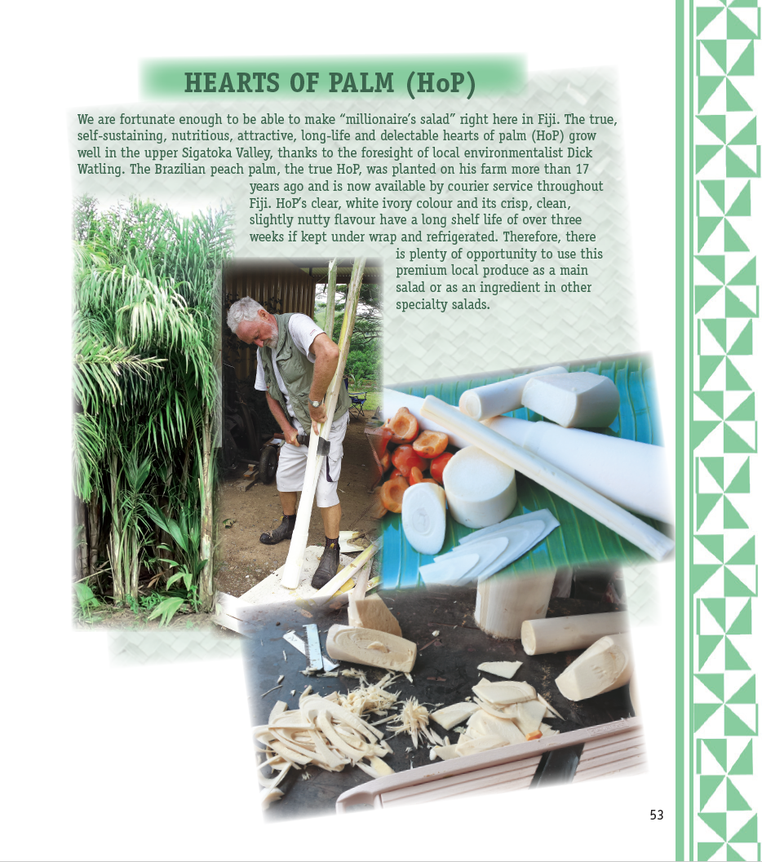
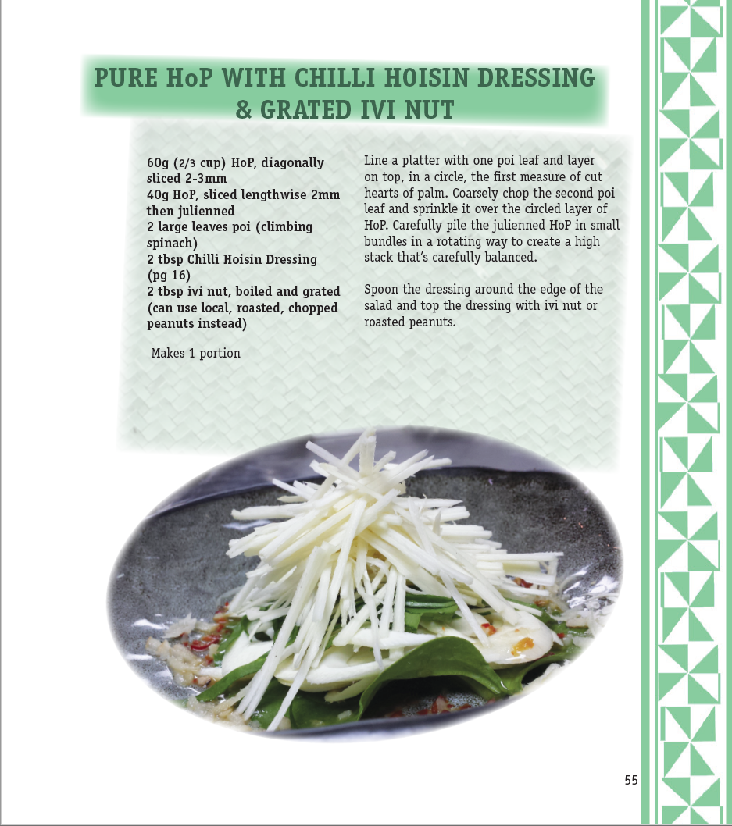

Slide 6
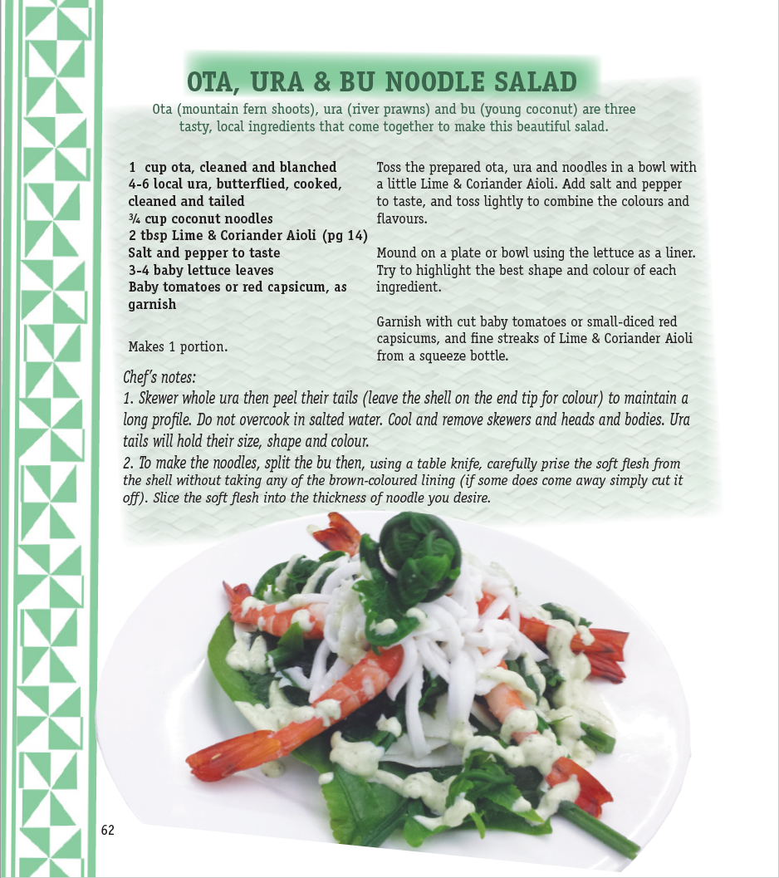

Slide 7
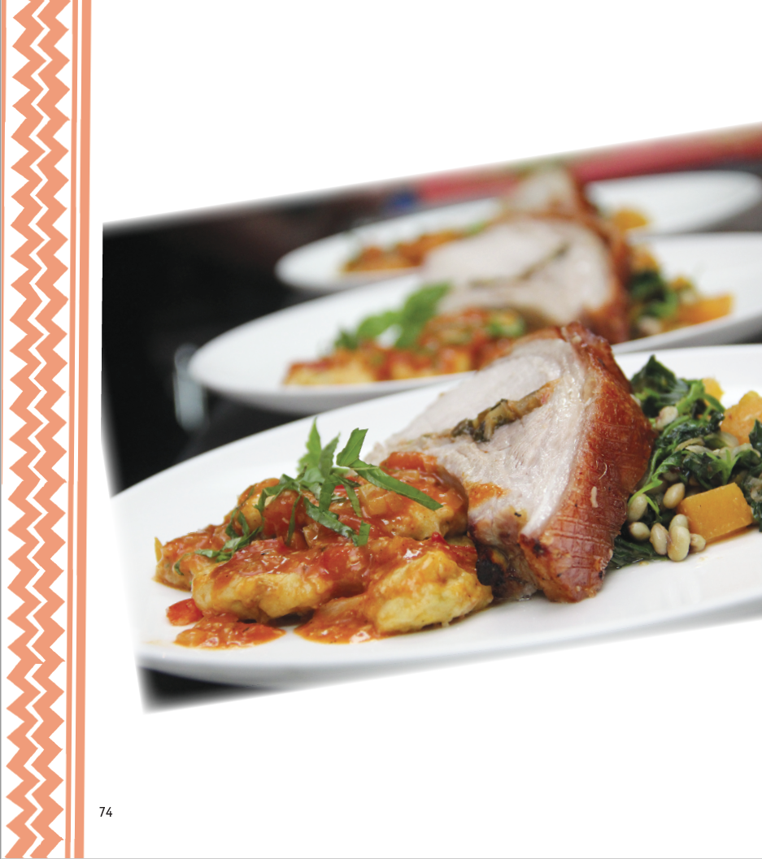
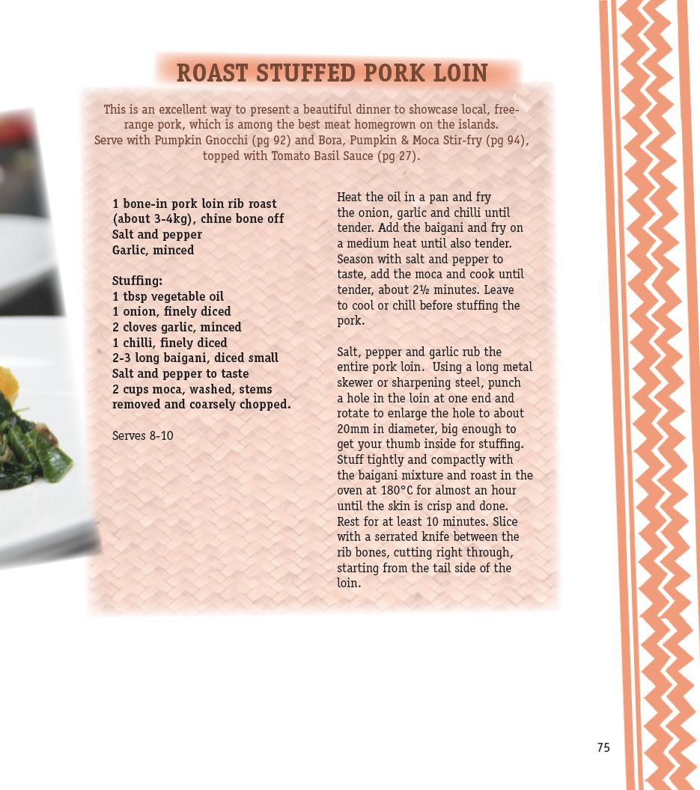

Slide 8
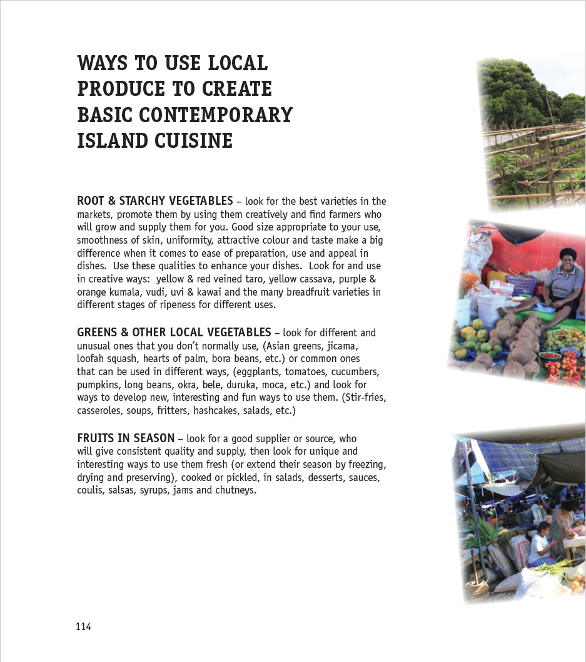
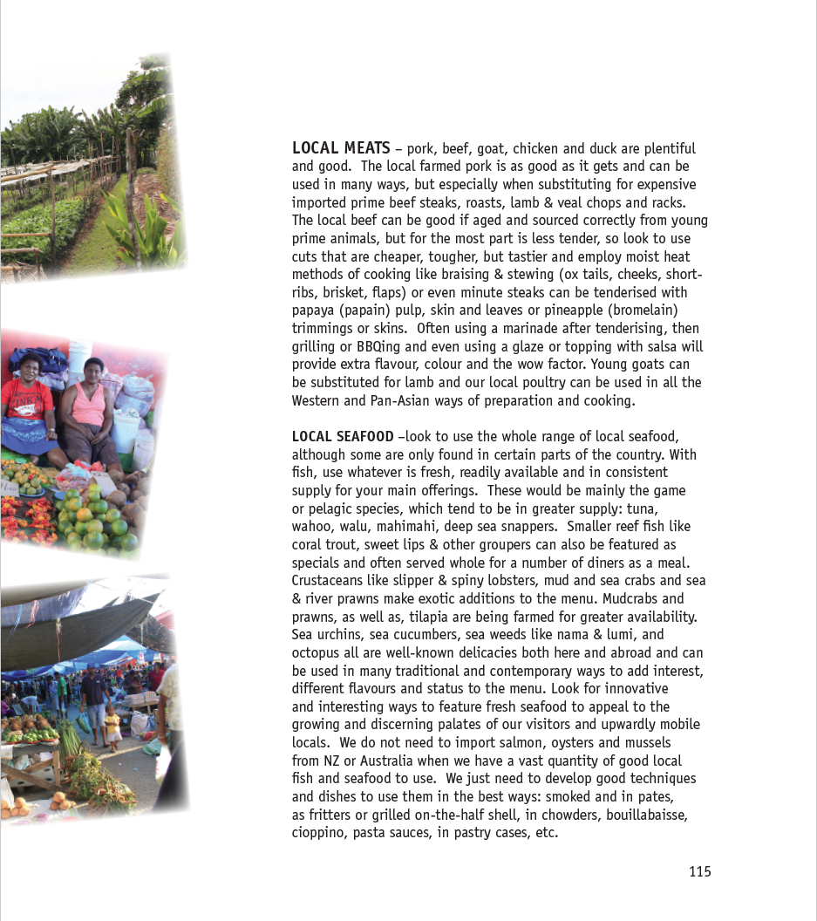

Slide 9
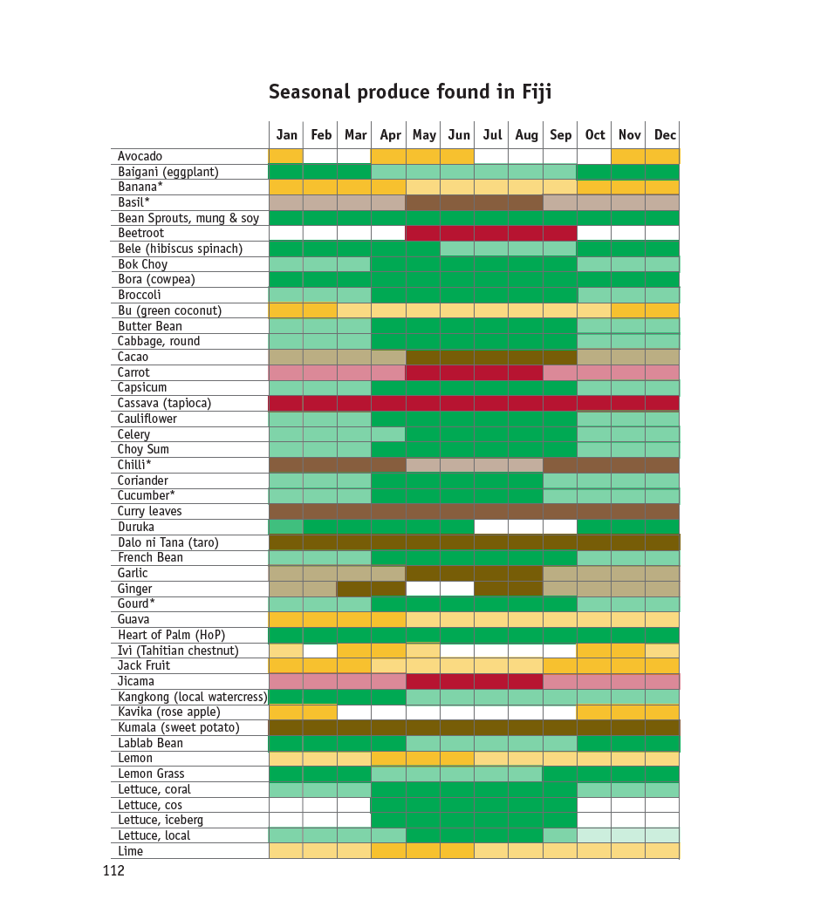
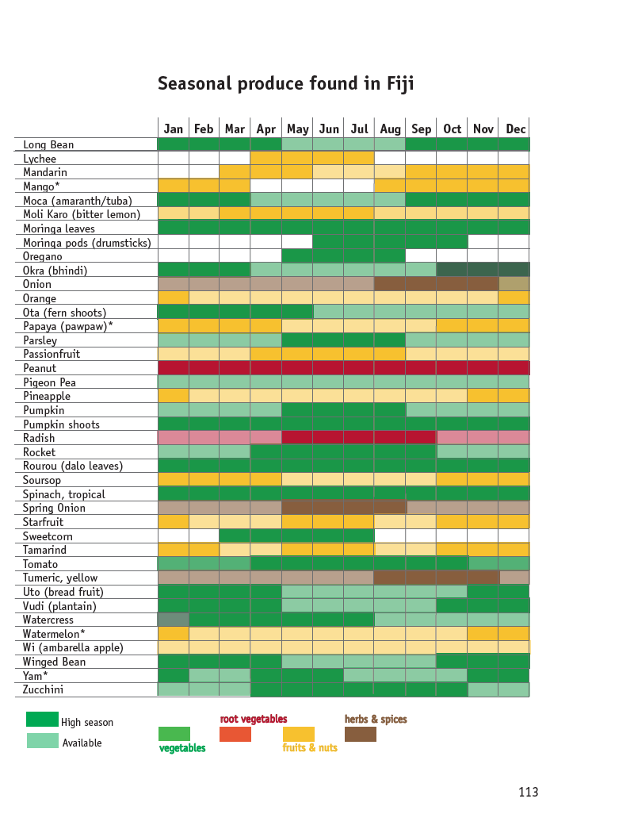

Slide 10
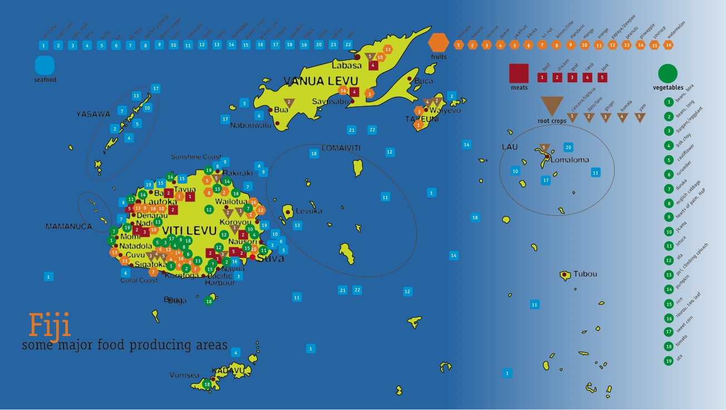

Slide 11
AGRI-TOURISM TRAINING WORKSHOPS CONDUCTED;
SPTO Pacific Island Culinary Workshops – Nadi, Apia & Savaii in Samoa, Tuvalu and Munda, Solomon Islands
MoA & MITT jointly sponsored CTWs – Botaira, Yasawas, Beachouse, Coral Coast
MoE CTW workshops – Suva and Nadi
Other private workshops:
Novotel Nadi 2 sessions to reduce food cost and learn to use as much local produce as possible.
Captain Cook Cruises similar, week long cruise to show best use of seafood and vegetarian alternatives

Slide 12
………….continued
Raffe Hotel Group - Plantation, Lomani, Gateway (lower food cost, increase use of local produce in new dishes)
RFMF – upgrade army cooks Suva
Uprising Resort (co-share with SSC, Nanuya, Talanoa Treks

Slide 13
Proposed and planned Culinary Training
MoA-MITT Sun Coast & Savusau 2019
MoE August 2019
BSP Life – staff and High Value Clients, video clips for general public
FNU – inclusion in new courses (NTPC new courses, cookery classes to include better use of local produce in creating Contemporary Island Cuisine )

Slide 14
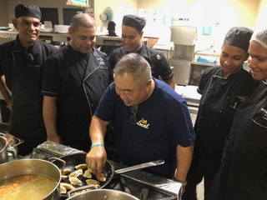
Novotel Nadi Culinary Training and Menu Modernisation

Slide 15
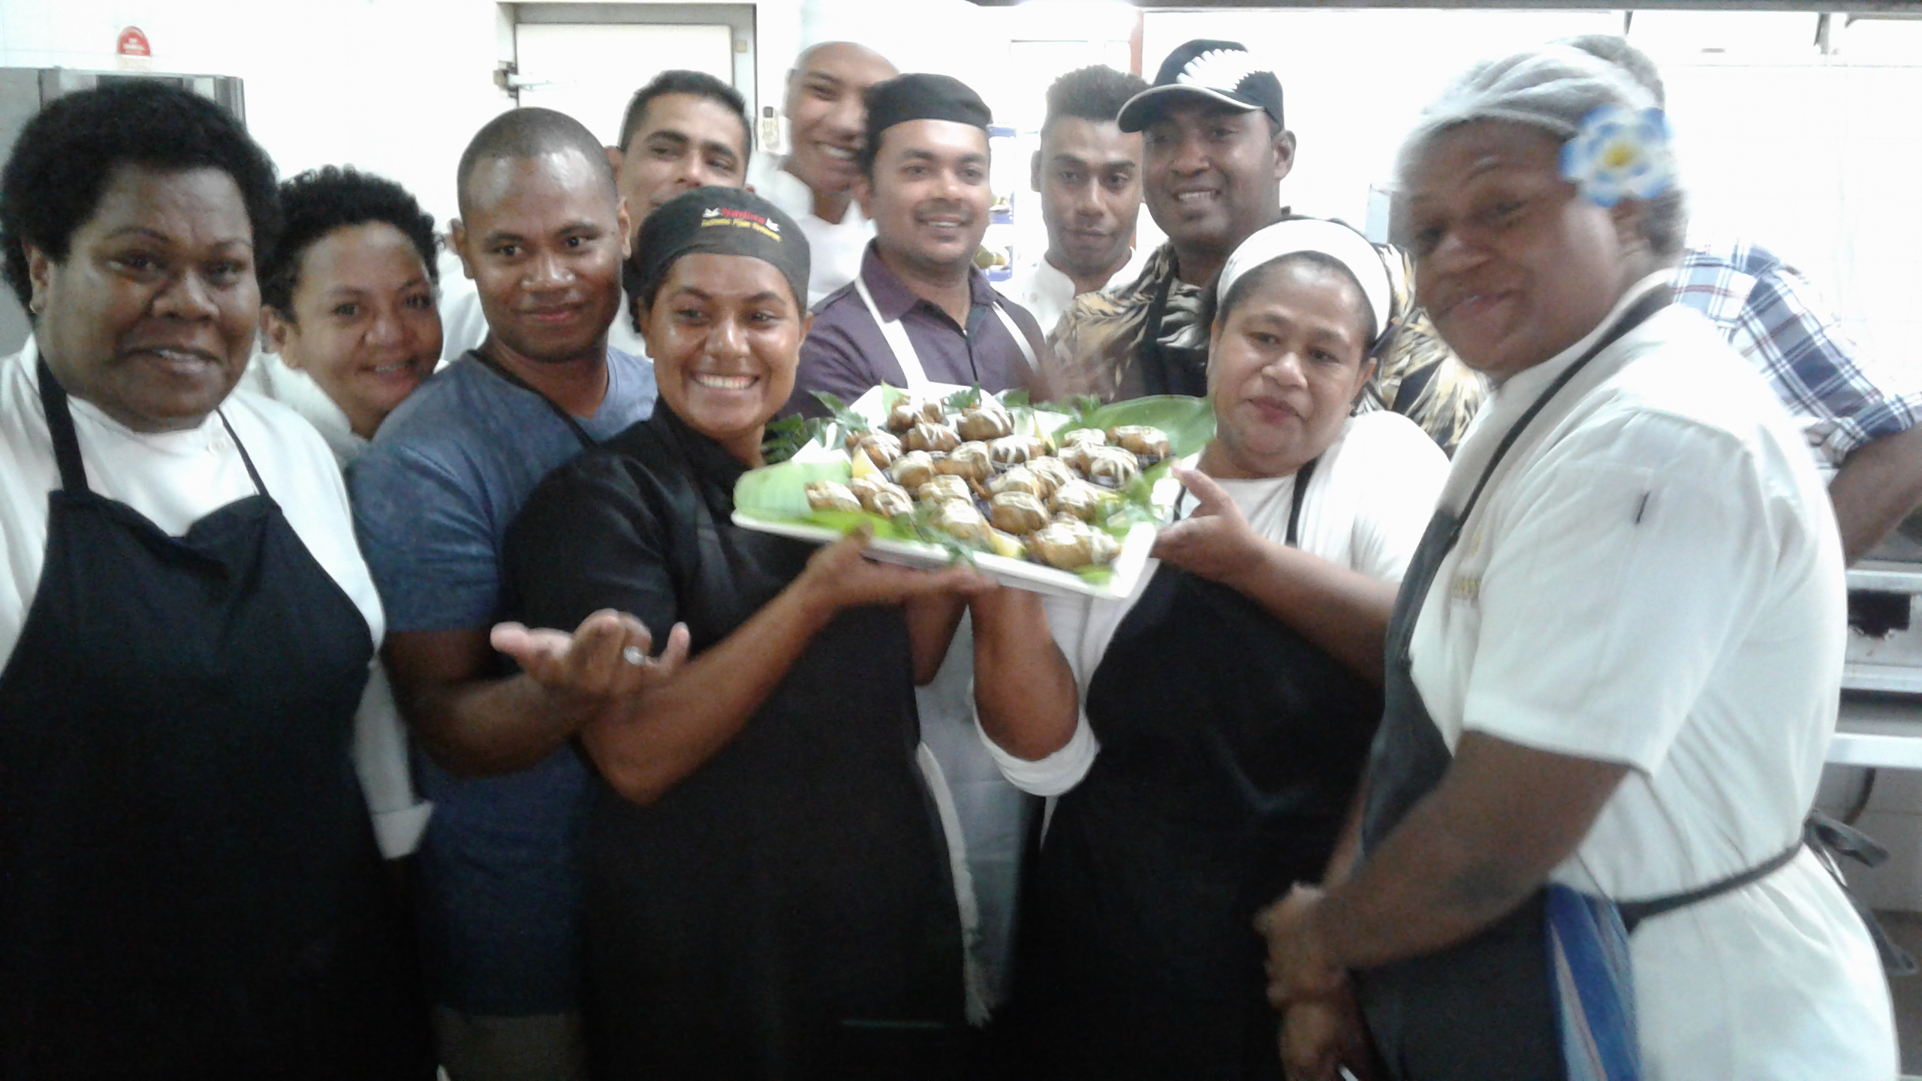
Ministry of Agriculture & MITT CTW at Beachouse

Slide 16
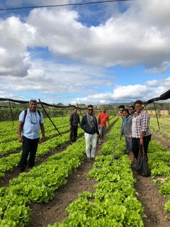
MoA-MITT Sigatoka Farm visit

Slide 17
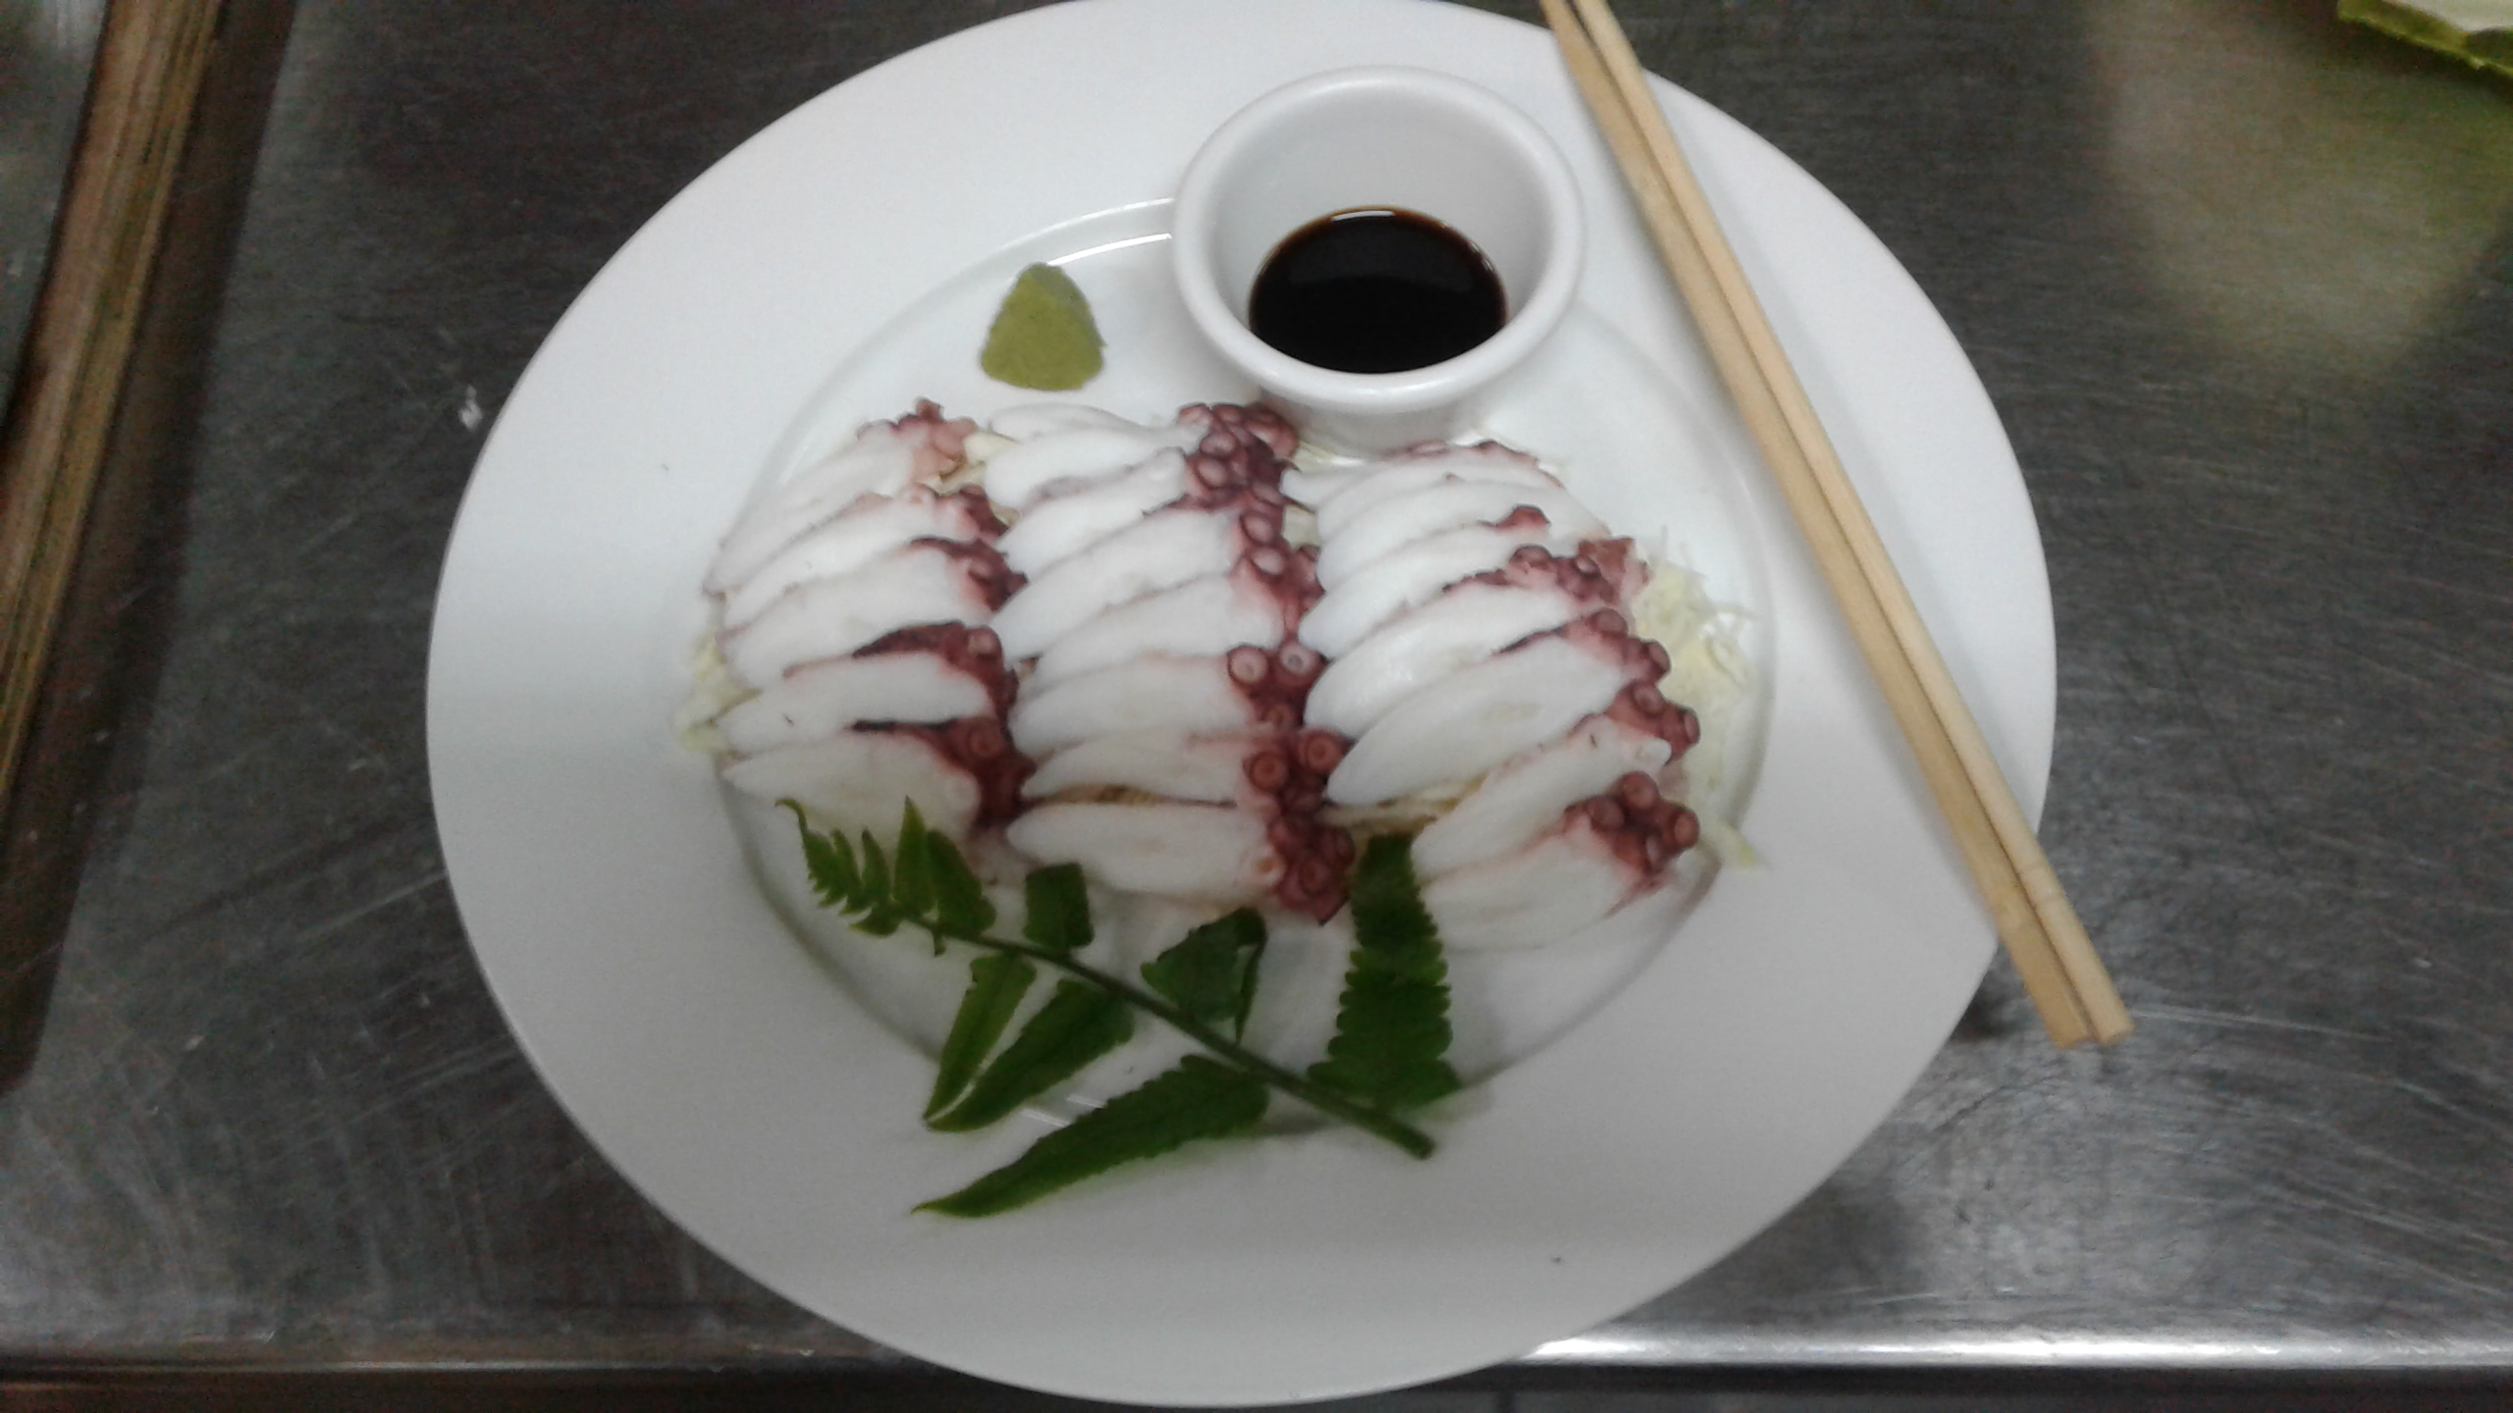

Slide 18
Uprising Resort Culinary Training Workshop with invited participants

Slide 19
Royal Fiji Military Forces training in MoE facility

Slide 20
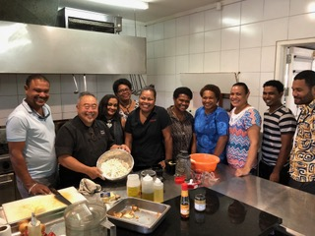
Suva Master Class & Kana Vinaka dinner at Paradiso

Slide 21
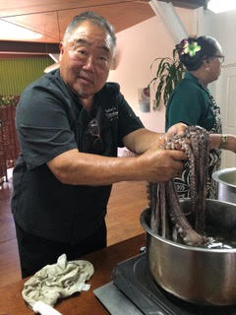
Flavours of Fiji Cooking School

Slide 22
Ministry of Education
Home Economics teachers, Technical College lecturers and Boarding House cooks

Slide 23
SPTO Tuvalu training

Slide 24
Nanuku 5 star dinner for house guests and visitors from Suva

Slide 25
Munda, Solomon Islands CTW

Slide 26
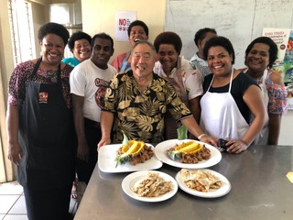
MoE CTW 2

Slide 27
Captain Cook Cruises – new vegetarian menu inclusions

Slide 28
CTW potato substitution
Morning Tea (10-10:30qm)
Discussion, demonstration, production of SUBSTITUTES FOR POTATOES (10:30-1pm)
Island Fries & Chips, garlic honey aioli Hashed Local Root Vegetables Mashed Combos (pumpkin & kumala) Dalo & Moca Hashcakes Dalo or Pumpkin Gnocchi
Lunch Break (1-1:45pm)

Slide 29
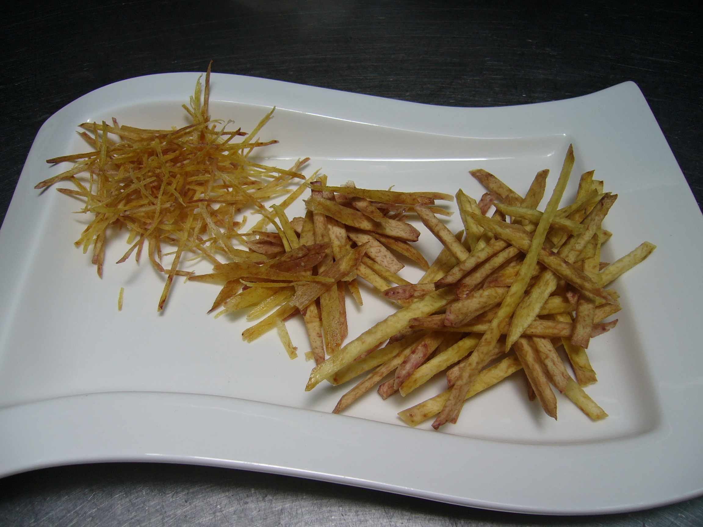

Slide 30
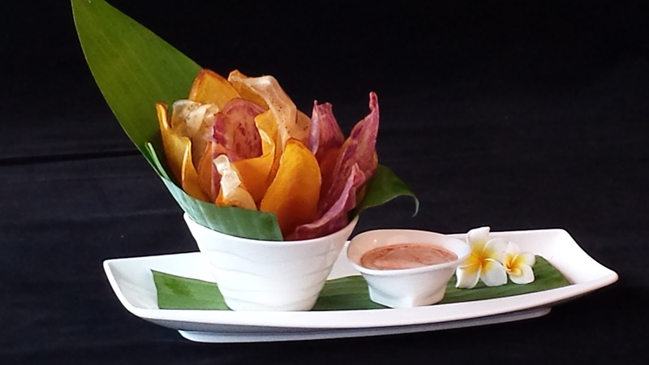

Slide 31
TUESDAY: Discussion, demonstration, production of LOCAL VEGETARIAN & VEGAN. (8-1pm)
Pulled Jackfruit (Pork) Jackfruit & Bora Tex/Mex Chilli Vegetarian Bolognese Uto wafers, carmelised onions, feta
Morning Tea (10-10:30am)
Island Nachos of Yellow Dalo Chips, Vegetarian Chilli & Cheese
Jackfruit and Eggplant Moussaka Gluten-free Vegetarian Lasagna

Slide 32
Chef’s Capacity Building How and Where to?
1. Find a way to fund a book for each Pacific Island nation to show the special value and variety of their local produce, traditional foods and customs as well as Contemporary Island Cuisine in each country as is shown in Kana Vinaka which they would be proud of, and can be used as an effective training tool.

Slide 33
2. Funding to train expatriate chefs and General Managers new to the islands
3. Introduce a basic week long Kana Vinaka training session in all first year cookery courses, and including market gardening
4. Cooking school lecturers to be up skilled on using local produce in contemporary ways for the hospitality industry
5. Funding for linking farmers with local nearby resorts
6. Introduce new varieties of fruit and vegies that will do well here and can be used effectively to feed locals and visitors alike
7. Assist farmers with seeds, irrigation, better growing methods – stop subsiding sugar and support these farmers to grow market garden crops that are needed to feed locals and visitors

Slide 34
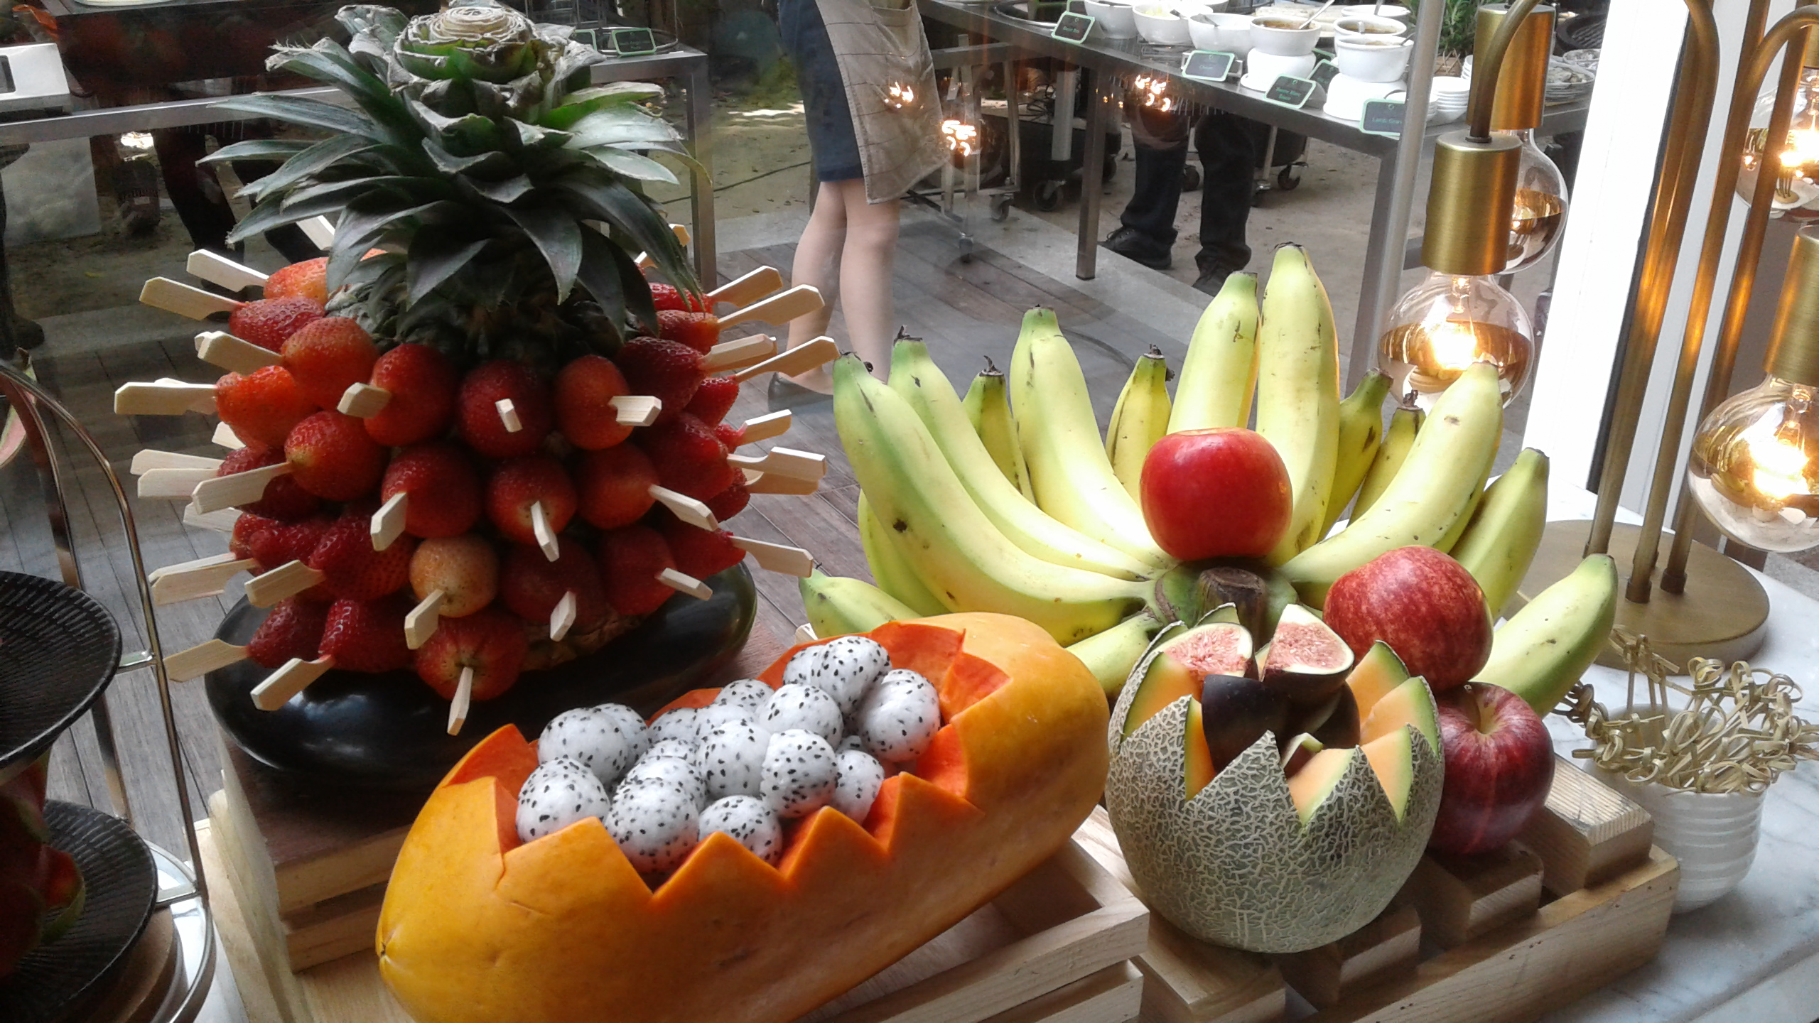
EAT LOCAL

