Slide 1
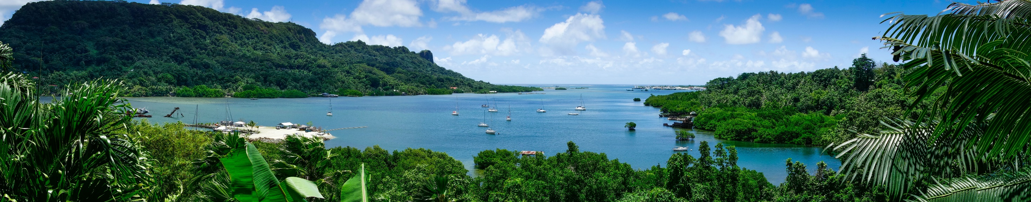

REGIONAL POLICY SETTING FOR IMPROVED LINKAGES BETWEEN AGRICULTURE, TRADE AND TOURISM
Strengthening the Agrifood Sector and Promoting Healthy Food in Agritourism
Branding the Pacific as Delicious Food Destinations: The Pacific Sustainable Tourism Experience
Christina Leala Gale
Manager, Sustainable Tourism Development
1-2 April 2019, Nadi, Fiji

Slide 2
THE PACIFIC
Our islands, environment and culture are yours to discover, experience, respect!

Slide 3
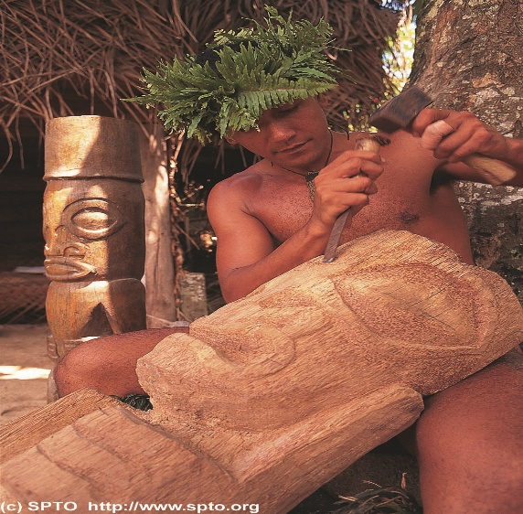

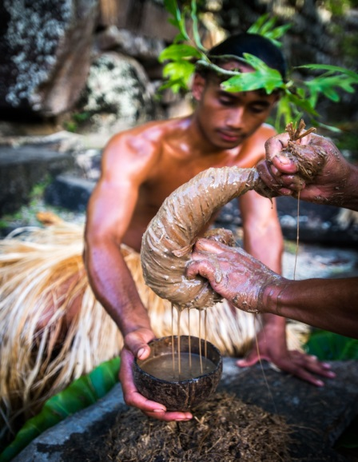
THE PACIFIC TOURISM OFFERING
OUR ISLAND ENVIRONMENT
PEOPLE
CULTURE

Slide 4
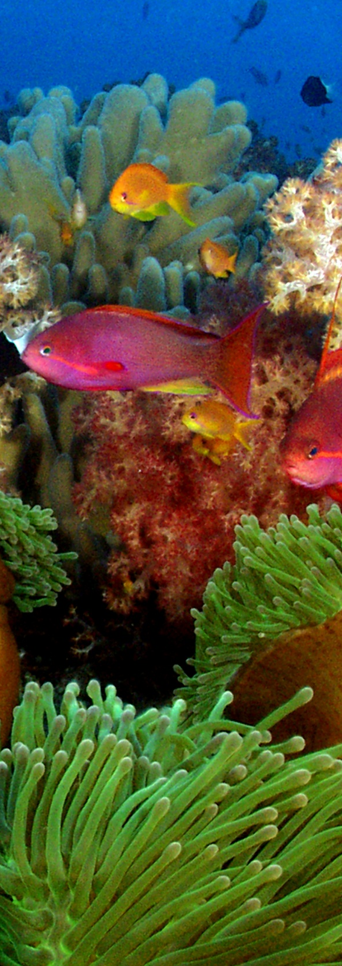
PRESENTATION OUTLINE
SPTO in brief
Branding in the context of Destinations
Pacific Food Destinations and the Sustainability Tourism Experience
Way Forward

Slide 5
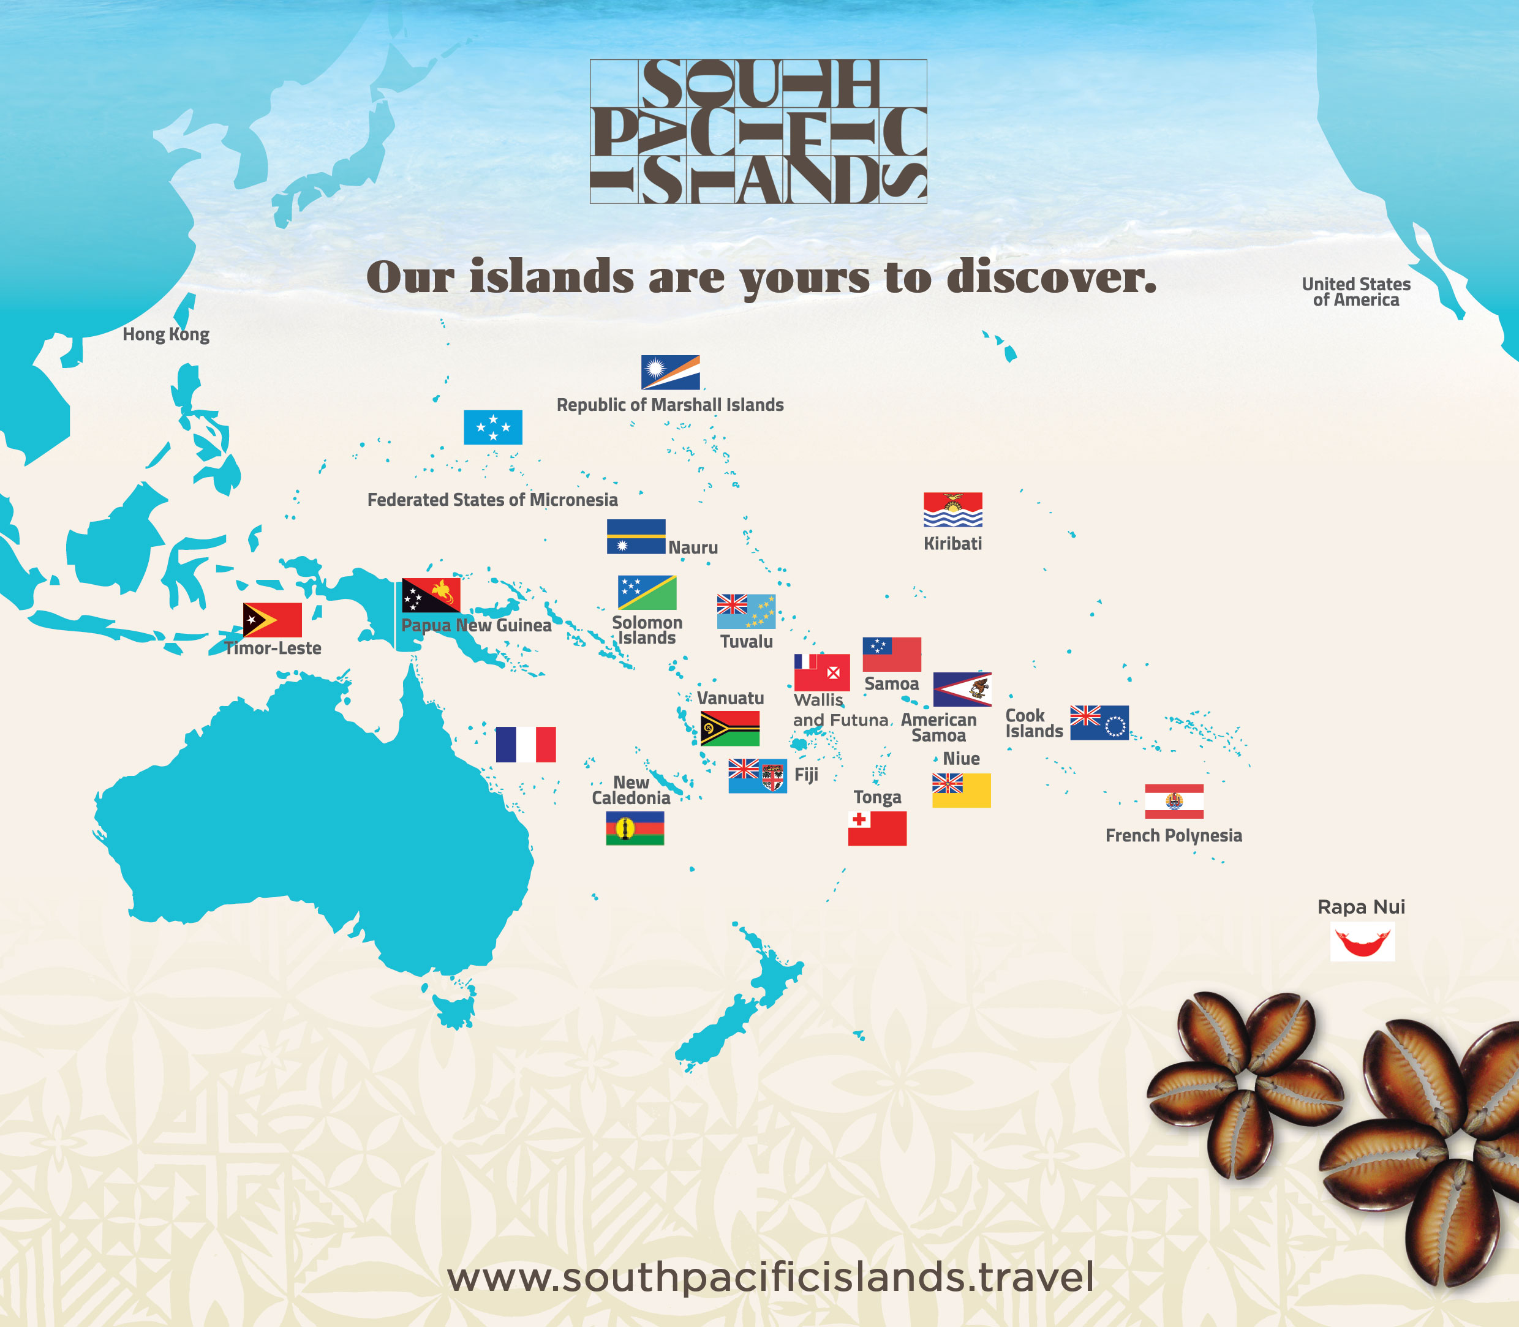
ABOUT SPTO
Intergovernmental body for tourism marketing and development in the region
Mandate: Market and Develop Tourism in the Pacific
19 Pacific Island Countries
Over 140 Private Sector members
Core areas of focus:
Marketing
Research and Statistics and
Sustainable Tourism Development

Slide 6



TRAVELERS’ VALUES ARE CHANGING
Aspirations and core values of travelers are changing – environmentally responsible, seeking culturally rich and off-the-beaten track experiences, desire to give back to communities.
Travelers want to immerse themselves in true authentic and unique experiences (Natural Beauty and Culture), with a “WOW” factor

Slide 7
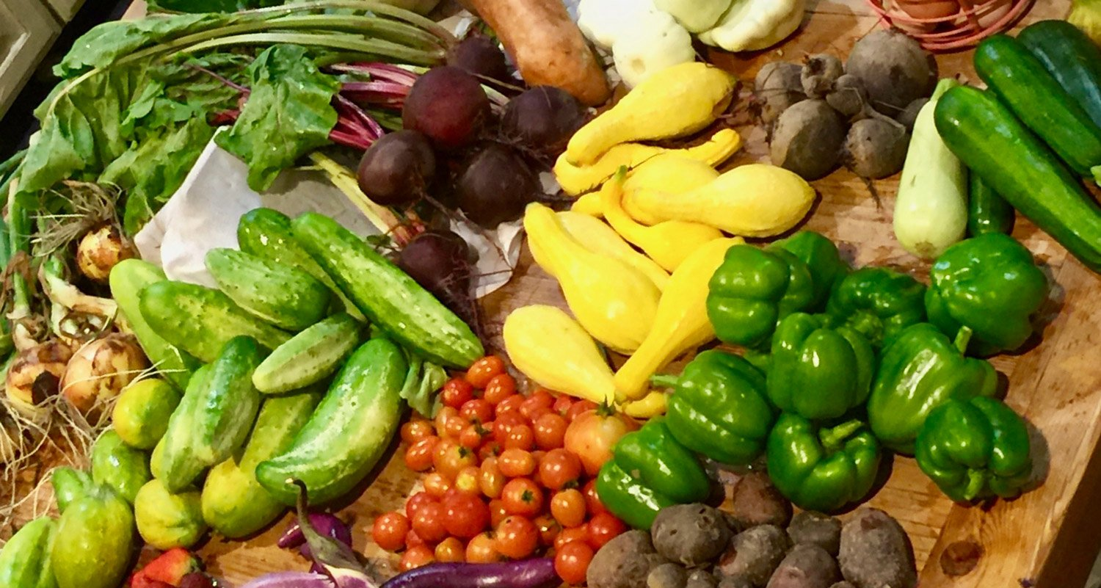
BRANDING THE PACIFIC ISLANDS AS
FOOD DESTINATIONS

Slide 8
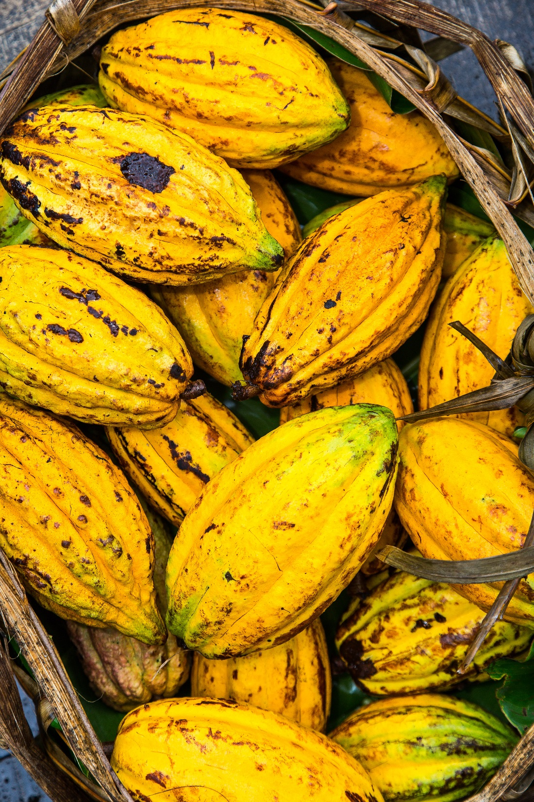
BRANDING IN THE CONTEXT OF DESTINATIONS
Identifying the destination’s competitive IDENTITY
Building a story that makes the destination standout above competitors
Consistent messaging across all communications
About WHO YOU ARE
Forms the basis of destination marketing
Ideally owned by ALL
Notes:
Identifying the destination’s strongest and most competitively appealing assets in the eyes of its prospective visitors

Slide 9
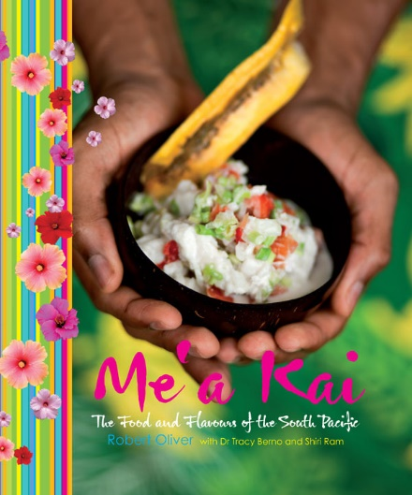
What Global Experts are saying about branding…
Need high quality visioning and planning – must convey the spirit of a place, helping people understand what makes it distinct and magnetic
Manage and address visitor feedback
Sustainability is driving change, understanding climate change & environmental impacts is key
Working together – create a network where you share access to resources, knowledge and talent
Notes:
Identifying the destination’s strongest and most competitively appealing assets in the eyes of its prospective visitors

Slide 10
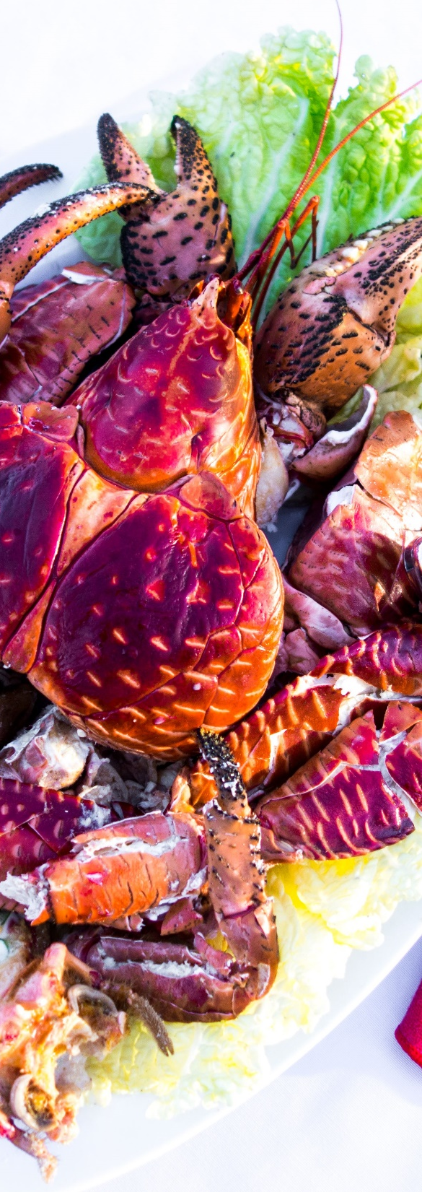
BRANDING THE PACIFIC ISLANDS AS FOOD DESTINATIONS
Increase the level of competitive performance against other regions
Invest in niche market development
Nurture sustainable farm-to-table partnerships
Drive change from national level according to destination branding/positioning
Inspire change in the food culture through whole of island/country/region approach to prioritize health benefits
Notes:
Pacific tourism needs to maintain a higher competitive performance against other regions
Agri-business is a potential ‘niche’ product and ‘money maker’ for the tourism industry
Crucial for all players in the value chain to realise the importance of building sustainable farm-to-table relationships
Pacific destinations need to have the confidence and pride themselves on selling/serving quality, local food to visitors.

Slide 11
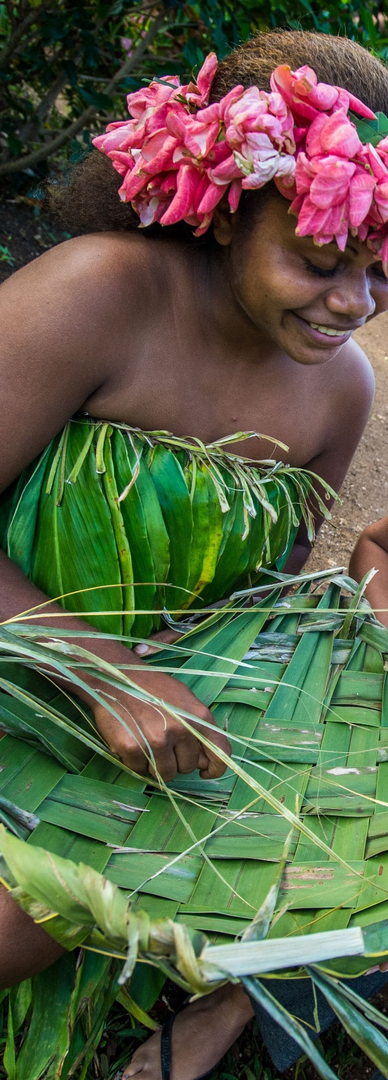

BRANDING THE REGION AS QUALITY FOOD DESTINATION
Diversify the tourism experience’ with ‘high quality locally grown food/local cuisine’
Invest in capacity building of businesses, chefs, farmers
Quality standards need to be developed for the Pacific before branding the region as a Quality Food Destination
Provide networking opportunities at regional and international level
Notes:
Complementing ‘sand, sea, and sun’ with ‘high quality locally grown food/local cuisine’
Capacity building of Owners and Chefs in the region to become innovative and to use local produce and seafood in their cuisine to promote culture
Quality standards need to be developed for the Pacific before branding the region as a Quality Food Destination

Slide 12
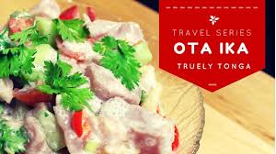
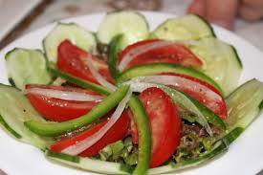
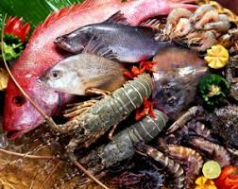
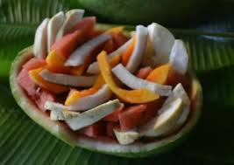
Way Forward

Slide 13

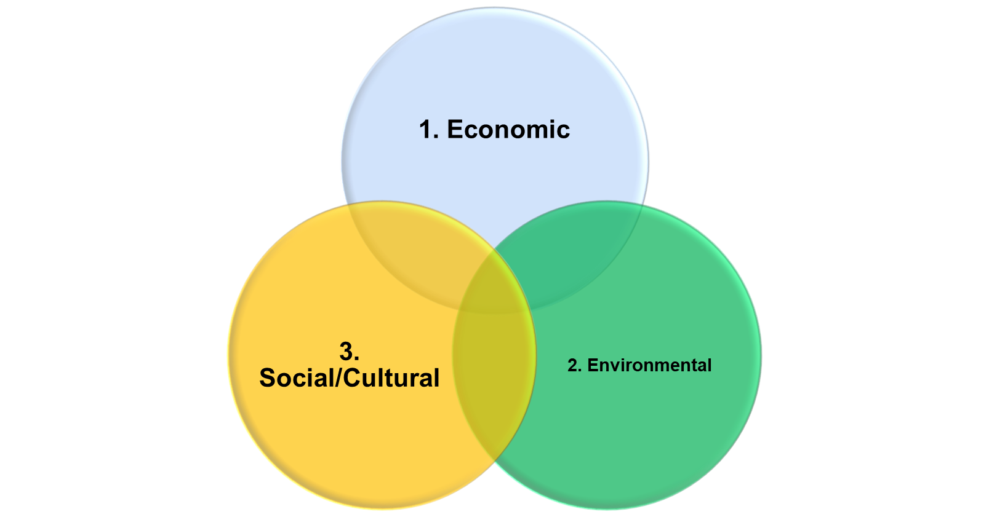
SUSTAINABILITY AN OPPORTUNITY FOR FOOD TOURISM DEVELOPMENT IN THE PACIFIC

Slide 14
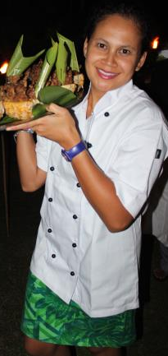
Sustainable Development Goals
Blue Pacific Identity
Embracing our Climate Change challenge
Increased development partner support for regional efforts: Monitoring, Capacity Building, Awareness and Research
Focused support for private sector and farmers
Notes:
Identifying the destination’s strongest and most competitively appealing assets in the eyes of its prospective visitors

Slide 15
SUSTAINABLE SOURCING
Value of locally sourced Vegetable and fruits,
Meat and protein

Slide 16
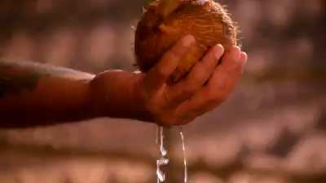
sustainable@spto.org
www.sustainability.southpacificislands.travel

