Slide 1

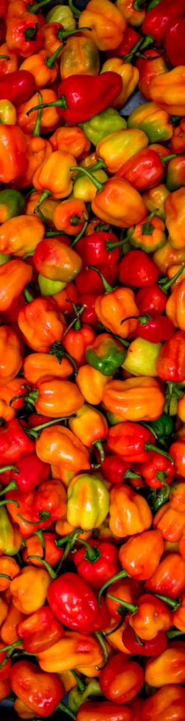

From Farm to Tourist’s Table: A study of fresh produce demand from Fiji’s hotels and resorts
April 2019

Slide 2
International Finance Corporation
IFC is the largest global development institution focused exclusively on the private sector in developing countries.
IFC works with the private sector in developing countries to create markets that open up opportunities for all by applying financial resources, technical expertise, global experience, and innovative thinking to help partners overcome financial, operational, and other challenges.
Sister organization of the World Bank and member of the World Bank Group.
In Fiji, IFC has many projects in various sectors mentioned above.
IFC’s Fiji Tourism Project 2017 - 2020, in partnership with the Government of Australia and the Ministry of Industry, Trade and Tourism, aims to:
  Increase arrivals from high yield tourism markets
  Improve the flow of the tourism dollar to the local economy by enhancing links between the agriculture and tourism sectors
  Develop a pipeline of tourism investment projects

Slide 3
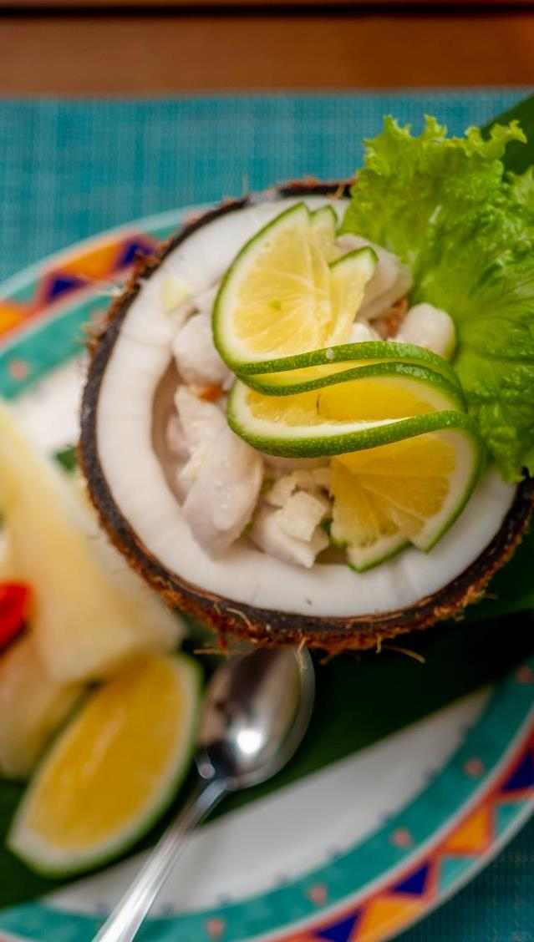
About the Study
Partnership between IFC, Ministry of Agriculture and Ministry of Industry, Trade and Tourism
Size the market for imported and local fresh produce sourced by hotels and resorts in Fiji’s main tourism area.
Areas covered in the study are home to 74% of all rooms
  Nadi and Lautoka
  Denarau
  Coral Coast
  Mamanuca and Yasawa Islands
Based on a similar study in Vanuatu in 2016

Slide 4
Study Methodology
Initial interviews with hotels during planning phase to inform methodology
Stratified sample based on hotel location, size (number of rooms), and price category
Qualitative questionnaire and interviews with 62 hotels on their purchasing preferences, habits and requirements
Quantitative volume data collected from 44 hotels on 112 fresh produce items for one high season and one low season month, 47% of hotels in the four areas
Extrapolated out to the whole population of 154 hotels
Average price data and market estimates used to obtain value results (VEP)
In depth interviews with key suppliers and aggregators

Slide 5
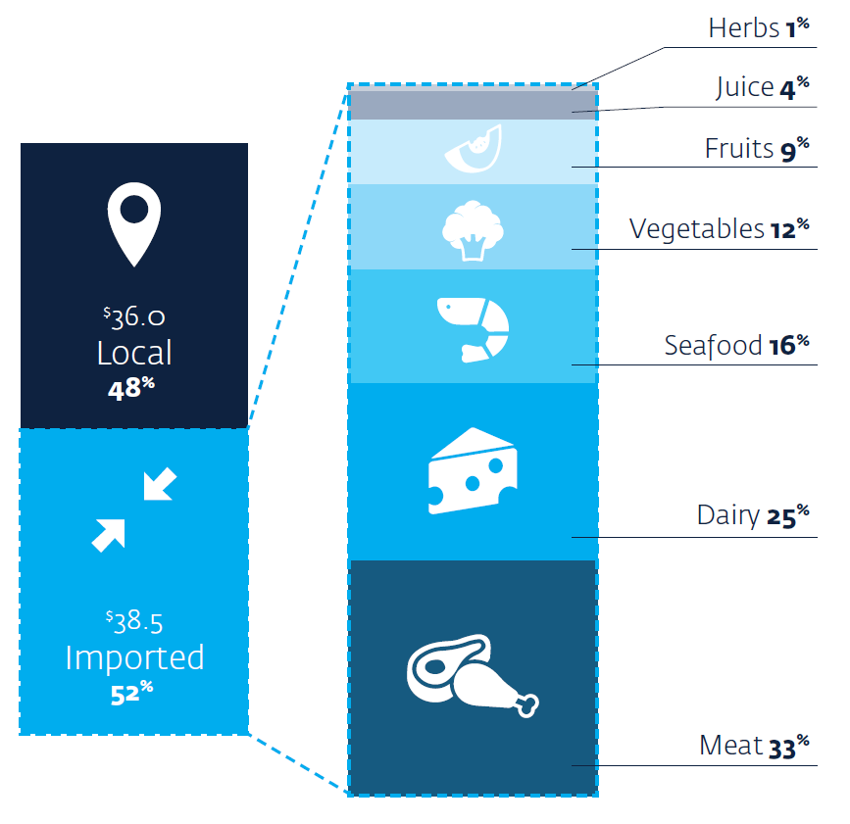

Imported and Local Fresh Produce Demand
FJ $74.4 million is spent annually by hotels in the main tourism area on fresh produce
FJ $38.5 million of all fresh produce sourced by hotels is imported
52% of all fresh produce sourced by hotels is imported
Imports are driven by meat, dairy, seafood and vegetables

Slide 6
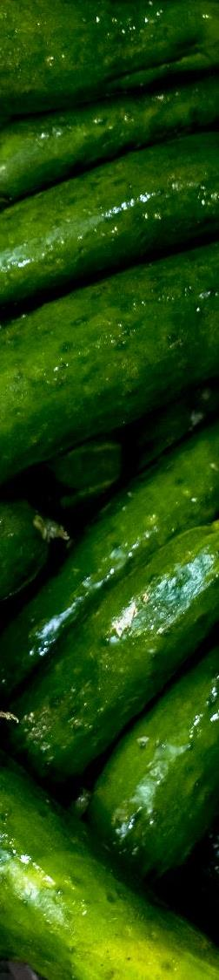
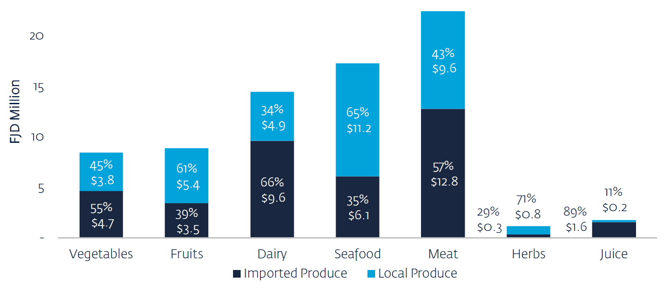

LOCAL And import demand by product category
Meat, dairy and vegetables drive import demand.

Slide 7
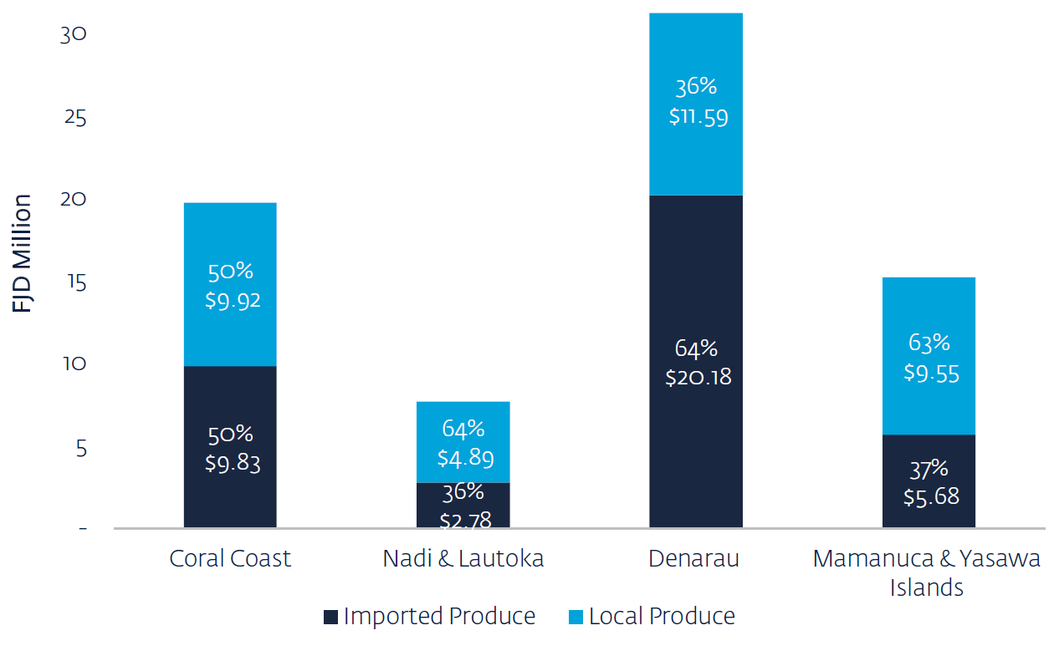
Sourcing by Hotel location
Mamanuca and Yasawa Islands use more local produce:
Flexible purchasing
Change menus to match produce availability
Strong community focus
Support local farmers by targeted purchasing and small-scale farming projects
Nadi and Lautoka use more local produce:
More budget and mid-range hotels with less demanding customers
More limited range of dishes on offer

Slide 8
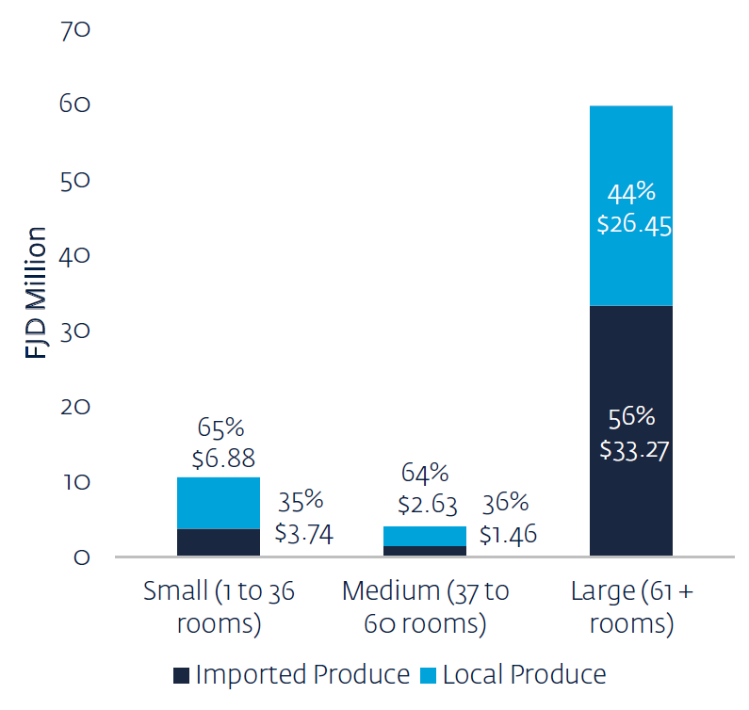
Sourcing by Hotel Size
Smaller hotels purchase more local fresh produce
Procurement staff visit local markets for purchases daily
Buy smaller amounts and tend to pay cash
Assess the quality of all available products and select according to preferences
Flexible menus and change dishes based on seasonality or availability of products
Medium to large hotels work with suppliers, ordering imported produce on a weekly or semi-weekly basis

Slide 9
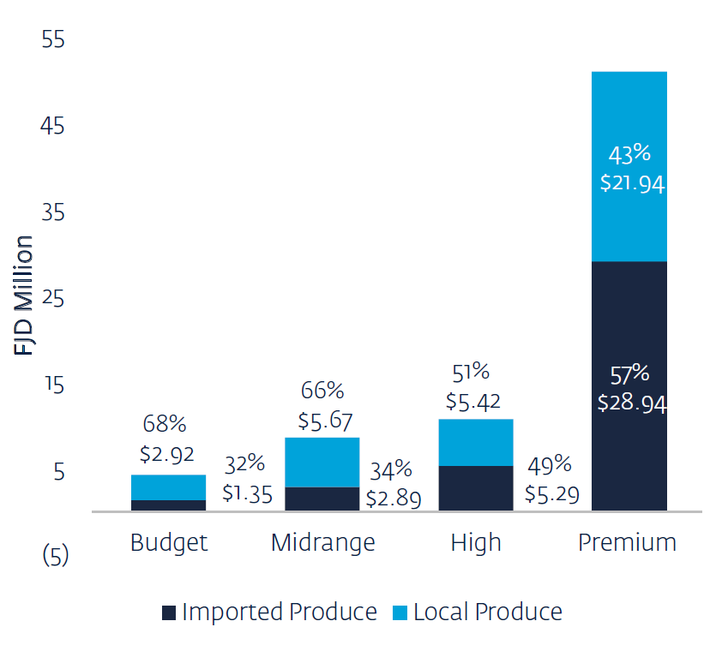
Sourcing by Hotel Price Category
High and premium hotels purchase more imported fresh produce
Guest expectations for top quality food and good food safety, especially for meat and dairy
Large, high end hotels have expatriate chefs that change every three to five years
  Lower knowledge of locally grown produce options
  Weaker suppliers networks

Slide 10
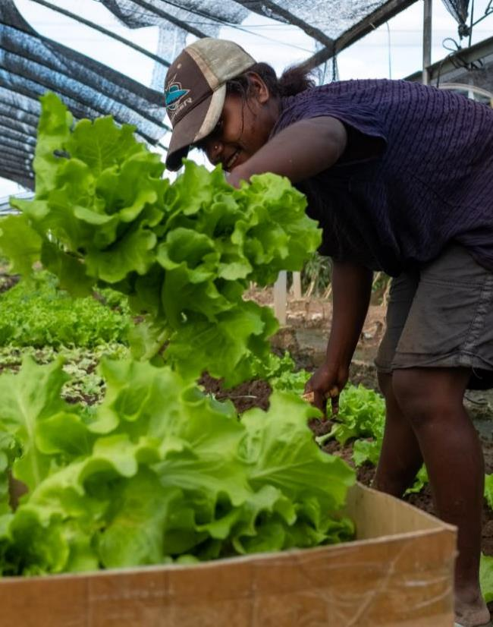
Fresh produce items with high potential for increased import substitution
18 fresh produce items account for 63 percent of total produce imports
Vegetables
Fruits
Meat and seafood
Dairy
Juice
Potato, colored capsicum, green capsicum, broccoli, lettuce, cauliflower, zucchini, purple cabbage, and green cabbage
Tomato, orange, rock melon and honeydew melon
Beef, bacon and prawn
Cheese
Packaged tropical juices

Slide 11
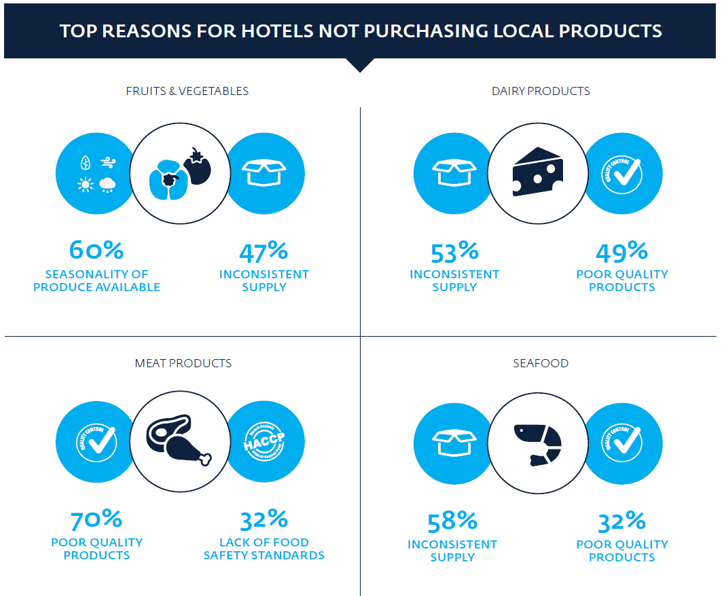
Key Issues faced by hotels

Slide 12
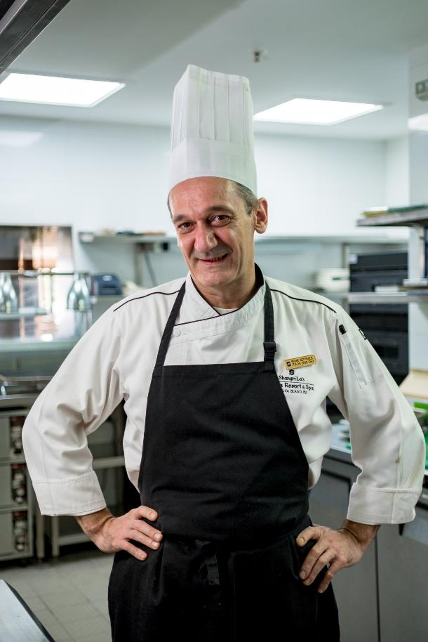
Key Factors that Increase Local Sourcing by Hotels
Assess produce needs on a daily basis and purchase more often
Change menus based on seasonality and availability of produce
Proximity to productive farmland that offers variety, quick delivery and strong networks
Assess produce quality at the market before purchasing
Commitment to local sourcing at all levels of the hotel purchasing system, typically driven by the chef
Imports driven by
Need to forecast volumes on a weekly basis and pre-order high volumes at competitive prices

Slide 13
Five Key Barriers
Decision maker networking
Inconsistent supply
Poor business ethics
Lack of understanding of hotel purchasing requirements
Seasonality of local produce
Lack of supply in the off season
Access to finance for smallholder farmers
Quality of products
Lack of proper infrastructure and poor post harvest handling
Food safety standards
Lack of applied food safety standards for meats and seafood
Chefs have decision making power, but not full information
Producers have low knowledge how to enter markets
Technical growing skills and equipment
Hotels want better cuts of meat

Slide 14
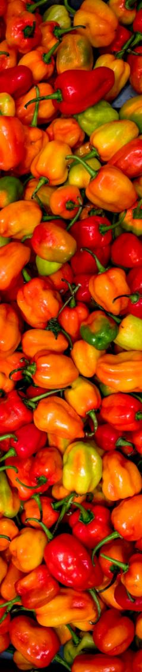
Key Recommendations
⦁ Agritourism Working Group to coordinate among stakeholders
⦁ Further product by produce analysis of the value chain for crops identified.
⦁ IFC hotel pilot program to increase ability to purchase more local produce and support hotel aggregators to increase supply by strengthening linkages with farmers
Overarching
Networking
⦁ IFC to partner with Chefs’ Association to set up field visits for chefs to meet suppliers
⦁ MITT to create further opportunities to integrate the Fijian Made-Buy Fijian Campaign into tourism
Inconsistent Supply
⦁ FAPP to include farmer training module on hotel requirements
⦁ IFC to create a guide to upskill key hotel suppliers
⦁ MoA and partners use report to prioritize items with high potential for import substitution

Slide 15
Key Recommendations
Produce Seasonality
Quality of Products
Food Safety
⦁ IFC to determine demand by hotels for meat and seafood CCL Lite certification
⦁ Work with HACCP Australia to develop CCP Lite for suppliers and train suppliers
⦁ IFC work with Ag-Trade team and Fiji Chef’s Association to create vegetable and fruit seasonal charts, a crop map and grading charts based on hotels standards for farmers
⦁ Private sector to invest in agri-infrastructure with focus on modern equipment and improved farming techniques
⦁ FAPP and MoA to prioritize high value produce for growing in high elevation areas in off season

Slide 16
Moving Forward
IFC has recently:
  Launched a local sourcing pilot project with an internationally branded hotel in Fiji.
      Based on results of the pilot, we plan on rolling out a full program soon
  Partnered with the Ag-Trade team to implement some of the key recommendations including:
      Creating a modern fruit and vegetable seasonal calendar
      Promoting local foods to chefs
      Establishing a database of hotel fresh produce suppliers and specialty crop growers
      Assist in linking exercises that link chefs directly to farmers/vendors and vice versa
      Encouraging MoA to act upon the various recommendations in the report
  Assisting the FAPP team through:
      Identifying products for off-season supply to resorts
      Linking the FAPP team to hotel /resort suppliers and industry players

Slide 17



    Vinaka and wish you all the best during this two day workshop
IFC's work in Fiji is guided by the Fiji Partnership. Australia and IFC are working together through the partnership to promote sustainable economic development, reduce poverty and stimulate private sector investment in Fiji.

