Slide 1
Pacific Agribusiness Research in Development

Slide 2
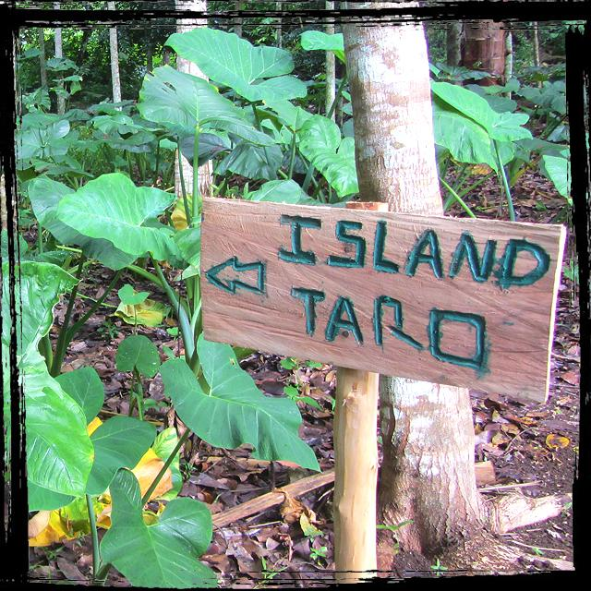
Snapshot
Research project (2017-2021)
Identify and understand how agribusiness development opportunities can contribute to improved economic growth and livelihoods
Similar framework to the Promoting Nutritious Food Systems: Analyse - Act - Advocate
Tools to support agribusiness assessment
Value chain and market assessments
Strengthening and evaluation of producer network systems including PGS
Technical advice and assistance to agribusinesses

Slide 3
Learning from the survivors
Success factors and constraints of enduring agribusinesses

Slide 4
Success factors
1: Understanding the requirements of the market
2: Transparency across the value chain
3: Strong relationships across the value chain
4: Quality assurance / standards
5: Good staff management and employee satisfaction
6: Resilience and risk management planning
7: Diversification of revenue from a solid core business foundation
8: Provision of quality support services for growers

Slide 5
Why AgriTourism Experiences?

Slide 6
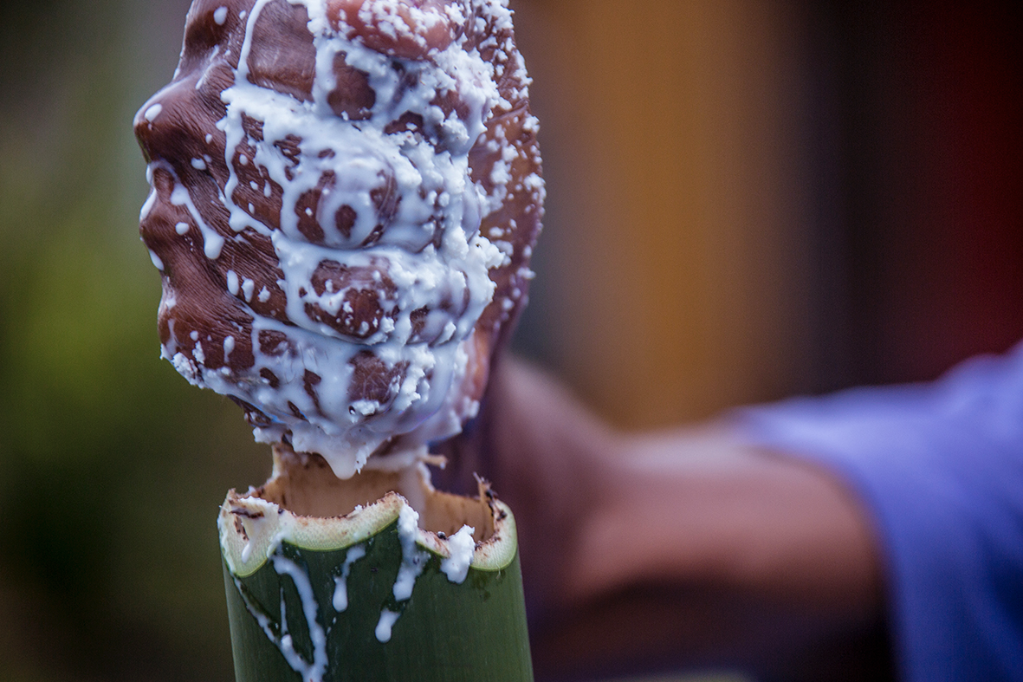

Slide 7
AgriTourism Experiences
Tourism is a significant and growing sector
Revenue diversification, a crucial success factor
Increasing demand for authentic experiences, allowing visitors to interact in a more meaningful way with the place, its people and food that’s likely to continue
Opportunity to build on the Pacific tradition of talanoa / storytelling

Slide 8
AgriTourism Situation Analysis

Slide 9
What is an agritourism experience?
Where agriculture and tourism meet!
Key elements of an agritourism experience
Farm - information and participation in food production and processing to better understand farm systems and culture
Farmers - getting a glimpse into agricultural life through farm stories
Nature - animals, plants and the environment
Sharing and talanoa!
An activity, enterprise or business that combines primary elements and characteristics of agriculture and tourism and provides an experience for visitors that stimulates economic activity and impacts both farm and community income.
Notes:
Skills that farmers have not necessarily those demanded in the tourism industry. Tourists want engagement, interaction. Not all farmers are great conversationalists!

Slide 10
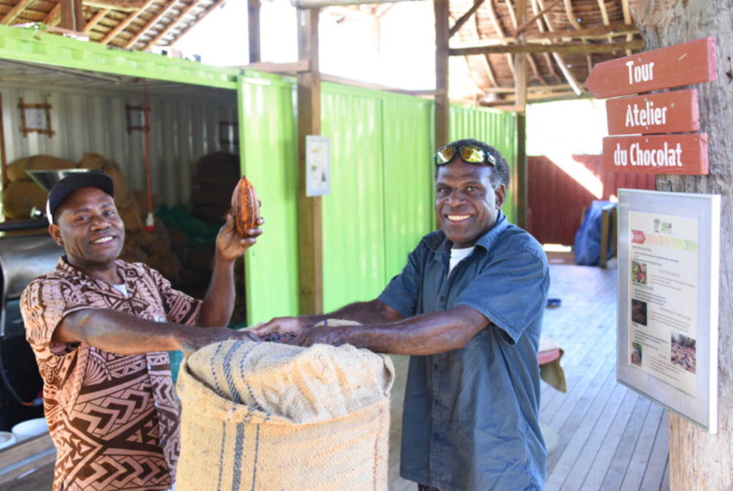

Slide 11
AGRITOURISM IS A GROWING MARKET
Globally there is a trend towards agritourism driven by tourists seeking out culinary activities, knowledge of local cultures and participatory experiences.
In Australia between 2011 and 2016, the number of domestic tourists who visited a farm on a holiday trip increased by 9% and the number of international tourists increased by 11%
1.8 million tourists visiting
farms each year in Australia
Tourism Research Australia
=
9% increase in domestic tourist farm visits
Tourism Research Australia
11% increase in international tourist farm visits
Tourism Research Australia
Notes:
But today we’re here to talk specifically about agritourism. As we’ve heard agritourism is a growing type of tourism globally. This is driven by tourists who seek out authentic experience in destinations including culinary, local cultural experiences and rural tourism.
In Australia along there are 1.8 million tourists visiting farms each year and agritourism visits by international tourist shave grown by 11% between 2011 and 2016.

Slide 12
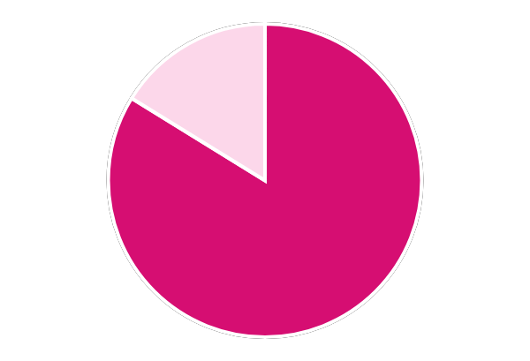
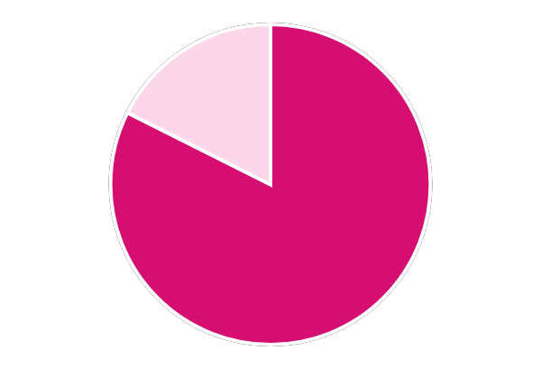
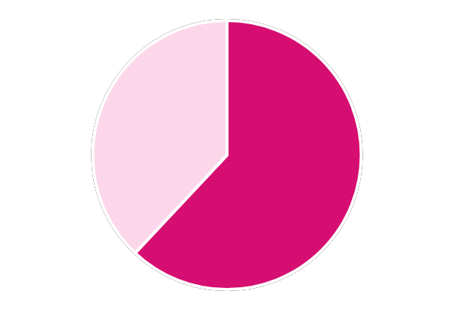
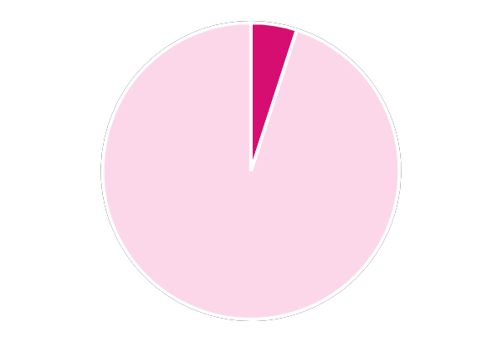
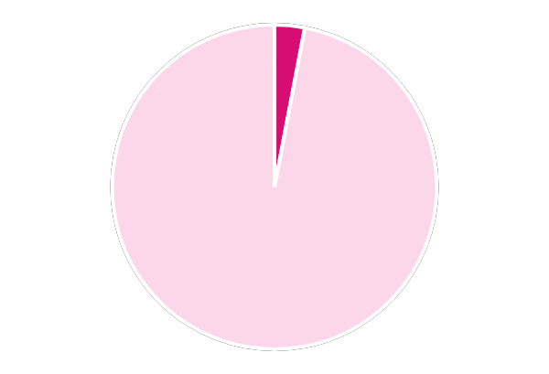
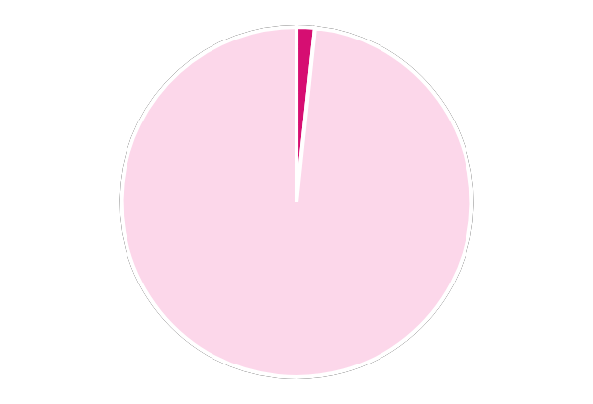
REGIONAL TRENDS IN AGRITOURISM
Australian Market - International Long Trip Travellers
83.8%
82.4%
62%
Attitudes
“I enjoy food from all over the word”
“I like to holiday where I can experience the local culture”
“I love to cook”
5%
3%
1.7%
Activities
2018 Roy Morgan Custom Report
Nature holiday on their last holiday trip of 3+ nights
Fishing or hunting on their last holiday trip of 3+ nights
Farm stay on their last holiday trip of 3+ nights
Notes:
And regionally, there is opportunity as well. Looking at the Australian international outbound market, we can see that people are highly interested in food – almost 84% “enjoy food from all over the world” and 83% “like to holiday where they can experience local culture”
However, we need to do a better job of capitalizing on these attitudes. Only 5% took a nature holiday on their last long trip and less than 2% had a farm stay on their last trip.
This also means that we need to be very specific in our marketing to reach these people.

Slide 13
Opportunities
Organic and ethical food
Gastronomy tours
Home cooking and cooking lessons
Interactive production tours – hands on
Festivals and events
Handcraft processing tours
Floriculture
Agritainment: farm mazes, petting farms, haunted houses, etc.
Agrieducation: production, cultural traditions, rural values
Nature based tourism: plant identification tours, medicinal plants, fishing, birdwatching

Slide 14
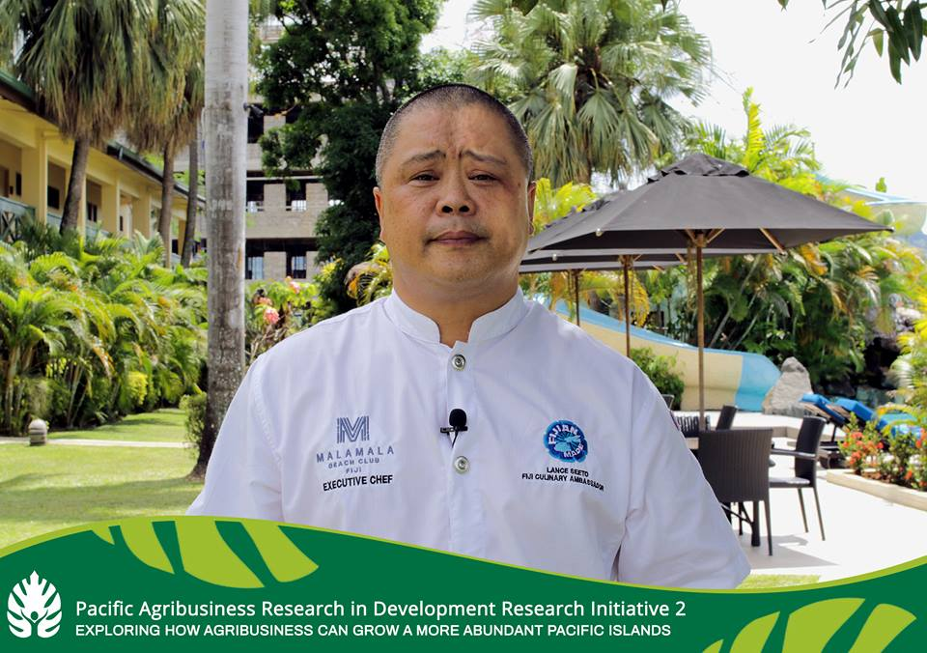
Promote peer to peer and inter-disciplinary exchange and talanoa Where some see a farm….I see a story

Slide 15
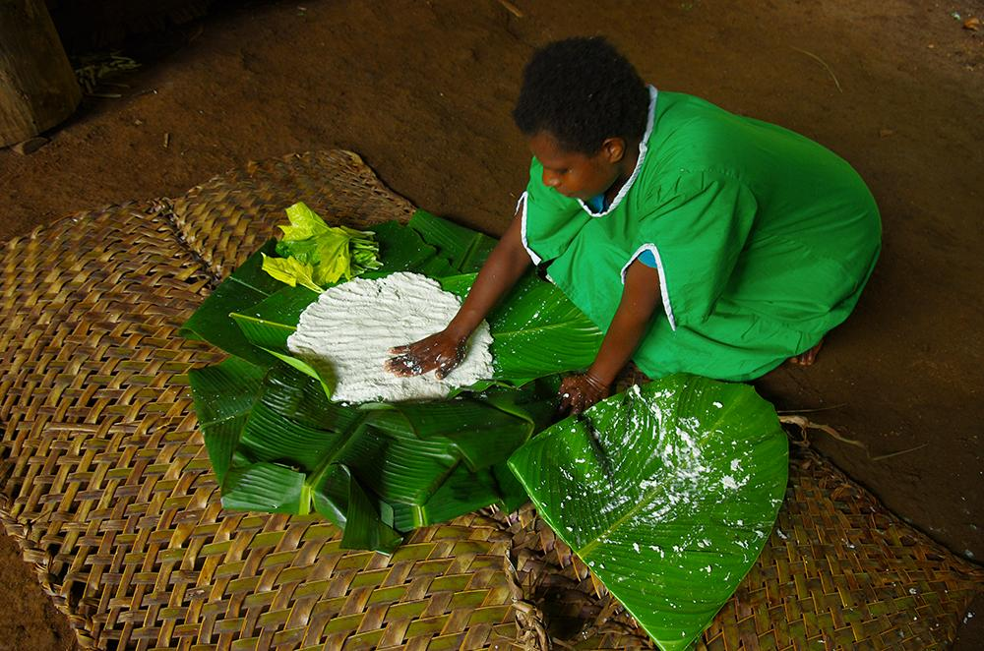
AgriTourism Experiences survey
Identification of 40+ agribusinesses and operators in Fiji, Vanuatu and Tonga offering agritourism experiences
Survey ongoing (types of experiences, number of visitors, source markets, pricing, revenue generation)

Slide 16
Situation Analysis: Preliminary Findings
Increase in demand for agritourism experiences, but undeveloped market.
Agritourism in the region is mainly centred around culinary experiences - farm to table, farm to fork concept, grow and eat local.
Very little documentation on farm visits/tours.
No clear agritourism experiences classification - data is difficult to capture. Often classified as Nature & Scenic Activities and grouped with hikes & walks, eco tours.

Slide 17
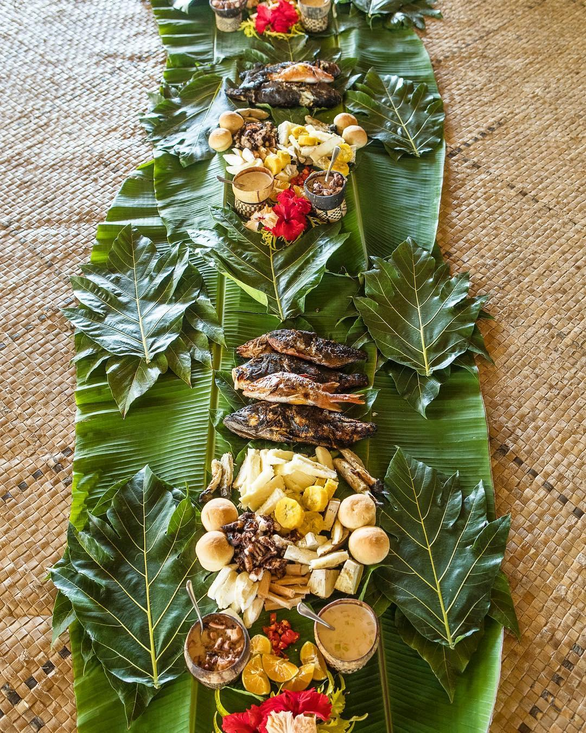
Situation Analysis: Preliminary Findings
Differing support across governments for the development and marketing of agritourism experiences
Luxury operators, inbound tour operators seeking to grow these experiences
Policy lagging behind the market

Slide 18
The market influences the type of experience
Vanuatu
61% cruise ship visitors, 39% air travel.
Tours designed for day visitors - food gardens, chocolate factory, coffee factory, wild food tours
Various existing operators - Tanna Coffee and the Summit, ACTIV - Aelan Chocolate, Round Island Tours, Port Vila Mamas Market, Vanuatu Handicraft Market, Ekasup Village Tour and Vanuatu Secret Garden and Outdoor Cultural Centre (VAPA, 2016).
Fiji
Mix of trips targeting cruise ship passengers (e.g. Spices of Fiji, South Sea Orchids), day trips from hotels (e.g. Flavours of Fiji, Gaiatree)
Limited number of farm homestay experiences (Bobo’s Farm, TeiTei, Namosi Eco Retreat, Palmlea)
Farm to table experiences integrated into hotel experiences

Slide 19
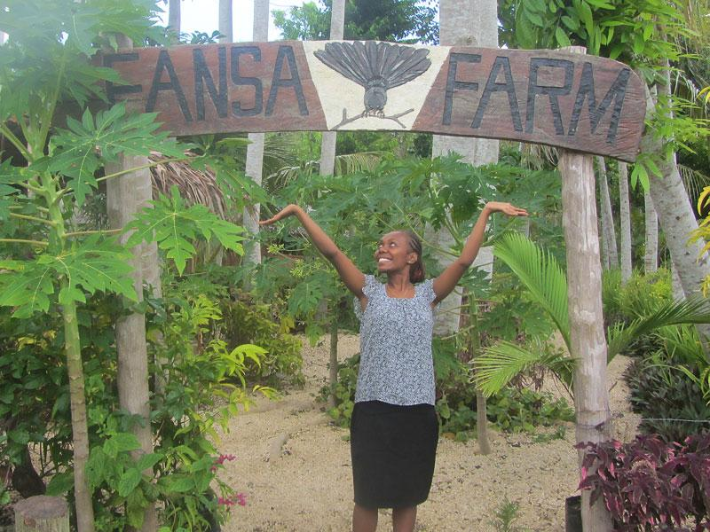

Slide 20
Constraints
1: The regulatory environment
2: Incoherent government policy
3: Supply side constraints (seasonality, price point, economies of scale, high costs of inter-island transport)
4: Weak research capability
5: Extreme events and climate change
6: Human resource constraints
7: Access to finance

Slide 21
Key lessons
1: Consistency - delivering the same quality product
2: Balancing business and culture
3: Reliability
4: Innovation and continuous improvement
5: Small can be beautiful
6: Partnerships are vital

Slide 22
ISLAND DREAMS
10-20%
Hibiscus Holidays
20%-30%
Veilomani Maramas
30%
Teitei Tokatoka
40%

Slide 23
Next steps
Complete agritourism experiences situation analysis
Develop tools and communication products to support policy and decision markets, tour operators, agribusinesses
Technical assistance and advice for individual agribusinesses
https://pardi.pacificfarmers.com/

