Slide 1
Value Chain – Increase in production and quality; The Farmers story 1st April, 2019, Nasau Villas Nadi, Fiji

Slide 2
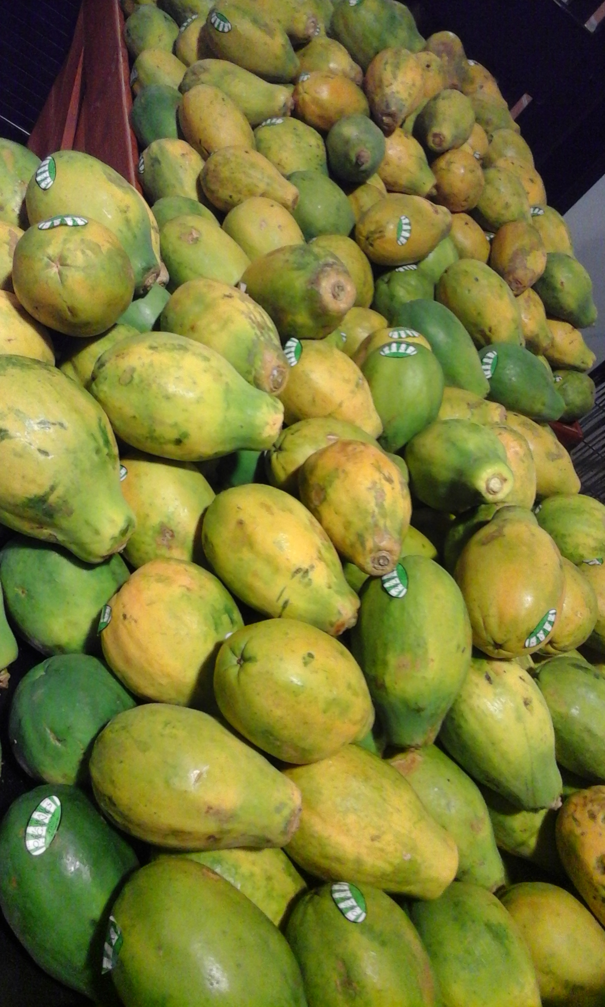
Who ?
Why ?
What ?

Slide 3
Definition of Agri-Tourism :
Connecting farmers to Tourism / Hotels ?
Connecting tourists to Farms ?

Slide 4
Issues : Consistency / quality
Small holder farmers, family farming (2 – 5acres average)
Land owning (Native / communal)
Production = Farmers working together, form Farmer Organisations/Clusters/Cooperatives
Quality = Farmers exposed to Research / Advisory Services / Farmer to farmer Learning Exchanges
PIFON

Slide 5
Members in 9 countries around the Pacific, 21 Farmer Organisations, +79,000 members

Slide 6
Our Program areas :

Slide 7
Policy Brief – FO’s & Agriculture Research & Extension
Related to agricultural extension/research the policy brief stresses that “farmer organisations can effectively and efficiently complement the work of government and aid agencies by extending the outreach of support to farmers”.

Slide 8
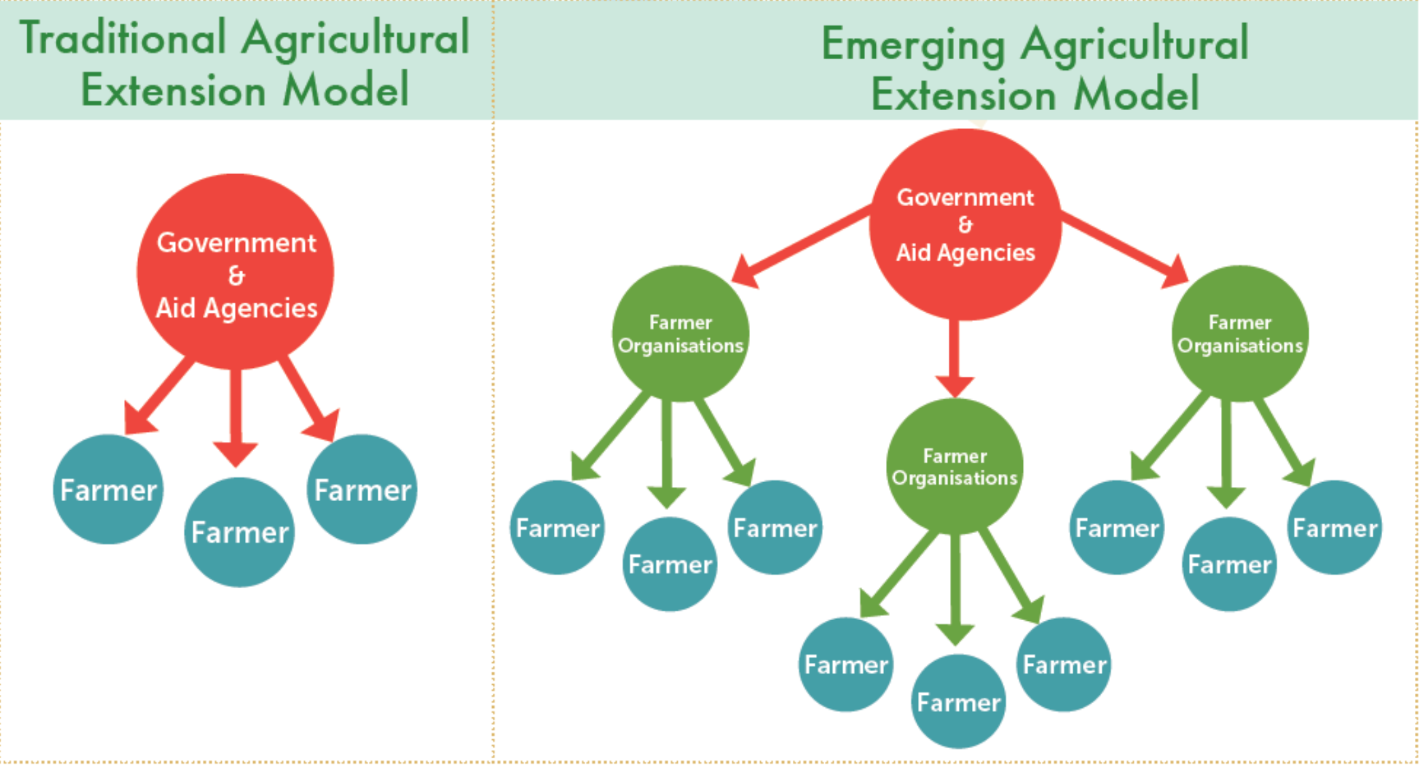

Slide 9
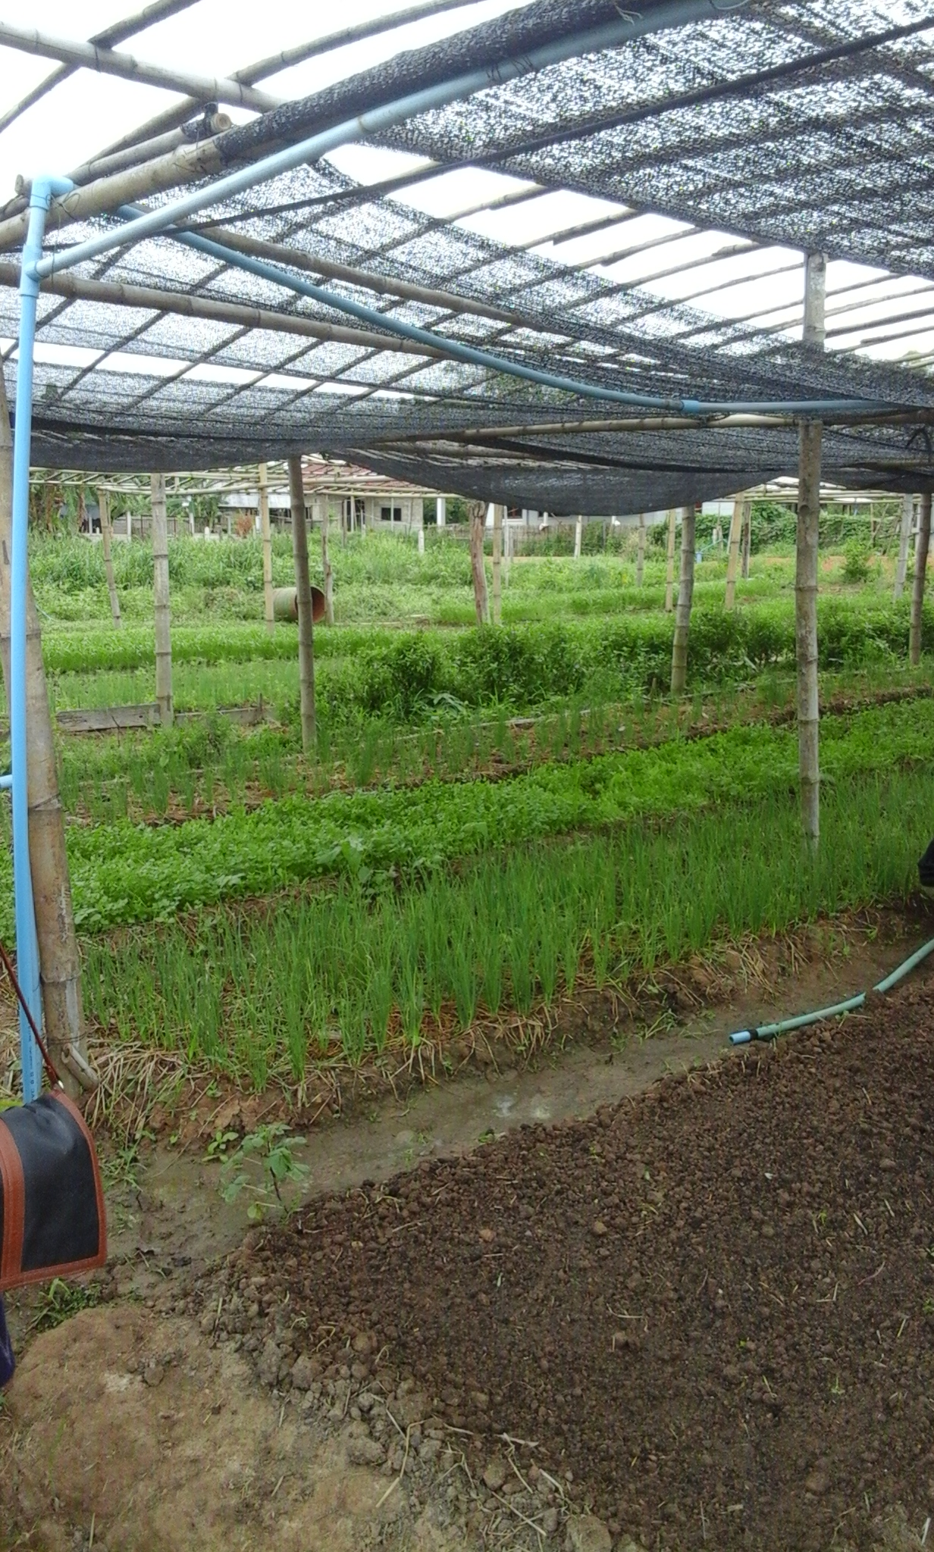
Work to support FO’s in national activities
Work to link national FO’s for information sharing
Work to access outside resources (technical and
financial) to improve capacity of FO’s
Facilitate Farmer to farmer exchanges
Piloted VC trainings with our FO members

Slide 10
Traditional Market models
Emerging Market models
Farmer
Farmer
Farmer
Farmer
Farmer
Farmer
Farmer
Farmer
Farmer
Markets - Hotels
Farmer
Agri-business
Farmer
Farmer
Farmer Organisations
Wholesalers / Middlemen
Markets - Hotels

Slide 11
Opportunity for Agritourism sector …….
Identified the opportunists farmers in our Farmer
Organisations
Capacity building - Agritourism (PARDI2 Agritourism Talanoa
Value Chain Awareness for Tourism (Opposed to Agriculture)
Connecting with Industry (PARDI2 AT Talanoa)
Making Farms – ‘farm ready!’ (HACAPP, Insurance, Tour guiding, Story Telling)
Allow Land issues Agriculture / Tourism development be
addressed
ICT solutions linking with Farmer Organisations
Finding middle ground - Agriculture & Tourism

Slide 12
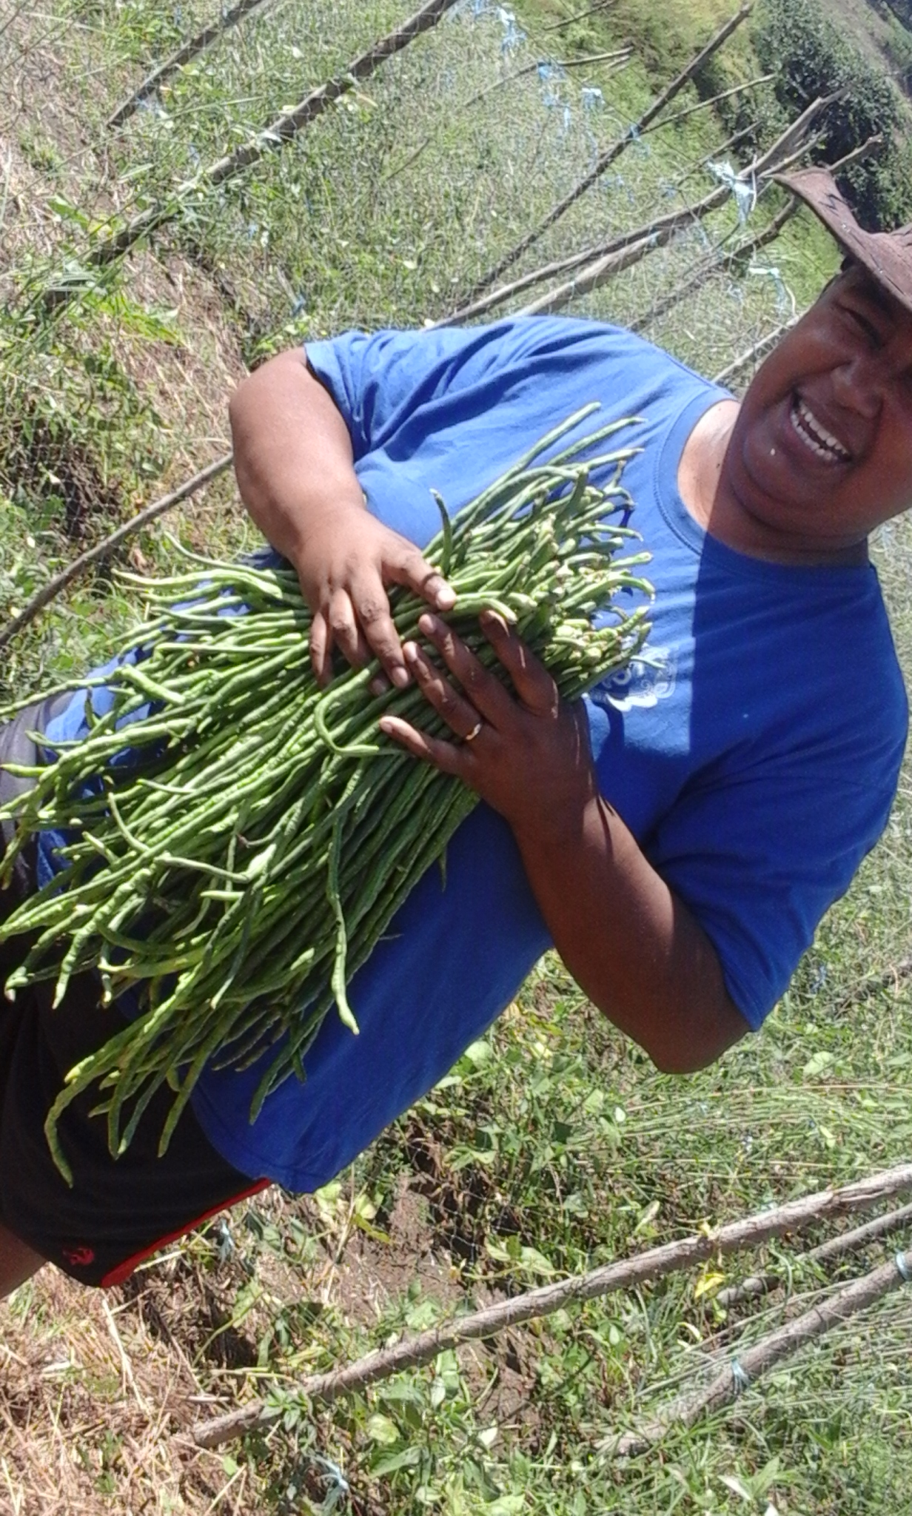
Two seasons : Rain / Dry
Consistency : Production / Quality
Access to Finance / Grants / Projects
Shade houses/ Cooler Storage
Irrigation / Inputs / Land prep
Technical mentoring / capacity building
Contract farming
Farmer to farmer exchange

Slide 13
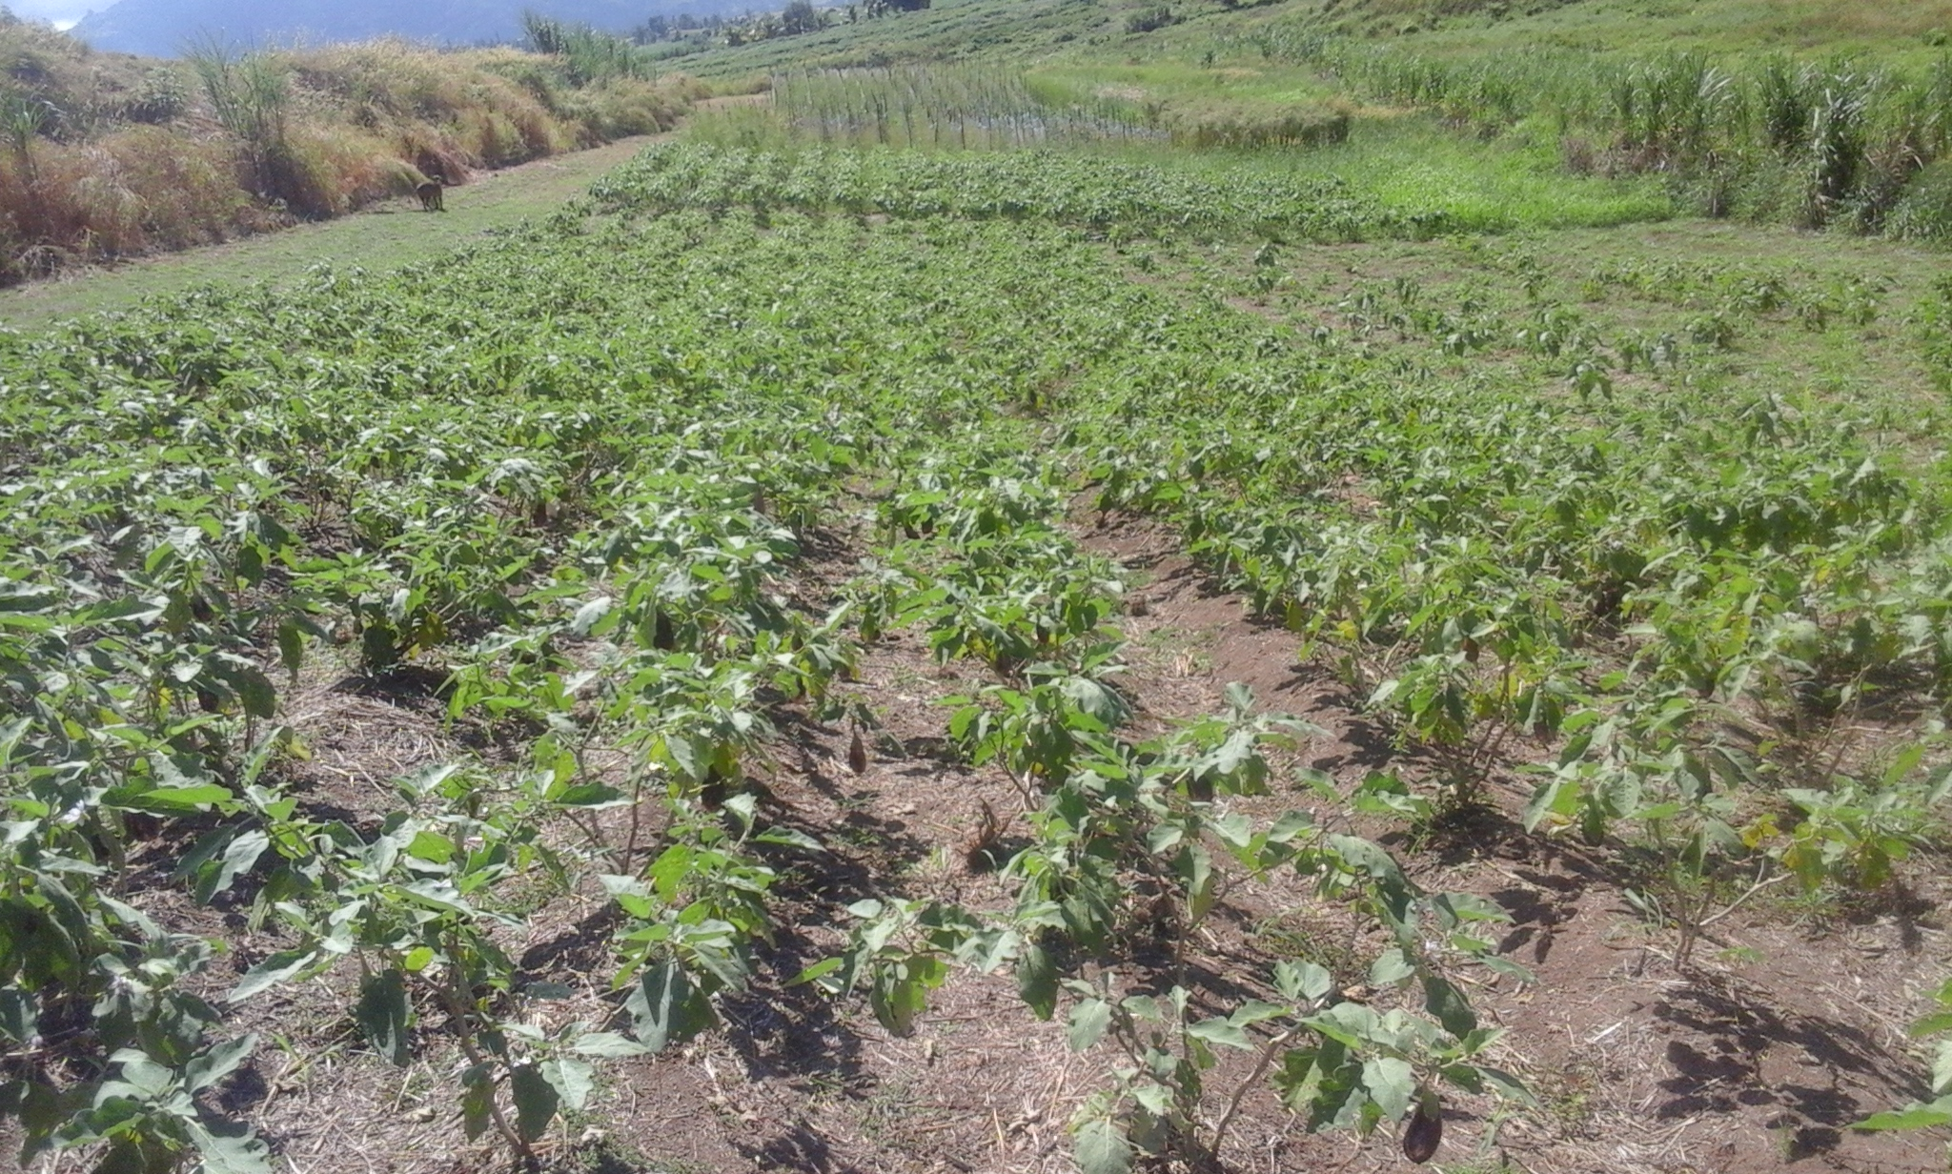
Possible Solutions :
Seasonal menus to suit seasonal produce
Invoice payments of 30days to COD
Farmer to farmer Learning Exchange
Bridge the gap (Value Chain awareness)

Slide 14
… vinaka

