Slide 1
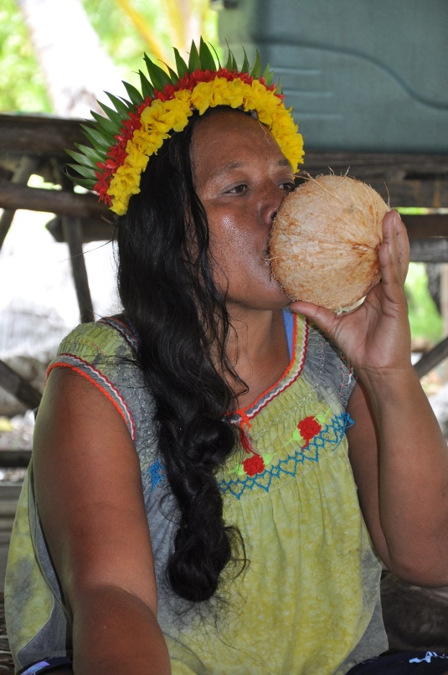
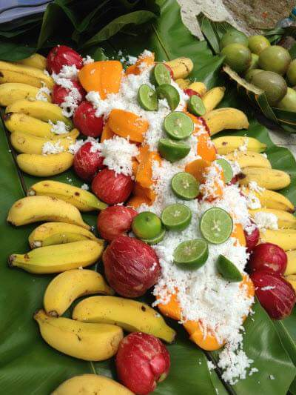
Supporting Agribusiness and Farmers to Reduce Importation Stephen Hazelman Acting Coordinator –POETCom Pacific Community Nadi, Fiji 1 & 2 April 2019

Slide 2
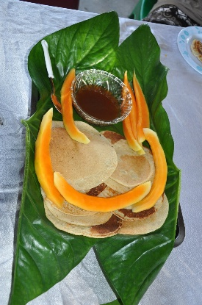
Content
The Pacific Community
Divisions of the Pacific Community
Land Recourses Division
Factors – Agribusiness & Farmers reducing importation
Organics

Slide 3
The Pacific Community
The Pacific Community (SPC) is the principal scientific and technical organisation in the Pacific region, proudly supporting development since 1947.
We are an international development organisation owned and governed by our 26 country and territory members.

Slide 4
Divisions of the Pacific Community
Climate Change & Environment Sustainability
Education Quality & Assessment
Fisheries Aquaculture & Marine Ecosystem – DG Vanuatu Moses Amos
Geoscience Energy and Maritime
Land Resources Division
Public Health
Human Right Resources Team
Social Development Program
Statistics for Development
Special Project

Slide 5
Land Resources Division
Mandates:
Ministers of Agriculture & Forestry Services (MOAFS)
Heads of Forestry & Agriculture Services (HOAFS)

Slide 6
Land Resources Division

Slide 7
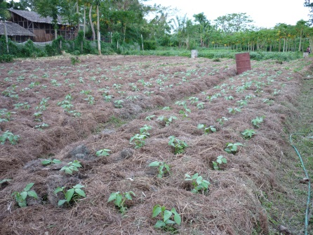
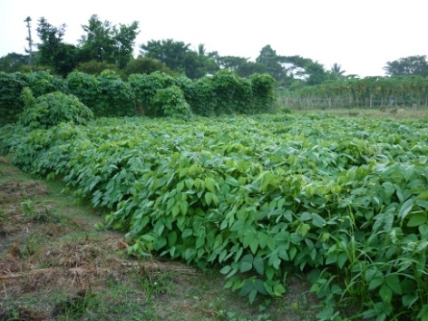
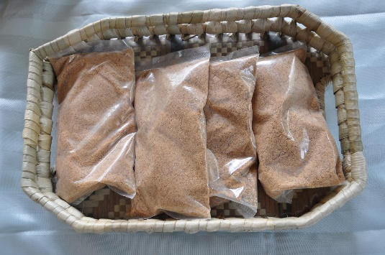
Supporting Agribusiness & farmers to reduce importation
Supportive Government Policy
Sustainable financing /capital/pricing
Capacity building for farmers
Sustainable farming practices
Effective and Functioning value chains
Quality of products/ food safety & certification
Consistence supply of produce
Value addition & processing
Partnership and coordination
Close partnership with Chefs and Procurement Officers
Effective advisory systems
Effective Market Information Systems/ICTs
Effective targeted Agricultural Research
Engagement of Youth
Value and learn from Informal marketing arraignments

Slide 8
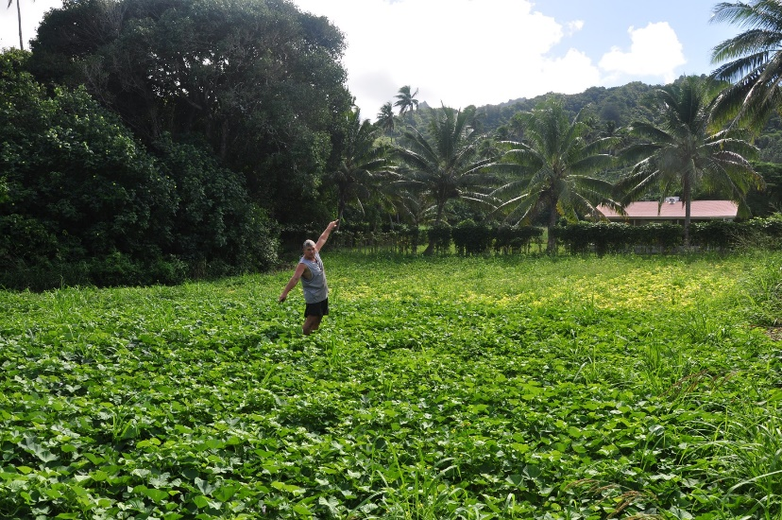
Continue….
Production, production, production
Farming systems – Biodiversity vs mono
Season and Off Season production
Sustainable farming practices – no other option
Local cuisine on menu

Slide 9
POETComs actions to facilitate access to Certification & Brand development
Pacific Organic Guarantee System
Development of Pacific Organic Standard
Suits local conditions
Fair trade component
Partner Certification Bodies
Local Auditors
Organic Pasifika Marks

Slide 10
Pacific Organic Tourism & Hospitality Standard

Slide 11
Our International Partners
International Certifying Bodies we work with - MOU
NASAA – Australia
Australian Certified Organics – Australia
Bio Gro – New Zealand
Bio Agricert – EU
Ecocert- France/EU
Combine Union – Asia
One Cert – USA
POETCom has MOUs with these Certifying Bodies
Seat on POETCom’ s Standards & Certification Committee – our technical arm
Auditors Training – to certify on behalf of CBs in the Pacific – cut costs of 3rd Party Certification

Slide 13
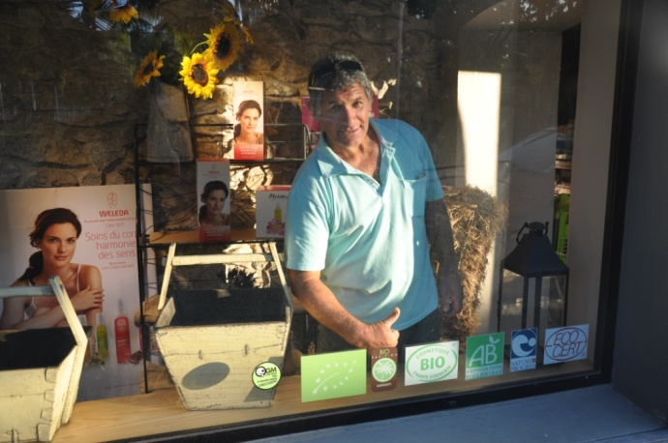
Local Market Development
-meeting local needs, including tourism and preparing for export-
Participatory Guarantee Systems
Low cost
Focus on farmer empowerment, capacity building and organisation
Prepares small holders for entering markets
of PGS.

Slide 14
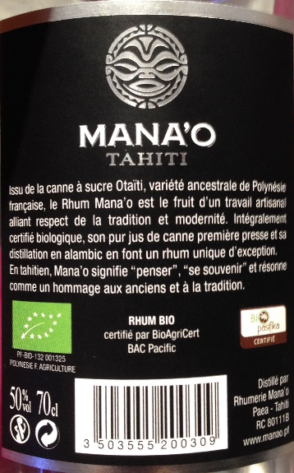
2 methods of Organic Certification
3rd Party Certification
Participatory Guarantee System

Slide 15
Organic Policy
Development of the Pacific Organic Policy Tool Kit – IFOAM Organic International
http://www.organicpasifika.com/pasifikapolicytoolkit/
Vanuatu National Organic Policy
Fiji National Organic Policy

Slide 16
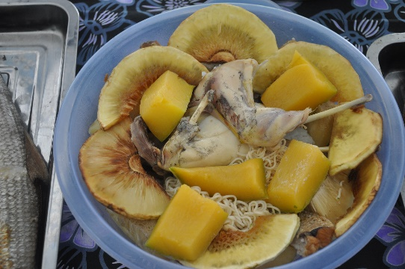
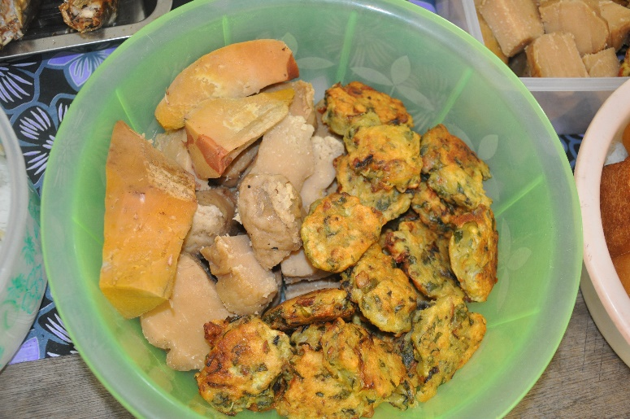
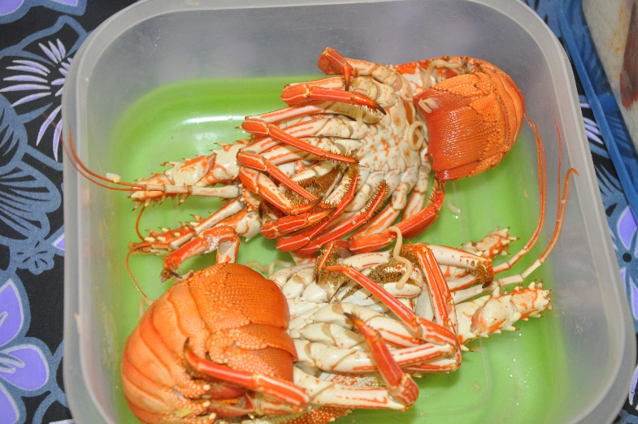
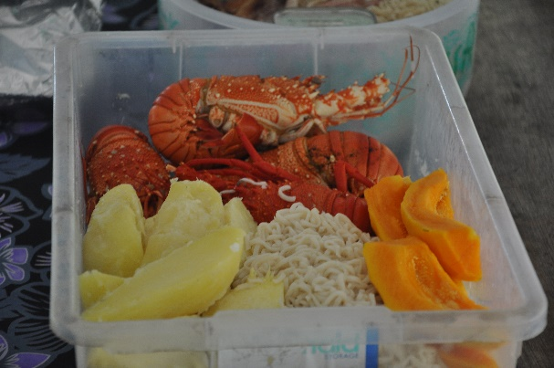
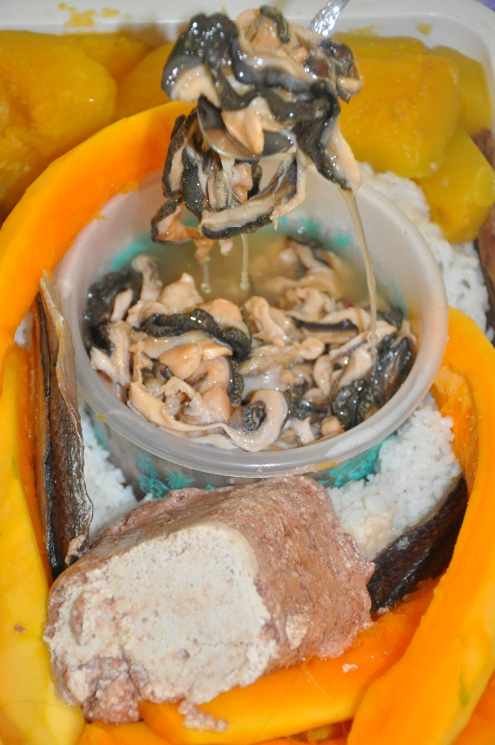
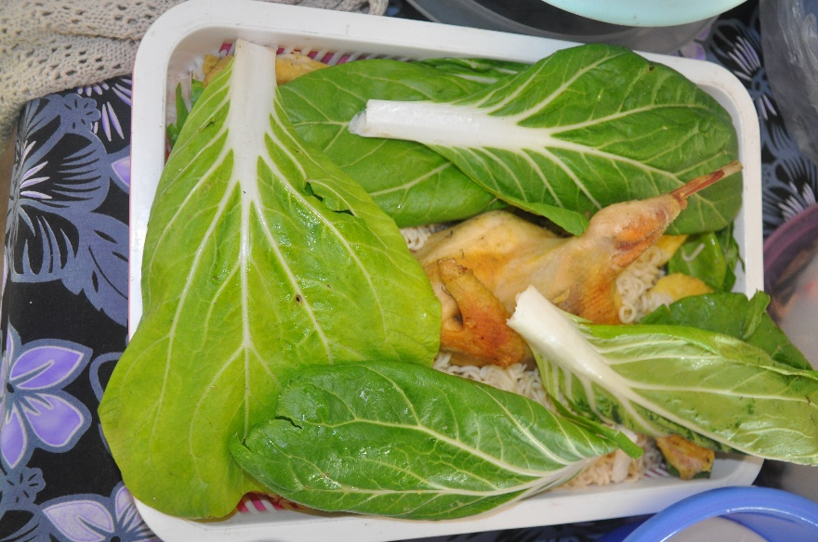
Thank You Stephenh@spc.int www.spc.int

