Slide 1
“Success in Hydroponics: Promoting consumption of Fresh Vegetables”
James Douglas, Owner Niue Fresh Hydroponics

Slide 2
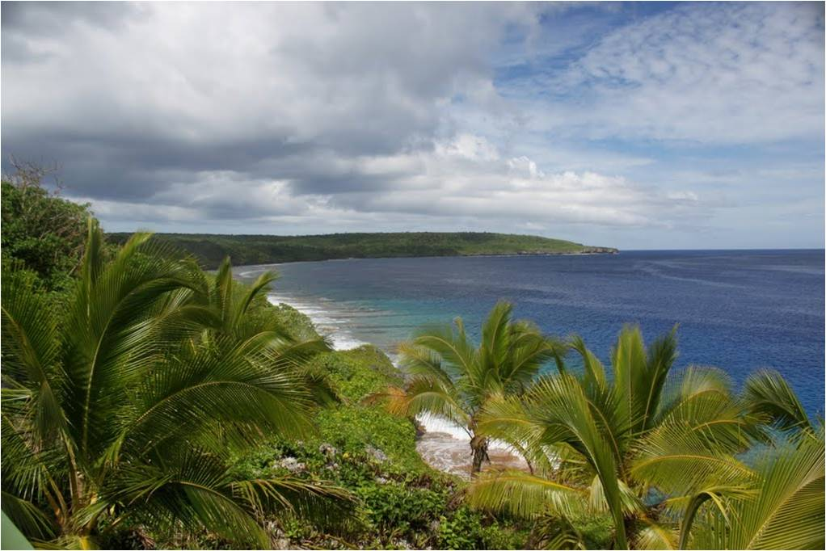
2nd Pacific Agribusiness Forum Apia, Samoa Success in Hydroponics: Promoting consumption of Fresh Vegetables
James Douglas, Owner
Niue Fresh Hydroponics

Slide 3
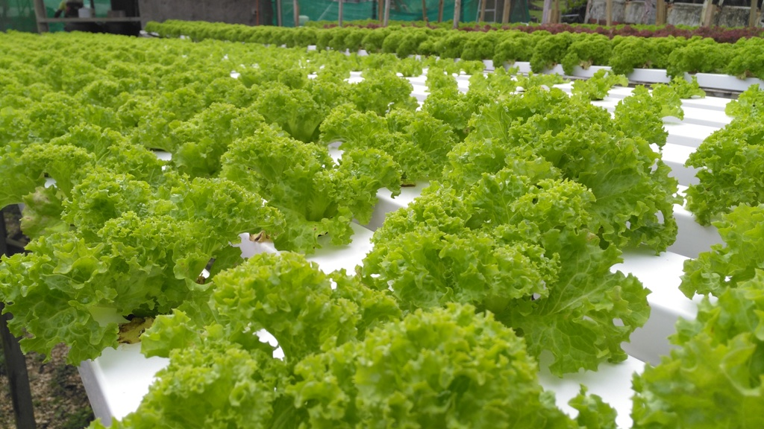
OVERVIEW
Introduction
Health and Education
Staff
Mother Nature
Market Opportunity
Product Range
Risks
Awards
Future for Niue Fresh
Conclusion

Slide 4
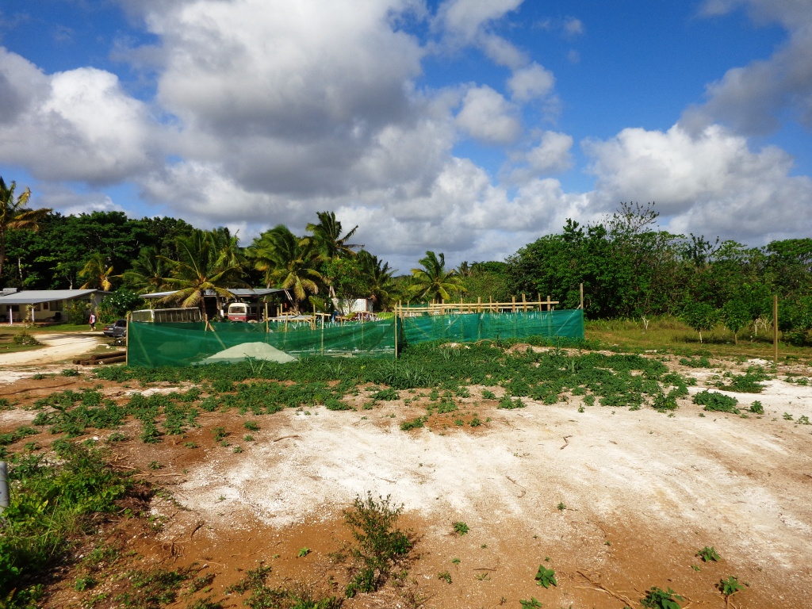
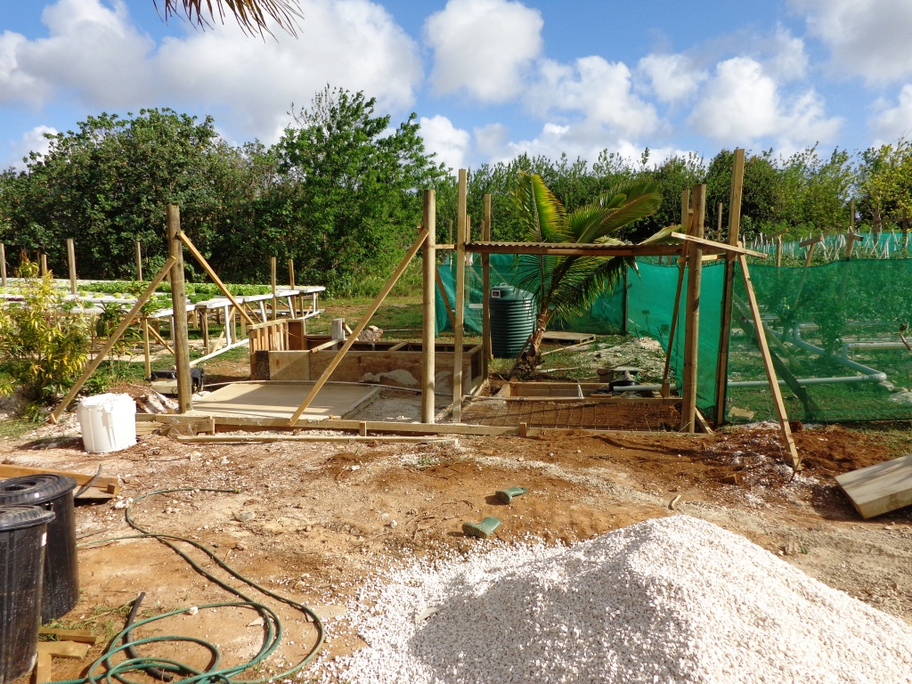
INTRODUCTION
In 2011 during a round of golf two mates were talking about how terrible the salads were and how expensive exported lettuces were! Those two chaps were myself and Mark Blumsky and it was the foundation for what is today known as Niue Fresh.
Niue Fresh formed a bond with PGO horticulture a company with a history of work pioneering hydroponics in NZ

Slide 5
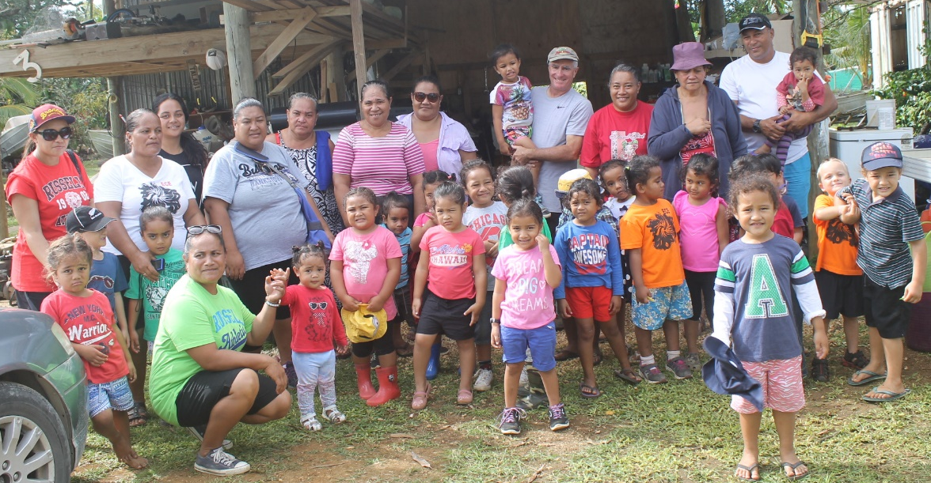
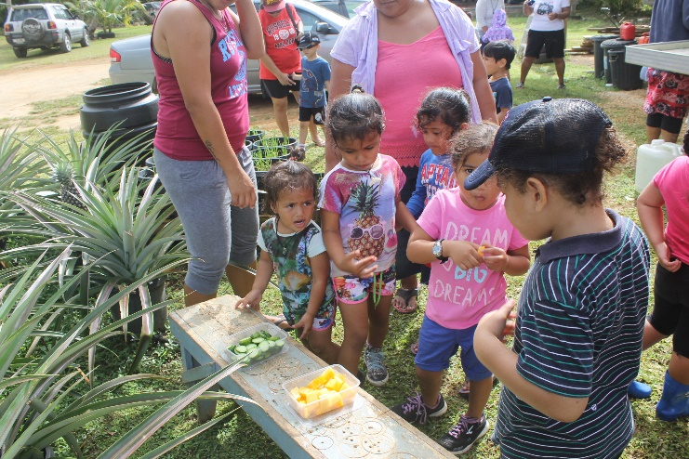
Health and Education
In Niue we are presented with distressing statistics in regards to obesity , gout and other ‘diseases’ caused in the main by poor diet . A poor diet not helped by healthy alternatives being too expensive and irregular with supply. Clearly it was this freight obstacle that was fundamental to many of the problems facing local Niuean’s in regard to the health issues we faced as a nation
Educating our children at an early age we feel will benefit the Island as the flow on effect will also educate the parents.

Slide 6
STAFF
Initially during the early stages I worked on the set up as the only staff member then we began to grow to where we are today with 6 fulltime staff members.

Slide 7
MOTHER NATURE
Located in tropics we have a few hurdles to negotiate from time to time
Weather
Pests
Extremity of weather does create a whole set of challenges. Some plants just don’t do well in the extreme heat, unfortunately you only find out the hard way ….when they die . By trialing different varieties of the same plant to find best fit ,we now can keep most of the range available to the market all year round. But experimenting does come at a cost.
In line with the weather comment above , extreme rain fall also creates problems , and a lot of produce in our early days was badly water marked or even destroyed until we managed to put a roof over the growing areas …………….again a significant cost .
And then you discover one day when you find all your tomatoes have gone soft and white ,that there is a fruit piercing moth that has discovered your farm and developed a liking for those ‘nice ready to pick tomatoes’ . That is why you now see, when you drive past the Niue Fresh farm, the green netting houses we have built in which we now plant the tomatoes to protect them from this moth…………. Again at a significant cost ,

Slide 8
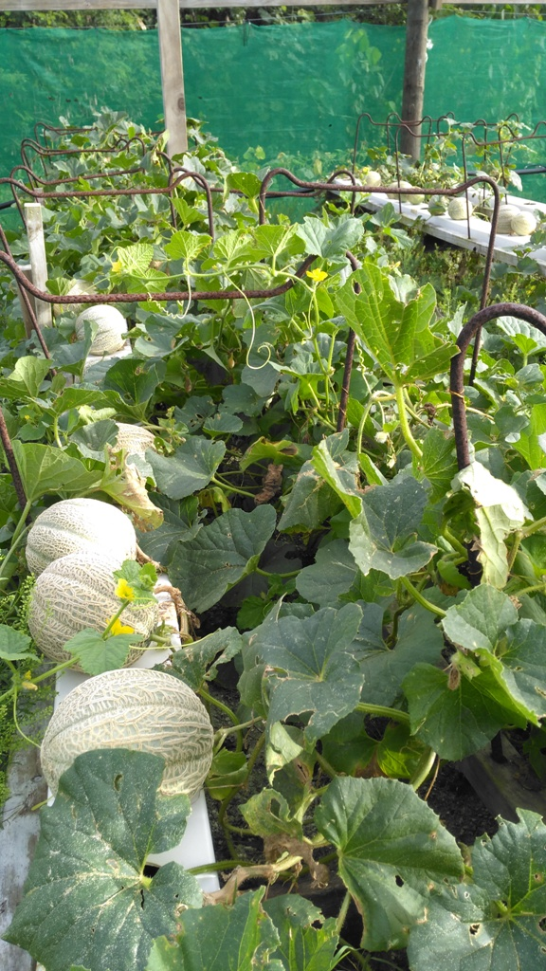
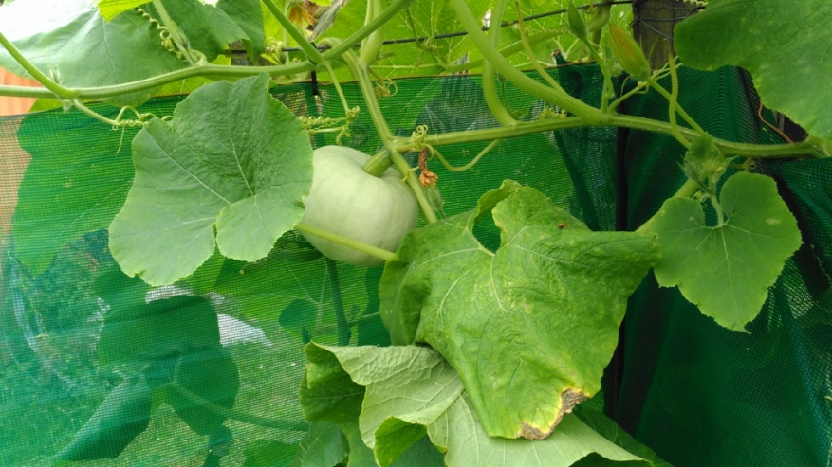
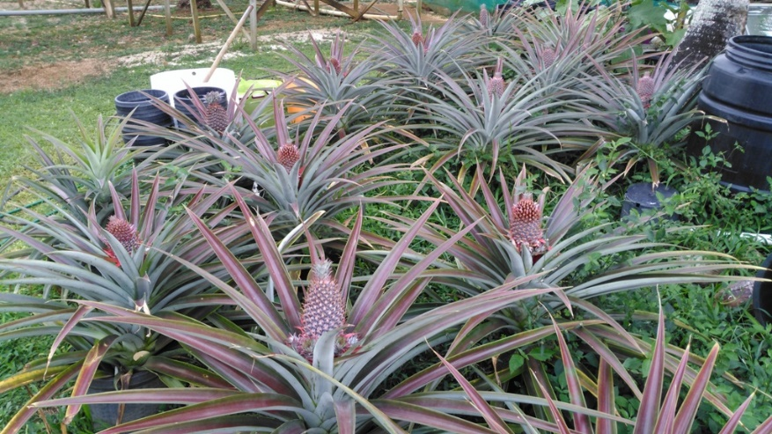
MARKET OPPORTUNITY
With growth has come many challenges, but Niue Fresh is happy to say that over 95% of all produce grown is sold to the local market via restaurants (including the Matavai Resort) with our own retail store and the local supermarkets adding real impetus to sales .
Niue Fresh is now the most significant supplier of Fresh Produce to Niuean’s and Tourists
Niue’s population

Slide 9
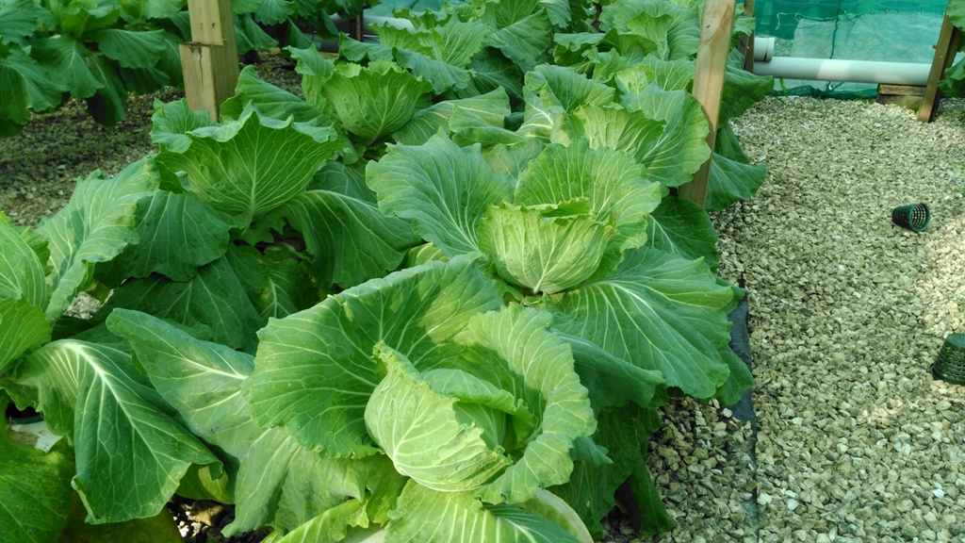
PRODUCT RANGE
Once the early Hydroponic growing trial had proved successful, to seriously enter Niue Fresh into the market with a wider range of produce that the market actually needed and wanted .Needed and wanted because early into our start up , Niue Fresh made it business value to talk regularly to the chefs and owners as to what it was they would want to cook , eat and sell .
Menus were discussed together to ensure supply was regular so that restaurant confidence was gained. Important when putting together a new menu and going to print ,to ensure that the produce required for cooking was going to be available on a regular basis .

Slide 10
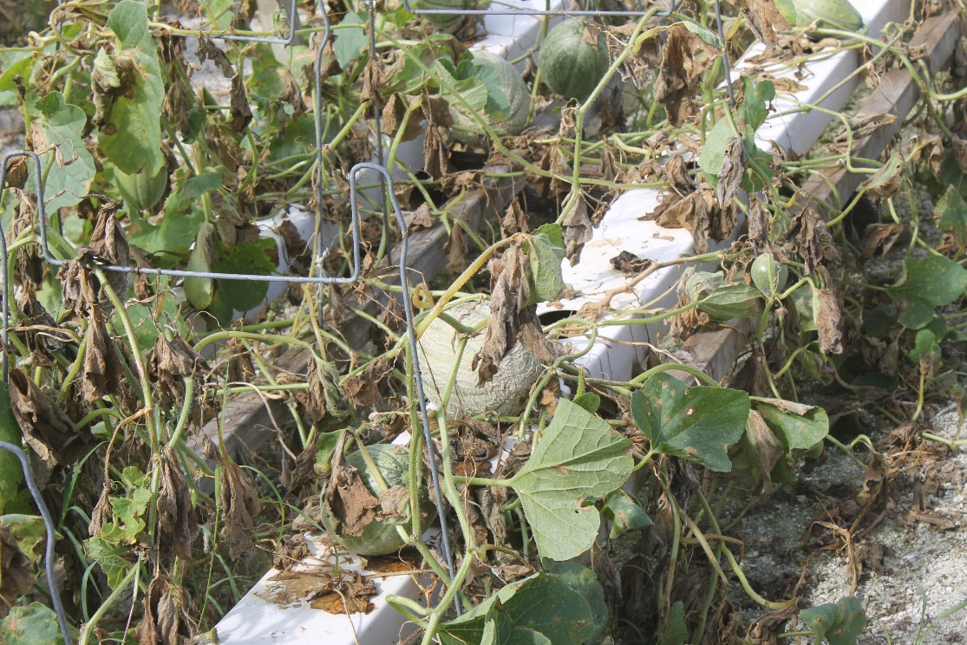
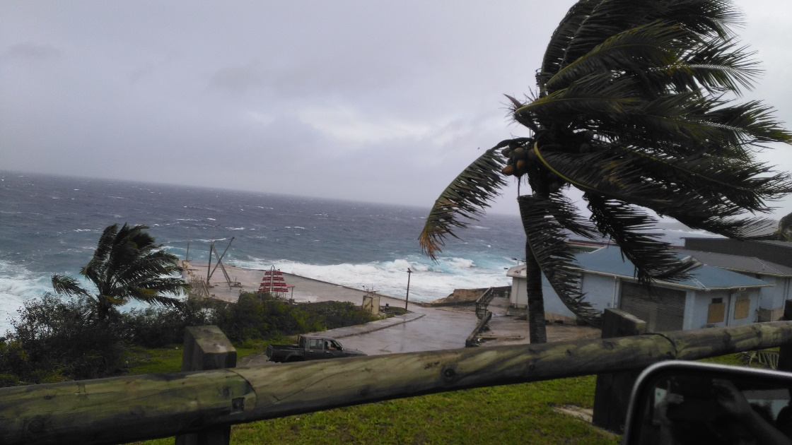
RISKS
Hydroponic growing needs 100% reliable power supply ………… not always guaranteed here on Niue. The plants need a constant unbroken supply of water and nutrients. With the heat and humidity being so devastating to the plants if without, its important the water cycle and associated pumping is maintained at all times .To minimize risk we purchased our own generator
Cyclones, having a sound contingency plan in place for a cyclone threat is a must.

Slide 11
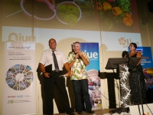
AWARDS
In 2015 Niue Business Awards
Niue Fresh won the category for best business in Retail Trade and Service.
In that same evening went on to win the 2015 Supreme Award for the best Overall business.

Slide 12
FUTURE FOR NIUE FRESH
Mark has just returned (last week in fact) from talks with MPI in Wellington and shared samples with Importing companies, Chefs and large supermarket chains in Auckland with an eye to exporting our herbs into NZ. The positive response (virtually ripping our arm off) has given us confidence to move to the next step of allowing our respective Bio security departments to sort out the paperwork.
We think the Future is bright for Niue Fresh

Slide 13
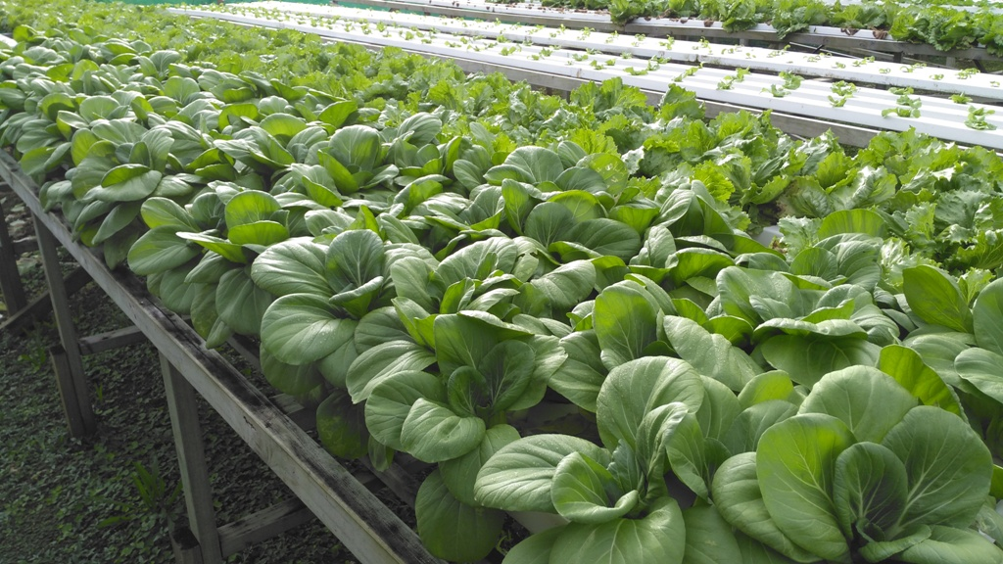
CONCLUSION
From virtually 3 gullies to where we are today has been an amazingly bumpy ride but neither Mark nor I would have changed a thing.
Credit must go to our amazing staff who for years braved the heat and humid conditions, our Mentor and supplier PGO horticulture in NZ
We thank you for giving us this opportunity to showcase our Business.

Slide 14
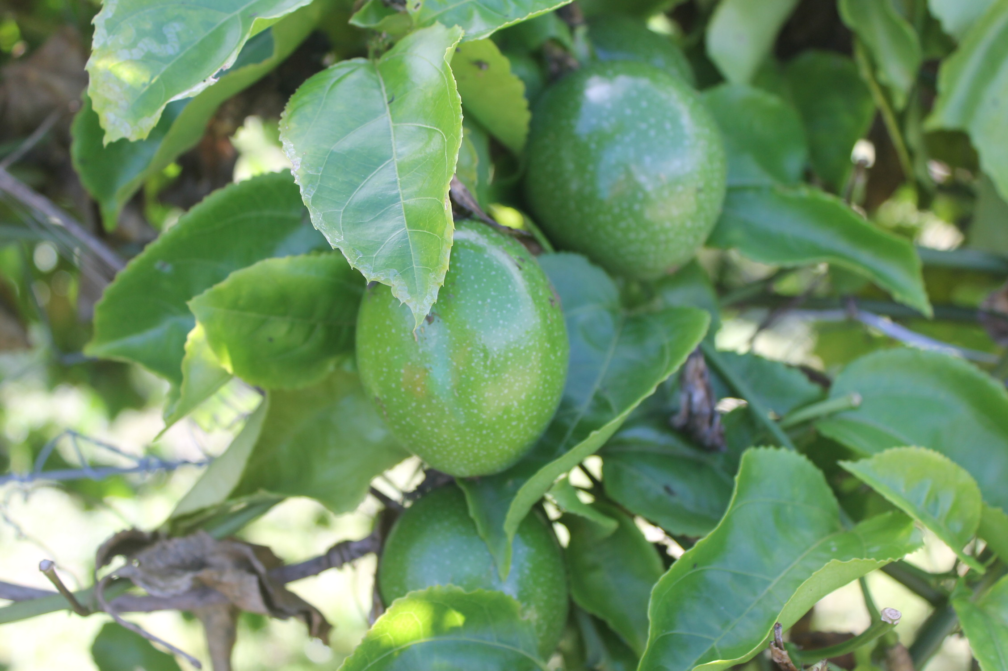
THANK YOU ANY QUESTIONS

