Slide 1
“Nature’s Way Cooperative: A Model for Agribusiness Service Provision”
Michael Finau Brown, CEO NWC Nadi Airport Fiji

Slide 2
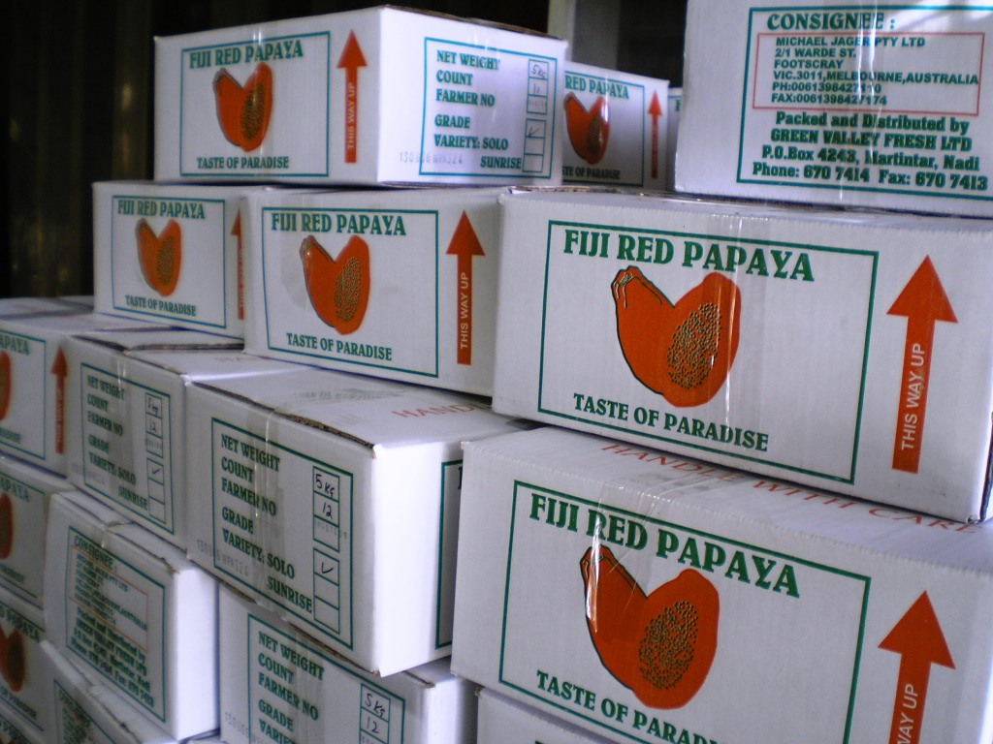
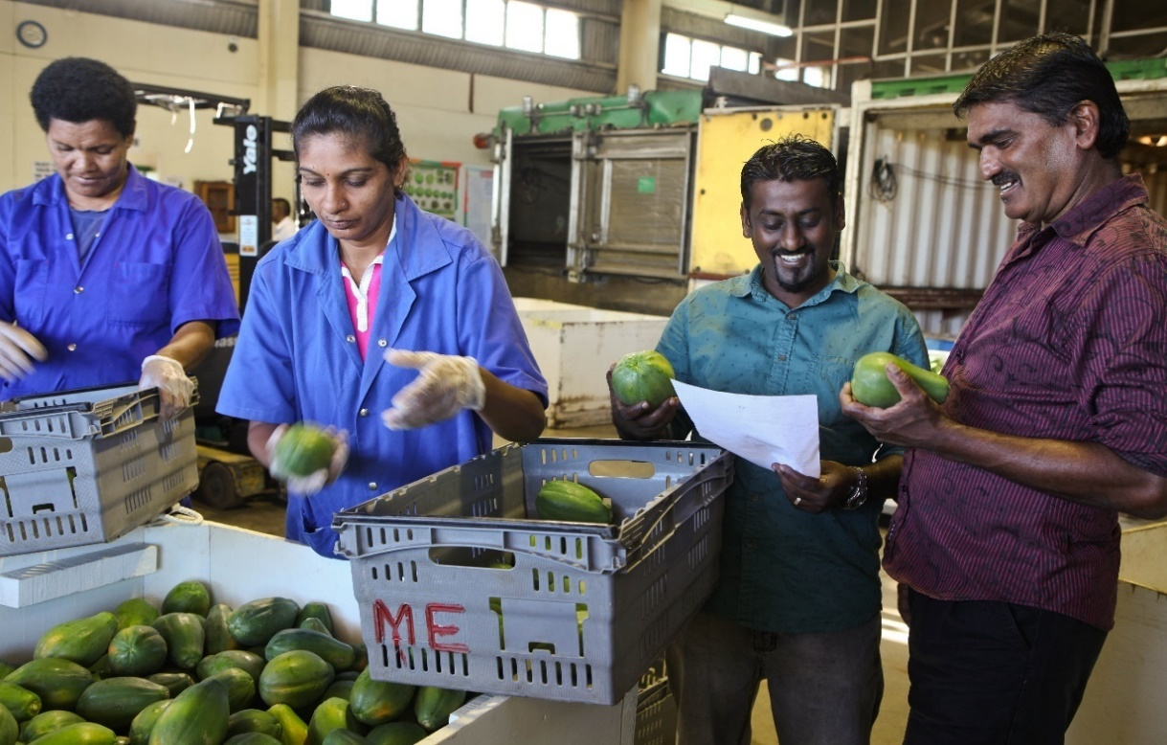
Nature’s Way Cooperative A Model for Agribusiness Service Provision
Michael Finau Brown- CEO NWC Nadi Airport Fiji

Slide 3
Proudly serving our members since 1995

Slide 5
Natures Way Cooperative (Fiji) Ltd: From small business to substantial Agribusiness

Slide 6
Core business
NWC was established in 1995 to undertake mandatory quarantine HTFA treatment on behalf of Fiji’s fruit and vegetable export industry.
Natures’ Way Cooperative (Fiji) Ltd is registered under the Fiji Cooperative Act of 1996 and is owned and operated by the Fiji fresh produce export industry.

Slide 7
NWC Organization Structure
BOARD OF NATUER’S WAY COOPERATIVE (FIJI) LTD
Chief Executive Officer
Manager Research/Extension
Manager Administration /HR
Manager Operations
HTFA Operators
Graders/Packers
Manager Accounts
3 Research/Extension Officers

Slide 8
Key success factors
PPP (Private Public Partnership)
The public sector cannot be successful on its own nor can the private sector.
Success can be achieved when both sectors are working together appropriately

Slide 10
Key success factors
Strong and focused leadership
Agribusiness approach to service provision with a focus on ‘profits’ and risk mitigation
Mediating between various stakeholders to keep them together and engaged over common goals
Enabling exporters and growers to interact with transparency and build long lasting business relations

Slide 11
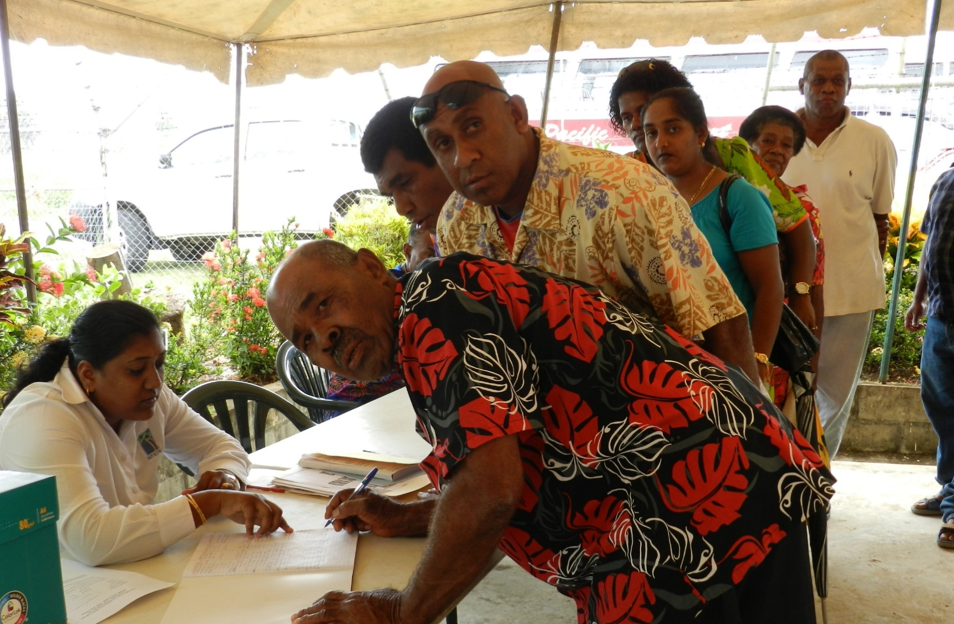

Slide 12
Key success factors
Focus on problem solving and innovation
NWC Research and Extension Programme has been very active over the past 10 years at solving problems and driving innovations
Focus on improving profitability for all actors in the value chain
NWC and the export industry likely would not have survived the various threats and challenges without this mechanism

Slide 13
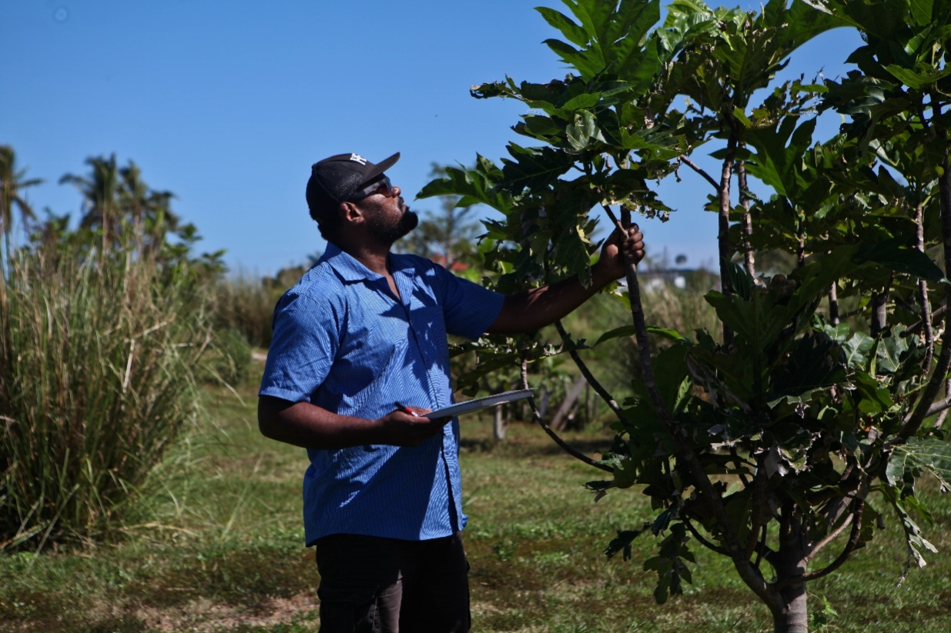
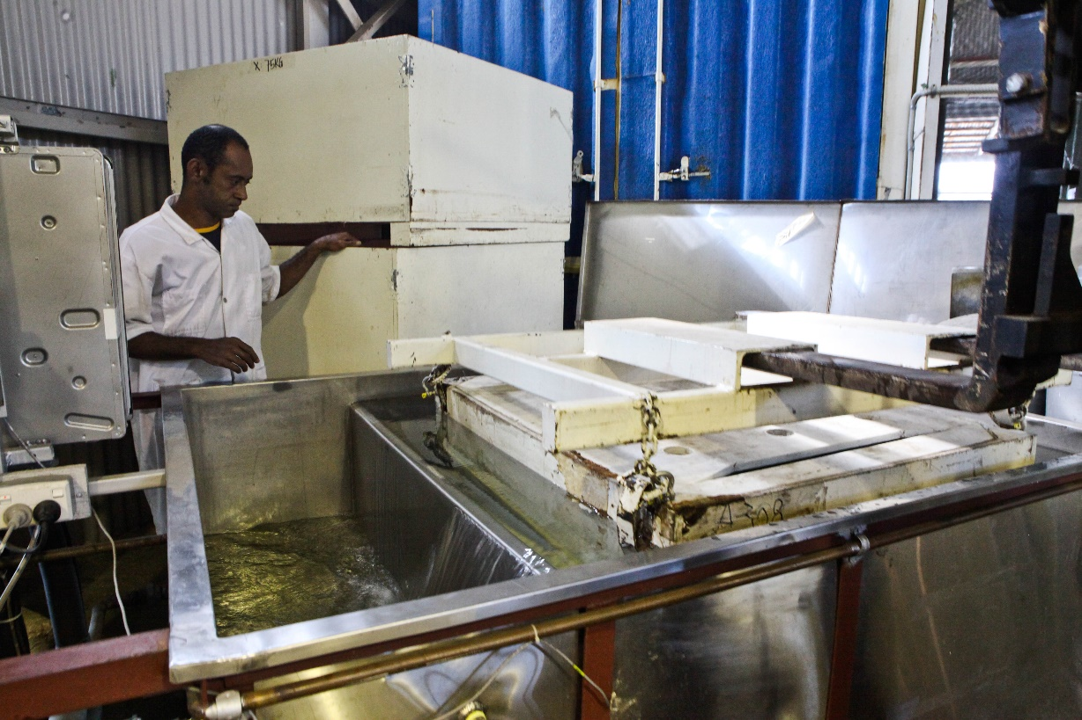
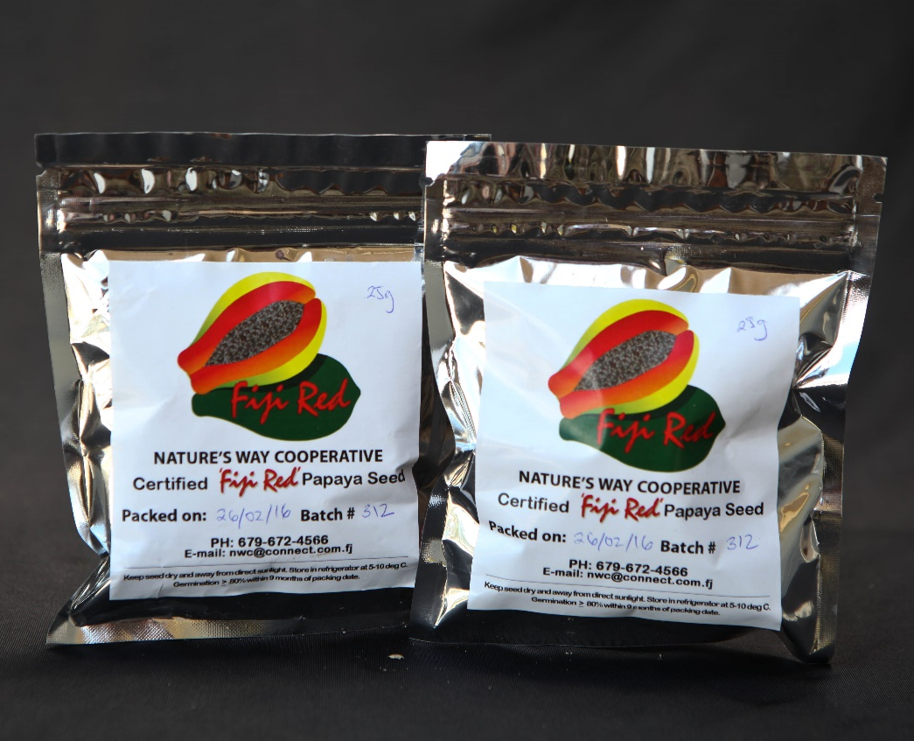

Slide 14
Additional benefits of a thriving export industry
High quality ‘Fiji Red’ papaya is widely available for local tourist and non-tourist markets (except after TC Winston).
Export farmers engage more successfully in domestic trading with their ‘agribusiness’ experience
Export traders also supply local markets with better service, quality and price.

Slide 15
Local Market Opportunities
NWC registered growers export 50% of quality produce to overseas markets (Australia and New Zealand)
The other 50% is channelled to the hotels and local municipal markets.

Slide 16
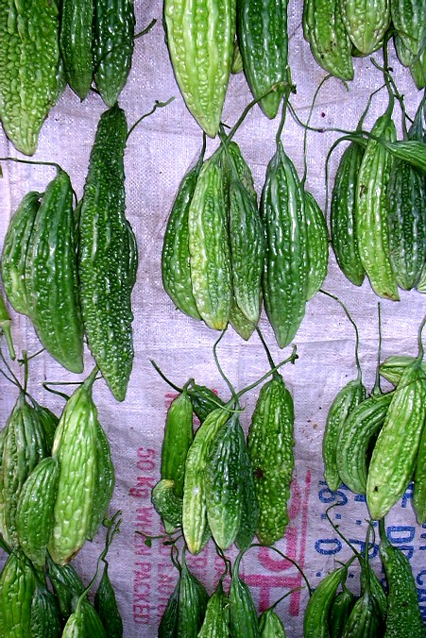
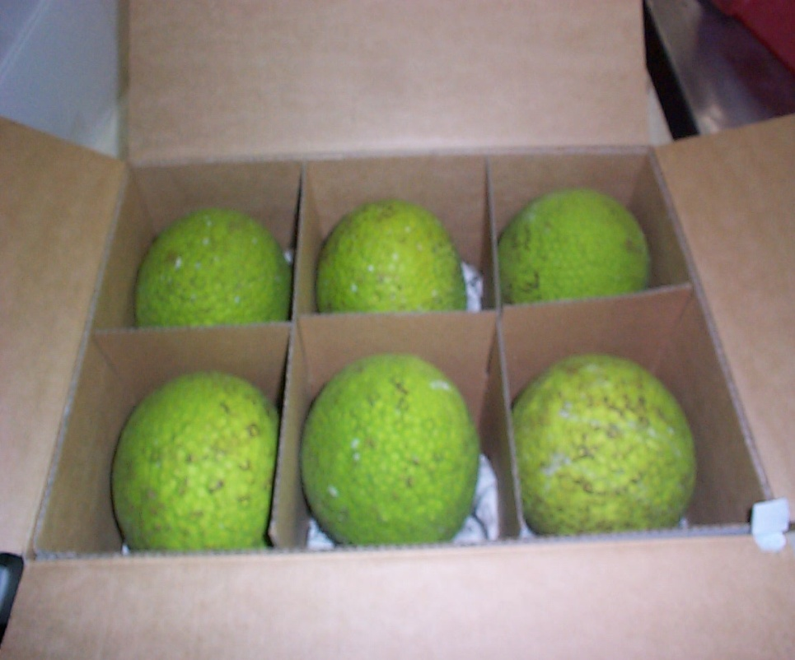
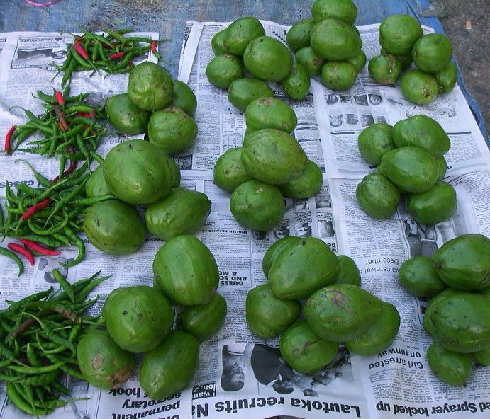
Additional opportunities in Regional Markets
Australia – breadfruit, eggplant and fresh ginger
USA - papaya and breadfruit
New Zealand – wi, bitter melon, other gourds, jackfruit

Slide 17
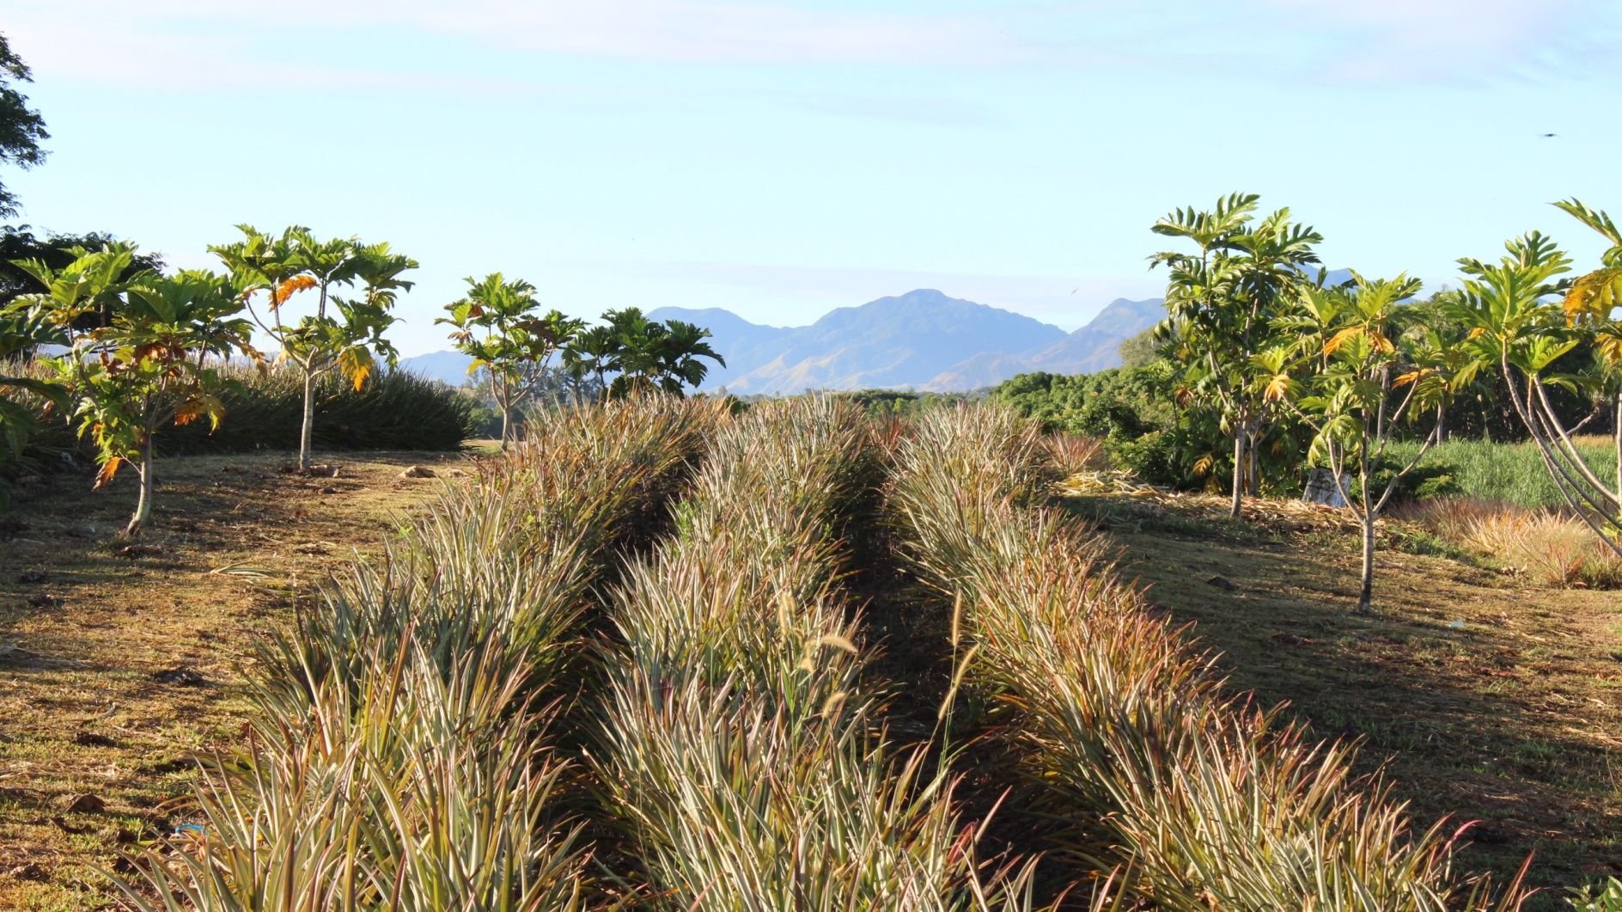
Vinaka
www.nwcfiji.com

