Slide 1
“Vanuatu Agritourism Strategic Action Plan”
Ross Hopkins, Principal, TRIP Consultants

Slide 2
Vanuatu Agritourism Strategic Action Plan
Ross Hopkins
August 2016

Slide 3
Background
Increased awareness of benefits and opportunities of agritourism
Agritourism Policy Dialogue – CTA -June 2016
IFC Baseline Demand Study – highlighted the opportunity for import replacement
Agritourism Steering Committee formed
New Zealand Government support to develop Agritourism Strategic Action Plan
Complements other MFAT support in tourism and agriculture

Slide 4
Tourism Sector Leakage
The IFC’s 2015 study into agritourism linkages highlights the high level of food imports used by hotels and restaurants
The study estimates that approximately 54 percent of all fresh produce used by hotels and restaurants in Vanuatu are imported (equivalent to VUV1.5 billion (USD $15.6 million)
Import levels are high for vegetables (50 %), fruit (30 %) and meat, seafood and dairy products (60 %).
The level of imported supplies (leakage) is increasing (post Cyclone Pam)

Slide 5
VASAP Process

Slide 6
Vanuatu Tourism Arrivals

Slide 7
Agritourism Definition

Slide 9
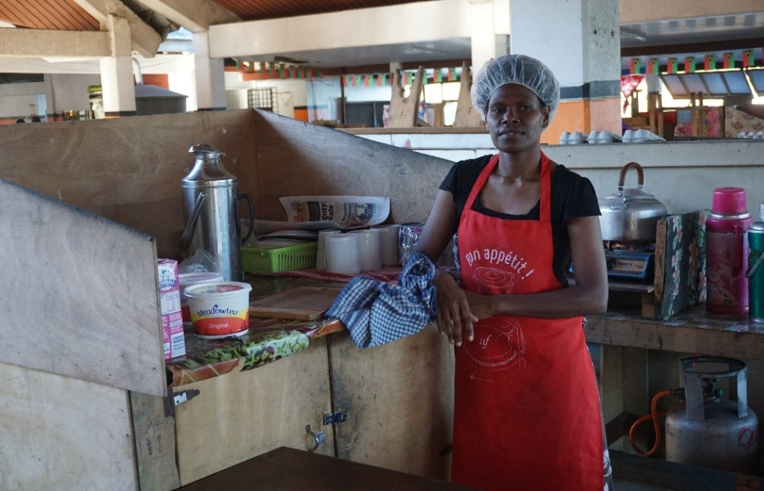
Agritourism – Tourism Products
Agritourism includes attractions and tours which have a significant agricultural focus
Examples include the markets, attractions such as Tanna Coffee Centre, the Summit Gardens and Eden on the River, ACTIV as well as farm and plantation tours

Slide 10
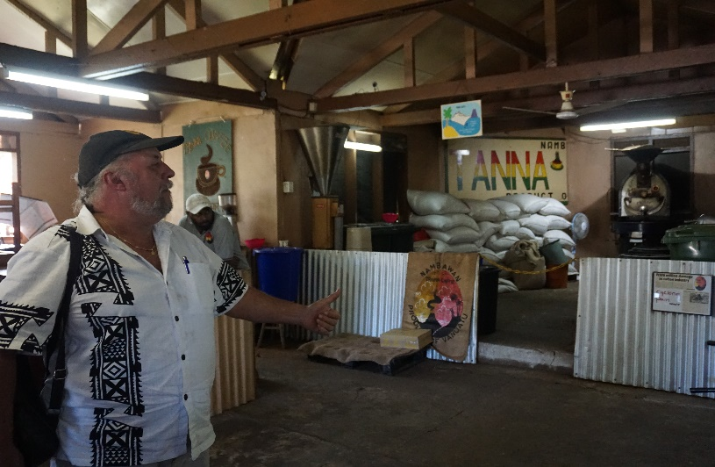
Agritourism Attractions
Most attractions are component of larger tourism experience or tour rather than major attraction of agritourism tour
Agritourism products showcase the strengths of Vanuatu – unspoilt natural/organic product and unspoilt people and environment
Constraints exist for many businesses including inadequate marketing and limited access to finance

Slide 11
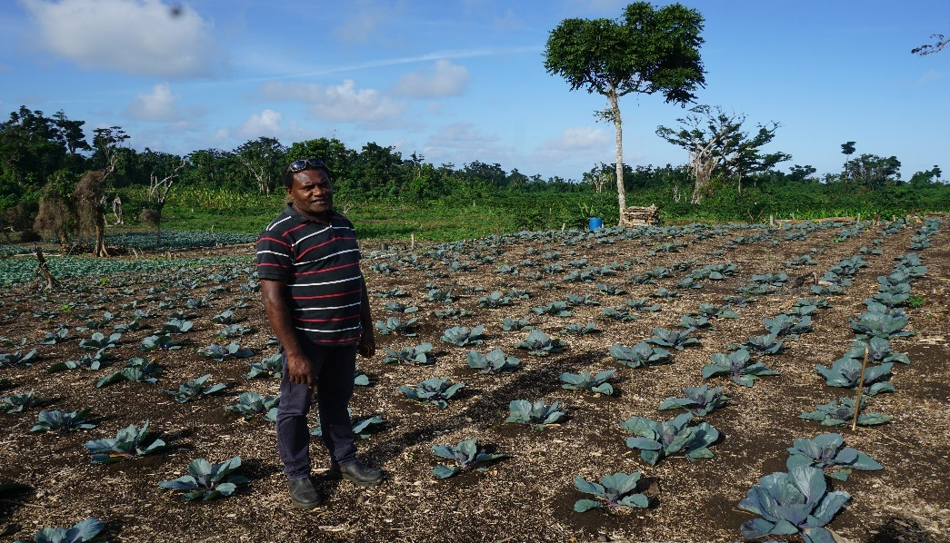
Agritourism – Tourism and Productive Sector Linkages
Agritourism includes the supply and demand linkages between the productive sector and tourism
Tourism operations (restaurants and hotels) are significant consumers of local produce
However substantial gaps exist in the supply chain resulting in a high level of imports

Slide 12
Supply Side Constraints
Hotels and restaurants identify a lack of reliable supply of high quality local produce as the key constraint
There are a number of productive constraints, including:
A lack of modern infrastructure, technology and farming techniques
Inefficiencies of inter-island shipping, storage and road transport resulting in high cost and quality reduction
Poor access to training and extension services and lack of advisory and agribusiness skills
Lack of established and functional farmers associations/coops and low numbers of larger (lead) farmers
Lack of linkages between the buyers (hotels and restaurants) and the farmers (consolidators and lead farmers)

Slide 13
Opportunities
Increased production of fruit and vegetables through lead producer/aggregator model and scaling up existing commercial farmers ie Nasi Tuan model, Efate producers
Improving product quality through targeted extension support and technical advice ie crop planning, pest and disease control, agribusiness skills, harvesting, handling, storage and packaging
Extend growing season – irrigation, better seeds, farm management, technology – hydroponics and greenhouses

Slide 14
Opportunities
Improve knowledge and increase direct links between hotels and production – ie information exchange, hotel sponsored gardens (Ratua/Oyster Is), B2B
Increase demand for local produce and agribusiness attractions – destinational marketing and value added showcasing and packaging, information for tourists and business support
Build stronger producer organisations – through lead farmer model, training and supply chain support ie targeted extension, storage, transport

Slide 15
Agritourism Strategic Framework
Strategic Goal
Enhanced Economic Growth from strengthened linkages between the productive sectors and tourism
Three Strategic Areas
Stronger Agritourism Attractions
Enhanced Value-added Agritourism Products
Increased supply and usage by tourism operators of local productive sector inputs

Slide 16
Thank Yu Tumas and Fa’afetai

