Slide 1
Agribusiness development in sids: the potential of tourism related markets
Brussels Development Briefing 46
Wednesday 21st September 2016
Papalii Sonja Hunter
CEO Samoa Tourism Authority
Chairperson South Pacific Tourism Organisation

Slide 2
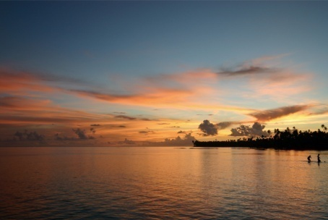
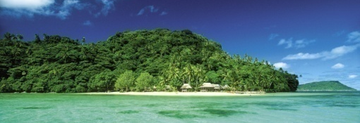
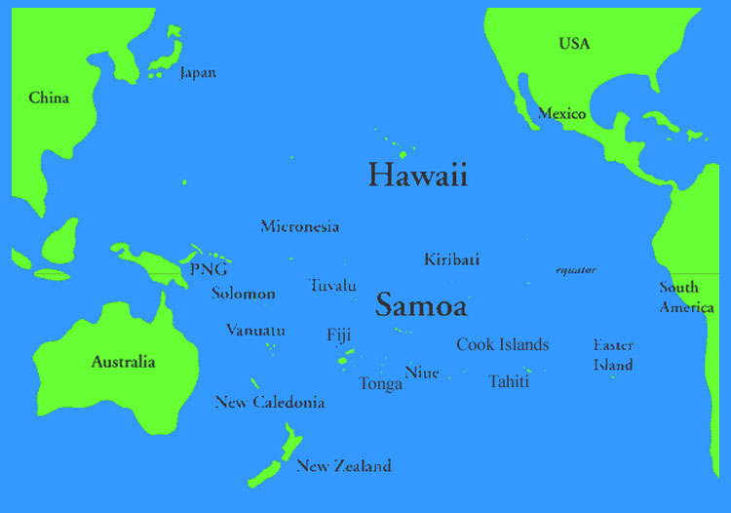
Favourable Geographical Location in the Heart of the Pacific and the World

Slide 3
Overview of Samoa
Samoa consists of two (2) large islands of Upolu and Savaii and eight small islets. The climate is tropical throughout the year with a moderately wet season from December to March. Favourable Geographical in the Pacific.
Population : 193,000 (Est. 2015)
Infrastructure & Utilities to 99% of Samoan Population
Official Languages : Samoan & English
Democratically Cultural Political Structure
Weather : Tropical with Average Temp of 28 deg. cent
Capital : Apia (on the island of Upolu)
Sustainable Tourism has been identified as a Priority and the Mainstay of the Samoa Economy.

Slide 4
Performance
Visitor Arrivals
2015 - 139,000 (5.5% Growth)
2016 – Forecast Growth of at least 10% (approx 153,000 V.A.)
Tourism Earnings
2015 – SAT$360 million (3.8% Growth)
2016 – Forecast Growth of at least 8% (approx SAT$390m)
Employment
Direct – approx 4,800 direct employment (which equates to 14% of total workforce)
Accommodation
Since 2009 - 22% increase in accommodation providers, with 84% of this being new establishments and 2324 rooms
Occupancy – 52% annual average for Deluxe Properties
Airline Access
2015 – Total Inbound Capacity of 212,000 seats, at 82% (175,000) seat utilization (representing 7.2% growth on 2014)

Slide 5
introduction
Agritourism …. A form of Sustainable Tourism
UNWTO Definition:
"Tourism that takes full account of its current and future economic, social and environmental impacts, addressing the needs of visitors, the industry, the environment and host communities"
Agritourism links Tourism with Agriculture in Agribusiness
“Set of policies establishing specific guidelines, obligations and incentives to assist and encourage farmers to diversify their entrepreneurial portfolio through tourism and hospitality services thereby fostering the development of agritourism.”
Agritourism links and ensures usage of Agriculture Products and Services
Agritourism refers to popular coordinated Agriculture Based Attractions and Tours
Agritourism promote Agribusiness Value Added Personal Care and Health Products and Services

Slide 6
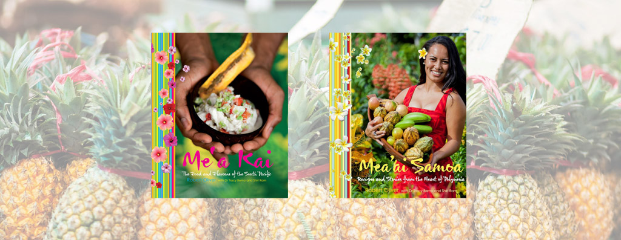
Samoa Agritourism progress
Milestones
Me’a Kai Cook Book (2010) ‘The Foods and Flavours of the South Pacific’ by Celebrity Chef Robert Oliver Winner of the Best Cookbook in the Gourmand Cook Book Awards 2011
Mea’ai Samoa Cook Book (2013) ‘Recipes and Stories from the Heart of Polynesia’. The development of a Samoan cuisine cookbook designed to promote local fruits and vegetables produced by celebrity chef Robert Oliver, in partnership with STA and WIBDI. An Award Winning Cook Book of cuisines from the traditions and environment of Samoa., with practical recipes, that highlight local farmers, chefs, restaurant owners and provide stories on Samoa’s organic plantations and use of fresh local produce by the tourism sector.
Culinary Training in the region by SPTO, PIPSO and CTA has emphasised more usage of local ingredients in local restaurant cuisines emphasising the Farm to the Table mission.
The newly established Samoa Culinary Association (SCA) in 2015 continues to strengthen the Farm to the Table movement.
SCA train the youth to become cooks and be familiar with local ingredients

Slide 7
Samoa Agritourism progress
Milestones ;-
Agritourism Guided Tours: A total of 10 registered specialised tours which can cater for village/farms guided tours, fishing expedition, tours, etc
Samoa Minimum Accommodation Standards – The involvement of WIBDI as part of the technical committee further acknowledged and strengthened the agribusiness and organic farming initiatives as well as farm to table project;
HRD Culinary training (SPTO) in the last two years – Upolu and Savaii (50 cooks and chefs trained)
Training Calendar guided by the Tourism Training Task Force on food safety with all operators;
Food Act 2015 promoted by the Ministry of Health and Government Agencies
STA as one of the key stakeholders in the Agriculture Sector Committee
Floral Garden Toilets – Rest stops in strategic rural areas encouraging biogas systems, handicrafts and agriculture refreshment stalls i.e. coconuts and fruits;
The priority attraction sites development plan to further compliment Agritourism tours and the Development of a Ten Acre Agritourism National Park.

Slide 8
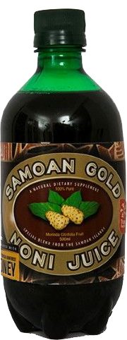
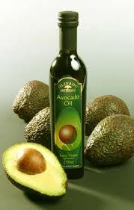
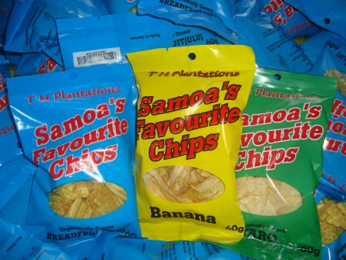
Value ADDED PRODUCTS
Nonu Juice – is locally made by a Samoan family to enhance Nonu’s natural purpose of healing. It is purely made and it contains no water, chemical preservatives, impurities, sugar, honey or dilution with cheap fruit juices
Avocado oil is produced by SROS as a cooking oil that contributes towards promoting healthy eating and living for Samoan people.
Taro/banana/breadfruit chips

Slide 9
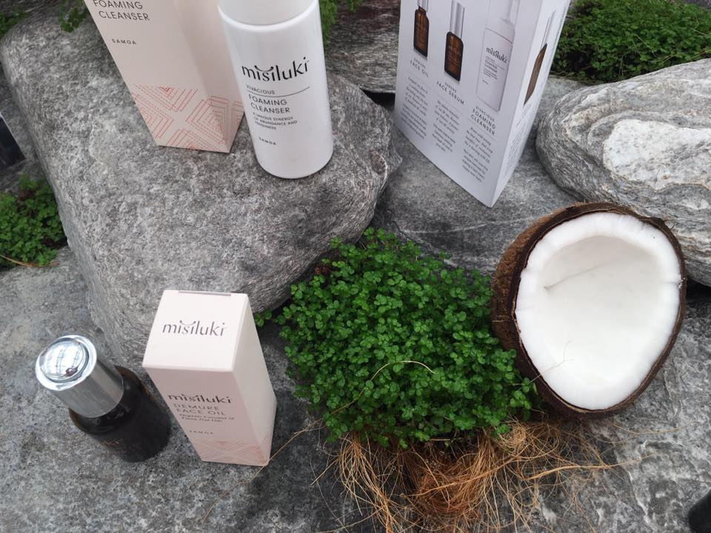
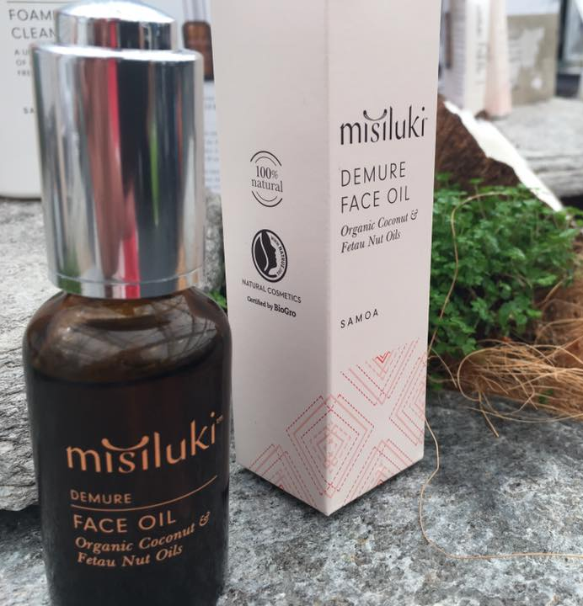
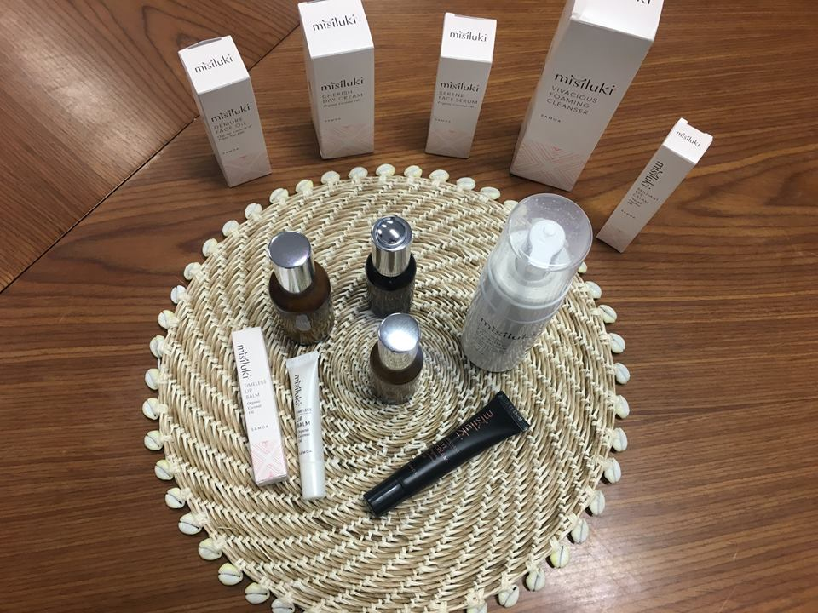
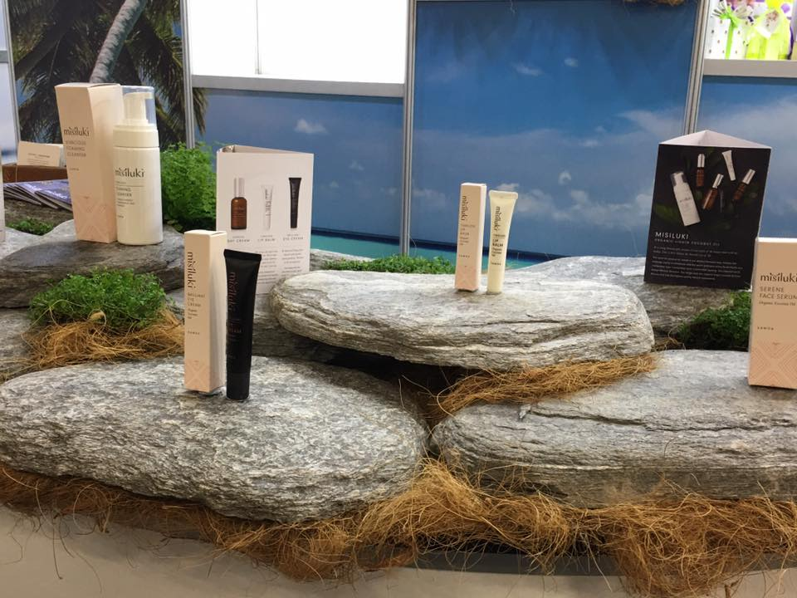
MISILUKI SKIN CARE PRODUCTS

Slide 10
LINKs TO ENSURE USAGE OF AGR PRODUTS & SERVICES
Samoa, 2015, spent SAT$214 million (approx 85 million USD) on the importing of food products
20% or equivalent SAT$43m (approx 17 million USD) directly attributed to the import of fresh fruits, vegetables, animal and fish products by the tourism industry.
3. International Visitor Survey (IVS 2013)
Visitors spend an average of SAT$269 per day; and SAT$69 is spent on food and drinks per day. Visitors average stay is 10 days.
Based on 2015 visitors numbers, SAT$96million was spent on food and drinks. An equivalent of 26% of total tourism earning of SAT$363 million.
Source: Ministry of Finance & Central Bank of Samoa Reports

Slide 11
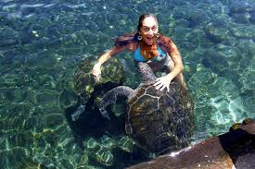
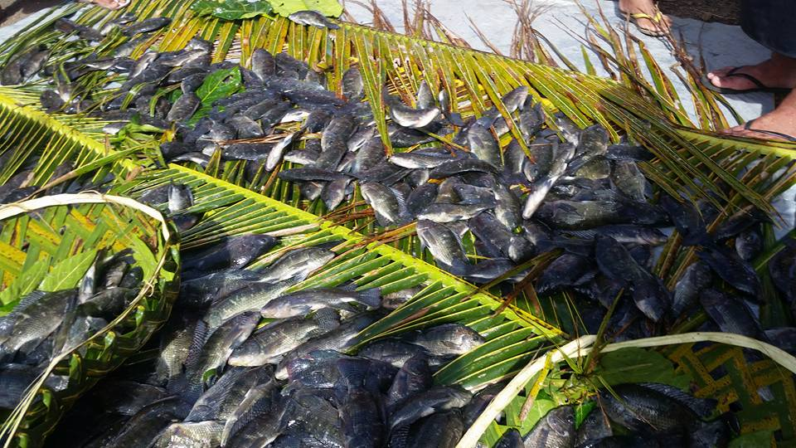
AGRITOURISM ACTIVITIES
Swimming with turtles at Satoalepai
Lotofaga Tilapia Farm
Samoa International
Game Fishing
Tournament

Slide 12
Way Forward
Important to Work Towards the establishment of a Samoa Agritourism Strategy
Mainstream Agritourism Strategy into Sector Development Plans to ensure well coordinated cross-sectoral programmes that upscale farm to table successes (eg. WIBDI), training of Chefs to use local fresh produce and encourage research on value added products and usage in all tourism
All Strategies to lead to the achievement of applicable SIDS and Sustainable Development Agenda 2030 Resolutions
CTA to assist Samoa with the establishment of the Agritourism Strategy and Policy, and the piloting of the Samoa Agritourism Park as the Marketing Catalyst similar to Meaai Samoa.

Slide 13
Thank you & God Bless!

Slide 14
Samoa Tourism Sector Plan
Samoa Tourism Authority roles and responsibilities are guided under the Tourism Development Act 2012 which stipulates and provides for the sustainable development, promotion and management of the tourism sector in Samoa through effective planning, administration, regulation, and for related purposes.
1.1 Strategies for the Development of Samoa (SDS) 2012-2016 – Ensure quality product and service delivery through implementation of tourism operators standards; strengthened linkages between tourism and other sectors of the economy; Support and encourage the linkages amongst training providers to strengthen relevant training for the industry;
1.2 Samoa Tourism Sector Plan (STSP) 2014-2019 – Overall lays the foundation for the coordinated and sustainable development of tourism for Samoa. Increase linkages between primary producers, handicrafts and tourism providers through business support and facilitation by lead agencies including WIBDI, STA, Manufacturer and Agricultural sector

Slide 15
Samoa Tourism Sector – Key Priority Areas

Slide 16
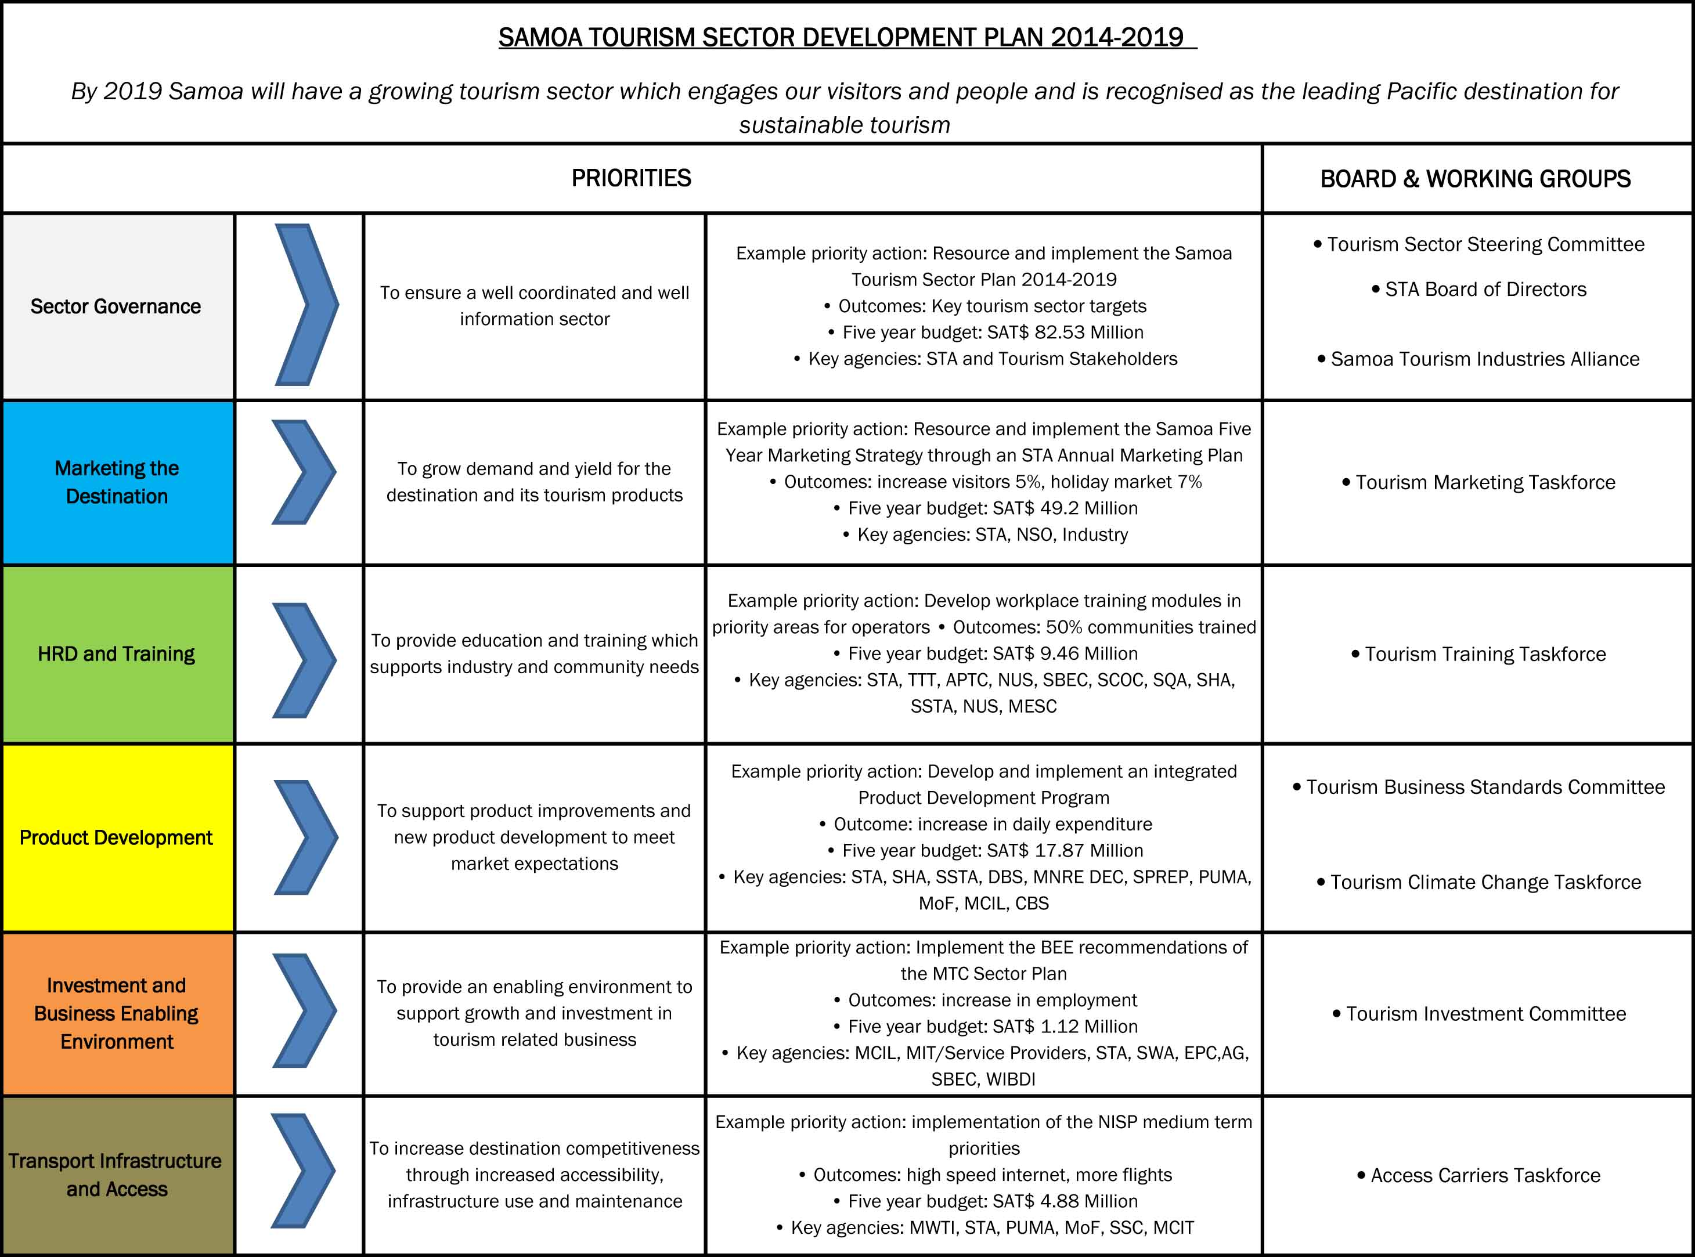
Sustainable Tourism ‘a National Development Tool’

Slide 17
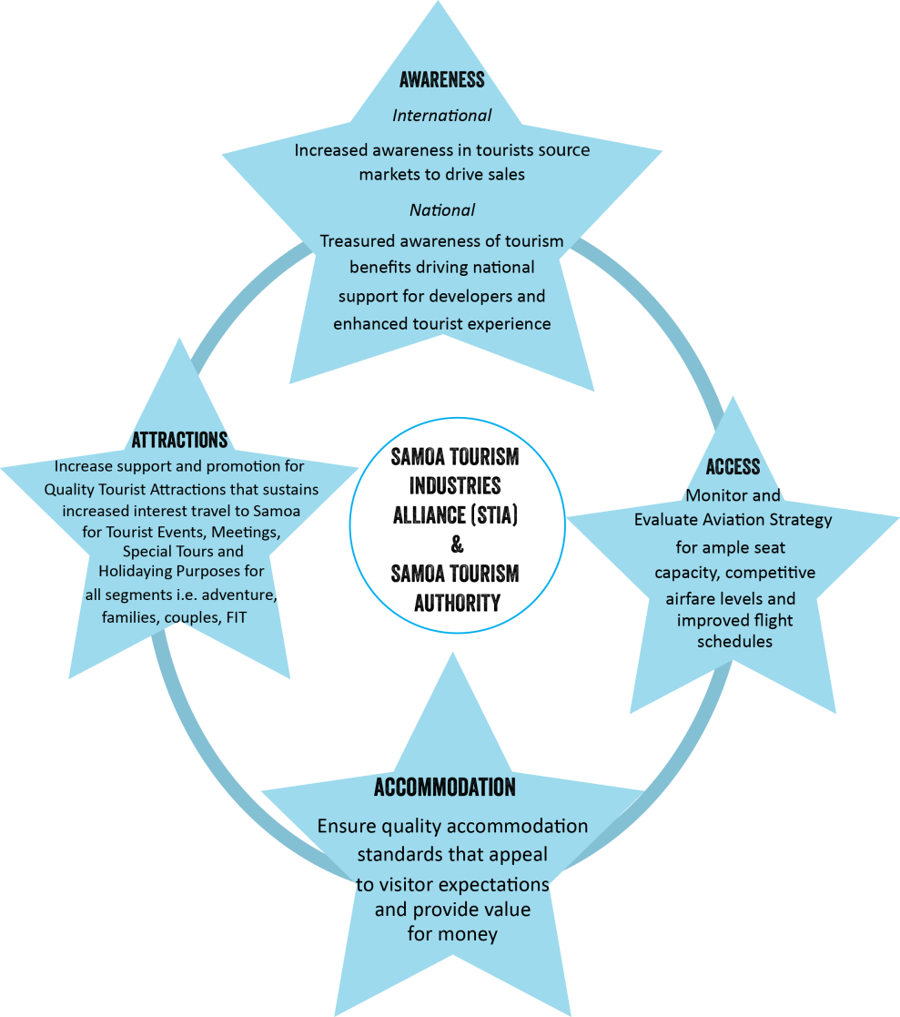
4A Tourism Coordination Model

