Slide 1
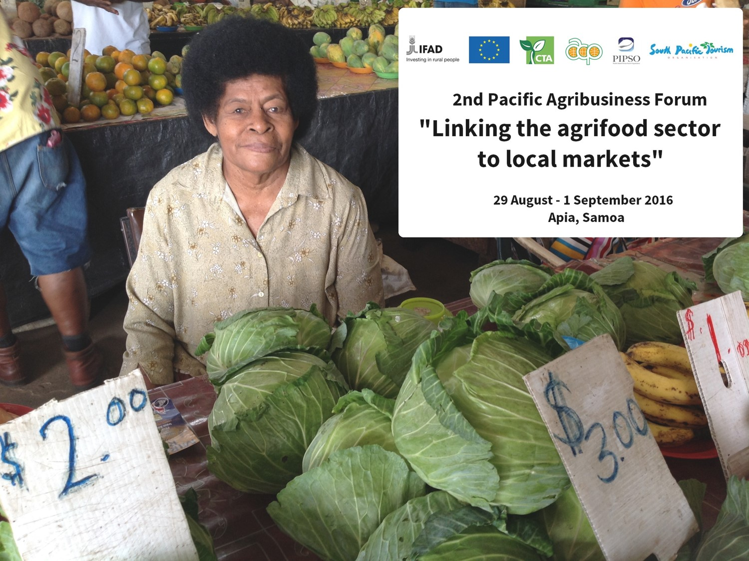
“Challenges in lending to Agribusiness SMEs and how can access to finance to agribusiness improved?”
Susana Laulu, CEO, Development Bank of Samoa

Slide 2
AGRIBUSINESS FINANCING
Challenges in lending to Agribusiness SMEs..
How can access to finance to agribusiness be improved??

Slide 3
DBS Lending to Agriculture

Slide 4
What access to finance entails?
A financing Obligation
Developer’s commitment
Financier’s commitment
Other parties commitment

Slide 5
Challenges/Constraints
Security/collateral
Credibility
Ability to pay/financing need to match capacity
Nature of development
Priorities

Slide 6
Solutions/Opportunities
Affordable sources of funding
Flexibility in terms and conditions
Sustainable development Partnerships
Capacity building
Effective coordination
Inclusive engagement

Slide 7
Conclusion
Access to finance is one of the mechanism to support sustainable business development.
Sustainable development through development financing partnerships need to be nurtured and strengthened continuously.
Success will be measured by growth for economic and social development and outreach for inclusive development.

