Slide 1
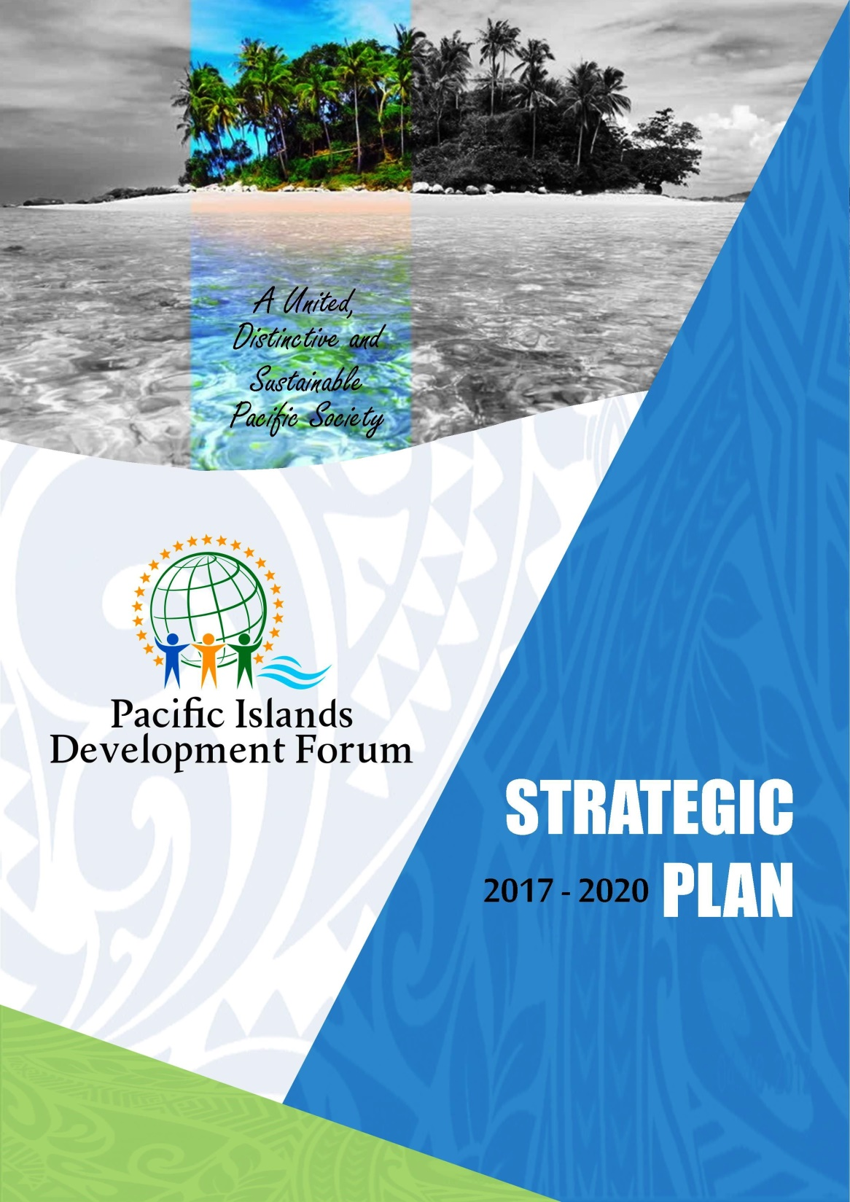

Strategic
Plan
Green Growth and Environmental Leadership in Business

Slide 2
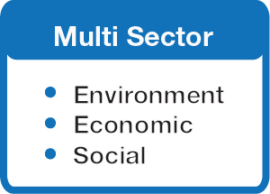

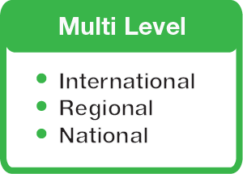
DEFINITION & UNIQUENESS
Design – Rio+20 (Green economy) and Agenda 2030 on Sustainable Development (SDG)
Multi-stakeholder P-SIDS&T
Platform for The Green and Blue Economies
Inclusivity (High Level Political Forum – UN)

Slide 3
PIDF - MISSION
Multi-Stakeholder Governance
Inclusive Strategies
Green/Blue Pacific Economies
Genuine Partnerships
Enabling green-blue Pacific economies through inclusive strategies, multi-stakeholder governance, and genuine partnerships
IMPACT
Notes:
Enabling Green–Blue Pacific Economies through
Inclusive Strategies,
Multi-stakeholder Governance, and
Genuine Partnerships.

Slide 4

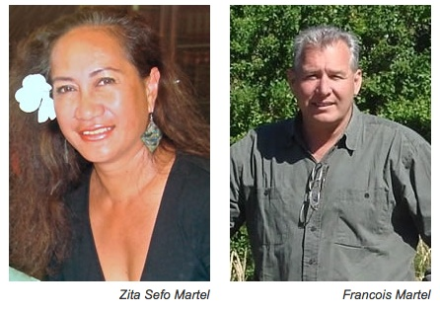

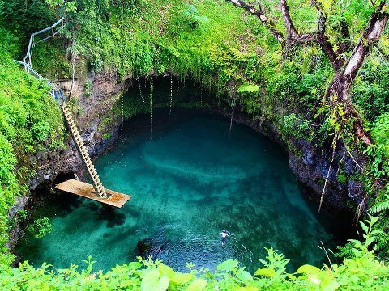
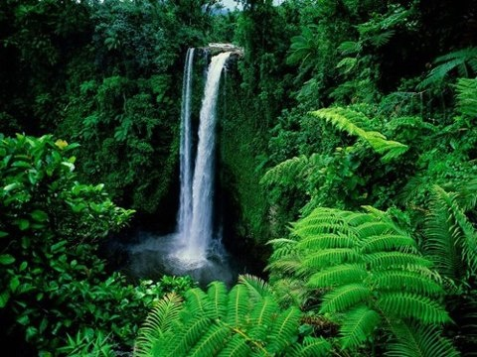
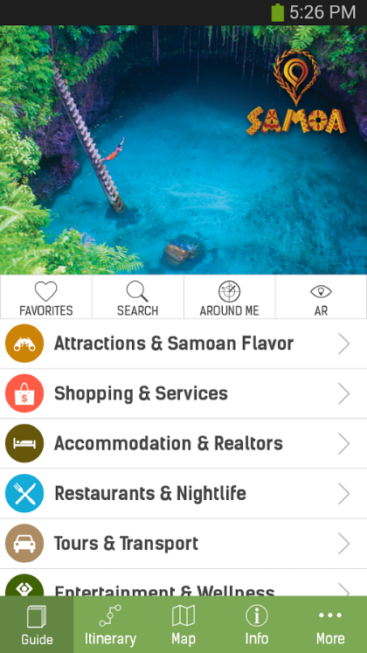
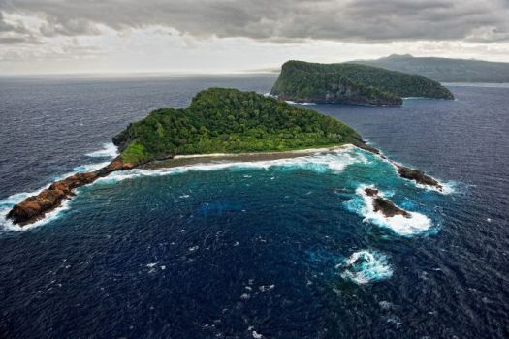
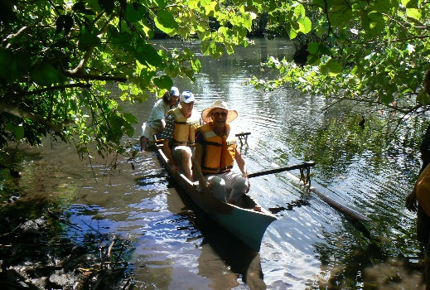
Business Owner – Director and CEO

Slide 5
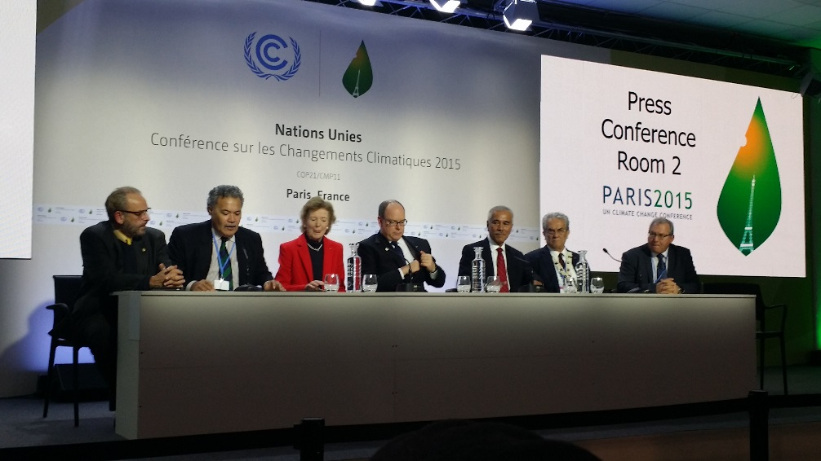
SUVA DECLARATION & COP21

Slide 6
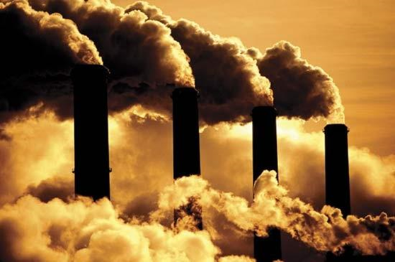

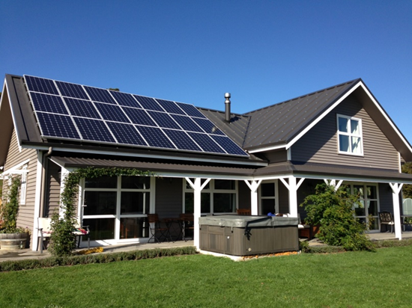
Paris Agreement is coming to town
Paris Agreement will enter into force
97 countries responsible for 66.4% of global emissions would have ratified the Paris Agreement – triggering the two threshold
Legally binding: 0% carbon emissions by 2050
Long-term 1.5 degree Celsius target

Slide 7
Reality check for Pacific Islands

Slide 8
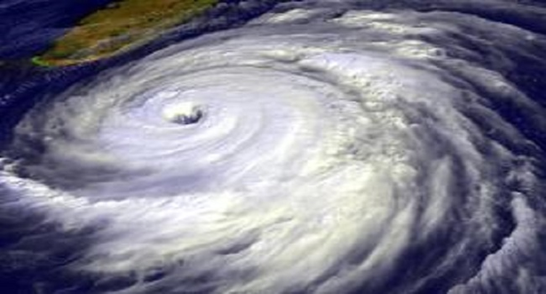
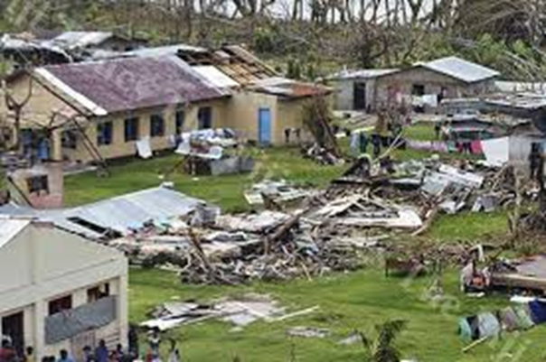
Reality check for Pacific Islands
Global 2020 emissions targets are not in line with either 2℃ or 1.5℃ pathways – more like 3.7℃
Most larger emitters - no emissions reduction policies in place to deliver on their pledges
GHG emissions continue to increase
Urgency to close the mitigation gap
Increasing existential risks for low-lying atolls and coastal areas

Slide 9
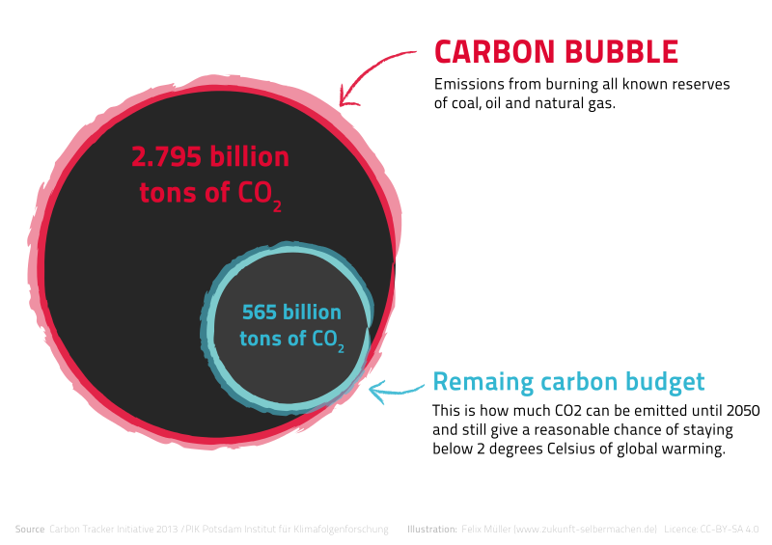
The Carbon budget and fossil fuel Carbon bubble
Only 5.2 years left with the world at 66% chance of remaining under 1.5⁰C
80% of known fossil fuel reserves need to stay in the ground
80% of all coal reserves
33% of all oil reserves
50% of all gas reserves
Fossil fuel companies overvalued (Carbon bubble)
Divestment trend strong

Slide 10
Green Growth – The Concept
The Concept
The Need
Fostering economic growth and development,
Ensuring that natural assets continue to provide the resources and environmental services
Maintain our well-being
Risks to development as growth erodes natural capital
Increased water scarcity,
Worsening resource bottlenecks
Greater pollution
Climate change and disasters
Green Growth is a strategy of sustaining economic growth and job creation necessary to reduce poverty in the face of worsening resource constraints and climate crisis”

Slide 11
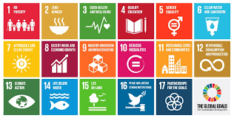
Role of business in green growth and SDGs
Achieving SDGs is a “whole of society” responsibility
Cannot be achieved without contribution of the private sector
Social and Environmental responsibilities/Charter is a must
Pacific Islands: 85% of businesses are SMSB – family based.

Slide 12

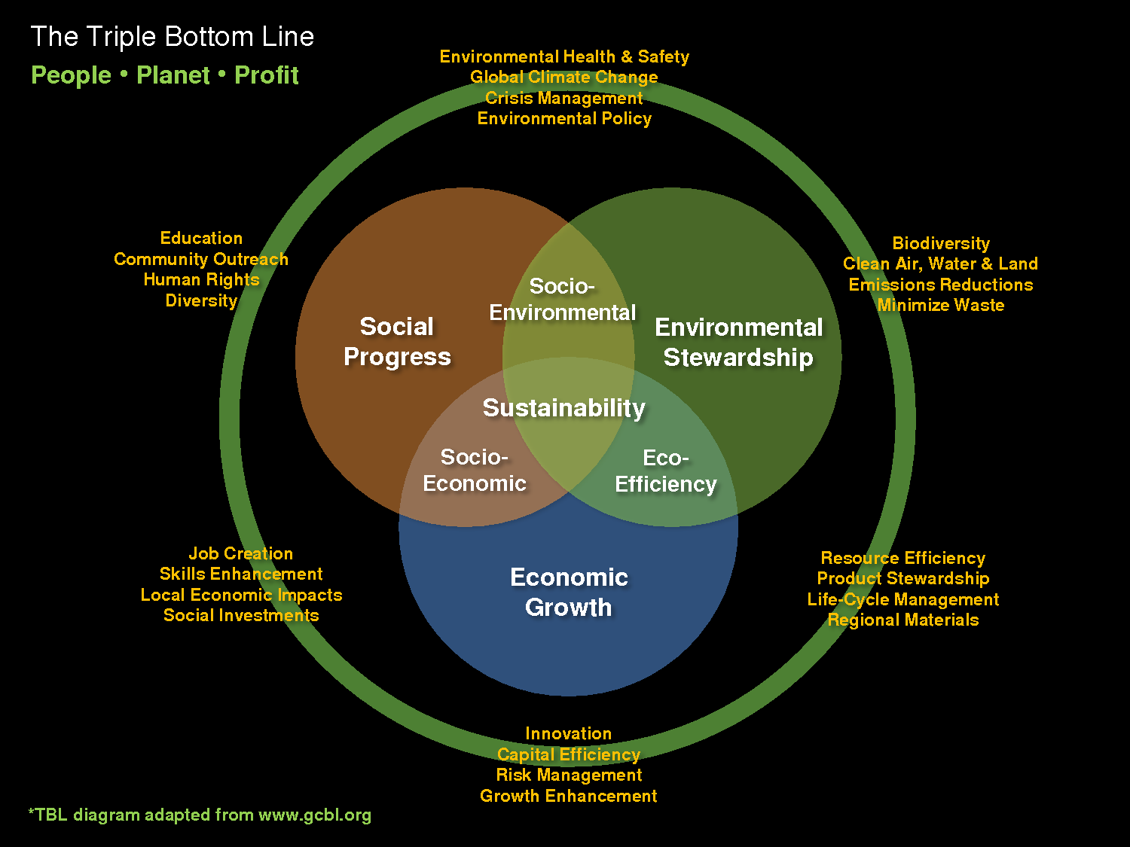
Social and environment responsibility
It is truly successful when it is considered a benefit to its community.
Business does not exist in isolation.

Slide 13

Engagement: Advantages to businesses
improve brand image,
reduce costs of operations,
support local community projects for SDGs,
good PR and advertising,
rewards by association,
certification through International Standards,
“we care” image,
increase client and customer base through green image
Increase profits

Slide 14

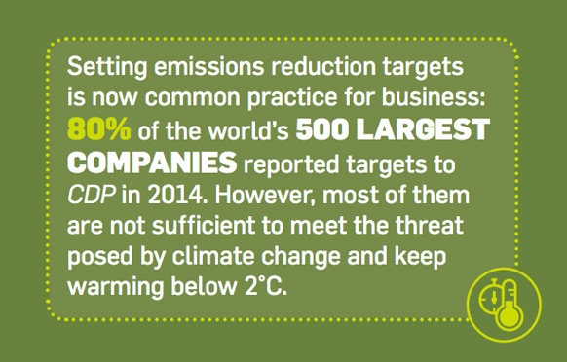
Incentives needed
Assistance with SER strategy development (green audit for businesses, green strategies),
website adjustments to advertise company SER and promotion,
certification system,
support services,
monitoring and reporting.

Slide 15






Green Business Centre - PIDF
Support businesses to be in a position to introduce cleaner technologies and offset their activities while ensuring their profitability.
Provide incentives, capacity-building, best practices, manuals, on-business tailored support, funding opportunities, web development support towards SERs for business.

Slide 16
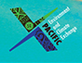
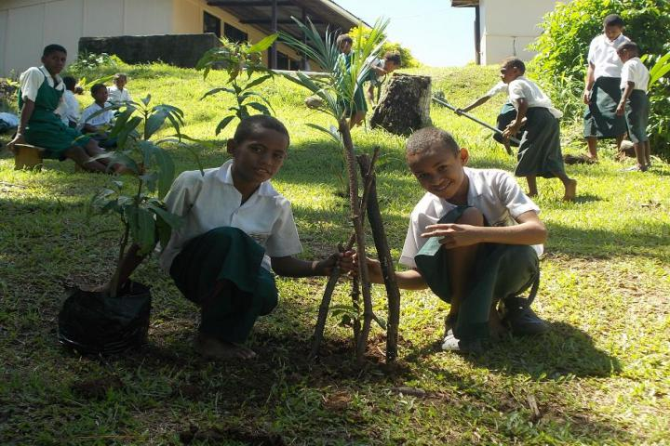
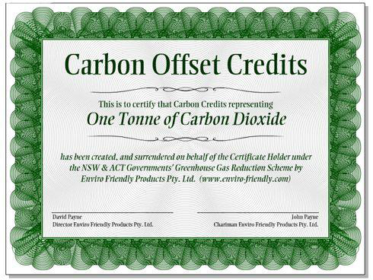
Pacific Environment & Climate Exchange
PECX is a marketing and sales platform in much the same manner as a Stock Exchange
Environmental Exchange to match engagement/funding with sustainable development, community development, poverty eradication, climate resilience, renewable energy and environment conservation
projects of Governments
and Civil Society at national
and regional level.

Slide 17
Environmental Leadership in Business
Our role is to mainstream green growth in the Pacific Islands – and engage the private sector in sustainable development and building climate resilience
Recognize the opportunities for business to engage
Conduct a green audit to assess potential to invest in green growth (energy efficiency, carbon-offsetting, recycling, greening of supply chains, or support to communities associated with the business)
Develop Social/Environmental Charter and Green Strategy that matches your company sector and profile.
Track, monitor and report progress (performance/action vs financial rewards)

Slide 18

We are looking for partners in green growth!
Join the 80% of the top 500 global companies!
Please approach our Secretariat or me directly for more information
Email: fmartel@pacificidf.org
Vinaka vaka levu, Fa’afetai

