Slide 1
Sailima Enterprises (Hands Together)
The realities of supplying locally
Jimmy Chedi

Slide 2
Background
Initiative after attending a workshop on Small business Enterprise (SBEC) 2009.
Located at Areatakiki Village; Central Guadalcanal (> 25 Km from Honiara)
Family/Communal working together for improvement of livelihood through utilisation of land for agricultural benefit.
After the social unrest; the need to promote income generating avenues (school fee, housing, transport etc.)is necessitated.

Slide 3
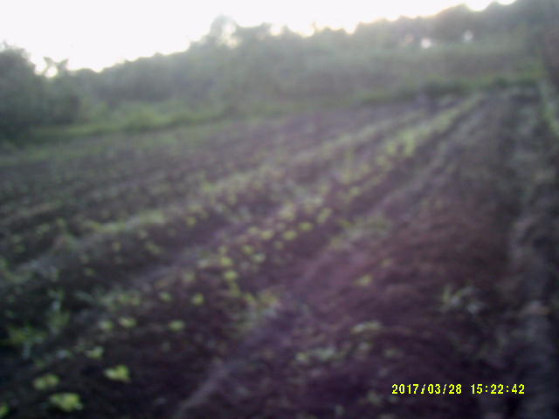
Project in a nut Shell
Farming of Agricultural products (beans, cucumber, egg plant, pumpkin, pineapple, melon)
Encourage community participation and ownership

Slide 4
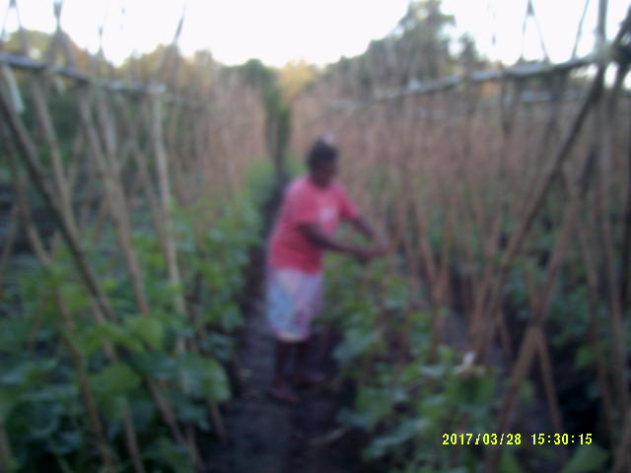
community work
Bridge repairing
Small scale Farm

Slide 5
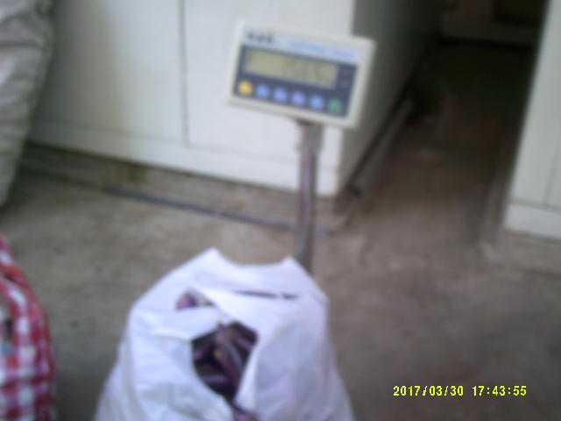
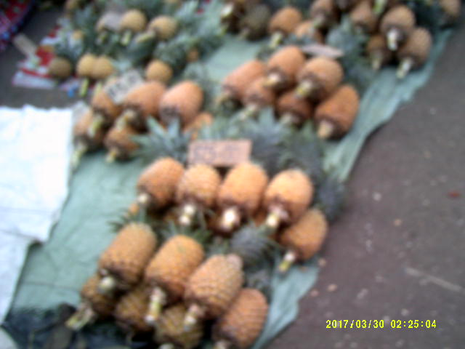
Achievements
Farm Products (vegetables)
Supply of Farm Products (income)
Farm produce is used to feed family
Sold at the market for income
Currently supplies vegetables to Heritage Park Hotel.

Slide 6
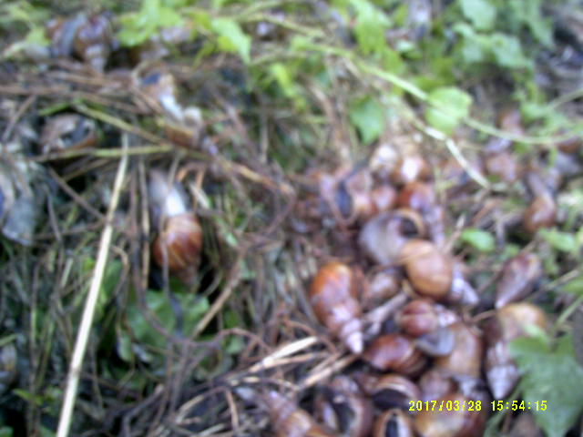
Challenges
Biotic
Giant African Snail
Abiotic
Lack of proper infrastructure (road & bridges)
Unfavourable weather (drought)

Slide 7
Other Challenges
Hotels demand Quality (freshness) and Quantity of product.
90% of product outsourced, 10% supplied.
Some produce cannot be met.
Seasonal crops
Other crops do not grow well (choysome, pineapple, shallot etc.)

Slide 8
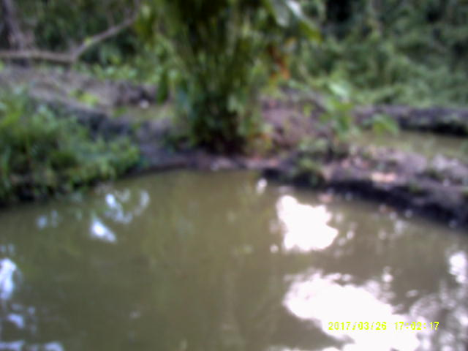
Future Prospect
Broaden Income generating avenues:
Venturing into fish (tilapia) farming
Build homestay (ecotourism)

Slide 9
Conclusion
It is important to meet the expectations of the customers (Hotel)
Proving Quality and Quantity

