Slide 1
Commonwealth Connectivity Agenda
Public Private Dialogue on Women in the Digital Economy and International Trade
January 2019

Slide 2
The Premise
Institutions, regulators and policymakers in Commonwealth countries speak several dialects of the same regulatory language.
This shared regulatory language allows for policy and regulatory conversations at a more granular, practical level than takes place in any other global fora.
This finds expression in the networked nature of the Commonwealth forums of regulators, professionals, government agencies and industries.
Notes:
OECD(2009, 2013) notes that regulatory heterogeneity is a constraint on increased trade. World Bank (2015) notes that regulatory cooperation is now a pre condition for further trade liberalization.
What drives regulatory similarity?
Legal Origin
Population Size
Ease of contract enforcement
OECD’s limitation is that it limits this thinking to services when this can easily apply to goods through the power of standards
regulators (e.g. Common Threads) and professionals (Accountants, Architects, Pharmacists, Lawyers, Doctors, Nurses, Judges, Planners) government agencies (CLGF) and industries (Agricultural Society).
Non-existent linkages of substantive discussions at the practical implementation level (e.g. AsiaPac-Africa, Caribbean-Pacific)Because of this
This means that Commonwealth members can have deeper discussion on challenges than they can in other global for Members know this to be true
Looking across the various regions of the Commonwealth we see a deeper level of understanding and co-ordination among Commonwealth members in sub-regional groups than with non-Commonwealth members
A regulator from a Commonwealth country can pick up the framework from another Commonwealth partner and understand
This similarity can be leveraged
The Commonwealth in this regard provides a venue where such members can meet and share
Difficult to have these conversations in other global fora because members approach the issue with one eye
he non-binding nature of the Commonwealth should also mean conversations can take place around issues which are difficult in other fora
Forward-looking element- provide insights into new areas
On a global level, nowhere else has:
(i) On
Continue the bottom-up member-led approach that defined the development of the Action Plan

Slide 3
The Road Ahead
2006
2030
1 Billion less people on the earth than today
45% of the world population lived in cities
No Global Financial Crisis
No sharing economy
2G was the standard speed on phone access
Facebook just became a public site opened beyond education institutions
No Kyoto or Paris Agreements
1 Billion more people than today
The 640 million young people in the Commonwealth currently aged 15-29 years old will be in prime productivity and in need of jobs in a new technological era
60% of the population will live in cities
4th Industrial Revolution will radically change nature of trade and industry
Environmental concerns will have led to fundamental shifts in a wide range of industries- plastics, automotive, agriculture
Notes:
All CW members will confront significant challenges ahead.
12 years ago the world was a very different place
In 12 years it will be even more different
The world in 2030 will be a much different place
Q is can Commonwealth serve as a platform for members to mitigate risks of disruption by bringing together members to to explore solutions to these new issues
Additive manufacturing, AI etc. will change industrial policy and trade flows as cost equations change as machinery becomes more sophisticated at changing how trade and investment flow.
The 640 million young people in the Commonwealth currently aged 15-29 years old will be in prime productivity and in need of jobs in a new technological era

Slide 4
Background
At the 2018 Commonwealth Heads of Government Meeting, Heads:
  Adopted the Declaration on the Commonwealth Connectivity Agenda for Trade and Investment;
  Mandated the Secretariat to develop an accompanying action plan that considers (i) capacity building (ii) hard connectivity and (iii) soft connectivity;
  Agreed to (i) share best practices and experiences (ii) under take voluntary mutual support; and
  In the context of the importance of long-term vision on trade and investment:
    Agreed to work together towards an appropriate framework, and
    Agreed to facilitate business-to-business contacts

Slide 5
General Objectives
Global Growth
Jobs
U$2 Trillion in Trade
Expanded Investment
Knowledge Exchange
Development
Notes:
Growth: Supporting global growth
Jobs: Creating employment
Sharing of best practices and learning
Development: Promoting development

Slide 6
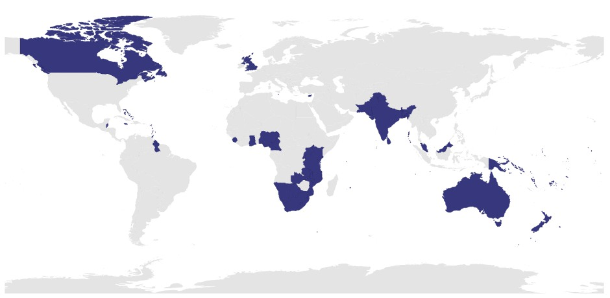
Which ‘Intra-Commonwealth’ Trade Are We Targeting?
Notes:
Question is which trade routes to focus on
Focus should not be on stimulating regional routes where members have well established patterns, but on stimulating underdeveloped routes. CW can be seen as 4 megaregions: Africa, Americas, Asia, Europe and Oceania

Slide 7
Areas of Engagement
Member-led dialogue structured around clusters:
  Physical Connectivity
  Digital Connectivity
  Regulatory Connectivity
  Business-to-Business Connectivity
  Supply Side Connectivity
2 cross-cutting issues mainstreamed:
  Inclusive trade
  Sustainable trade
Notes:
Heads decided based on

Slide 8
Clusters
Groups of members who have opted-in to work on a specific area
Trade+ discussions
Forum for sharing best practices, experiences and undertaking voluntary mutual support.

Slide 9
Physical Connectivity Cluster
Work programme will focus on Digital Infrastructure
Foundation of successful entry into the Digital Economy and as a base for smart cities
Two kinds:
  Pure Digital Infrastructure
    Fibre optics, 5G, cloud server farms
  ‘Smart Infrastructure’
    Existing system where digital hardware is bolted on
    Users of infrastructure provide the data
Traditional Challenges Remain
  Outdated regulatory policy
  Financing gaps
  Skills deficits, and
  Lack of access to affordable energy.

Slide 10
Digital Connectivity Cluster
Work programme will focus on the National Digital Economy
Particular challenges for digitisation on traditional trade and investment policy
Challenges here include:
  Breaching the Digital Divide
  Competition- How to address global anti-competitive behaviour
  Privacy and data protection- How do we strike the balance?
  Skills Gap

Slide 11
Regulatory Connectivity Cluster
Work programme will focus on the Business Environment for MSMEs
Bad regulations are expensive for MSMEs and create room for corruption.
Economy-wide impact on productivity, growth and ultimately development
Two particular aspects:
  Ease of Doing Business
  Good Regulatory Practice
Challenges:
  Political and Bureaucratic will

Slide 12
Supply Side Connectivity Cluster
The Integrating MSMEs into Agri-Food Value Chains
Changing global consumer needs for always fresh and higher sustainability requirements in some markets.
Initial focus will be on a coconut and soya to see how to move forward pre-existing studies into action
Particular focus on the nature of evolving green requirements on agriculture

Slide 13
Business to Business Connectivity
Increasing B2B and B2G engagement around increased intra-Commonwealth trade and investment.
Bringing private sector associations from across the Commonwealth to provide their views to officials as they engage on the process of growing intra-Commonwealth trade.

Slide 14
Mainstreaming Inclusive and Sustainable Trade
Inclusive Trade:
  Women: Address systemic barriers to women’s full and equal participation in the economy
  Youth: Support youth entrepreneurship
Sustainable Trade:
  Blue Economy: Linkage with the Commonwealth Blue Charter
  Green Economy : Linkage with the Digital Economy and Supply Side Connectivity

Slide 15
Kirk Haywood
Legal Adviser- Trade & Lead, Commonwealth Connectivity Agenda
28 January 2019

